Slide 1
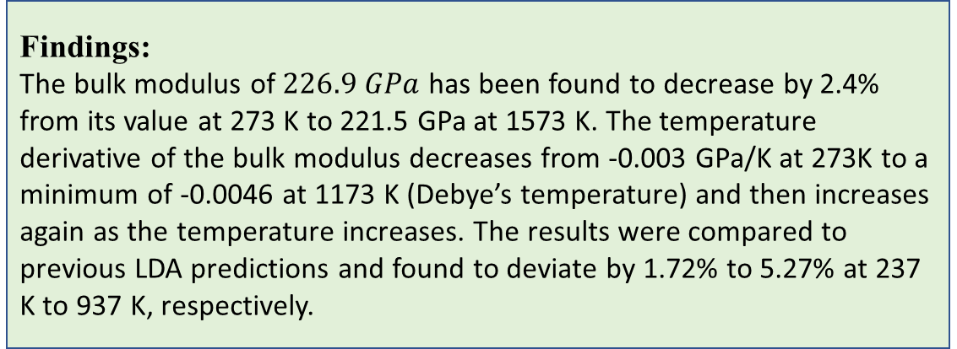
The Prediction of the Bulk Modulus and its Temperature-Derivative of the Crystalline β-SiC Ceramic
B(Gpa)
An empirical prediction that aims at
determining the bulk modulus B_{T}
and its temperature-derivative
(∂B/∂T)_{P} of crystalline silicon carbide
(β-SiC). Reliable experimental
measurements have been used. Both
B_{T} and (∂B/∂T)_{P} were traced as a
function of temperature within the
range of 273-1573 K
The Bulk Modulus versus Temperature
of β-SiC
The Temperature Derivative of the Bulk Modulus versus Temperature of β-SiC
T(K)
Findings:
The bulk modulus of $226.9 GPa$ has been found to decrease by 2.4% from its value at 273 K to 221.5 GPa at 1573 K. The temperature derivative of the bulk modulus decreases from -0.003 GPa/K at 273K to a minimum of -0.0046 at 1173 K (Debye’s temperature) and then increases again as the temperature increases. The results were compared to previous LDA predictions and found to deviate by 1.72% to 5.27% at 237 K to 937 K, respectively.

