Slide 1
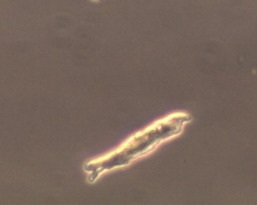
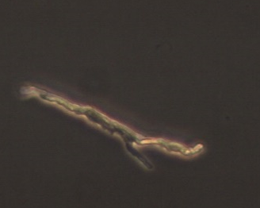

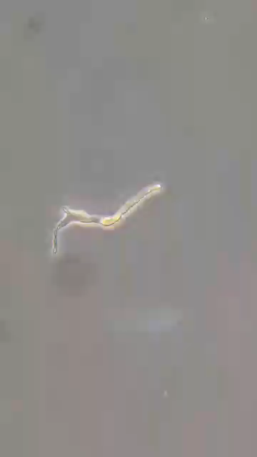
Supplementary Figure 4
A B
RA cell SAN cell
100μm
C D
Video
RA cell SAN cell

