Slide 1
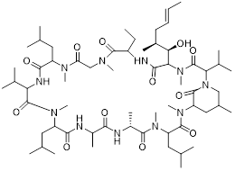
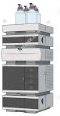
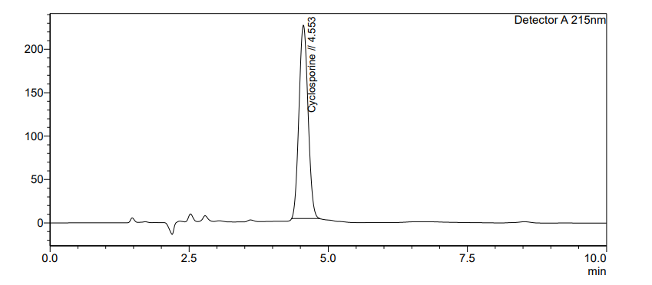
Cyclosporine
Cyclosporine loaded
Liquid crystalline Nanoparticles (LCN’s)
Drug release samples
Stress degradation study samples
O hr
2 hr
8 hr
12 hr
24 hr
48 hr
48 hr
RP-HPLC
Quantification of Cyclosporine in LCN’s
% Drug entrapment efficiency
Drug release profile of Cyclosporine in LCN’s
% Drug release

