Slide 1
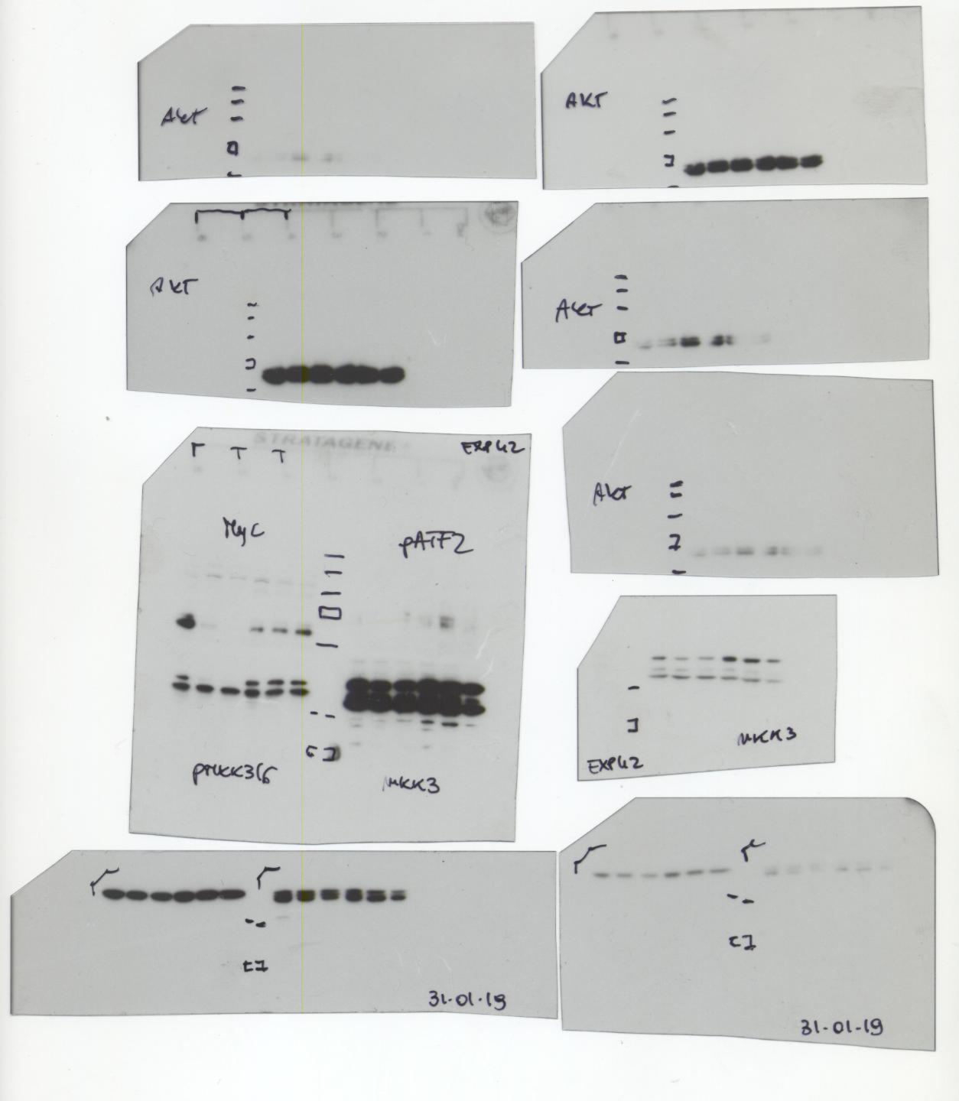
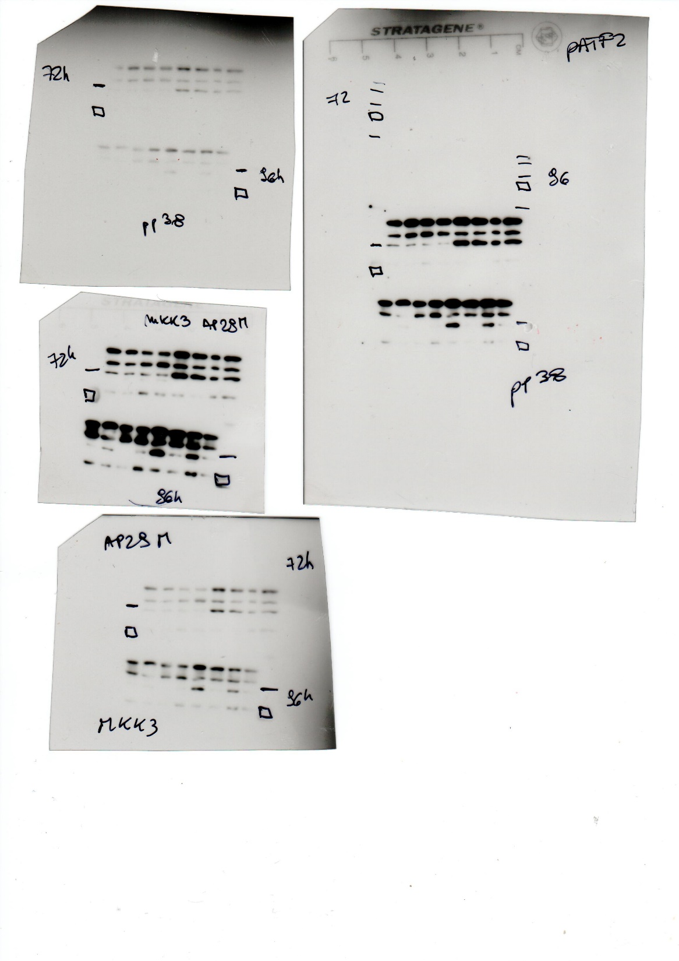
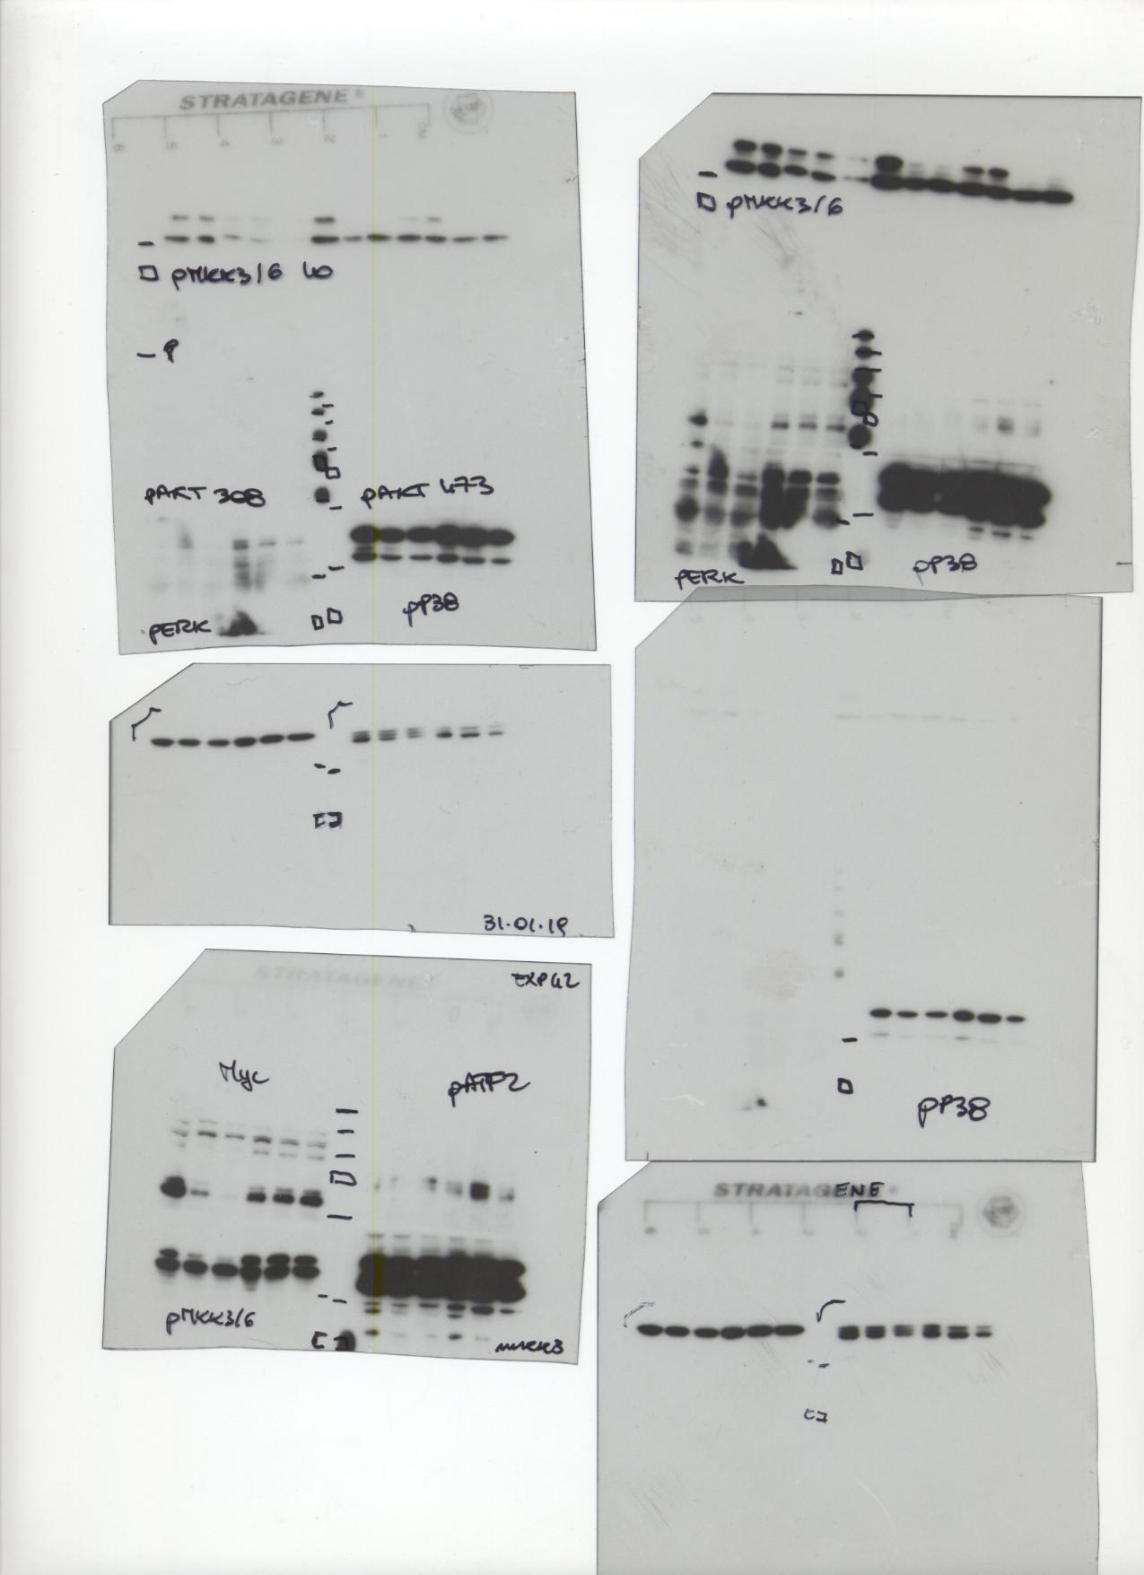
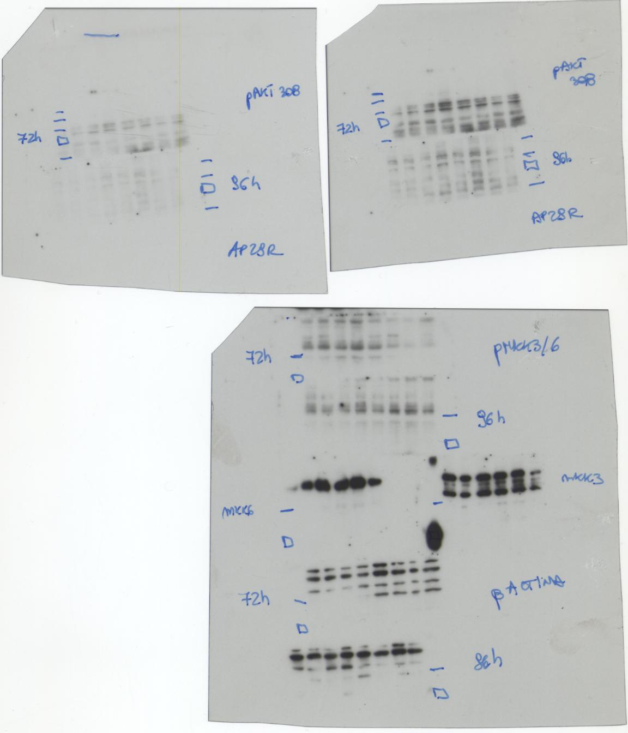
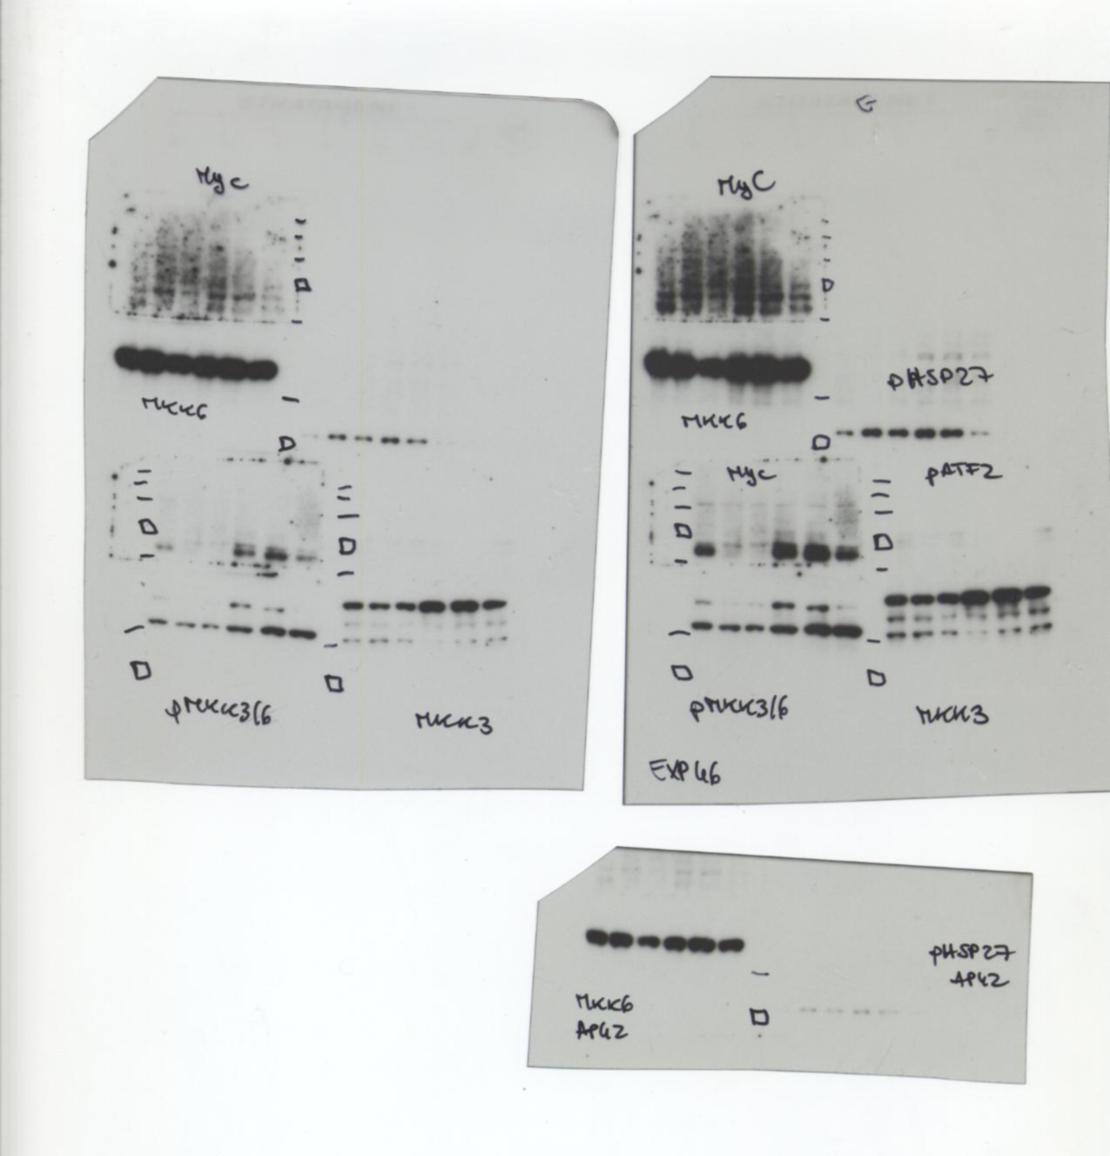

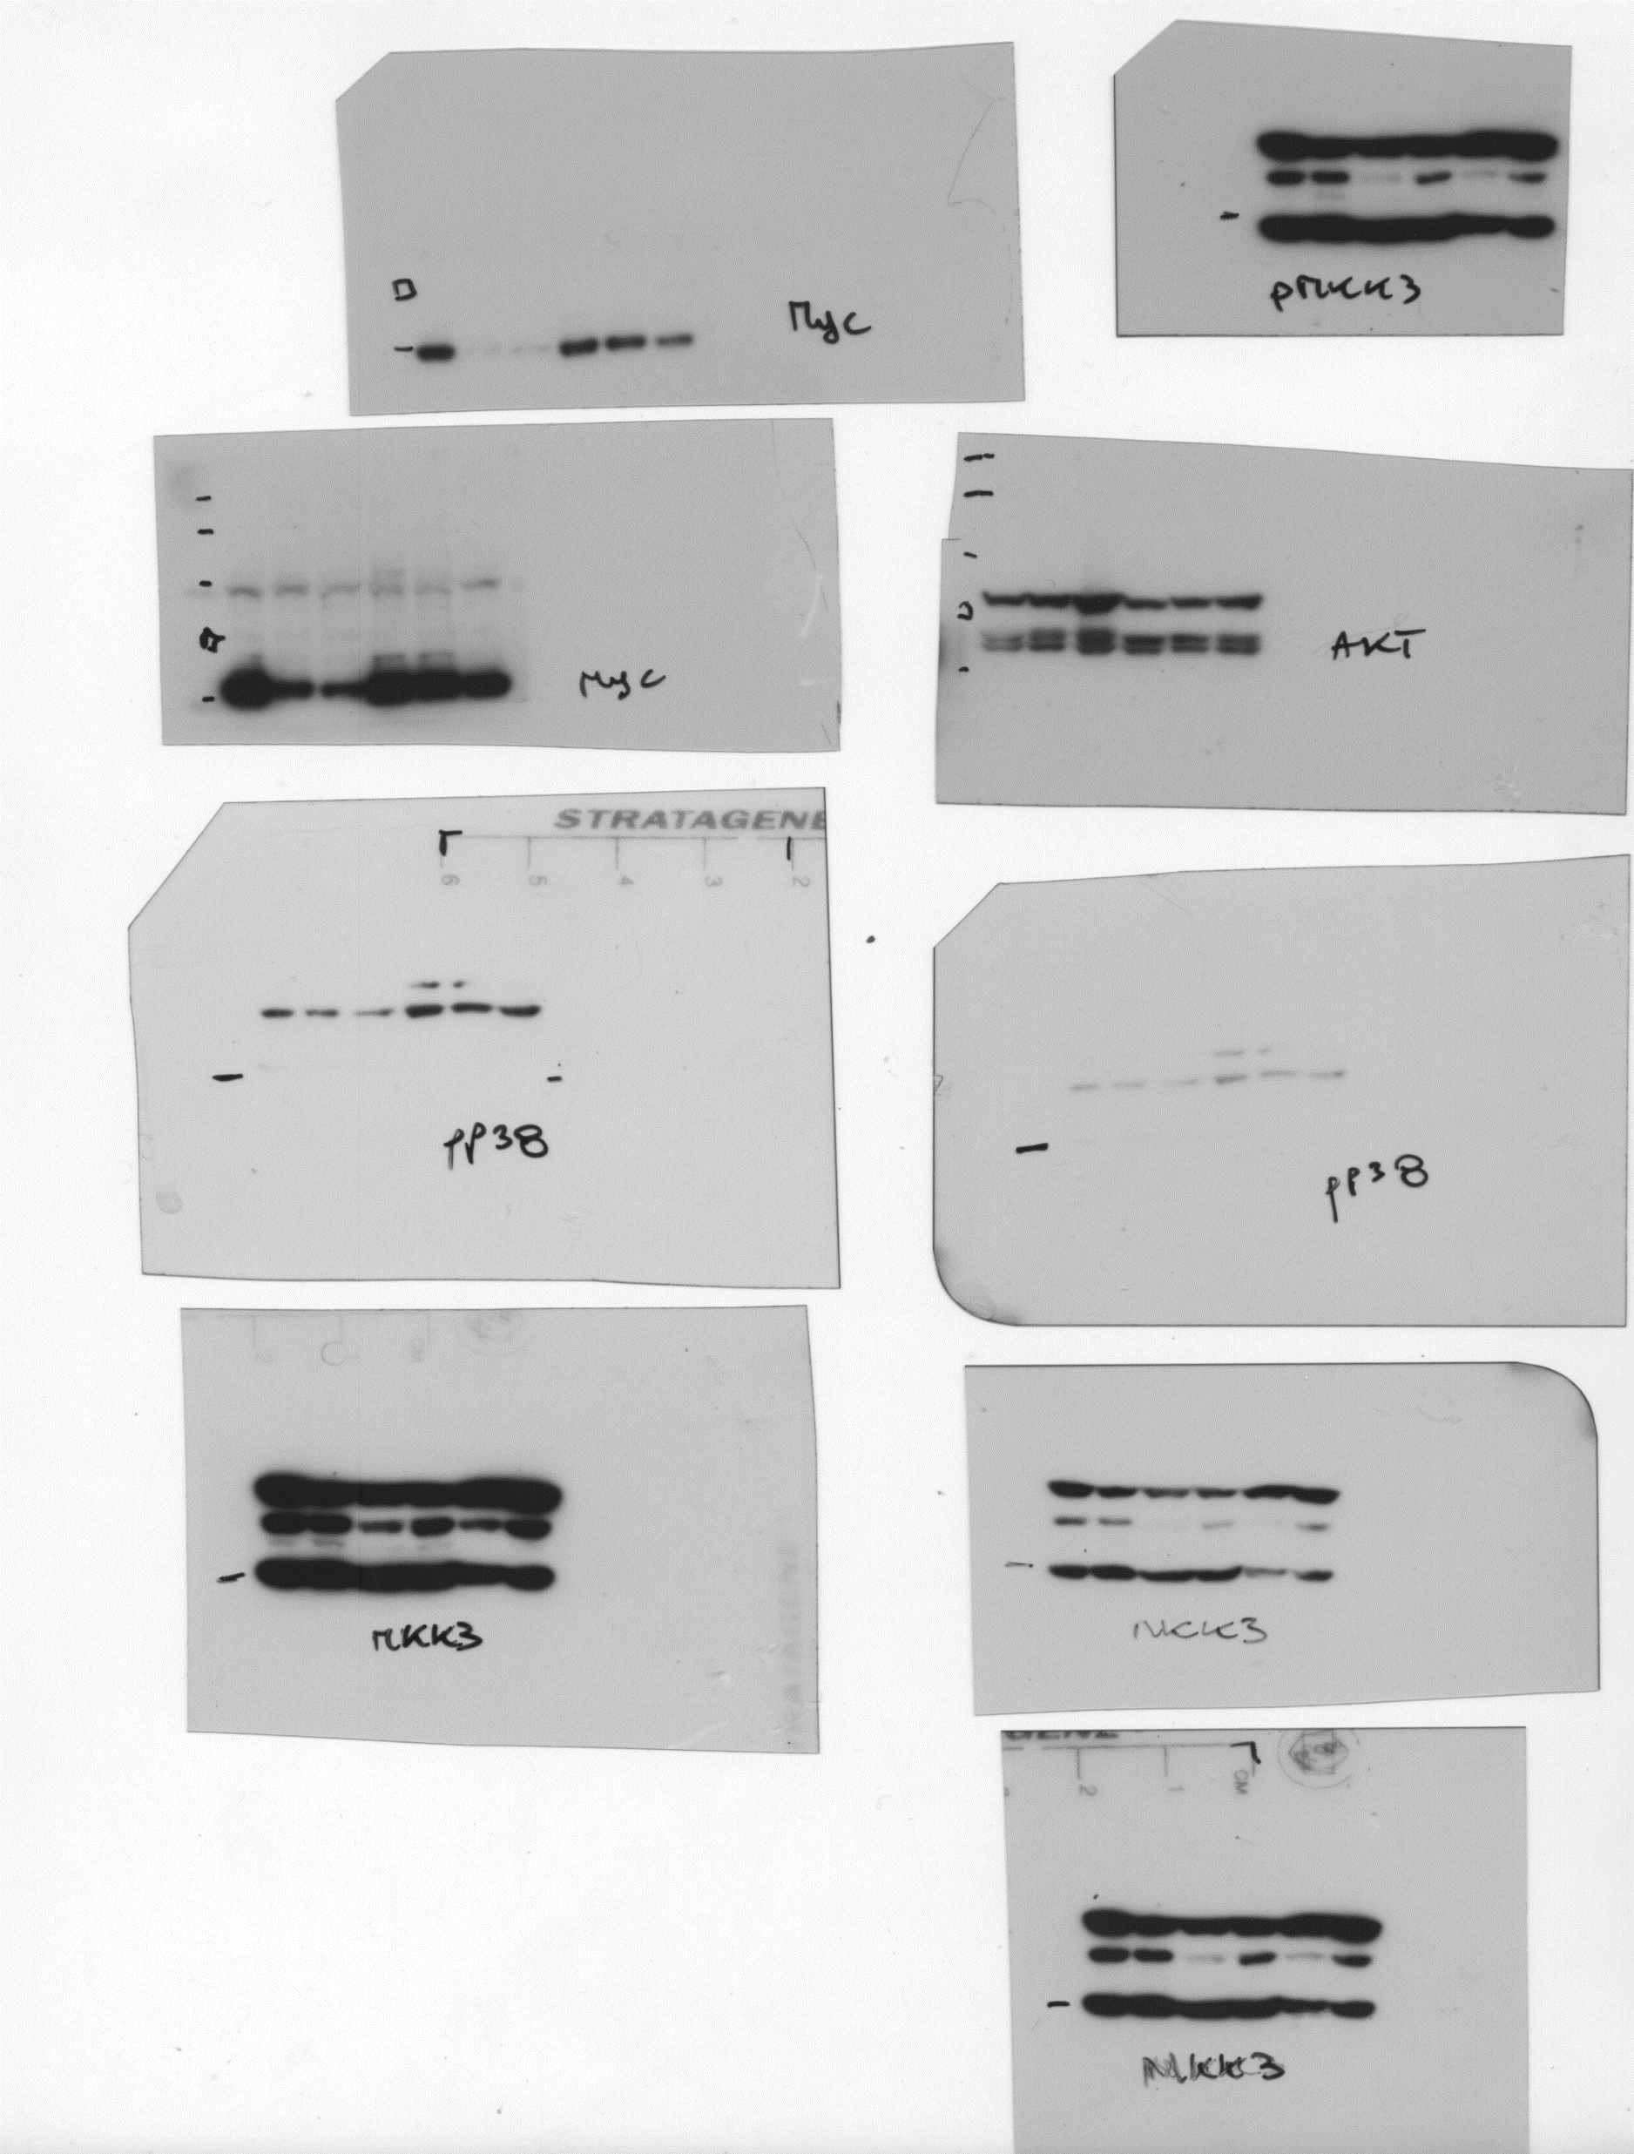
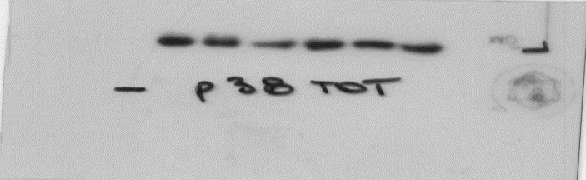
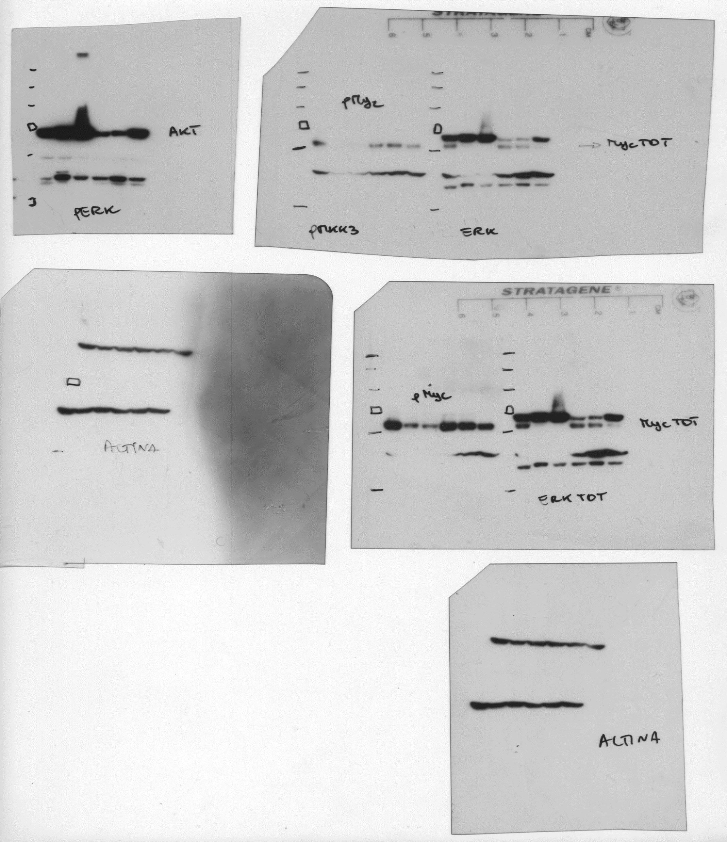
Figure 1D
COLO205
-55
-35
-35
-25
-25
p-MKK3/6
MKK3
100-
70-
55-
-35
35-
-35
25-
-25
-25
p-p38MAPK
p38MAPK
actin
HT29
-35
35-
-25
25-
p-MKK3/6
MKK3
35-
35-
p-p38MAPK
p38MAPK
actin
35-

Slide 2
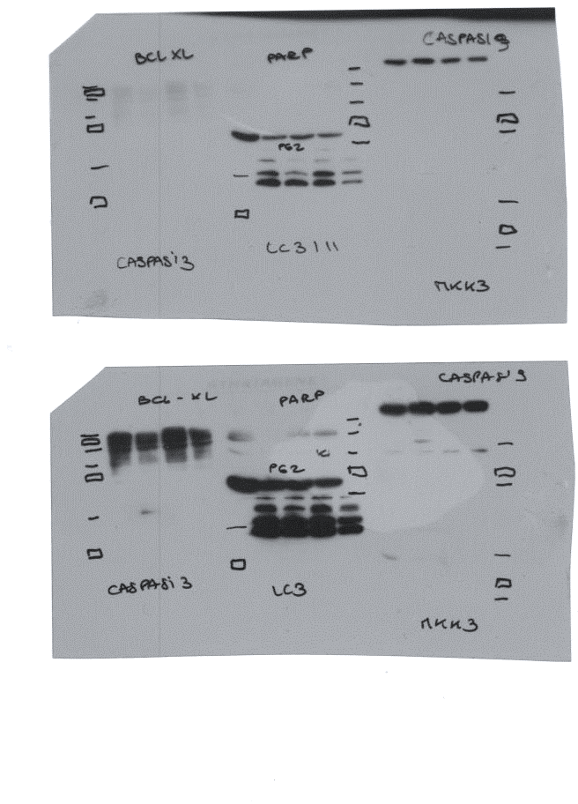
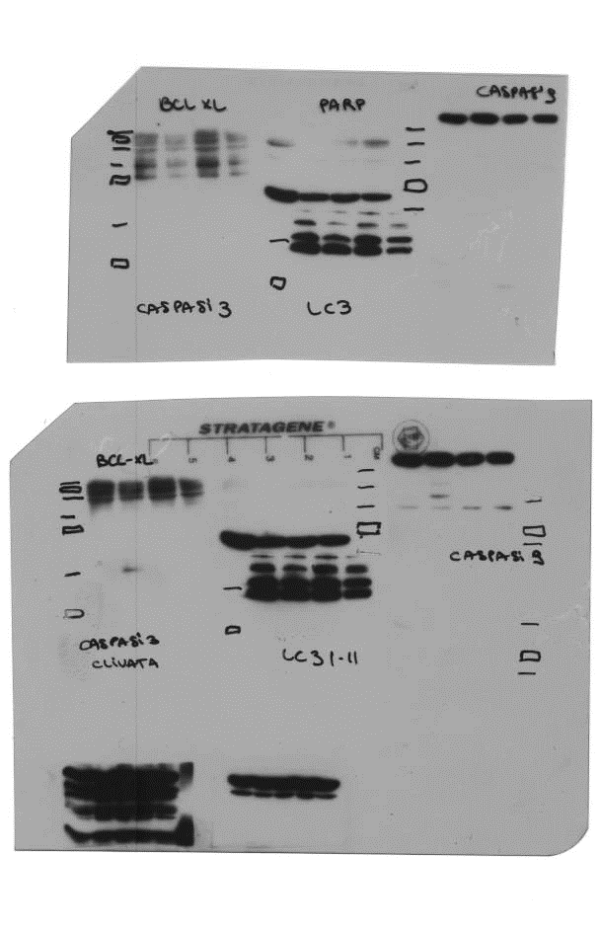
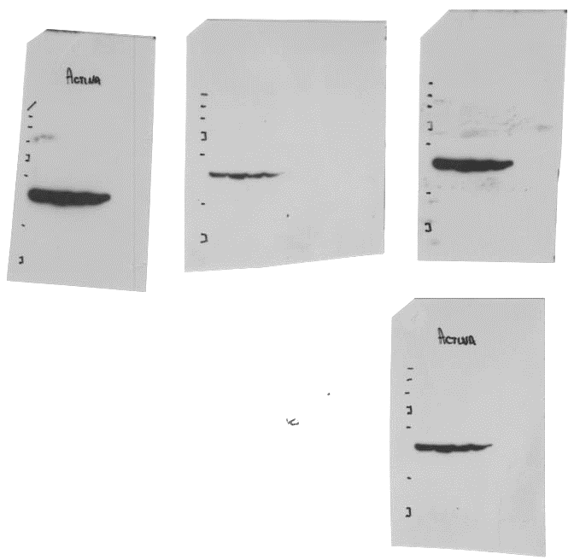
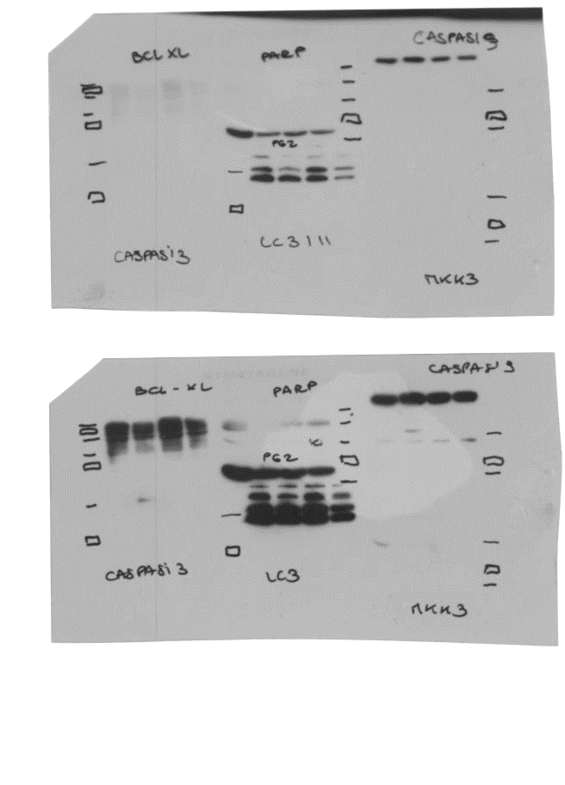
Figure 1E
70-
55-
-250
35-
-130
25-
-100
15-
-70
10-
-55
Full-lenght PARP
CLEAVED CASPASE 3
70-
-35
55-
-25
35-
CLEAVED CASPASE 9
25-
-130
ACTIN
-250
-100
-70
p62/SQSTM1
-55
15-
LC3 I-II
10-

Slide 3
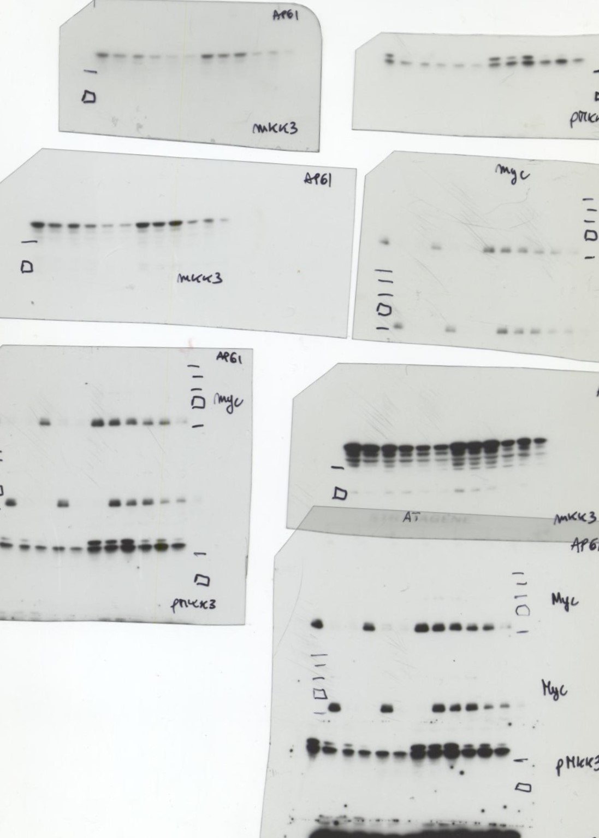
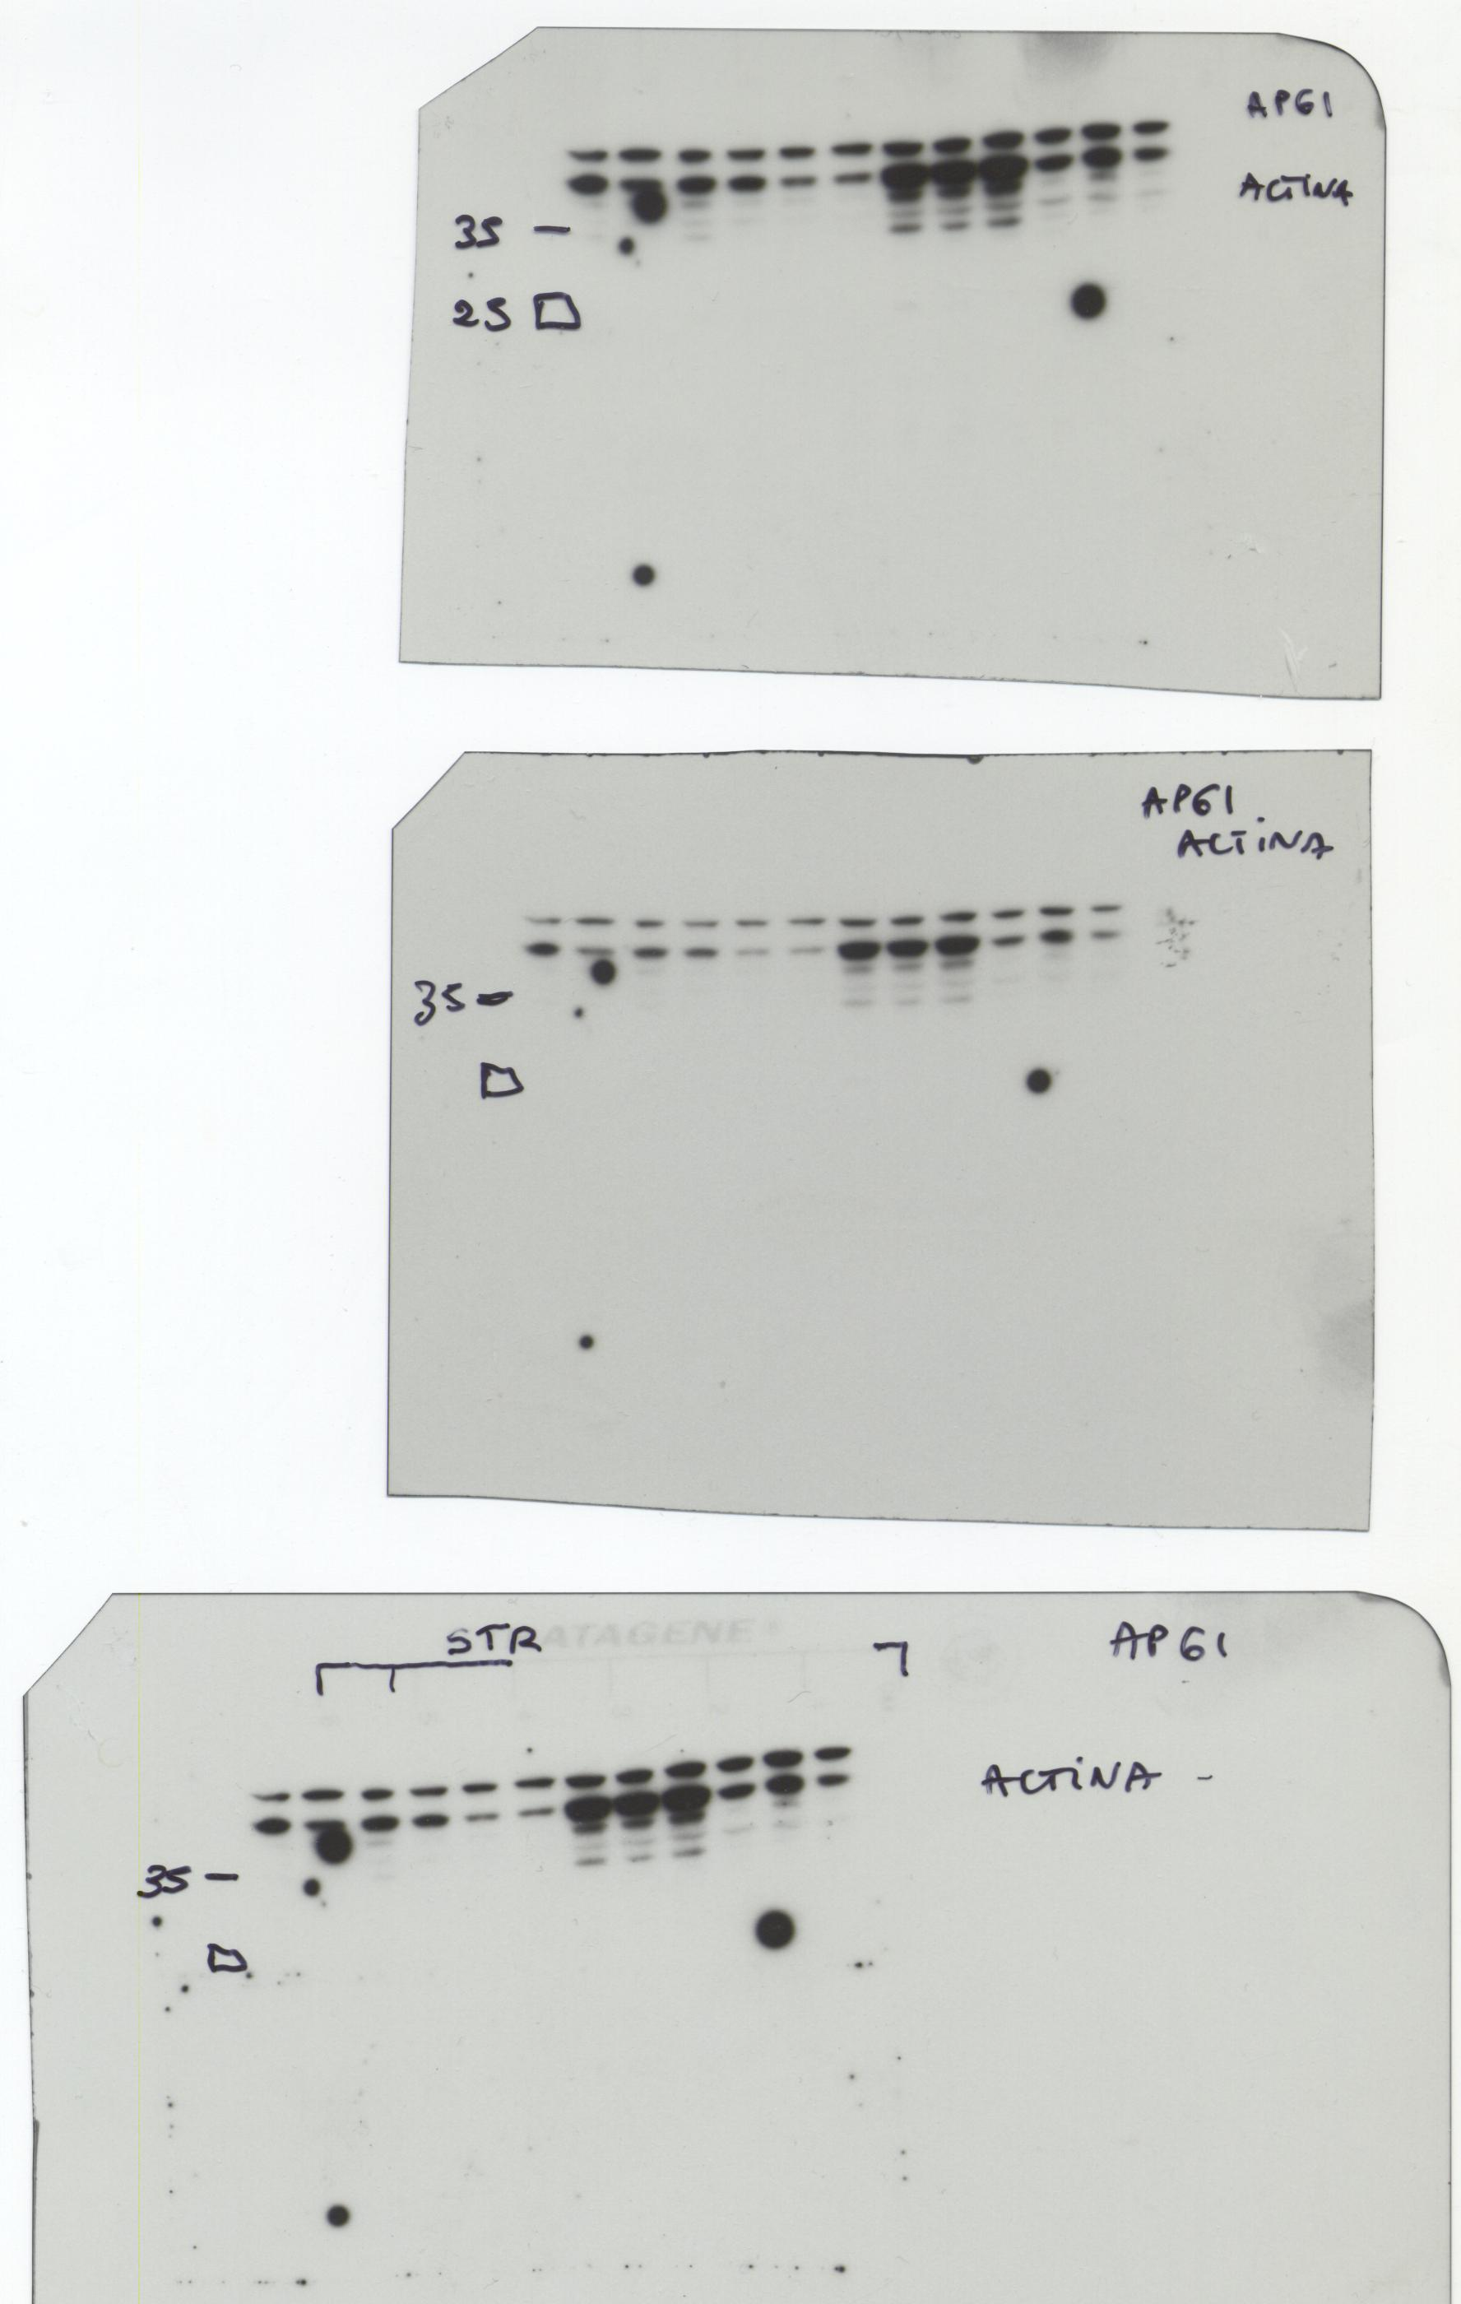
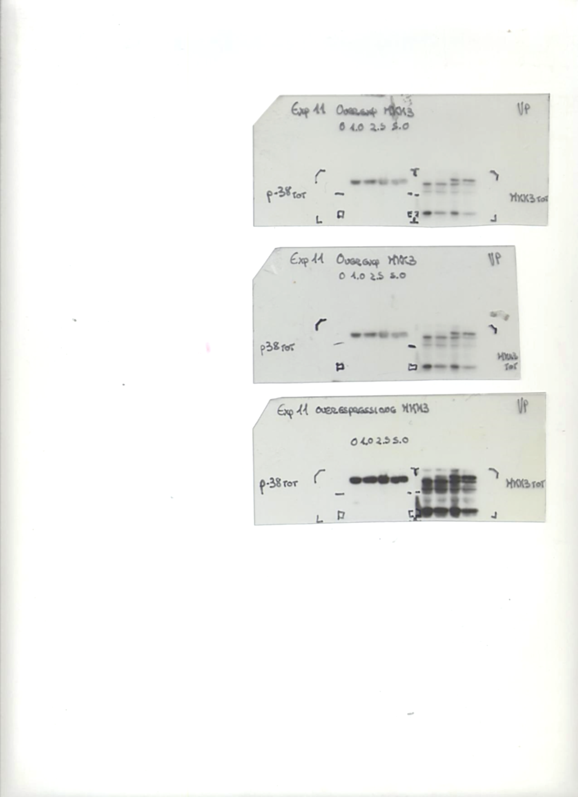
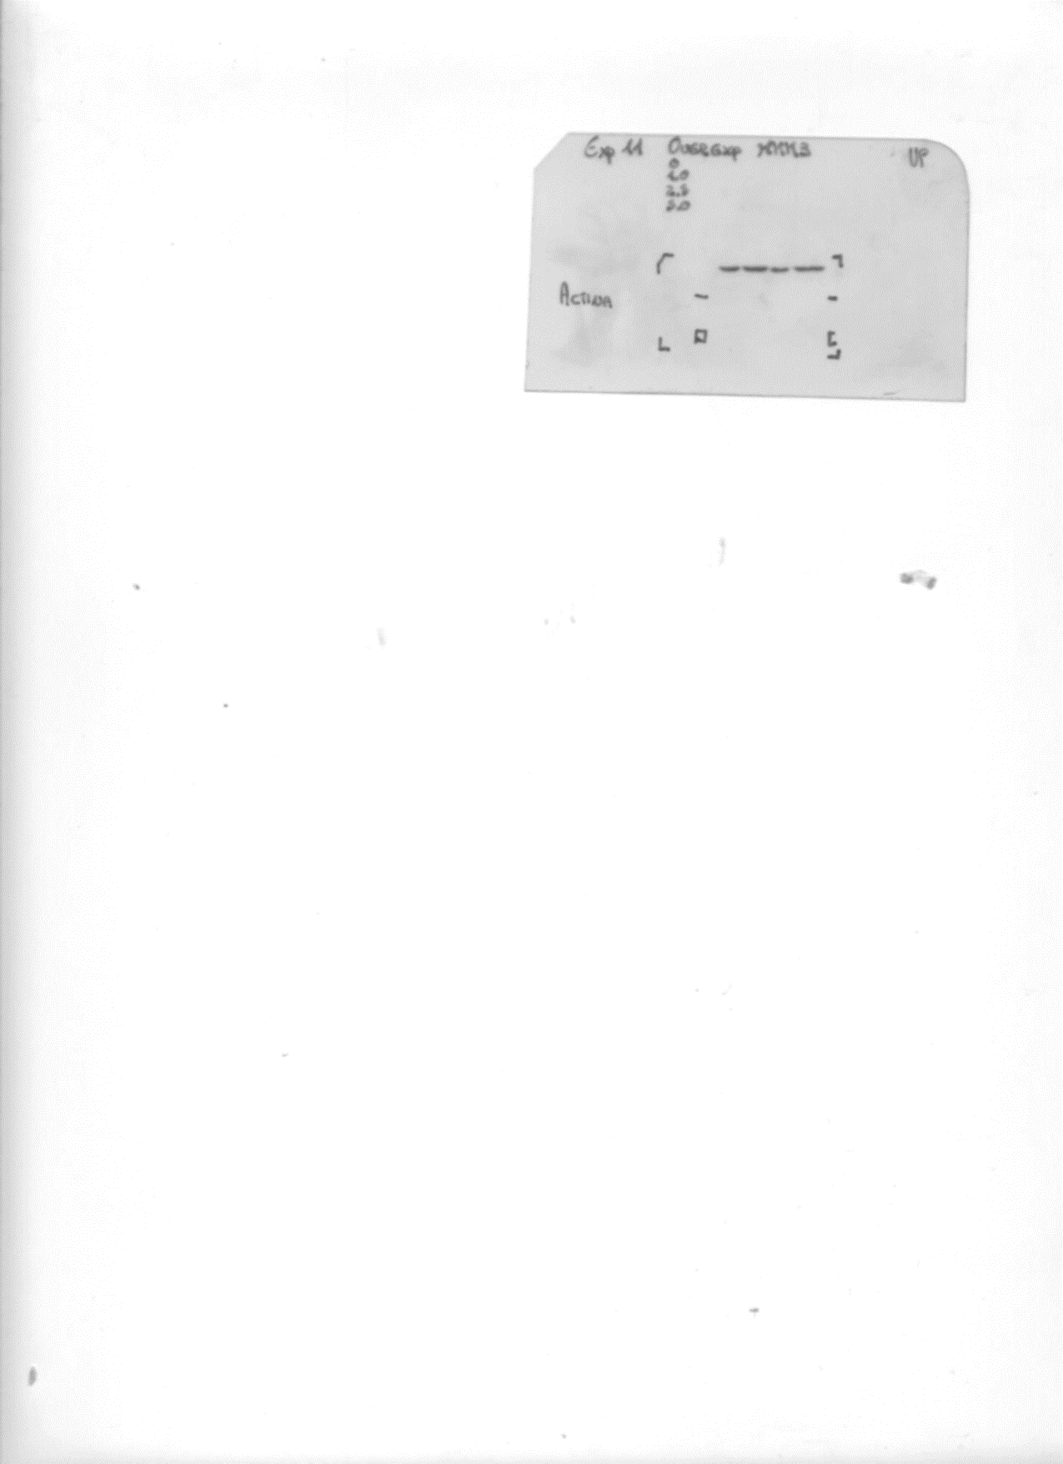
Figure 2A
MKK3
35-
25-
ACTIN
35-
25-
Figure 2B
MKK3
35-
25-
ACTIN
-35
-25

Slide 4

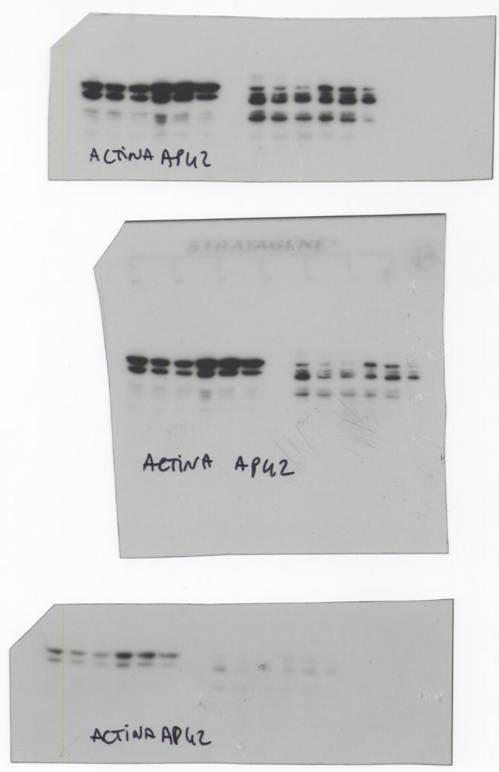
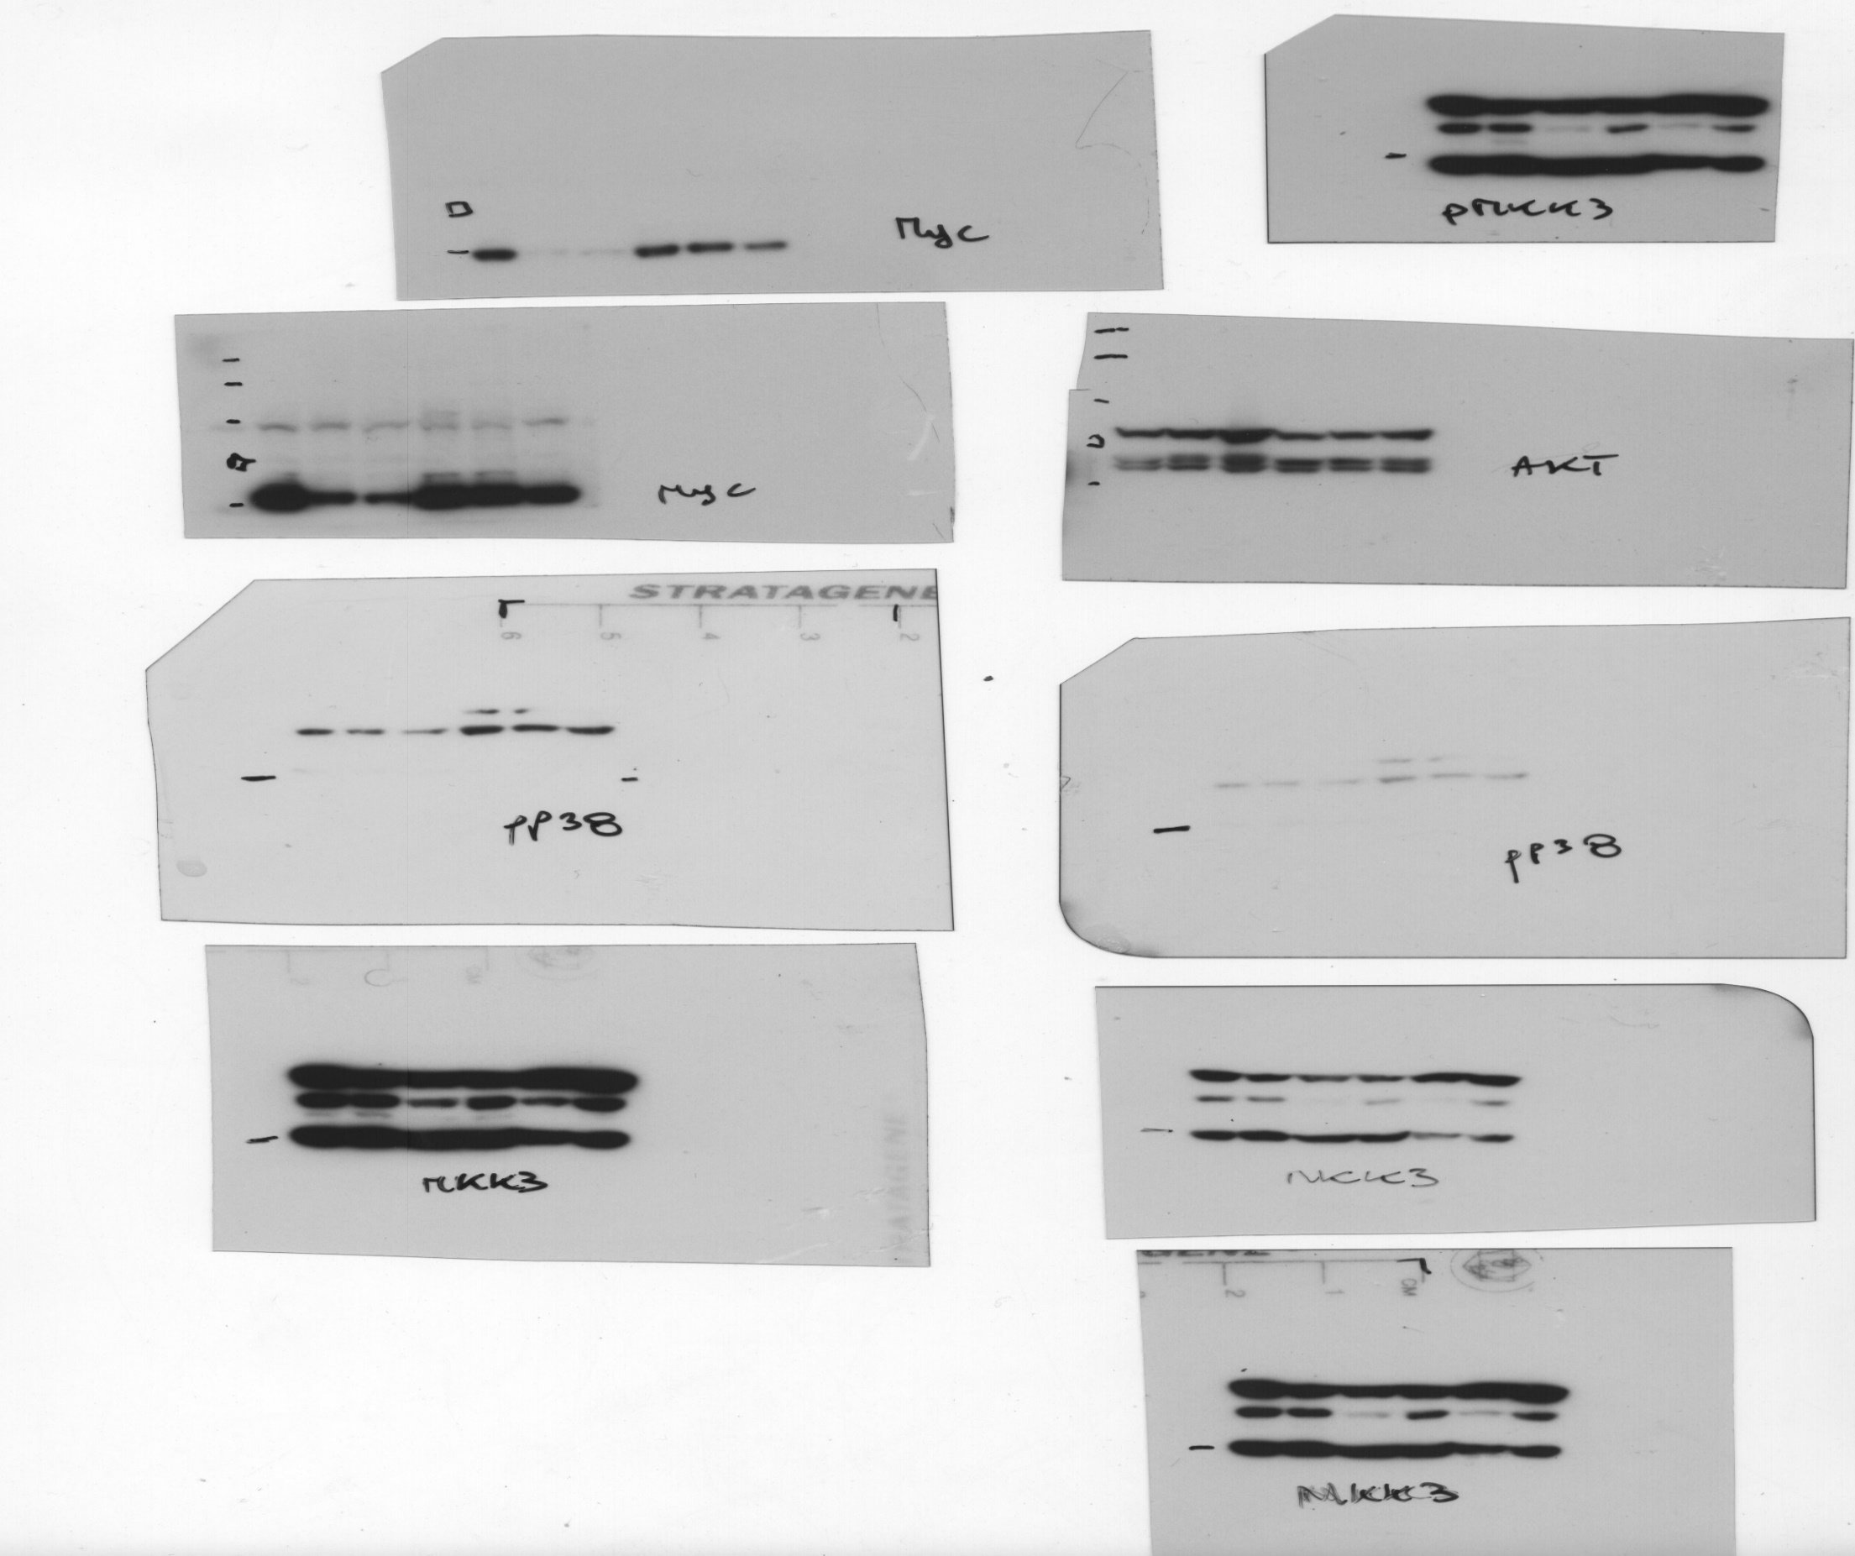

COLO205
Figure 3A
250-
-250-
130-
-130-
100-
-100-
70-
-70-
MYC
55-
-55-
ACTIN
-35
HT29
70-
55-
MYC
ACTIN
-35

Slide 5
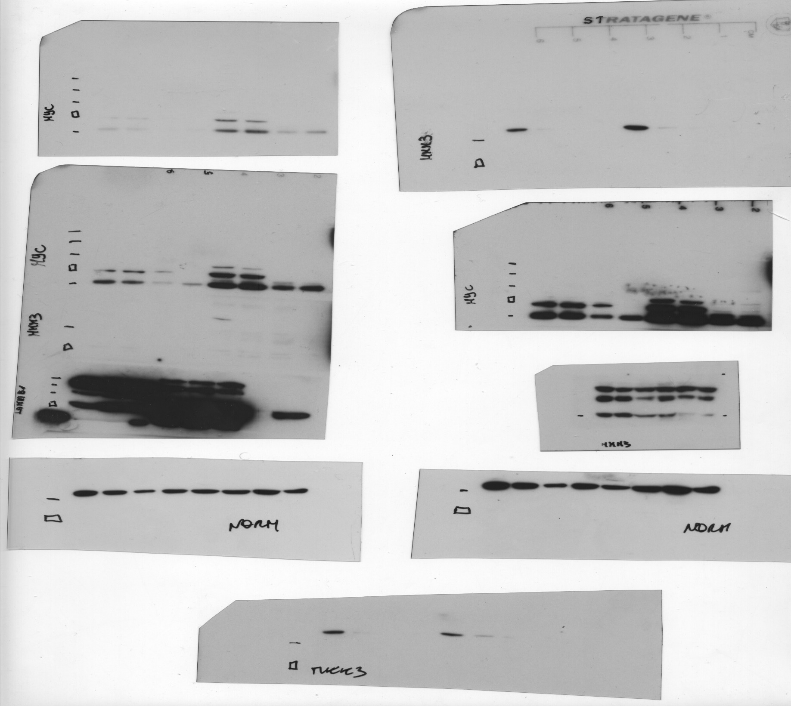
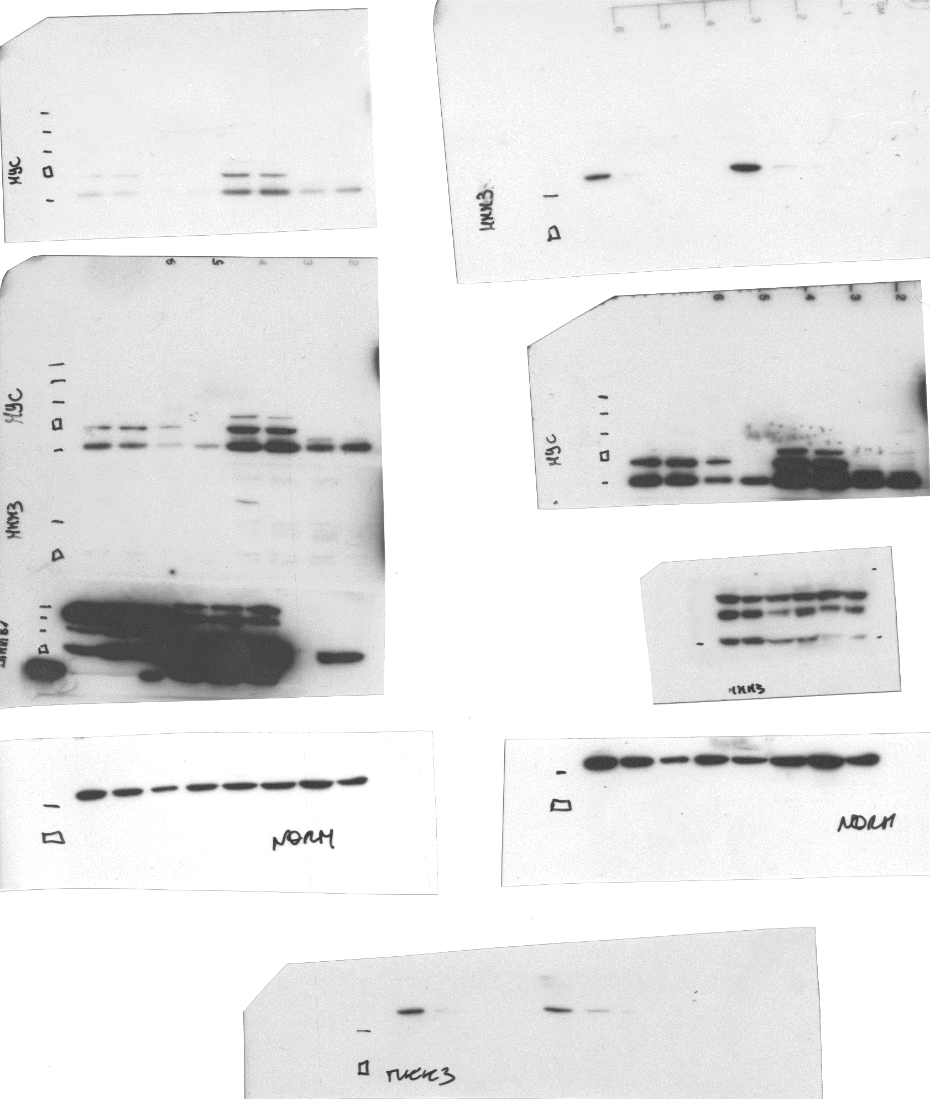

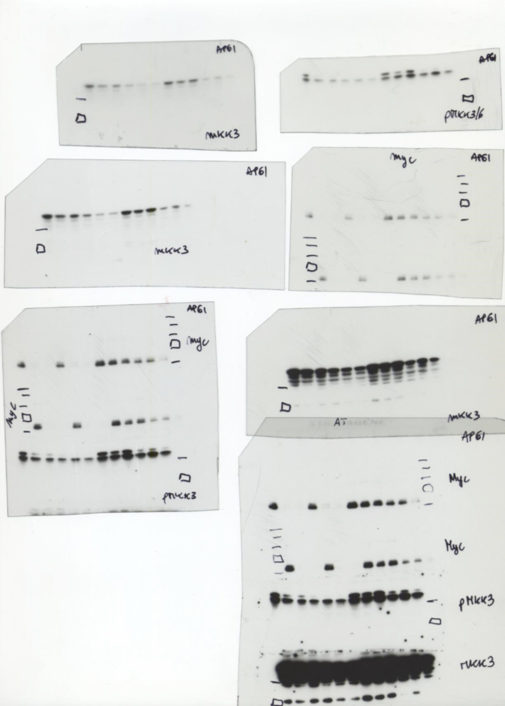
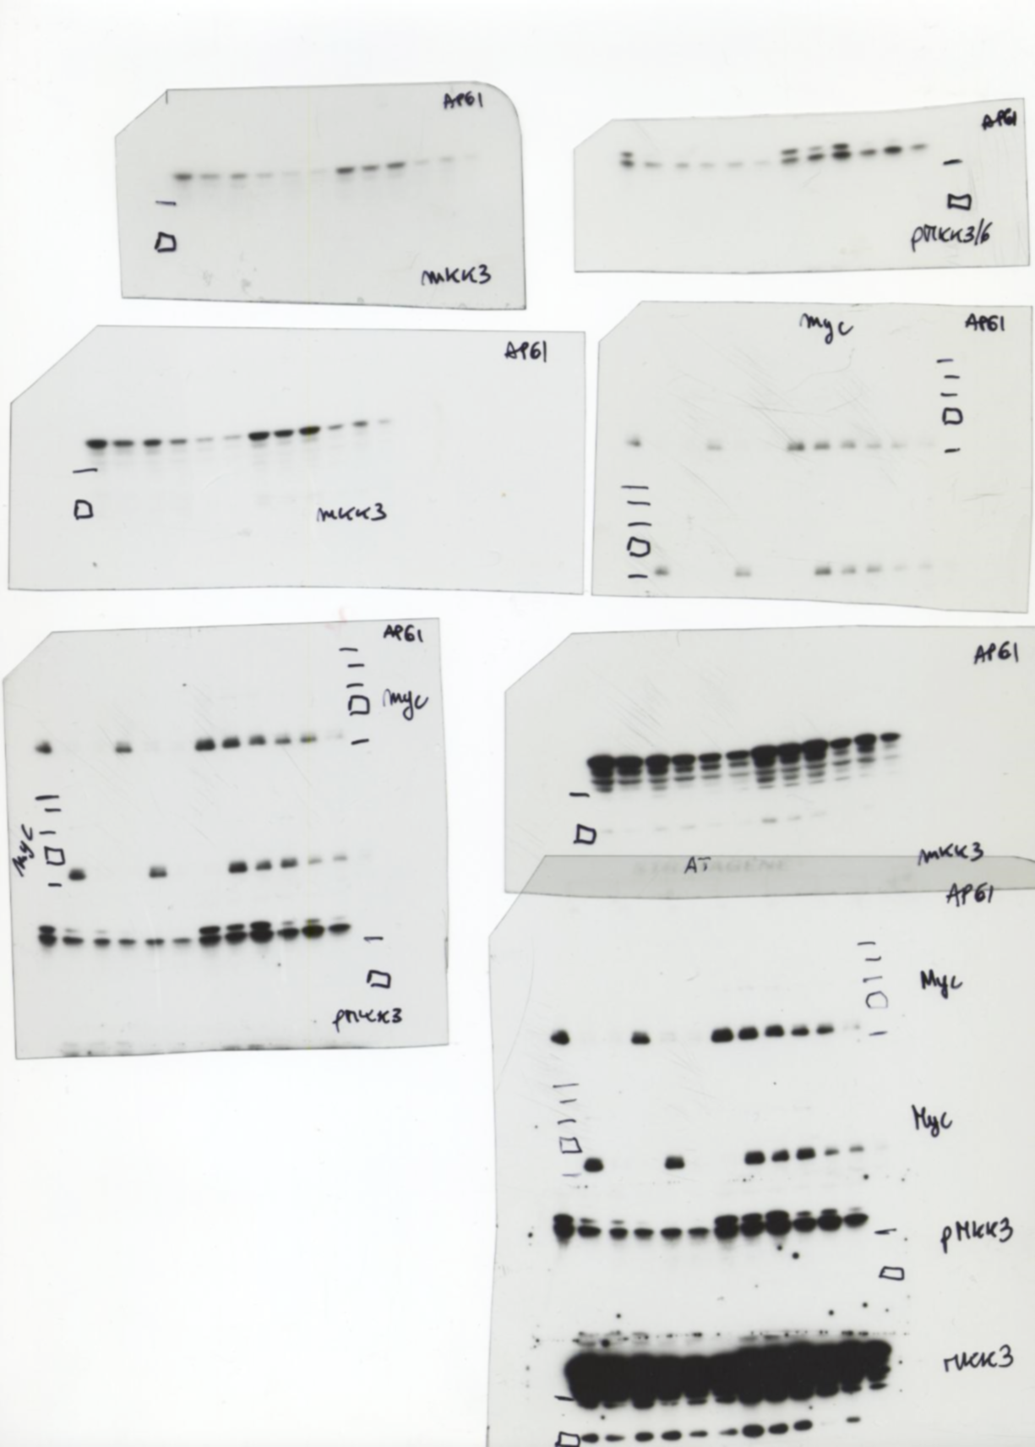
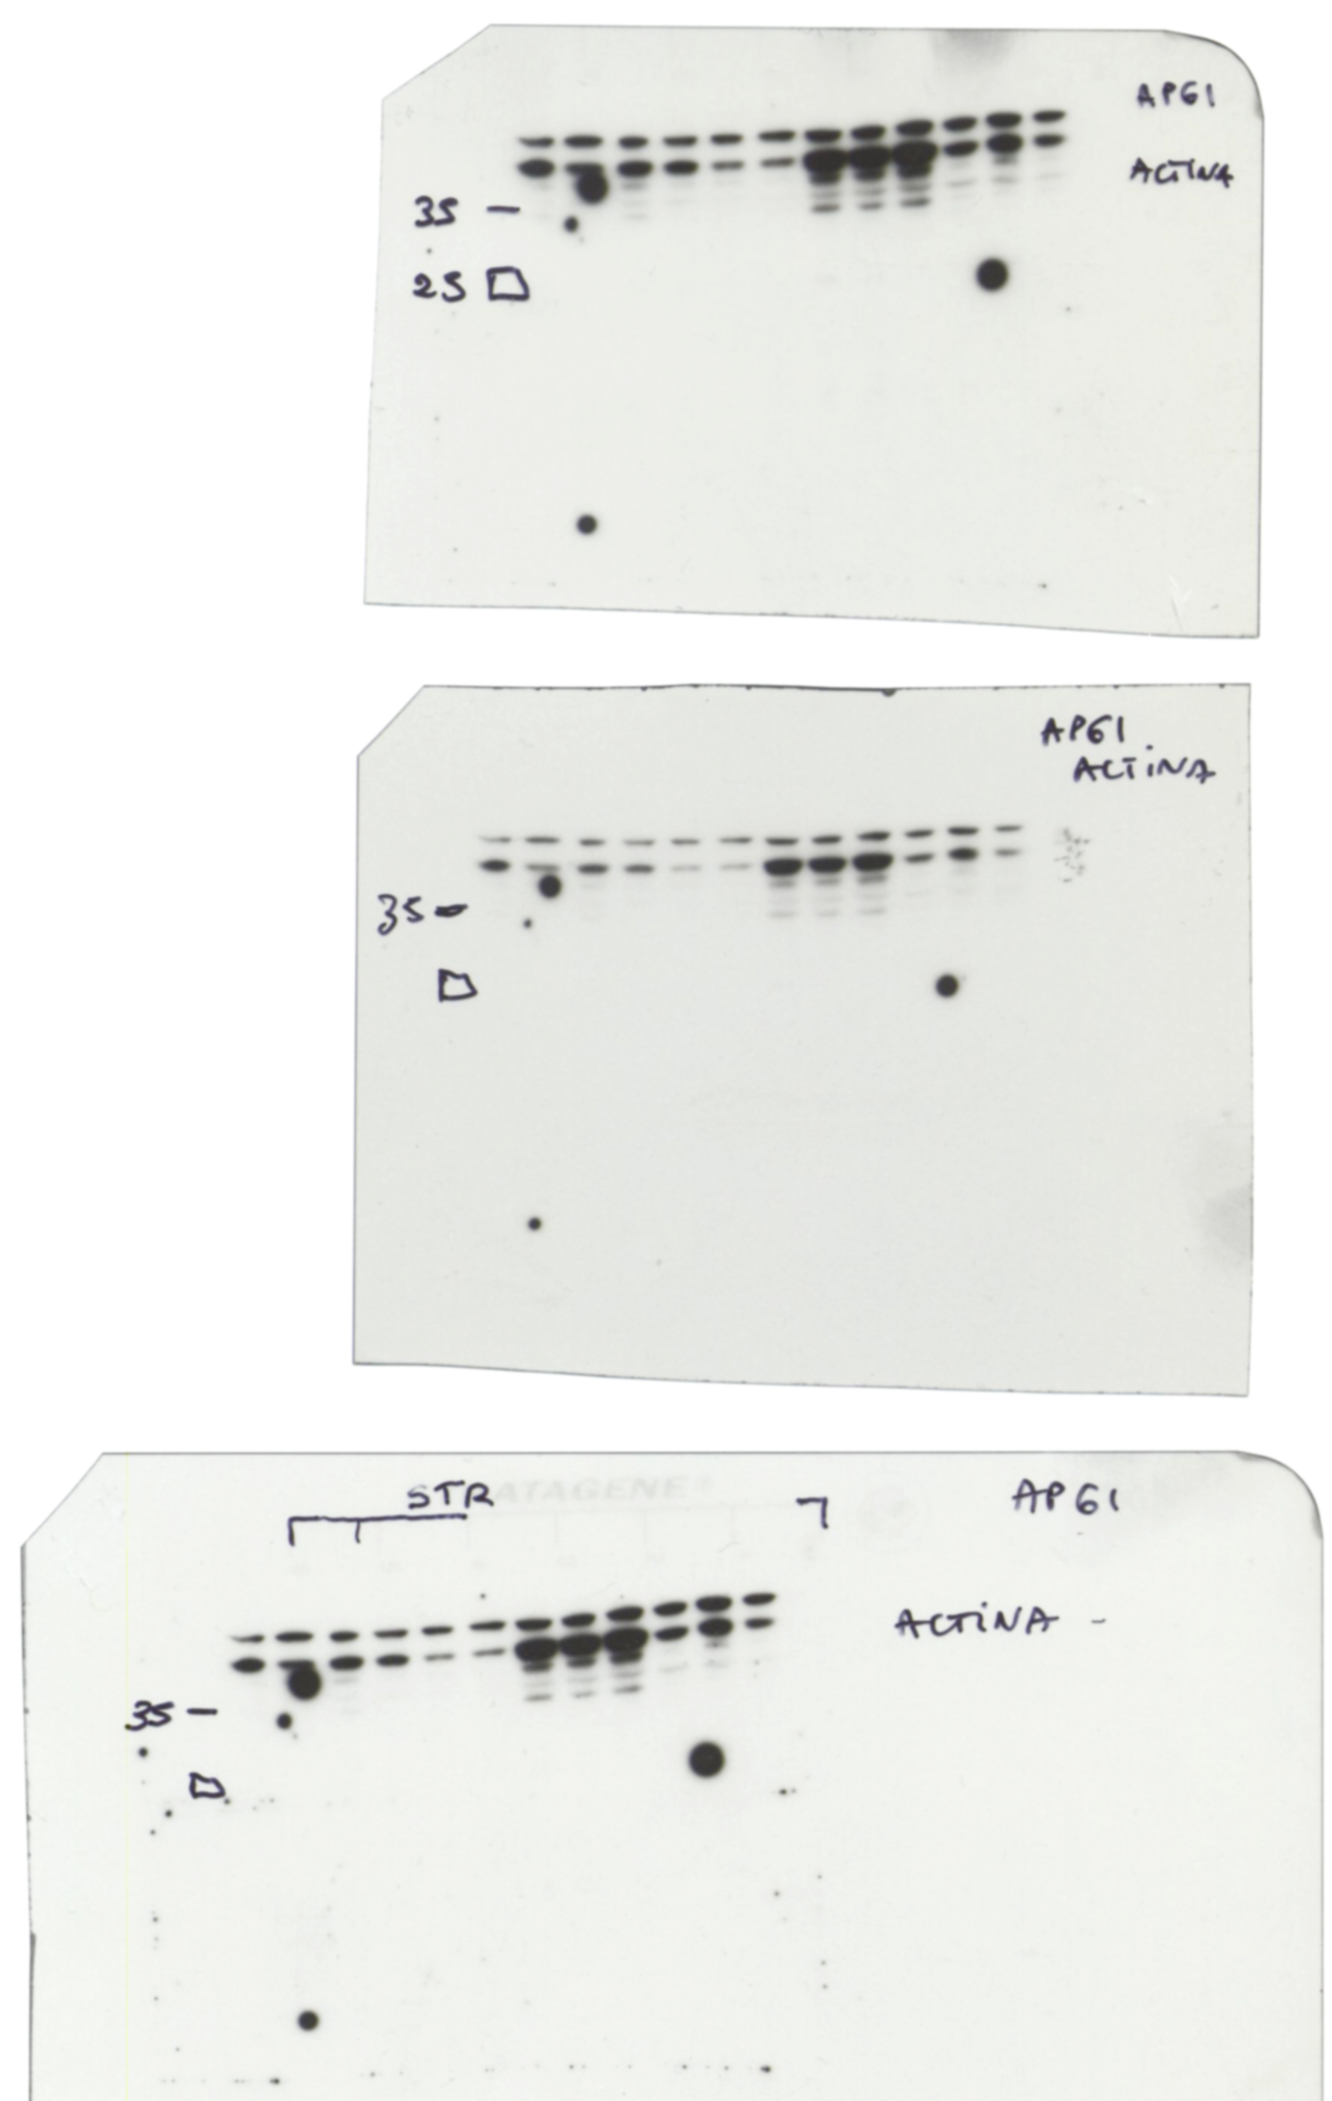
Figure 3B
MKK3
-35-
-25-
-250-
-130-
-100-
-70-
MYC
-55-
-35-
ACTIN
-25-
Figure 3C
MKK3
-35-
-25-
-250-
-130-
-100-
-70-
MYC
-55-
ACTIN

Slide 6
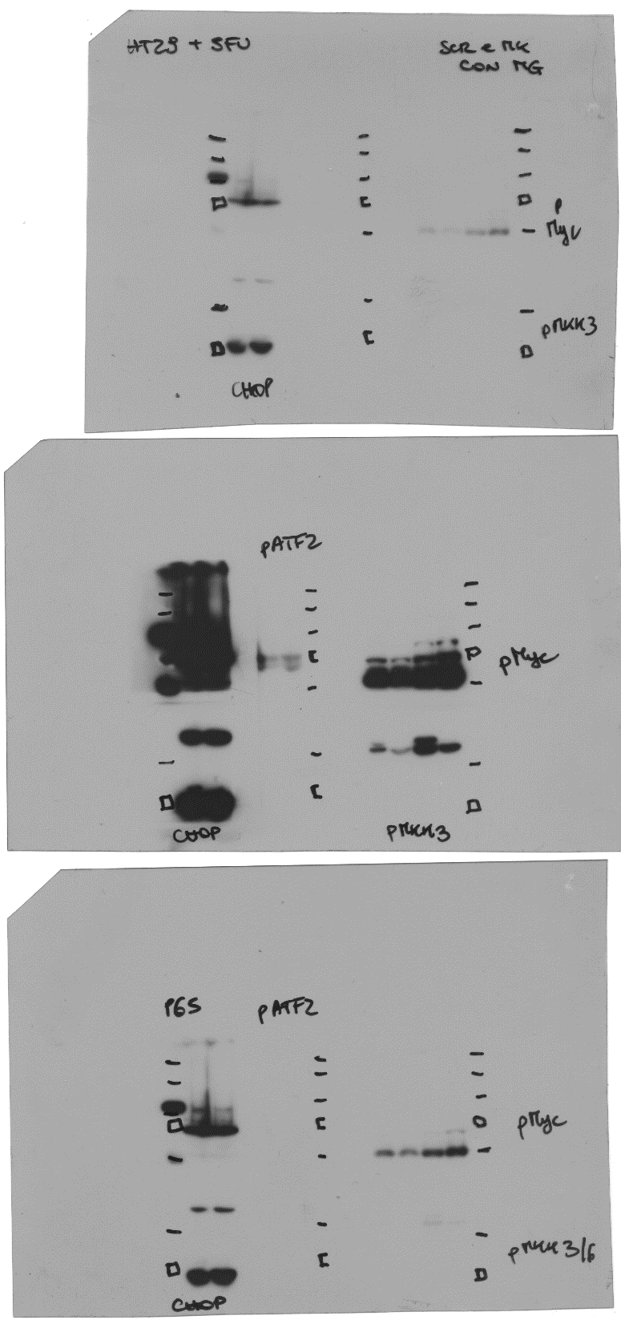
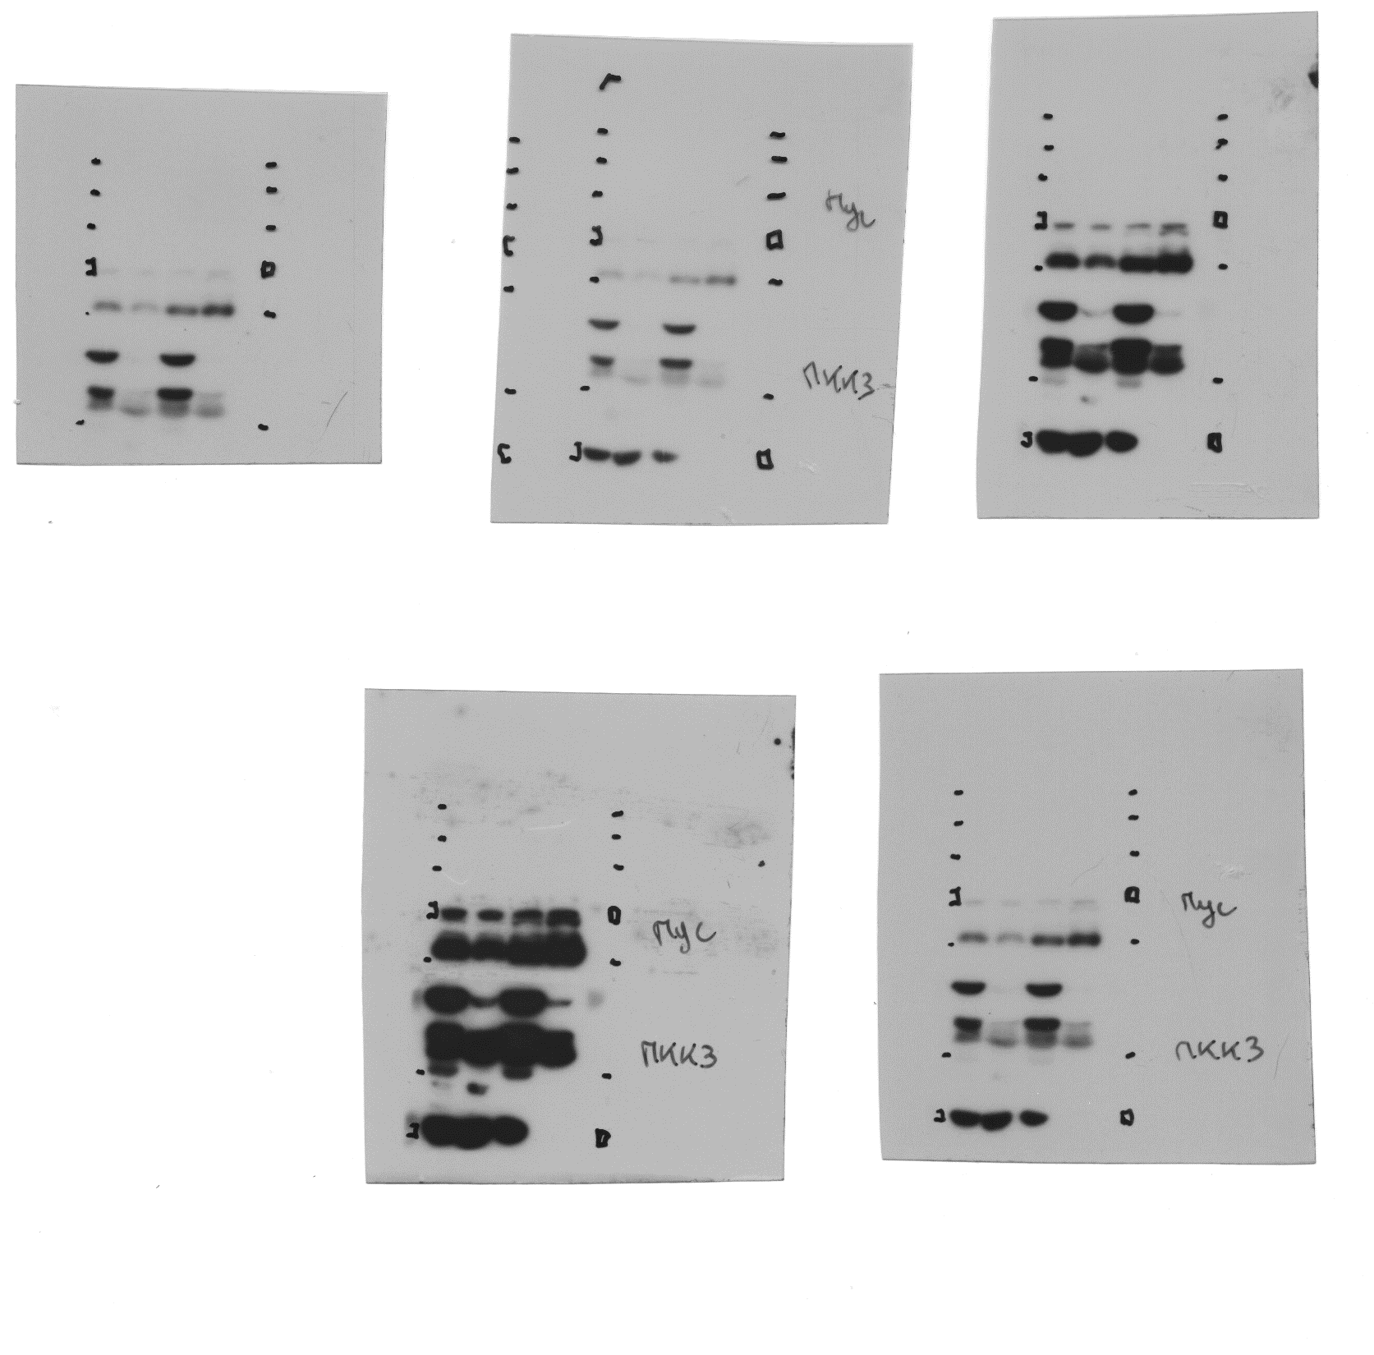
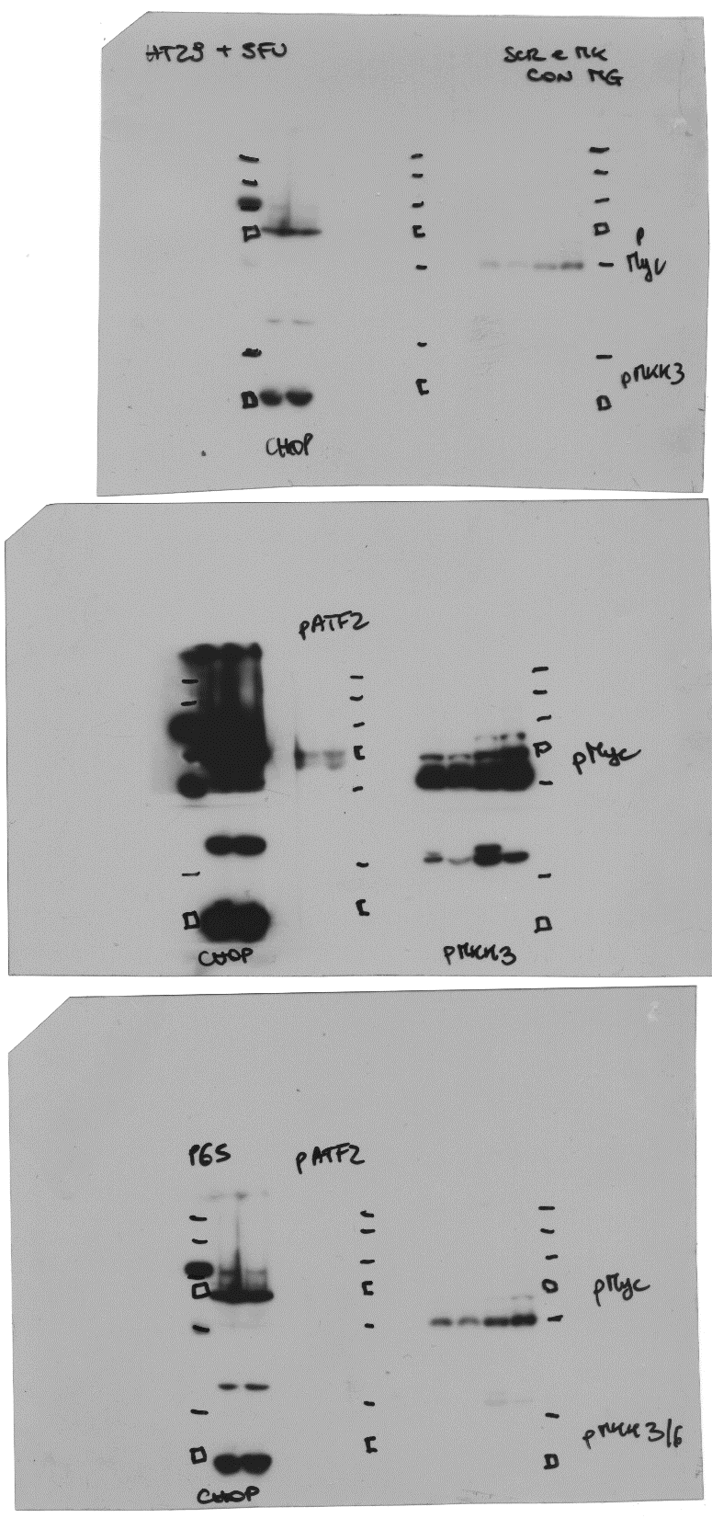
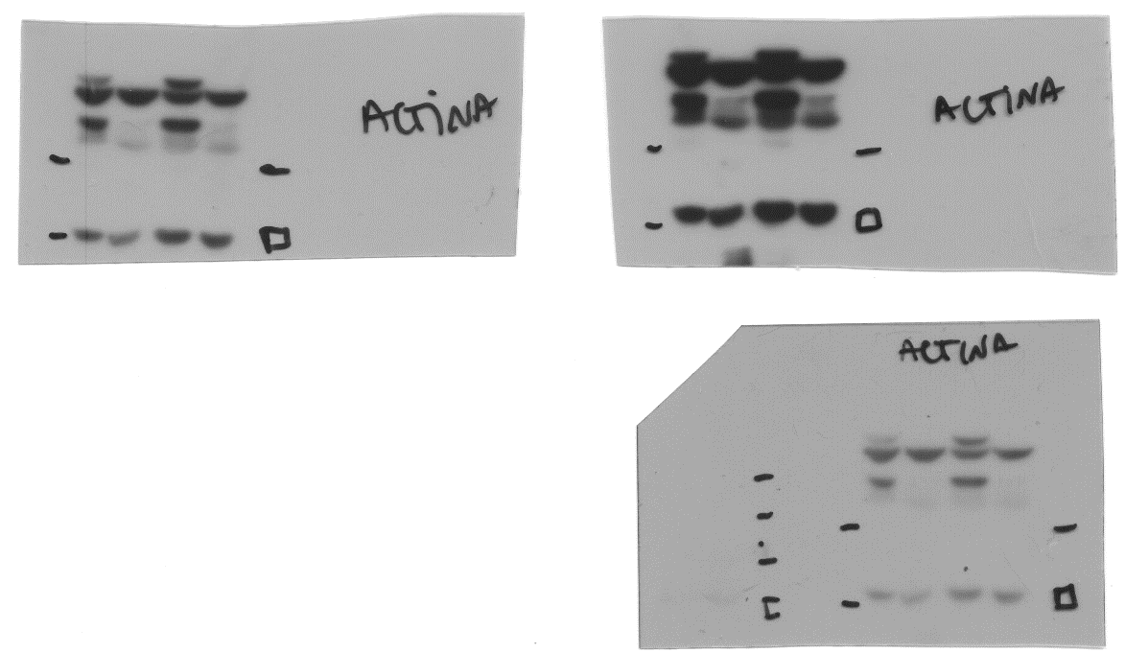
Figure 3D
-70-
-55-
-35-
p-MKK3
-25-
-70-
-55-
MYC
MKK3
-35-
-25-
-100-
-70-
p-MYC
-55-
-35-
-35-

Slide 7
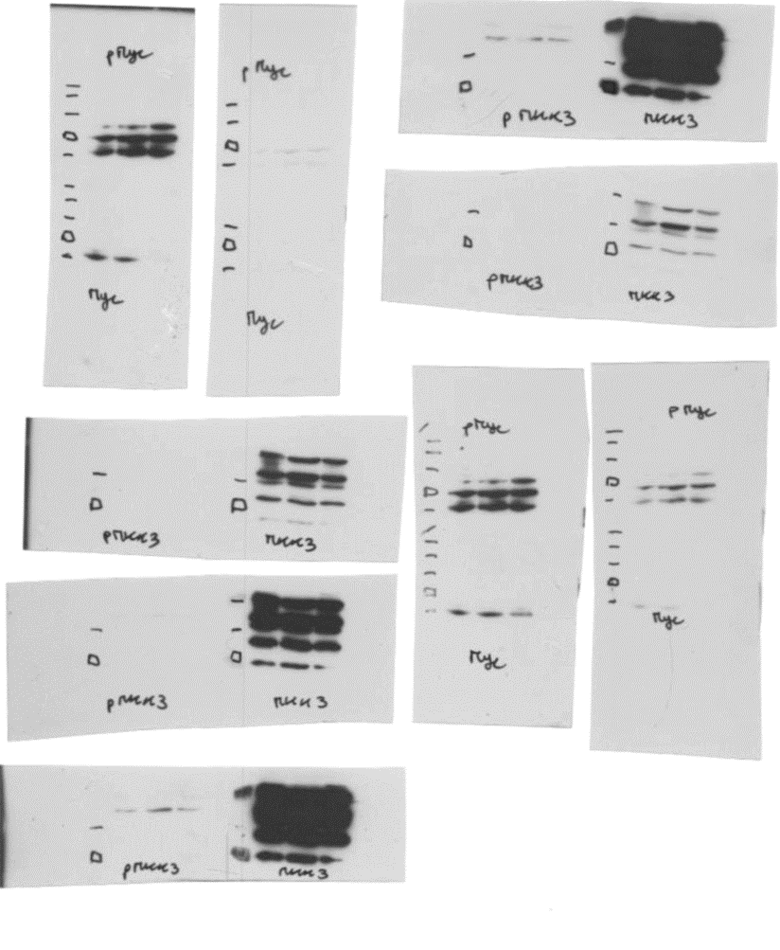
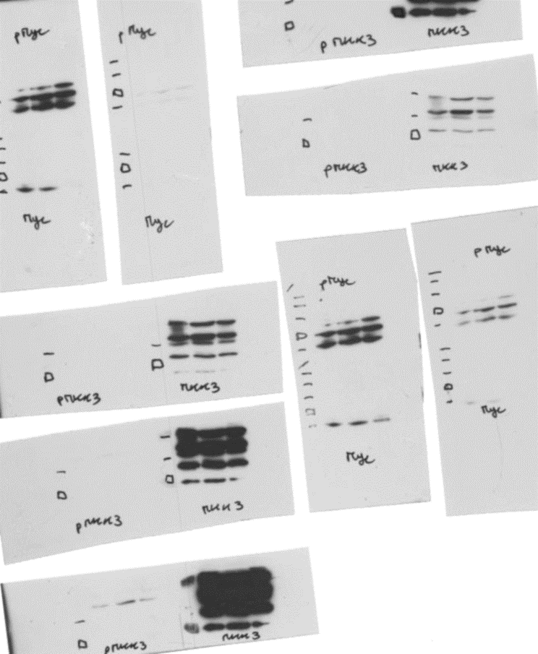
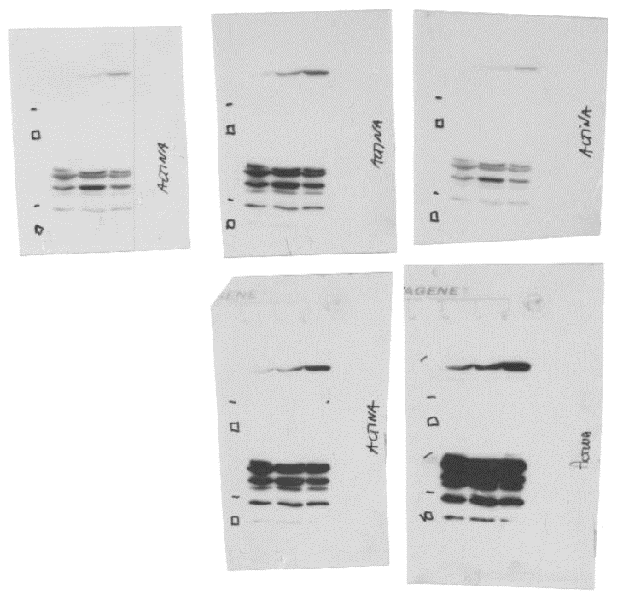
Figure 3E
-130-
-100-
-70-
-55-
MYC
-55-
-35-
MKK3
-25-
ACTIN
-35-
-25-

Slide 8
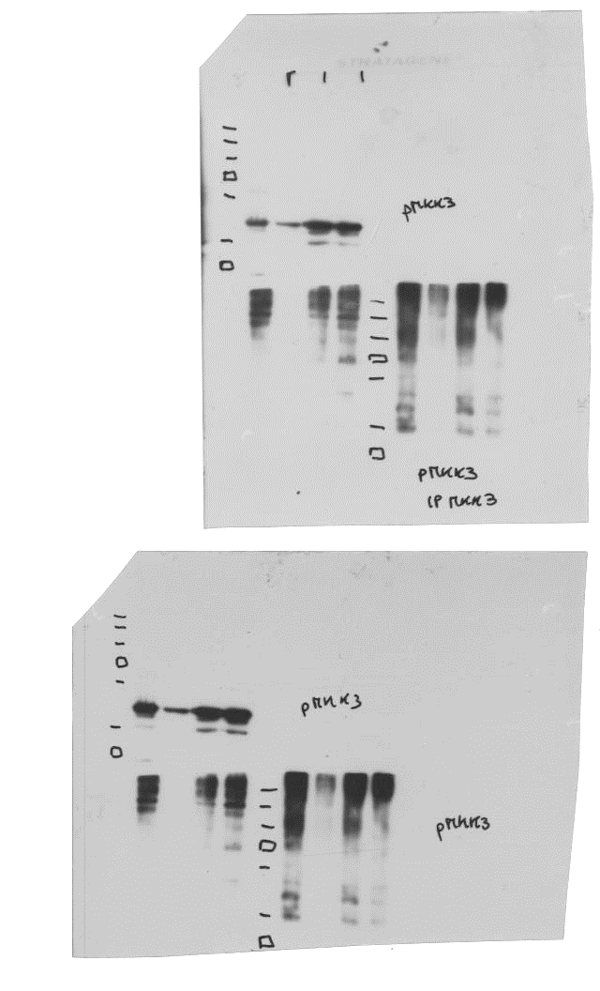
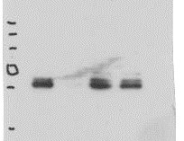
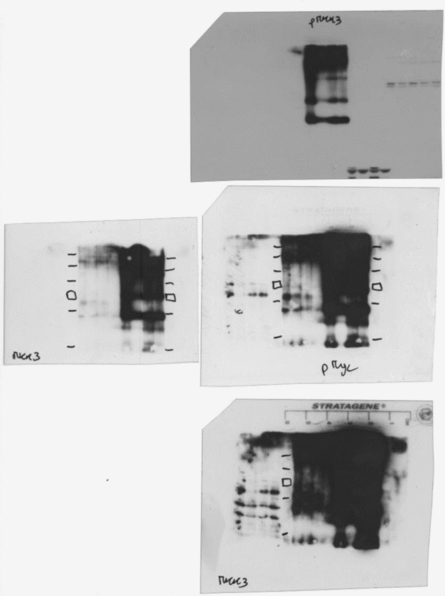
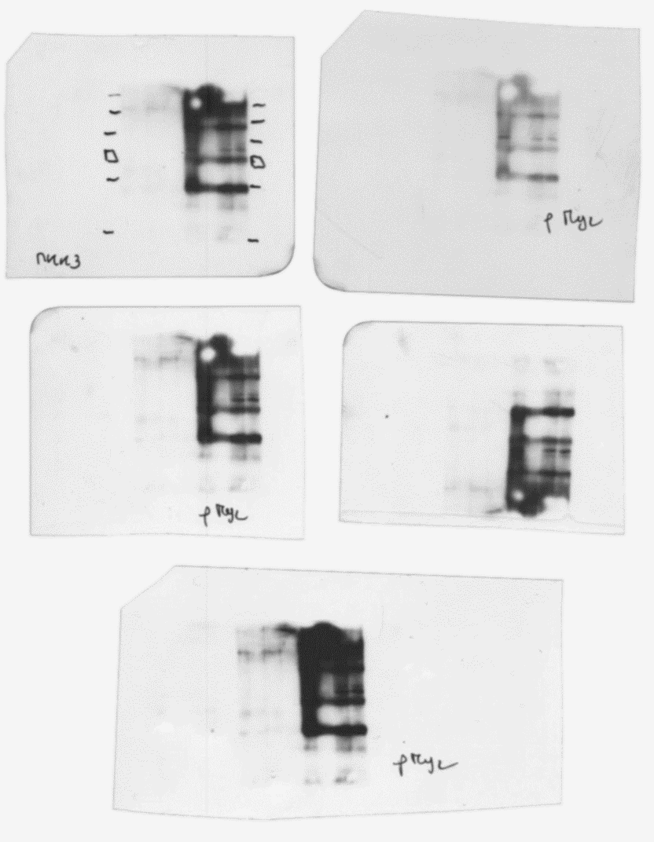
Figure 4A
INPUT
-250-
-250-
-130-
-130-
-100-
-100-
-70-
-70-
-55-
-55-
p-MYC
p-MKK3
-35-
-25-
-250-
-250-
-130-
-130-
-100-
-100-
-70-
-70-
-55-
-55-
p-MKK3
-35-
-35-
-250-
-130-
-100-
-70-
-55-
p-MYC
IP IgG1
IP MYC

Slide 9
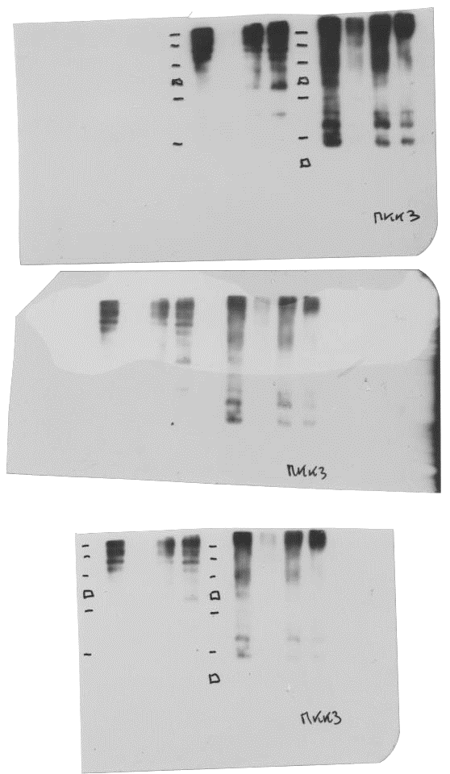
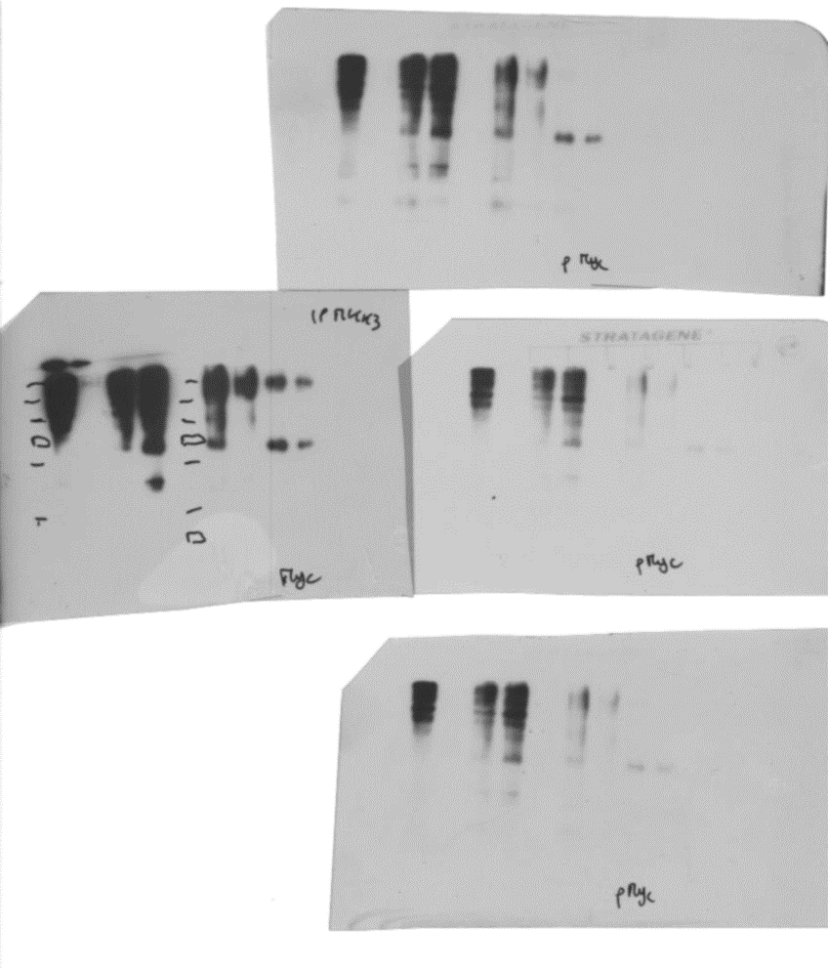
Figure 4A
IP MKK3
-250-
-130-
-100-
-70-
-55-
p-MKK3
-35-
-250-
-130-
-100-
-70-
p-MYC
-55-
-35-
IP IgG1
IP MKK3

Slide 10
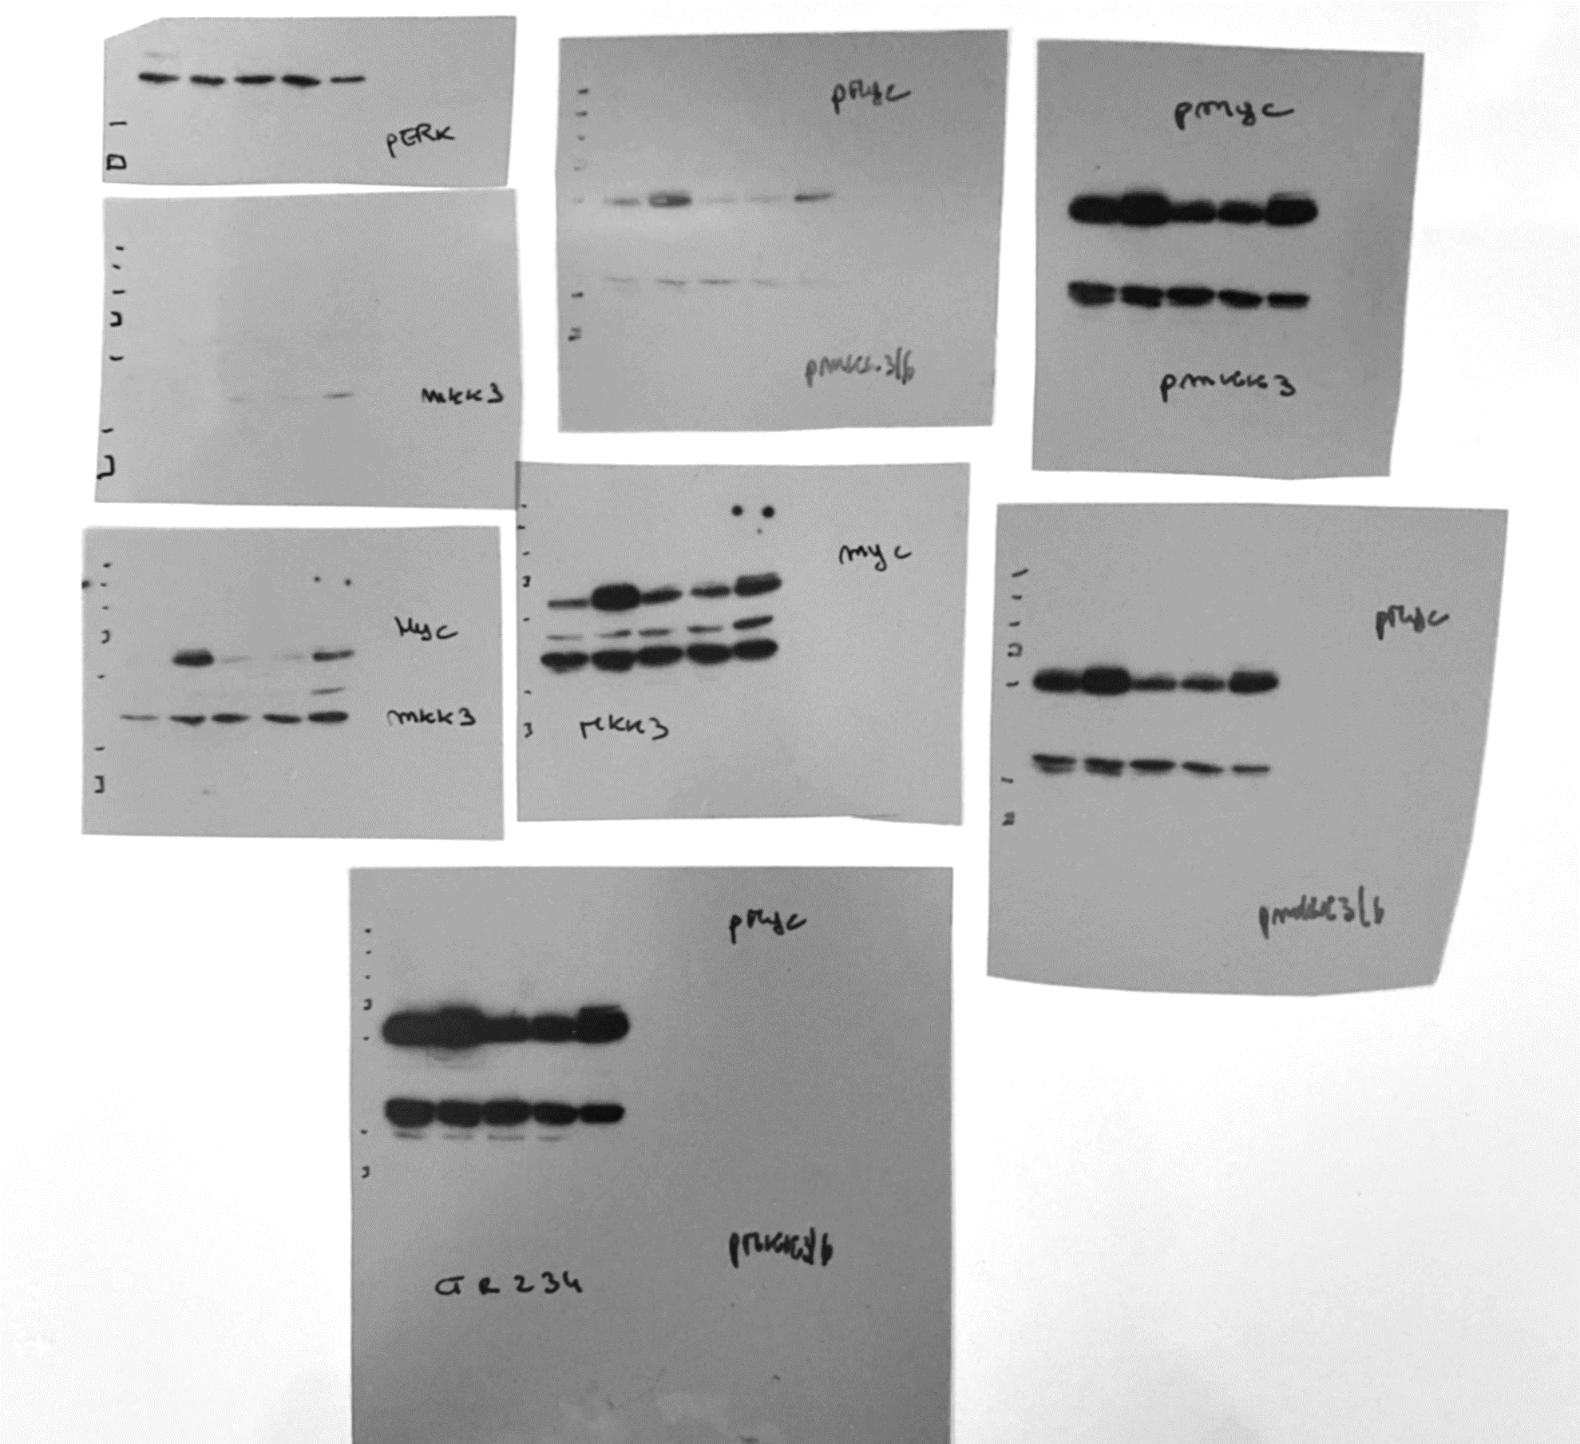
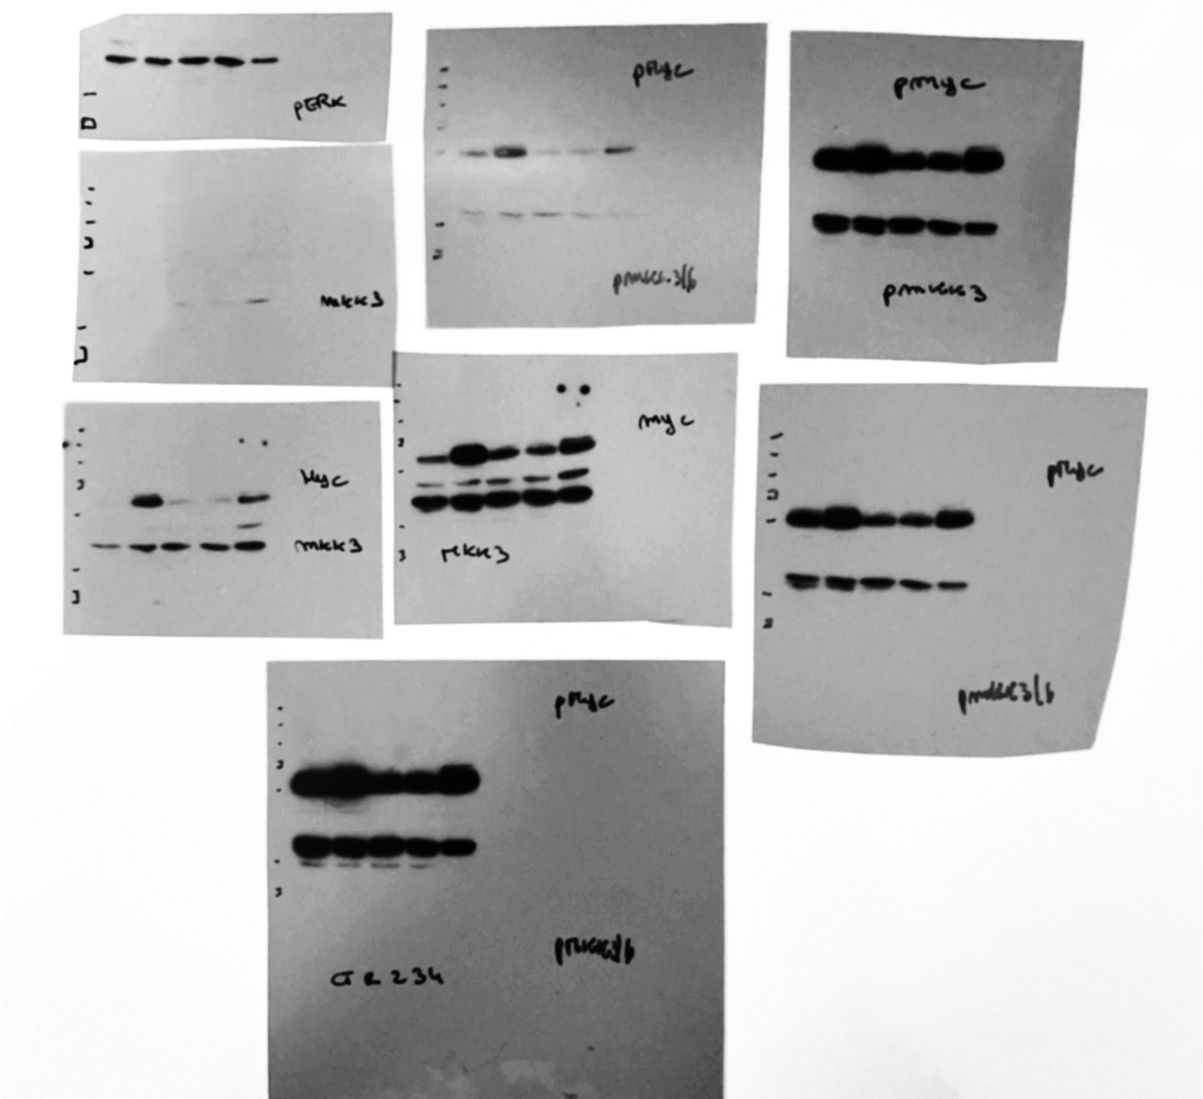
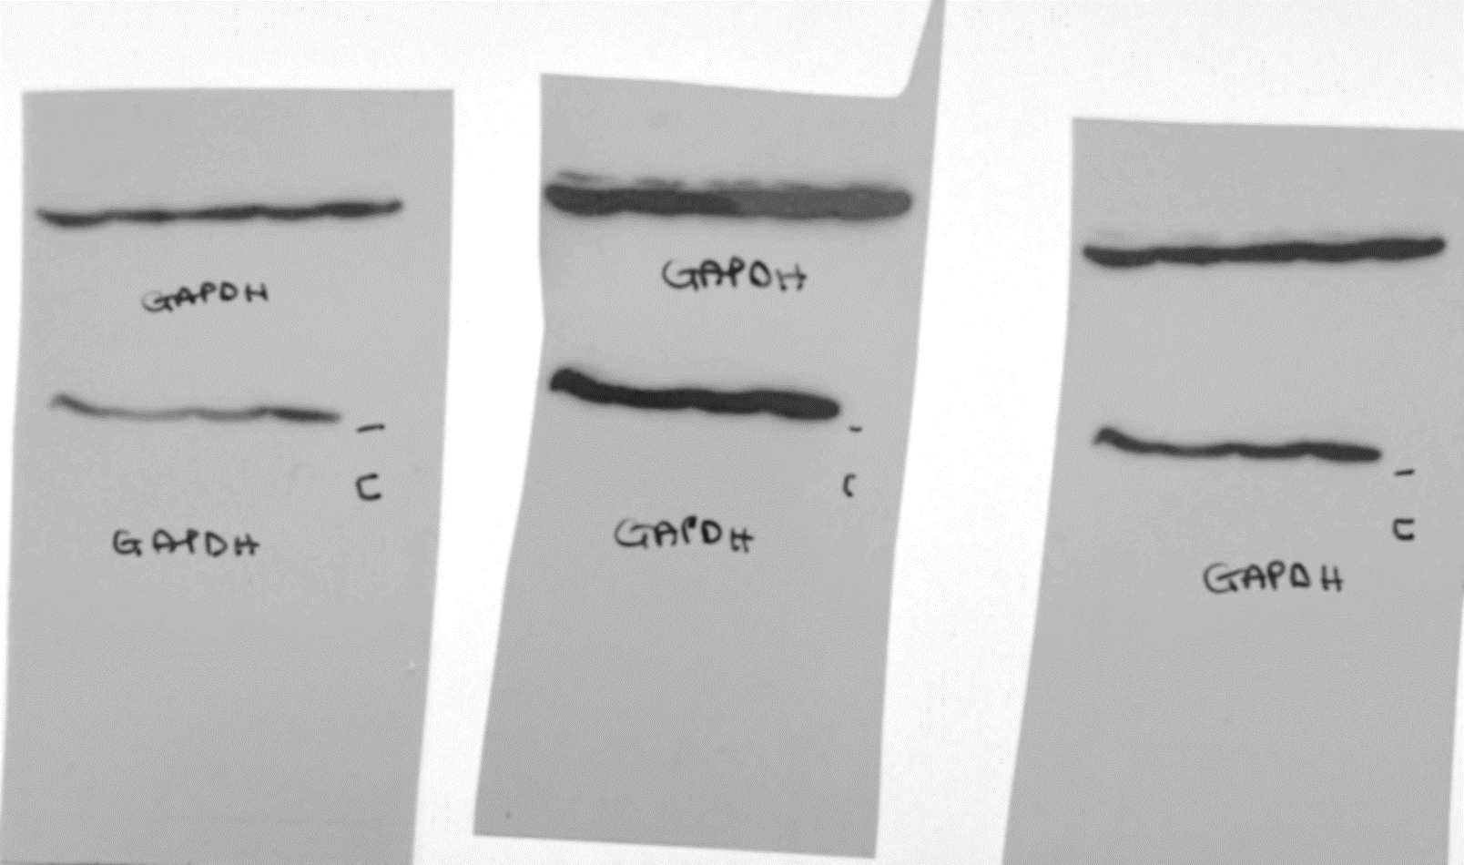
Figure 6B
-250-
-130-
-100-
-70-
MYC
-55-
MKK3
-35-
-25-
-250-
-130-
-100-
-70-
-55-
p-MYC
-35-
GAPDH
-25-
GAPDH
-35-
-25-

Slide 11
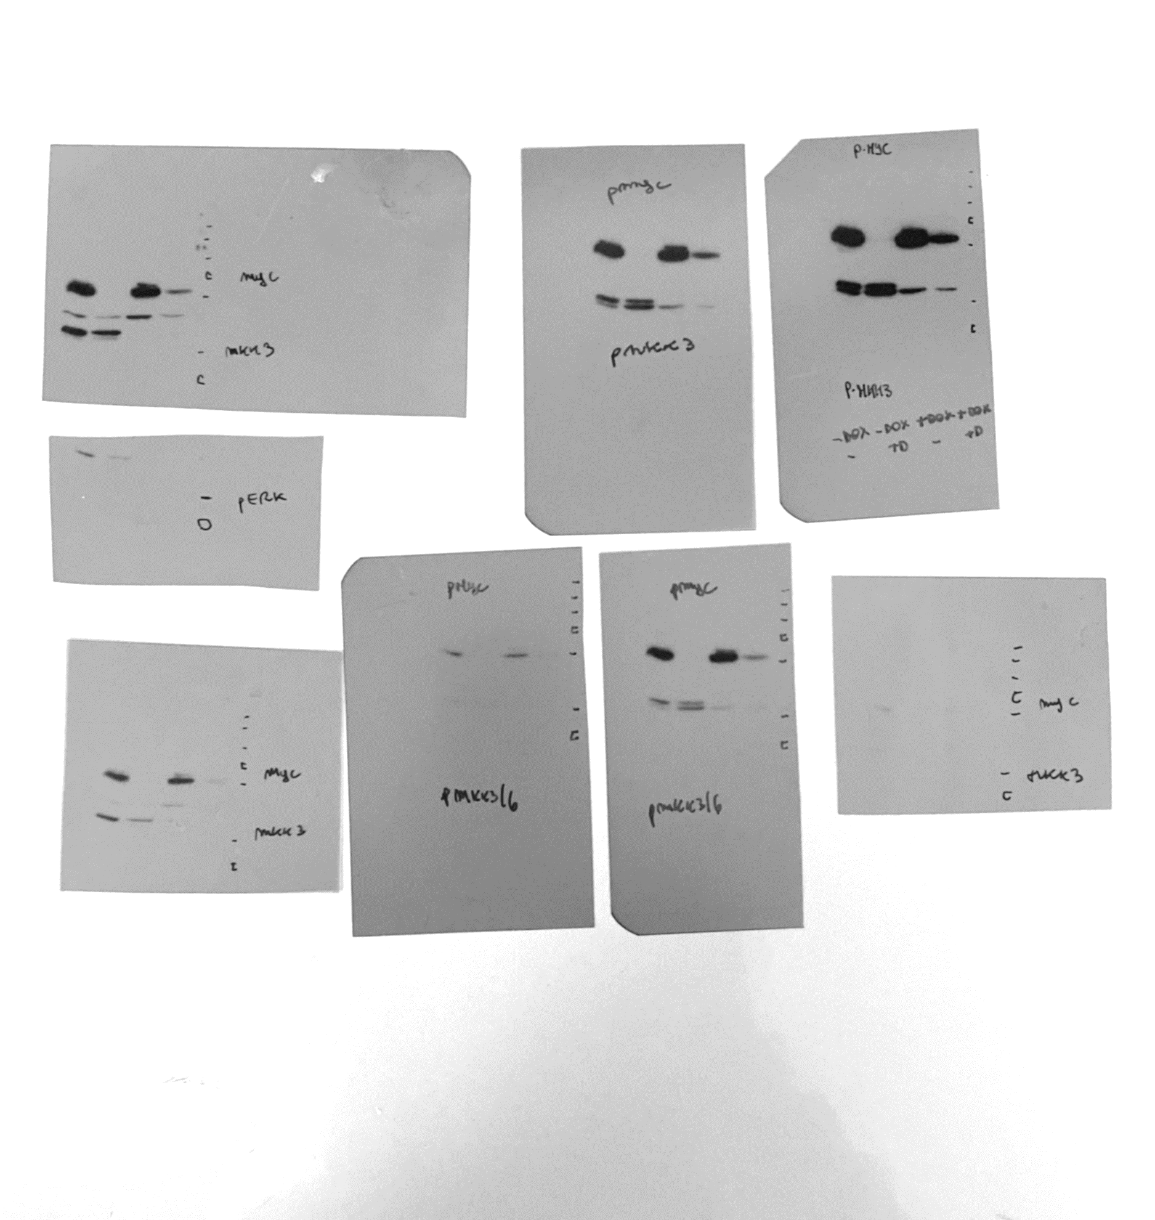

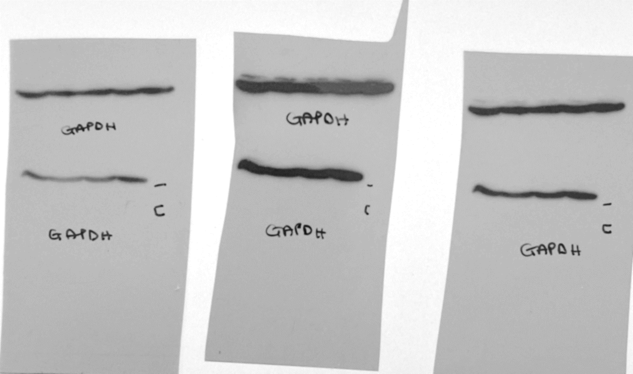
Figure 6E
-35-
-25-
p-MKK3
p-MKK3
-35-
-25-
-35-
GAPDH
-25-

