Slide 1
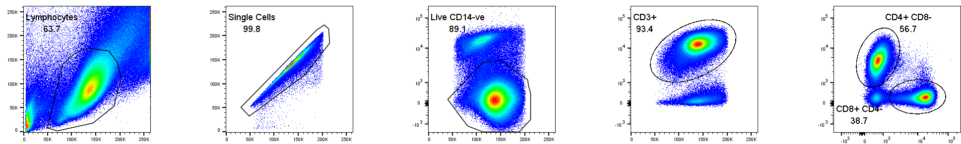
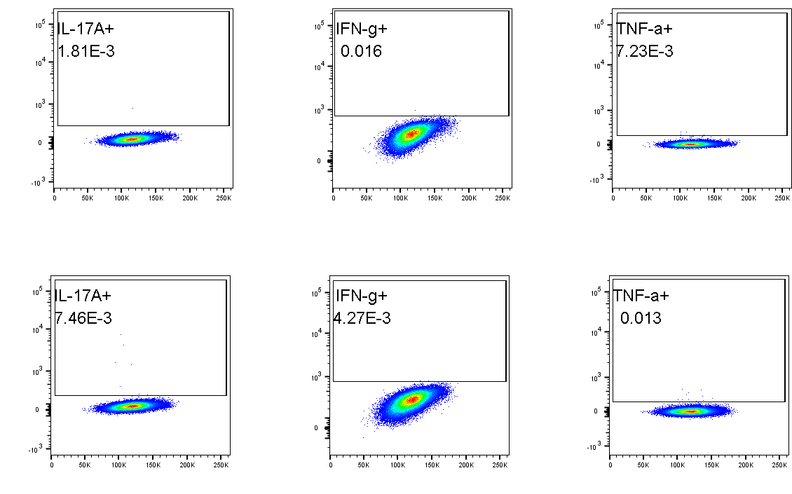
Hughes, Ryan, Steel et al. Supplementary Figure 1
A
SSC-A
FSC-H
L/D CD14
CD3
CD4
FSC-A
FSC-A
FSC-A
FSC-A
CD8
B
CD8+
CD4+
IL-17A
IFNγ
TNFα
FSC-A
FSC-A
FSC-A
Supplementary Figure 1. Gating strategy for analysis of cytokine-expressing CD8+ and CD4+ T cells. (A) SFMC were identified based on their FSC and SSC profile. This was followed by single cell gating and dead cell and CD14+ cell exclusion. CD3+ T cells were then gated, followed by CD8+CD4- and CD4+CD8- T cell identification. (B) For FM control staining, small sample aliquots were combined. Cells were stained as described in the Methods but without any anti-cytokine mAbs. FM gates were then set to aid the determination of cytokine-expressing T cells.

