Slide 1
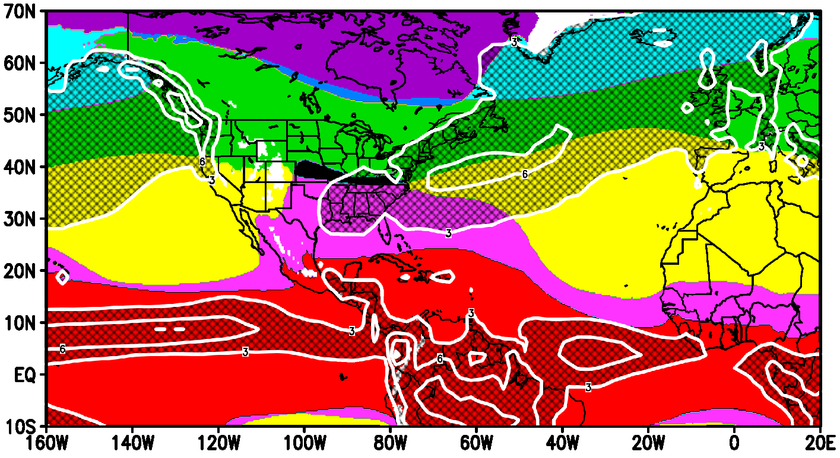
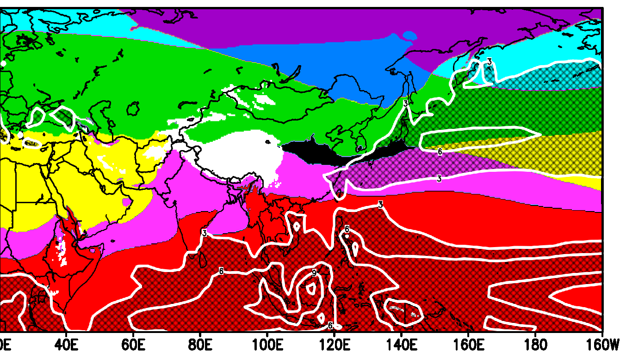
Comparison of location of fronts and intense rain bands
20E
The clustering-based Alisov’s climate classification renewed in this study seems to capture intense mid-latitude rain bands (white contours) as winter polar fronts (Boundary between yellow and green) with baroclinic instability.

