Slide 1
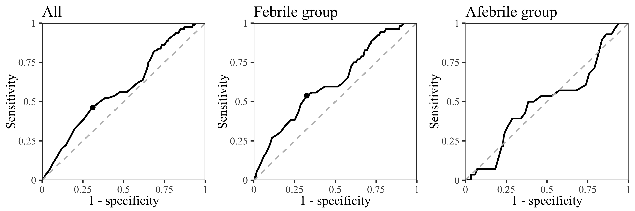
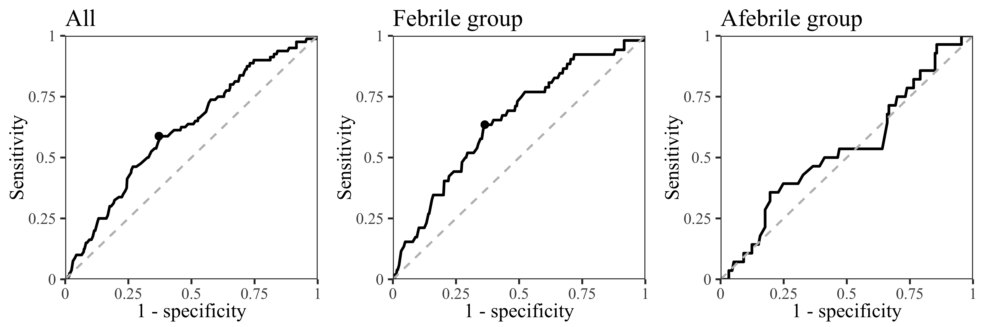
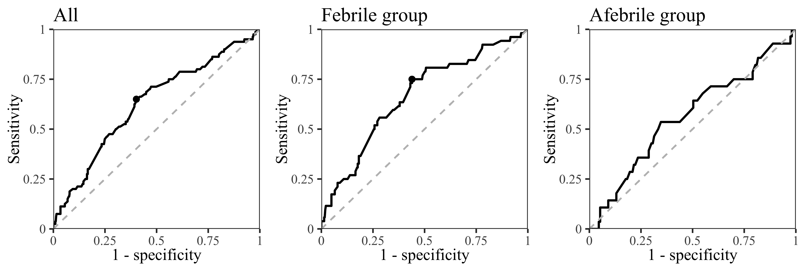
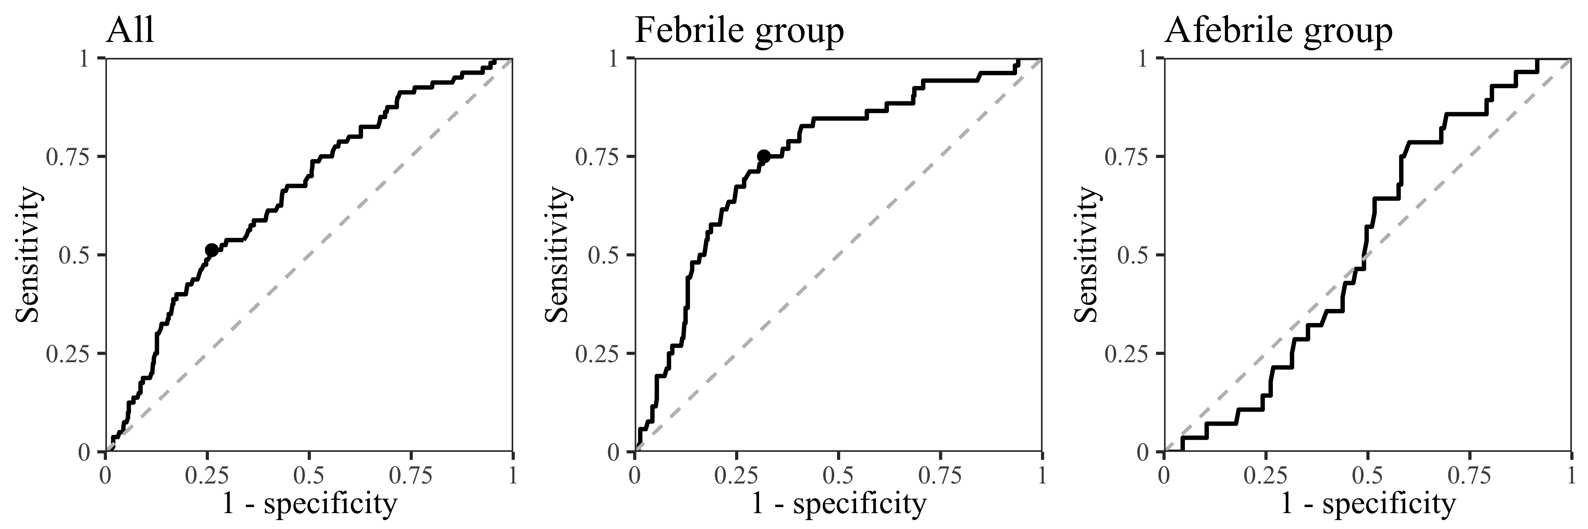
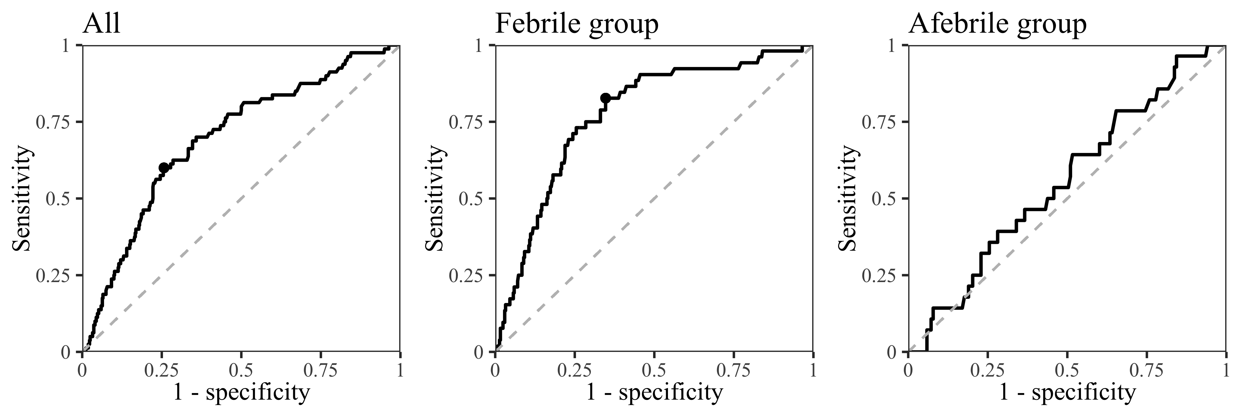
Supplementary Figure 1
A: Age
Cutoff 73 years
Se 46.2%
Sp 69.0%
AUROC 0.59
Cutoff 72 years
Se 53.8%
Sp 67.5%
AUROC 0.62
AUROC 0.50
B:WBC
Cutoff 6.3x10⁹/L
Se 58.8%
Sp 62.1%
AUROC 0.62
Cutoff 6.3x10⁹/L
Se 63.5%
Sp 63.4%
AUROC 0.65
AUROC 0.54
C: Monocyte-to-Lymphocyte ratio
Cutoff 0.625
Se 65.0%
Sp 59.8%
AUROC 0.63
Cutoff 0.625
Se 75.0%
Sp 56.1%
AUROC 0.66
AUROC 0.57
D: Platelet
Cutoff 138x10⁹/L
Se 51.2%
Sp 73.9%
AUROC 0.65
Cutoff 154x10⁹/L
Se 75.0%
Sp 68.3%
AUROC 0.75
AUROC 0.52
E: LDH
Cutoff 404 IU/L
Se 60.0%
Sp 74.3%
AUROC 0.70
Cutoff 345 IU/L
Se 82.7%
Sp 65.3%
AUROC 0.77
AUROC 0.55

