Slide 1
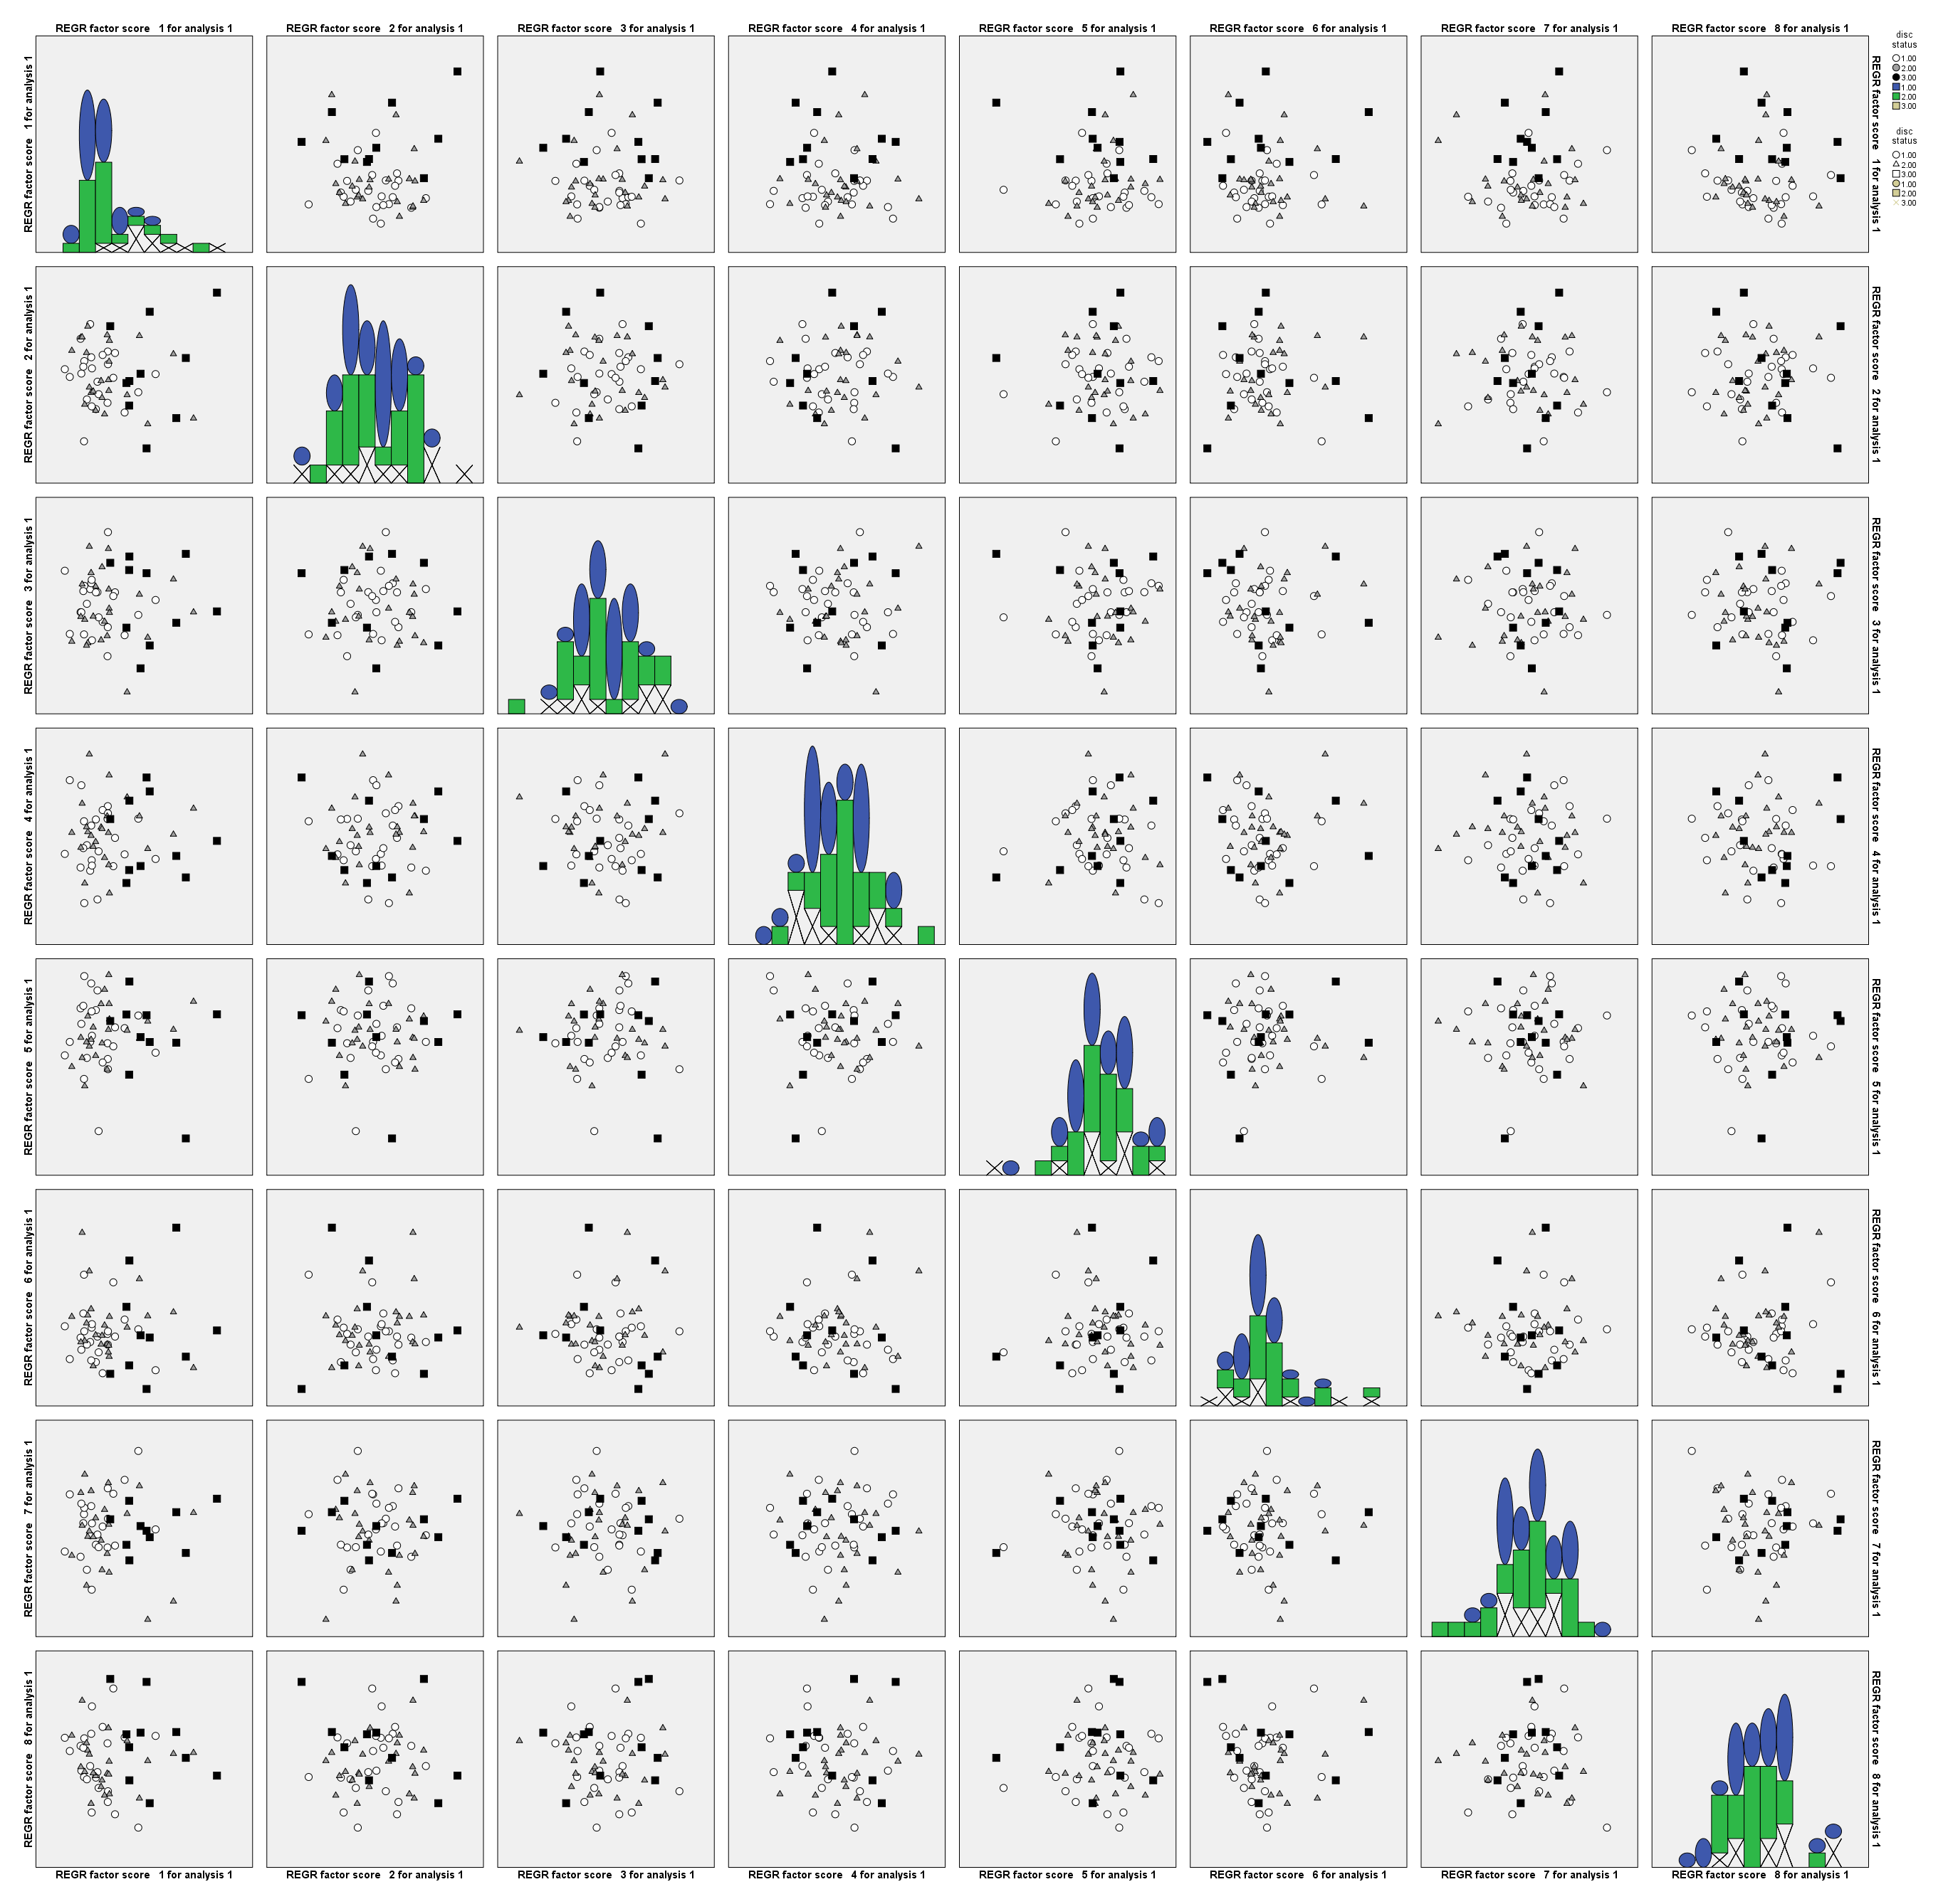
PC2
SKIII-NDP
PC3
SKIII-DDwR
SKIII-DDwoR
PC4
PC5
PC6
PC7
PC8
PC1
PC2
PC3
PC4
PC5
PC6
PC7
Supplementary figure.

