Slide 1
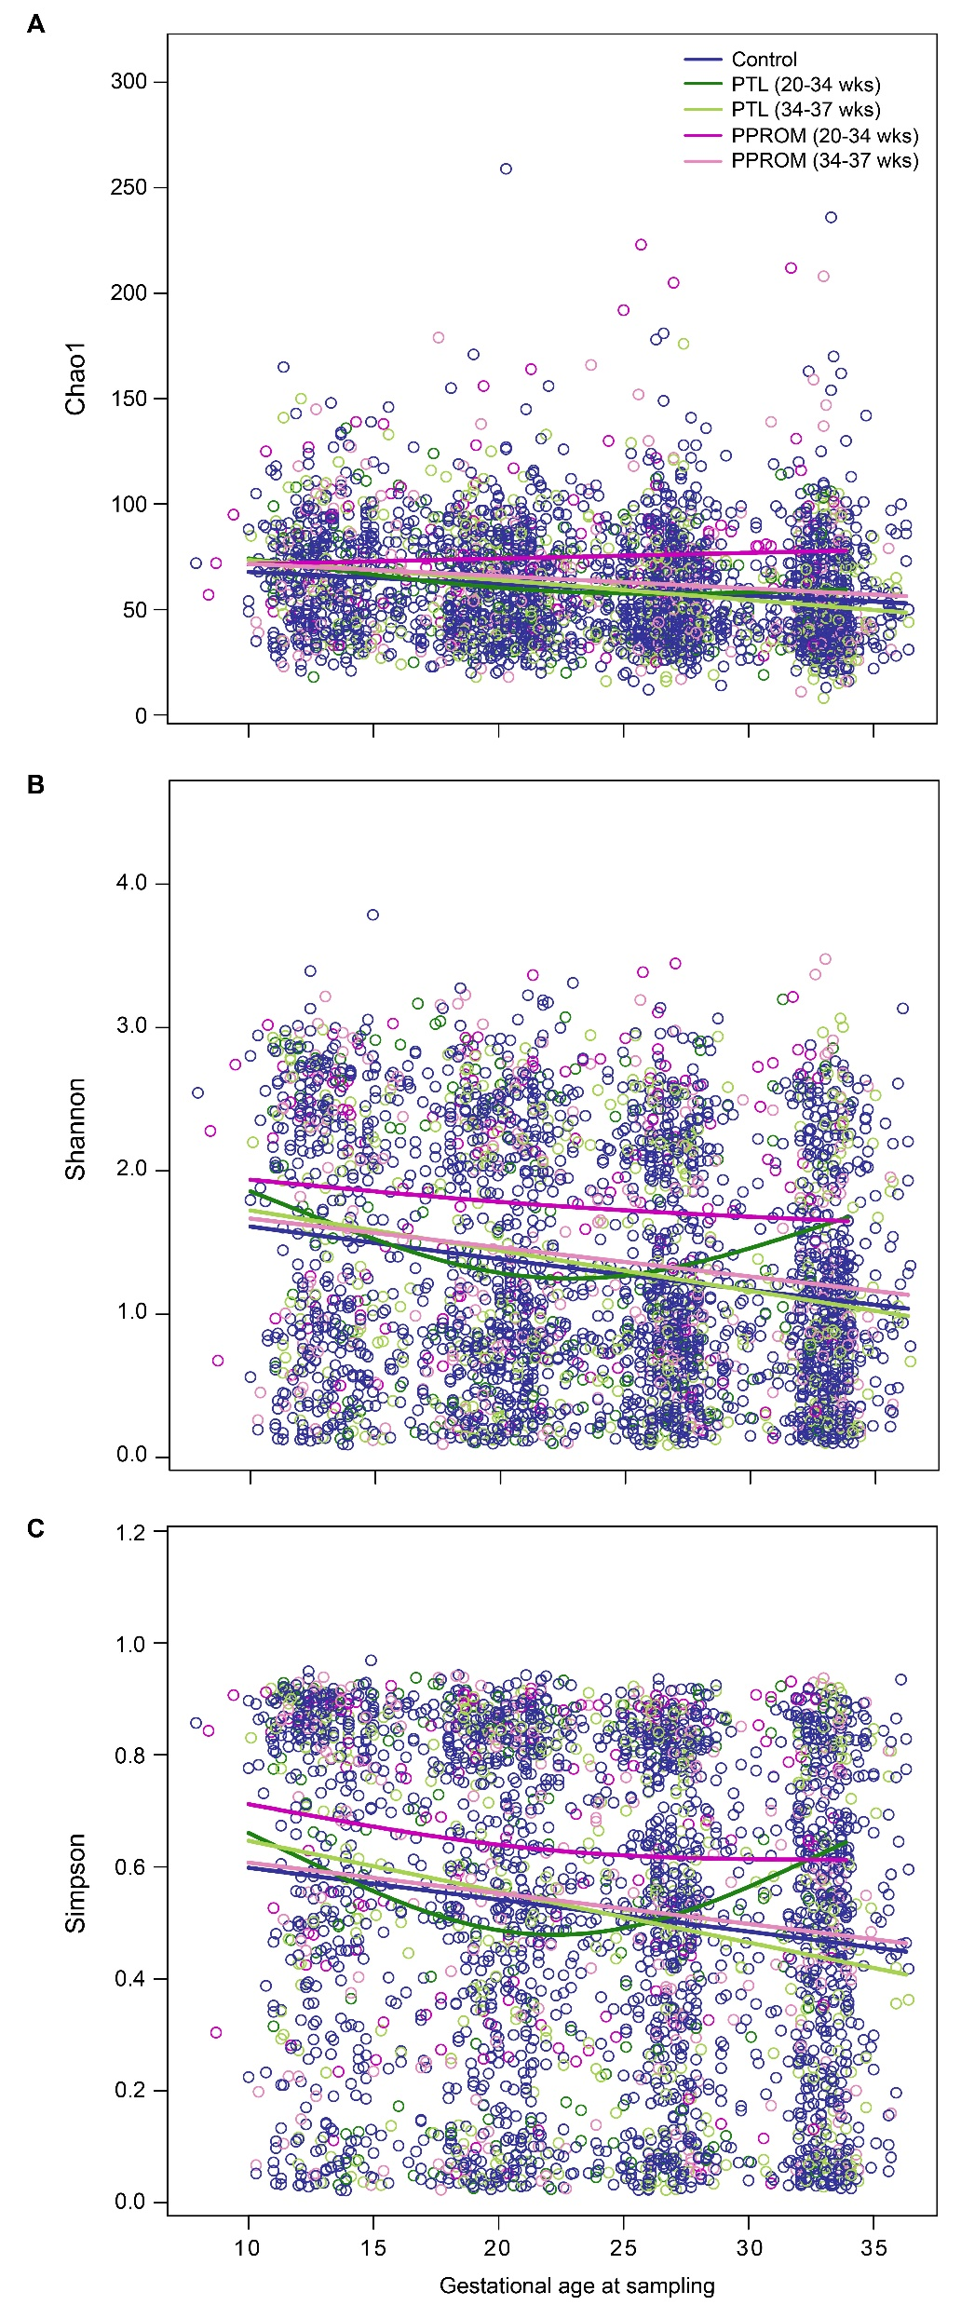
Supplemental Figure 1
Notes:
Graphical abstract

Slide 2
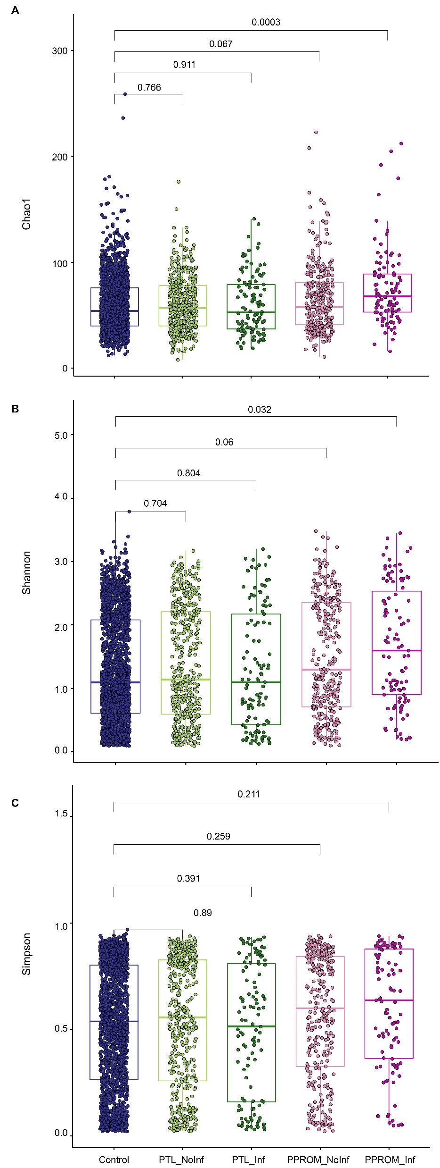
Supplemental Figure 2
Notes:
Graphical abstract

Slide 3
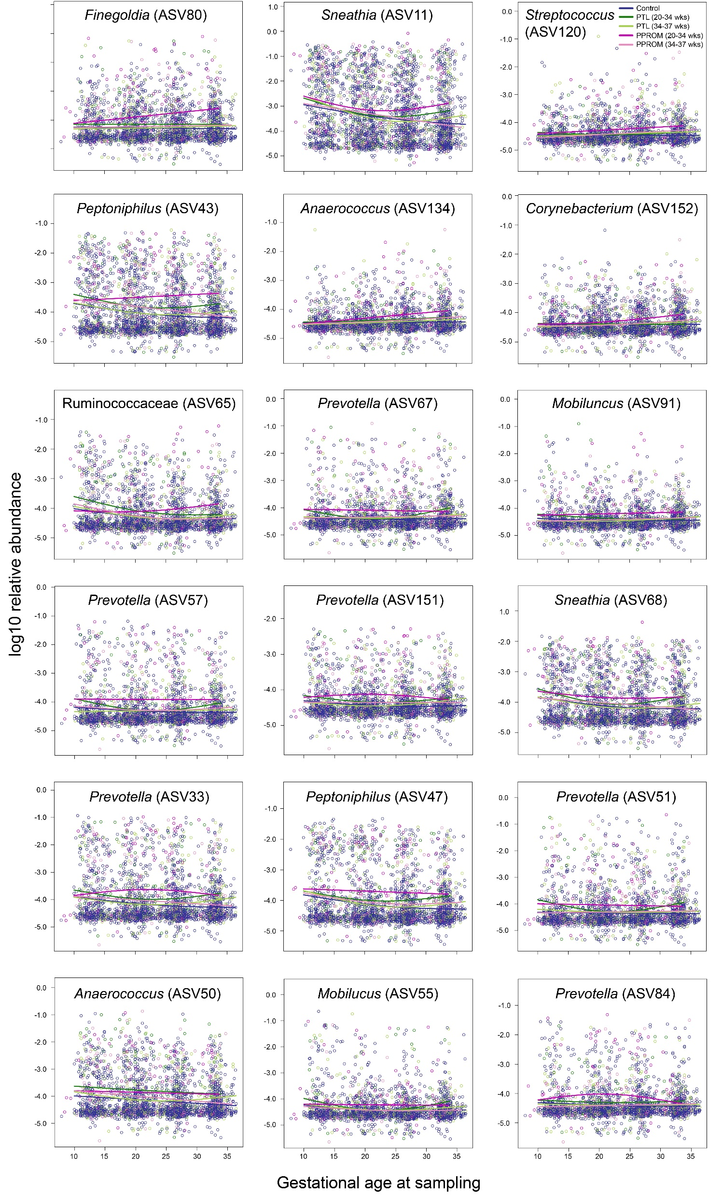
Supplemental Figure 3
Notes:
Graphical abstract

Slide 4
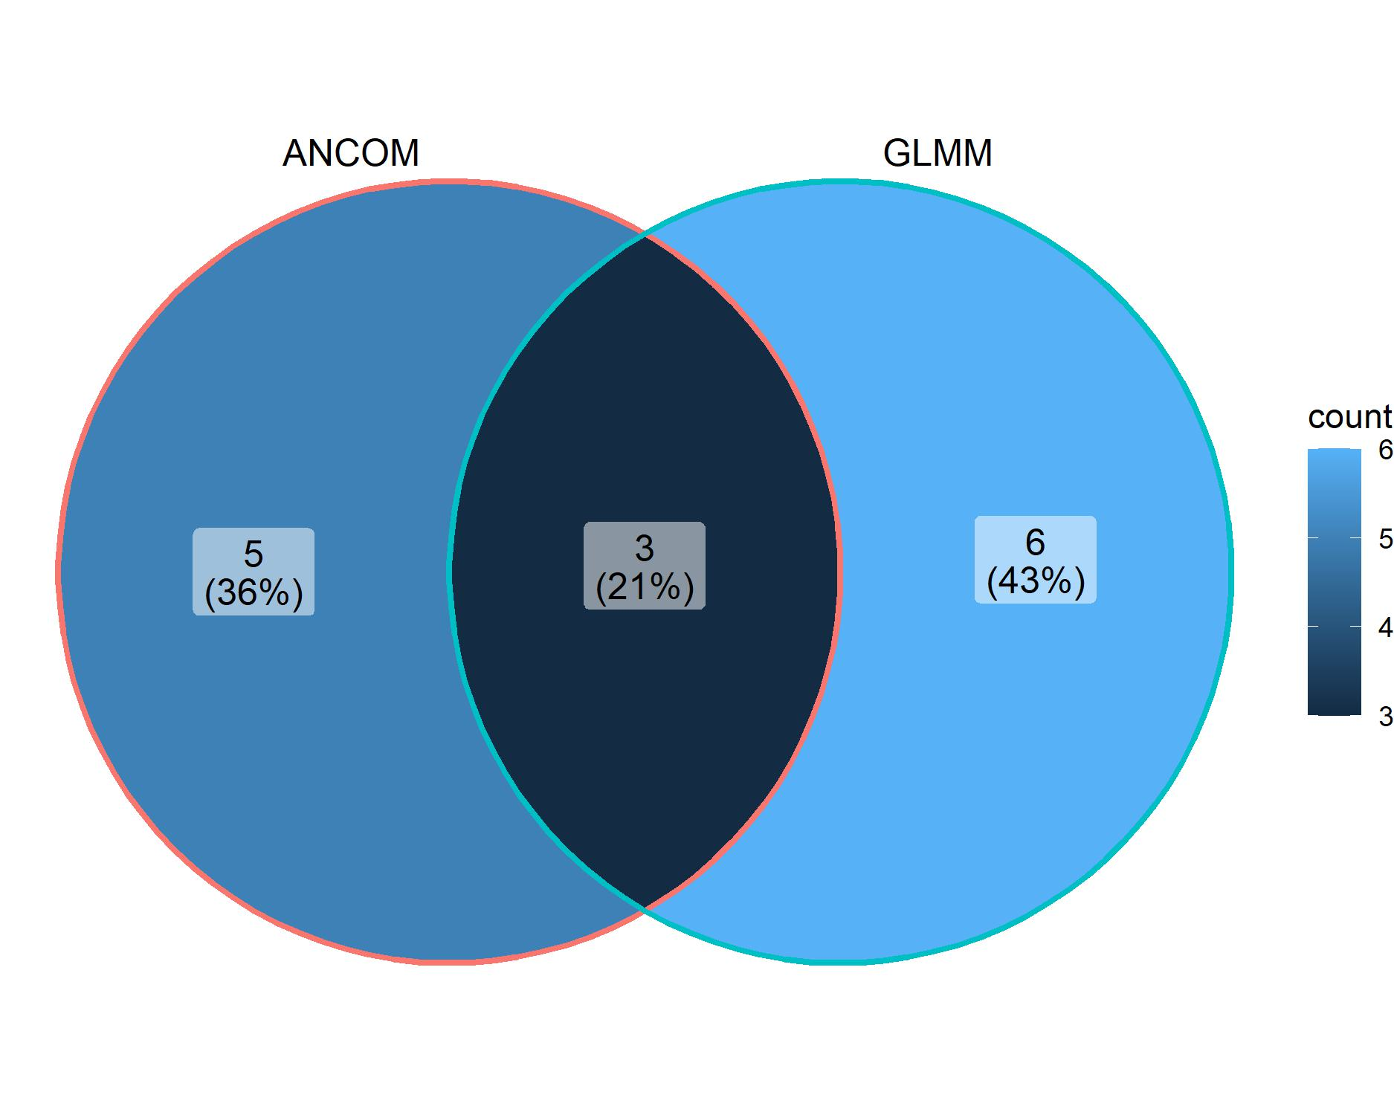
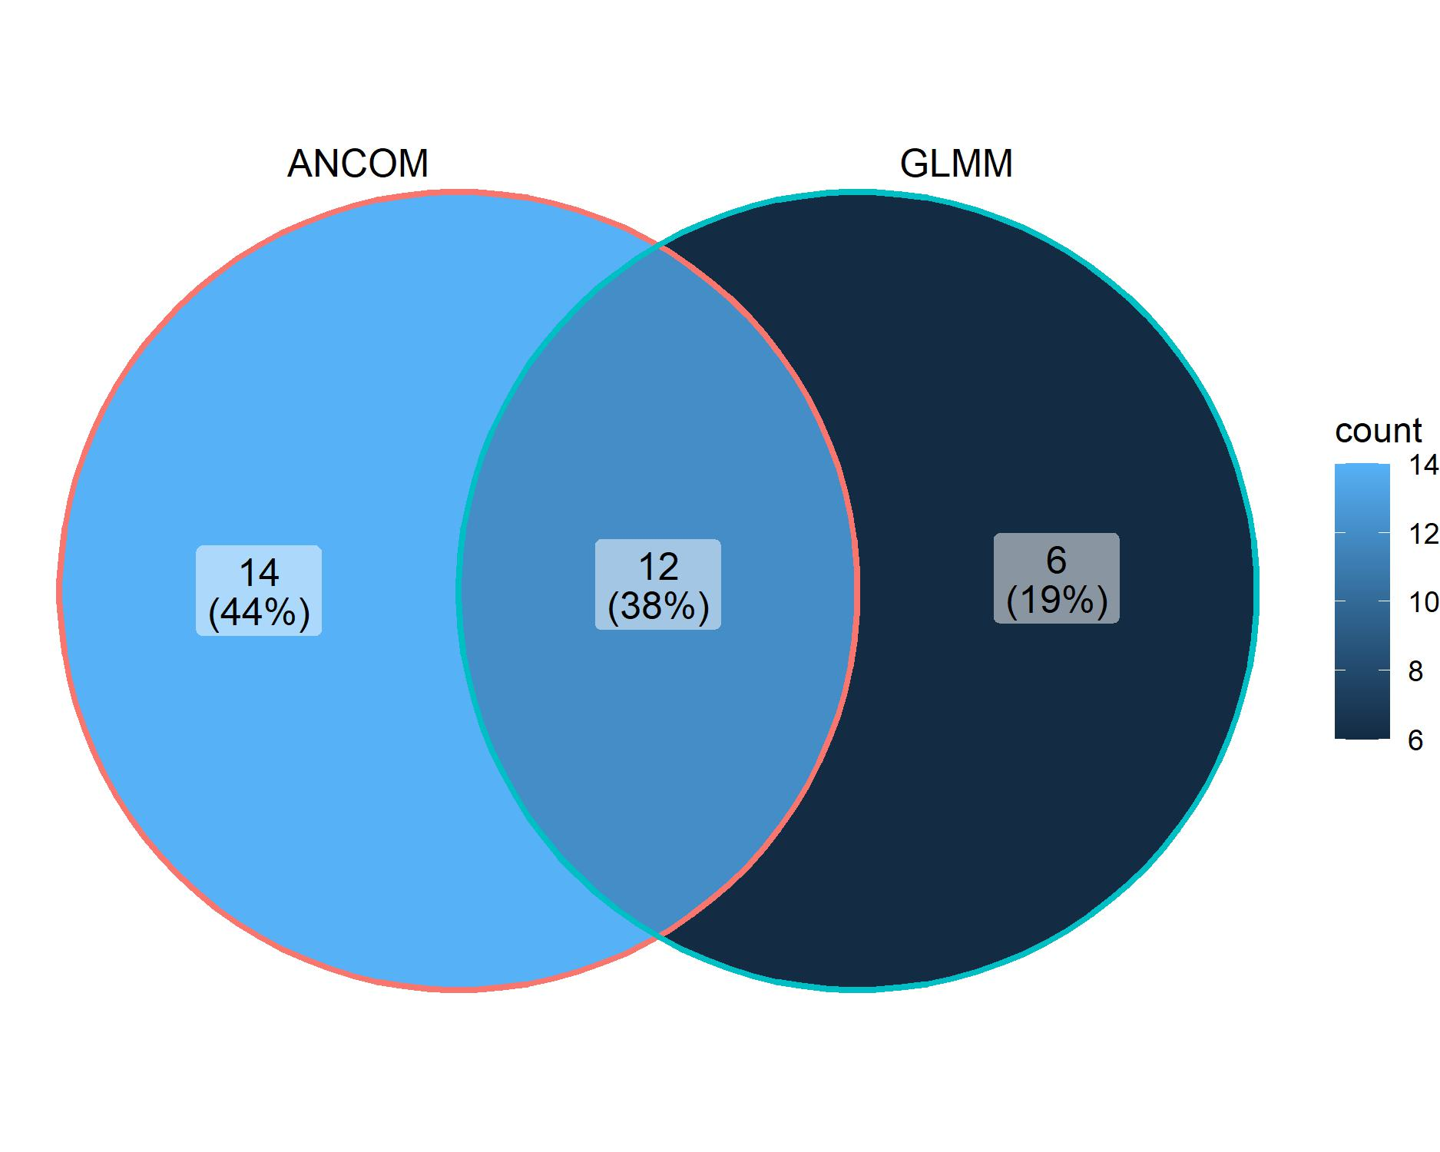
Supplemental Figure 4
A
All sPTB cases
B
Early PPROM cases

