Slide 1
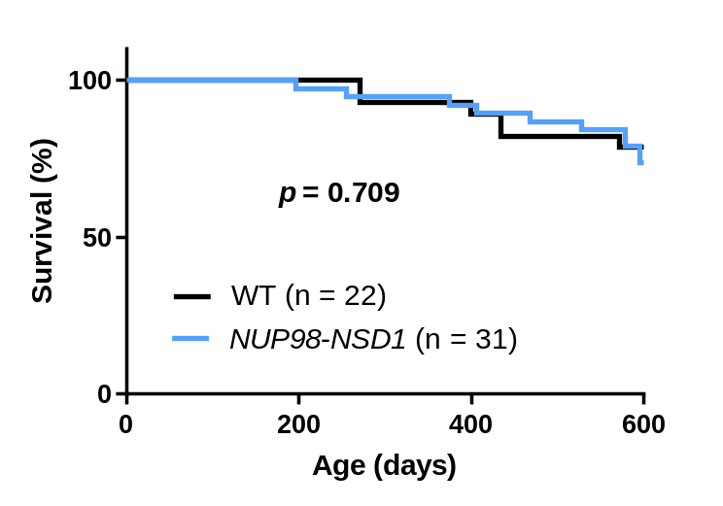
Supplemental Fig S1
Supplemental Figure. 1. No difference in survival of F1 generation NUP98::NSD1 and WT mice
Survival of F1 generation from the A10 founder shows no survival difference between NUP98::NSD1 transgenic mice and WT littermates.

Slide 2
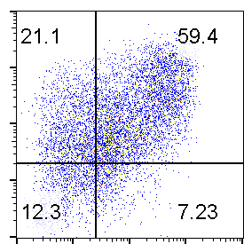
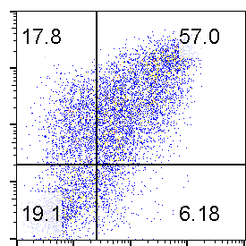
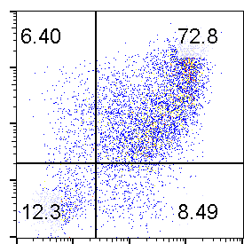
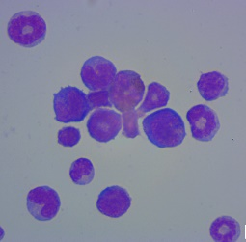
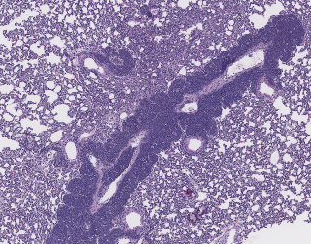
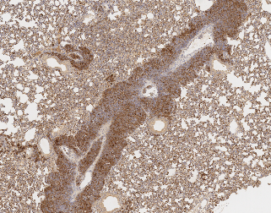
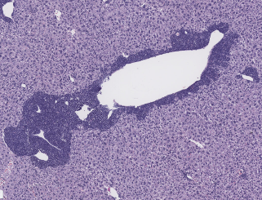
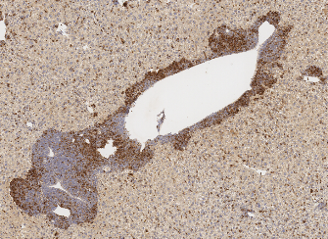
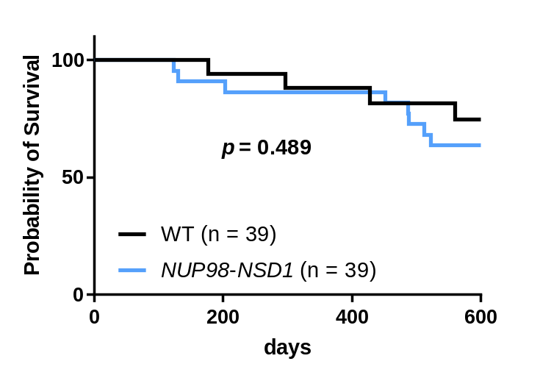
Supplemental Fig S2
A
Bone marrow
Spleen
Thymus
10⁴
10³
10²
10¹
10⁰
Mac1
10⁰ 10¹ 10² 10³ 10⁴
Gr1
C
H&E
MPO
B
Lung
Liver
D
Supplemental Figure S2. Generation of NUP98::NSD1 mice on a FVB/NJ background
A. Invasion of Mac-1⁺/Gr-1⁺ myeloblasts in bone marrow, spleen, and thymus from mouse MT1502.
B. Bone marrow cytospin from mouse MT1502 showing myeloblasts with high nuclear/cytoplasmic ratio. Scale bar = 50 µm
C. Invasion of liver and lung with MPO-positive myeloblasts. Scale bar = 500 µm
D. Survival of MT1502 F1 generation shows no difference between NUP98::NSD1 transgenic mice (n = 39) and WT littermates (n = 39).
.

Slide 3
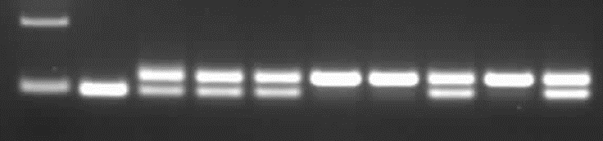

Supplemental Fig S3
A
Sample | Chr | Start | End | REF | ALT | Gene | HGVS.c | HGVS.p | Feature_ID | Annotation | Annotation_Impact | AF_TUMOR
K704 | chr2 | 26467702 | 26467702 | C | T | Notch1 | c.4915G>A | p.Ala1639Thr | NM_008714.3 | missense_variant | MODERATE | 0.545
K717 | chr4 | 101163691 | 101163691 | A | G | Jak1 | c.1951T>C | p.Tyr651His | NM_146145.2 | missense_variant | MODERATE | 0.271
B
N-NSD1
Flt3^{ITD/+}
AML
M
WT
K628
BM
K682
BM
K731
BM
K708
BM
K739
BM
K693
BM
K824
BM
200-
100-
Flt3^{ITD}
Flt3^{WT}
500-
NUP98-
NSD1
100-
Supplemental Figure S3. Acquired SNV are rare in NUP98::NSD1/FLT3-ITD leukemia.
A. No recurrent Tier 1 somatic mutations were identified; one leukemia each had a mutation in Notch1 or Jak1.
B. Loss of WT Flt3 allele in AML samples. Samples K731, K708, and K693 have lost the WT Flt3 allele in the AML sample. M; 100 bp ladder.

Slide 4
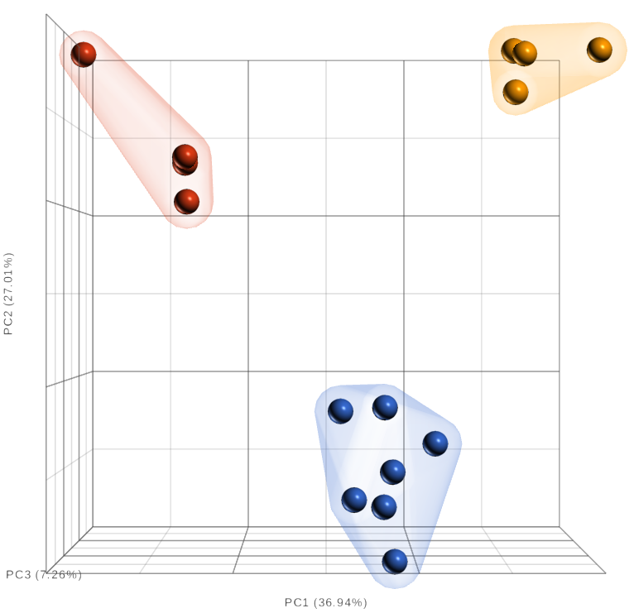
Supplemental Fig. S4
AML(NUP98-NSD1/FLT3-ITD)
WT Whole BM
WT Lineage Negative BM
Supplemental Figure S4. Clear separation between AML, WT BM, and WT Lineage Negative BM cells. PCA plot was generated using normalized RNA-Seq gene expression for 7 AML NUP98-NSD1/FLT3-ITD, 4 WT BM, and 4 WT Lin Neg BM samples.

Slide 5
Supplemental Fig. S5
K628
K682
K704
K742
K747
Mac1
Gr1
CD16/32
CD13
F4/80
Supplemental Figure S5. NUP98::NSD1/FLT3-ITD AML stain for myeloid and monocytic antigens.
AML blasts from the indicated mice stained with Mac-1, Gr-1, CD1/32, CD13, and F4/80.

