Slide 1
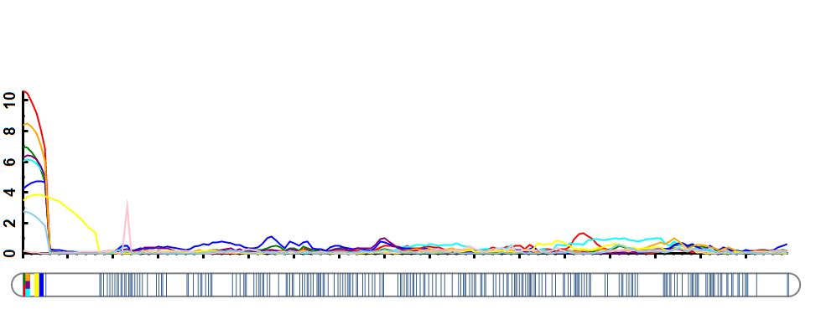
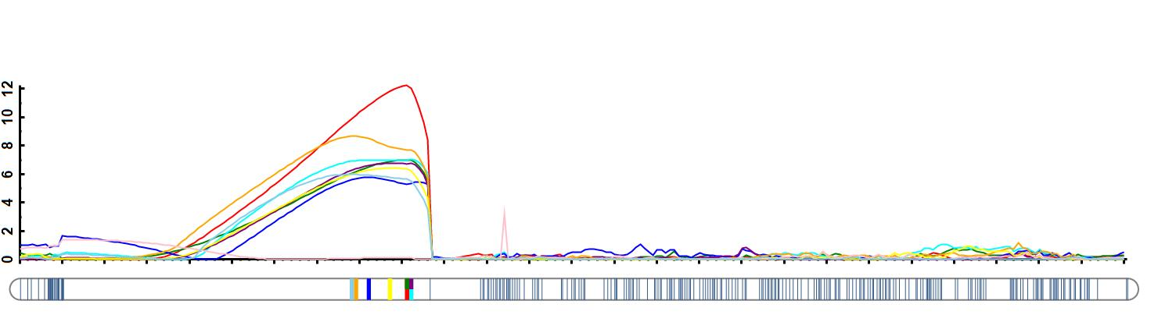
a
LOD score
Chr. 1B
AX-109320638
AX-111731227
b
LOD score
Chr. 1B
AX-109320638
AX-111731227
Notes:
Fig. S3 The stable QTL on 1B may be located on the 1BL/1RS translocation chromosome.
(a) and (b) represent the results of mapping spikelet number per spike using partial 1BL and 1B full-length genetic map, respectively. Colored lines represent environments (E1-9).

