Slide 1
SARS-CoV-2 engages replication and inflammasome activation through lipid remodeling via SREBPs
Vinicius Cardoso Soares^{1,2#}*, Suelen Silva Gomes Dias^{1#}, Julia Cunha Santos^{1#}, Isaclaudia G. Azevedo-Quintanilha¹, Isabela Batista Gonçalves Moreira¹, Carolina Q. Sacramento^{1,3}, Natalia Fintelman-Rodrigues^{1,3}, Jairo R. Temerozo⁴, Marcos Alexandre Nunes da Silva⁵, Debora Ferreira Barreto-Vieira⁵, Thiago M. L. Souza^{1,3}, Patrícia T. Bozza¹*
# - These authors contributed equally to this work
1- Laboratório de Imunofarmacologia, Instituto Oswaldo Cruz (IOC), Fundação Oswaldo Cruz (FIOCRUZ), Rio de Janeiro, RJ, Brazil.
2- Programa de Imunologia e Inflamação, Universidade Federal do Rio de Janeiro, UFRJ, Rio de Janeiro, RJ, Brazil.
3 - Centro de Desenvolvimento Tecnológico em Saúde (CDTS) and Instituto Nacional de Ciência e Tecnologia em Inovação em Doenças de Populações Negligenciadas (INCT/IDNP), FIOCRUZ, Rio de Janeiro, Brasil.
4 - Laboratório de Pesquisas sobre o Timo and Instituto Nacional de Ciência e Tecnologia em Neuroimunomodulação (INCT/NIM), Instituto Oswaldo Cruz (FIOCRUZ), Rio de Janeiro, RJ, Brazil.
5 - Laboratório de Morfologia e Morfogênese Viral, Instituto Oswaldo Cruz (IOC), Fundação Oswaldo Cruz (FIOCRUZ), Rio de Janeiro, RJ, Brazil.
*Corresponding author
Patricia T. Bozza
pbozza@ioc.fiocruz.br or pbozza@gmail.com
Vinicius Cardoso Soares
cardosodante42@gmail.com

Slide 2
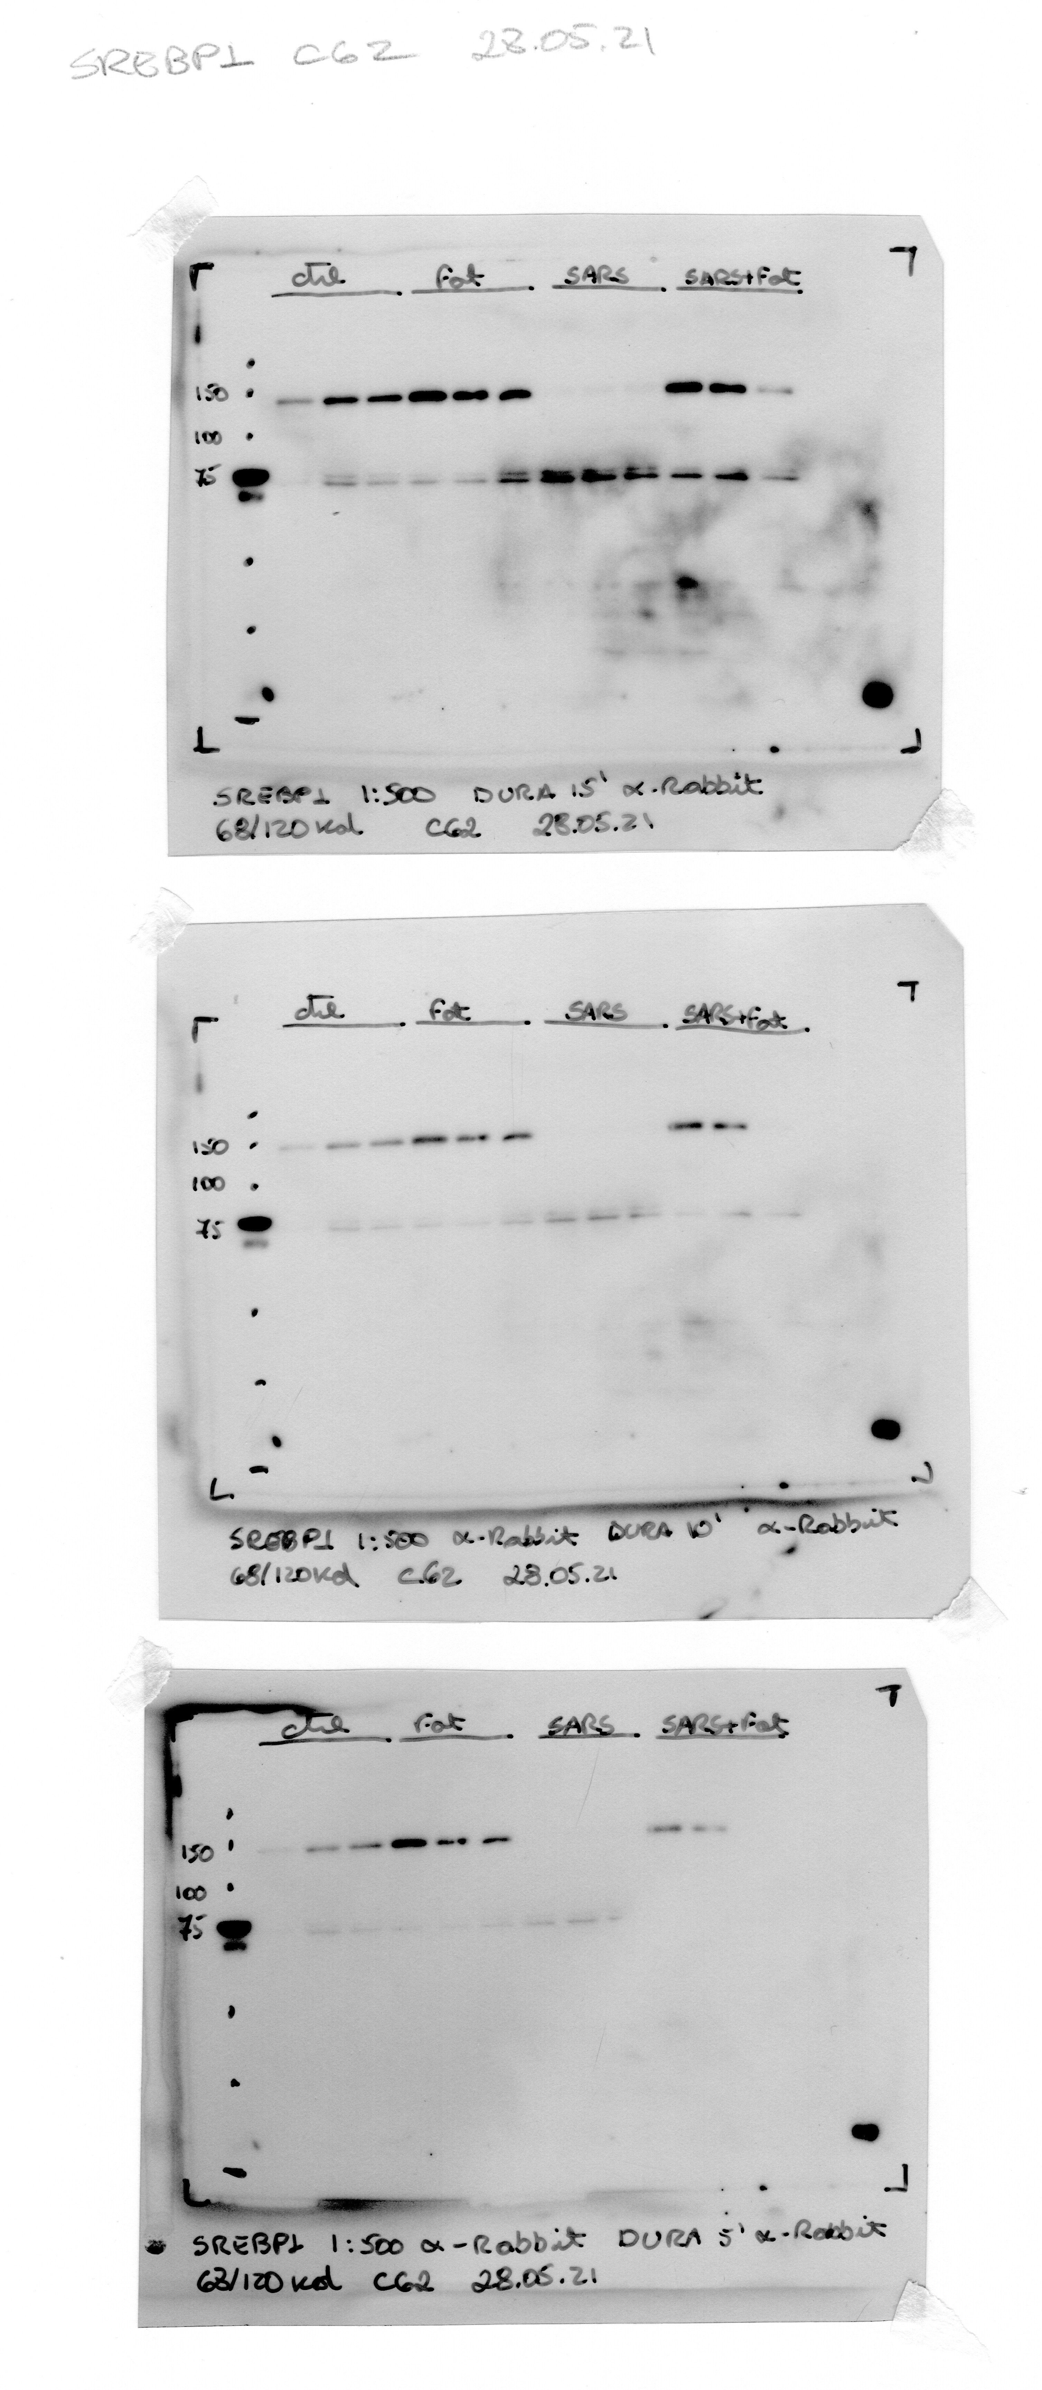
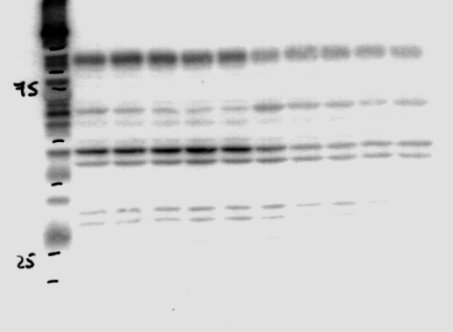
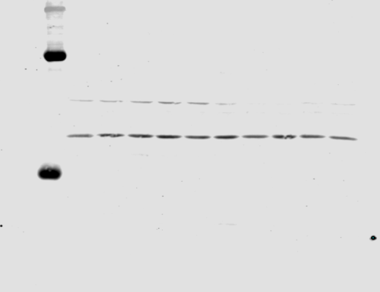
Full-length blots used in the article are indicated according to each figure. Red squares represent the images selected as a representative blot.
Figure 1A
SREBP1
SREBP2
Unifected
Fatostatin
SARS-CoV-2
SARS-CoV-2 +
Fatostatin
Unifected
SARS-CoV-2
precursor
precursor
mature
mature
GAPDH
GAPDH
SARS-CoV-2 +
Fatostatin
Unifected
SARS-CoV-2
Unifected
Fatostatin
SARS-CoV-2

Slide 3
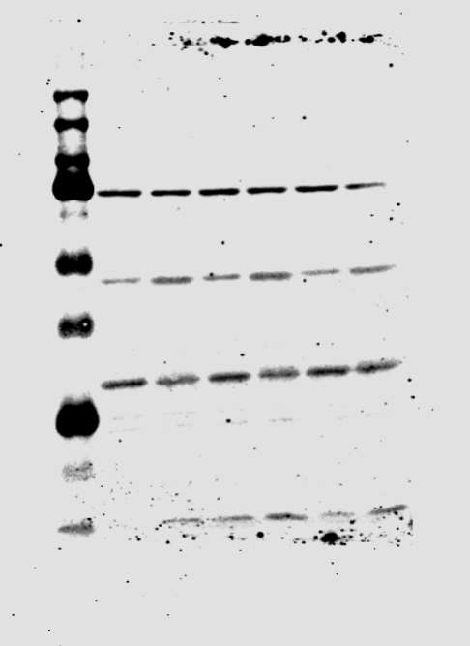
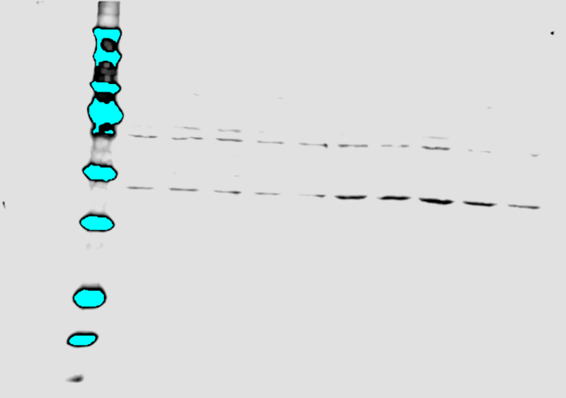
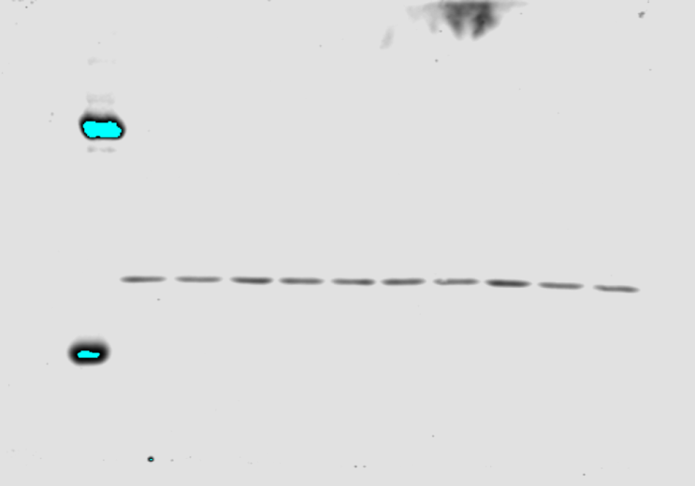
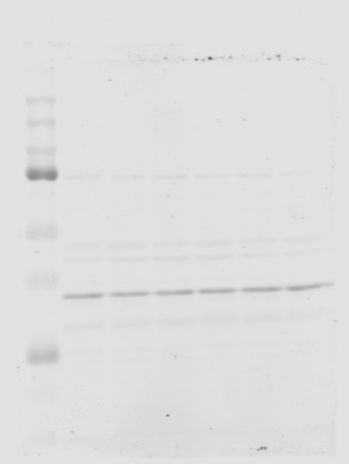
Figure 1B
DGAT1
SARS-CoV-2
SARS-CoV-2
SARS-CoV-2
PLIN2
Unif
Unif
Unif
Unifected
SARS-CoV-2
GAPDH
Unifected
SARS-CoV-2
GAPDH
SARS-CoV-2
SARS-CoV-2
SARS-CoV-2
Unif
Unif
Unif

Slide 4
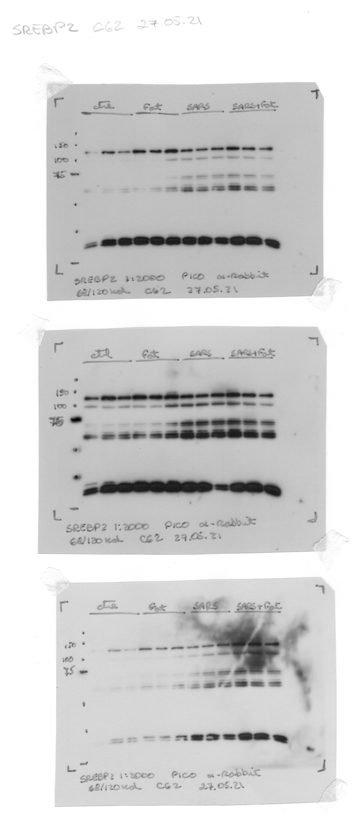
Figure 3A
SREBP1
SARS-CoV-2 +
Fatostatin
GAPDH
SARS-CoV-2 +
Fatostatin
Unifected
Fatostatin
SARS-CoV-2
Unifected
Fatostatin
SARS-CoV-2
precursor
mature
SREBP2
SARS-CoV-2 +
Fatostatin
GAPDH
SARS-CoV-2 +
Fatostatin
Unifected
Fatostatin
SARS-CoV-2
Unifected
Fatostatin
SARS-CoV-2
Notes:
SREBP1 C62
SREBP2 C62

Slide 5
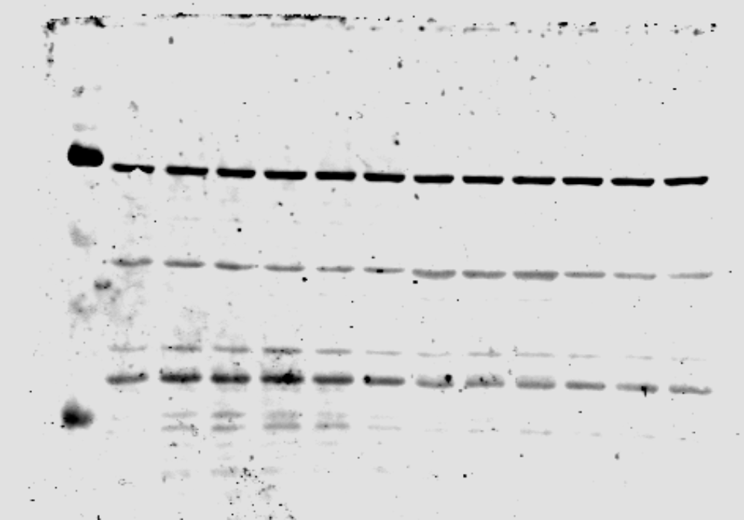
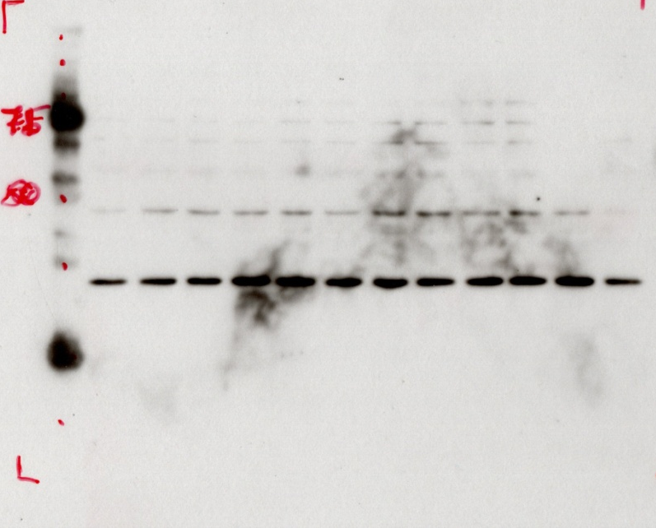
Figure 3H
DGAT1
SARS-CoV-2 +
Fatostatin
Unifected
Fatostatin
SARS-CoV-2
PLIN2
SARS-CoV-2 +
Fatostatin
Unifected
Fatostatin
SARS-CoV-2
GAPDH
SARS-CoV-2 +
Fatostatin
Unifected
Fatostatin
SARS-CoV-2
Notes:
C46

Slide 6
Figure 5F
GSDMD1
Unifected
Fatostatin
SARS-CoV-2
SARS-CoV-2 +
Fatostatin
GAPDH
SARS-CoV-2 +
Fatostatin
Unifected
Fatostatin
SARS-CoV-2

Slide 7
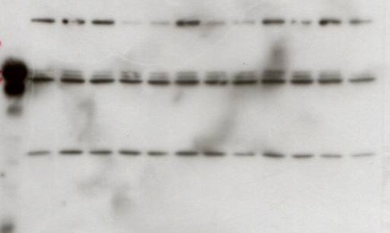
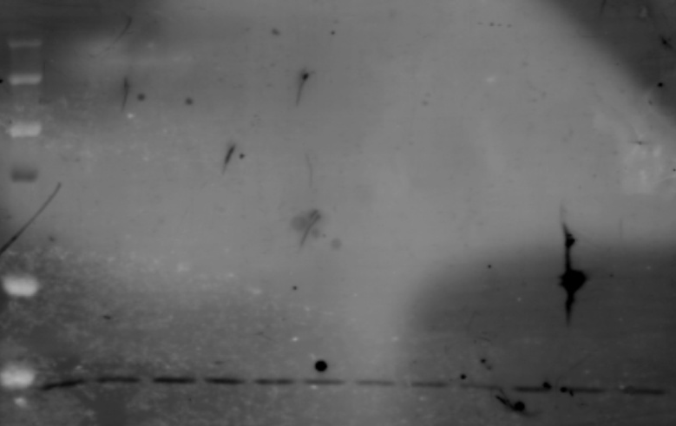
Figure S1A
SREBP1
Lipo
Lipo
Lipo
Ctrl
SCR
LPS
10
1
-
10
1
-
10
1
-
precursor
GAPDH
Lipo
Lipo
Lipo
Ctrl
SCR
LPS
10
1
-
10
1
-
10
1
-

Slide 8
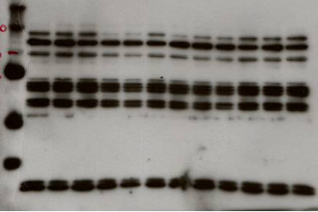
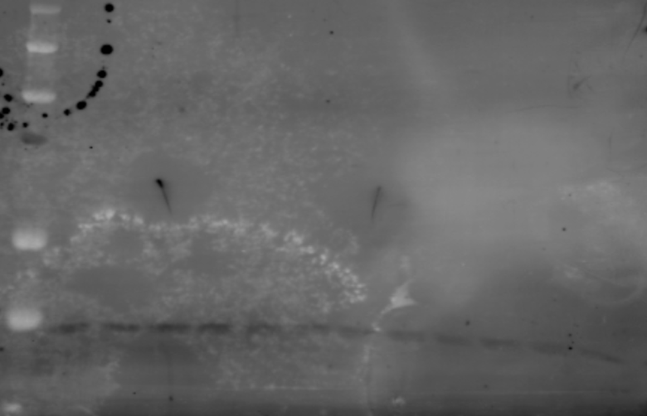
Figure S1B
SREBP2
Lipo
Lipo
Lipo
Ctrl
SCR
LPS
10
1
-
10
1
-
10
1
-
precursor
GAPDH
Lipo
Lipo
Lipo
Ctrl
SCR
LPS
10
1
-
10
1
-
10
1
-

Slide 9
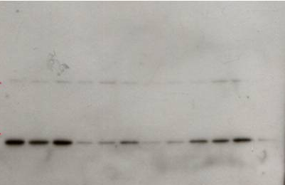
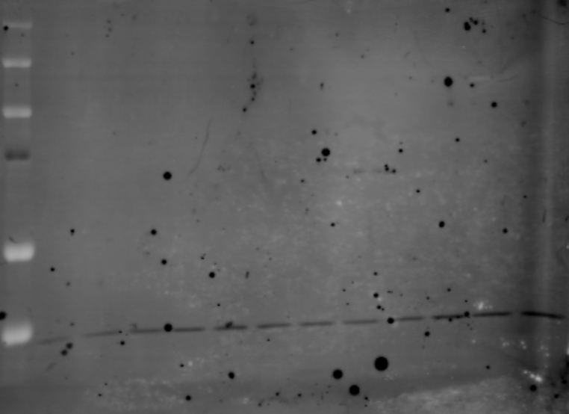
Figure S1C
DGAT1
Lipo
Lipo
Lipo
Ctrl
SCR
LPS
10
1
-
10
1
-
10
1
-
GAPDH
Lipo
Lipo
Lipo
Ctrl
SCR
LPS
10
1
-
10
1
-
10
1
-

Slide 10
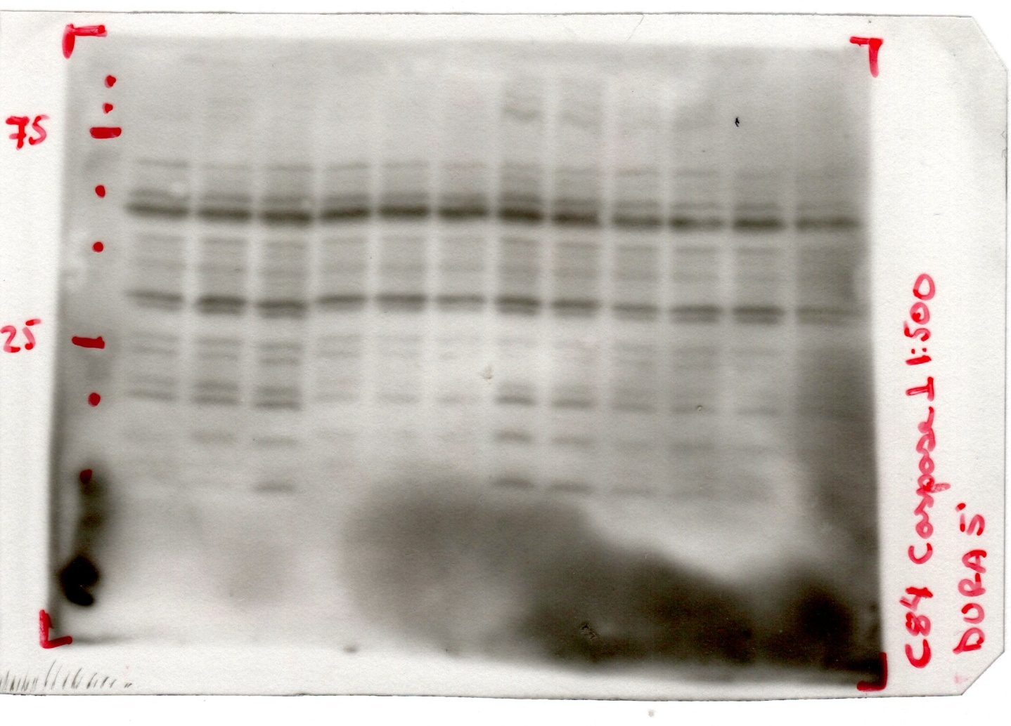
Figure S5B
Caspase-1
Unifected
Fatostatin
SARS-CoV-2
SARS-CoV-2 +
Fatostatin
p45
p10
GAPDH
SARS-CoV-2 +
Fatostatin
Unifected
Fatostatin
SARS-CoV-2

