Slide 1
FIGURE LEGEND
Supplementary data: Absolute quantification of IHHNV capsid gene through real time PCR. Fig S1: Standard curve; Fig S2: Amplification plot; Fig S3: Melt curve

Slide 2
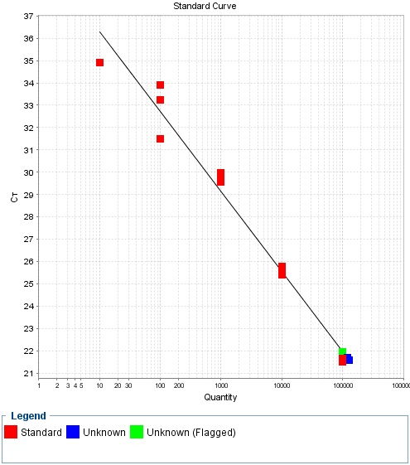
Supplementary data S1
Fig S1:
R value : 96
Slope : -3.6

Slide 3
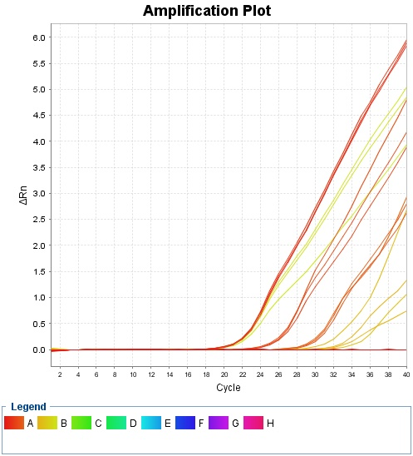
Fig S2:

Slide 4
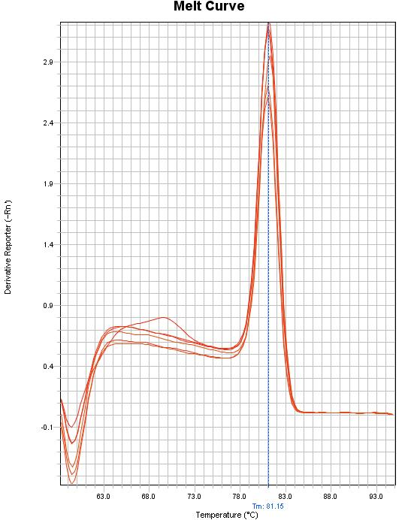
Fig S3:

