Slide 1
Anal human papillomavirus infection and its relations with abnormal anal cytology among MSM with or without HIV infection in Japan
Daisuke Shiojiri ^{1, 2} *, Daisuke Mizushima ¹, Misao Takano ¹, Koji Watanabe ¹, Naokatsu Ando ^{1, 2}, Haruka Uemura ¹, Yasuaki Yanagawa ¹, Takahiro Aoki ¹, Junko Tanuma ¹, Kunihisa Tsukada ¹, Katsuji Teruya ¹, Yoshimi Kikuchi ¹, Hiroyuki Gatanaga ^{1, 2}, and Shinichi Oka ^{1, 2}.
Author affiliations:
AIDS Clinical Center, National Center for Global Health and Medicine, Tokyo, Japan
Joint Research Center for Human Retrovirus Infection, Kumamoto University, Kumamoto University, Kumamoto, Japan

Slide 2
Supplementary Fig S1. Prevalence of all hr-HPV genotypes.
Frequency of each hr-HPV genotype was calculated to total participants. Statistical analyses using binomial test to expected frequency (median value) were performed to identify the outlier values.
Abbreviations: GT, genotype; hr-HPV, high-risk types of human papillomavirus.

Slide 3
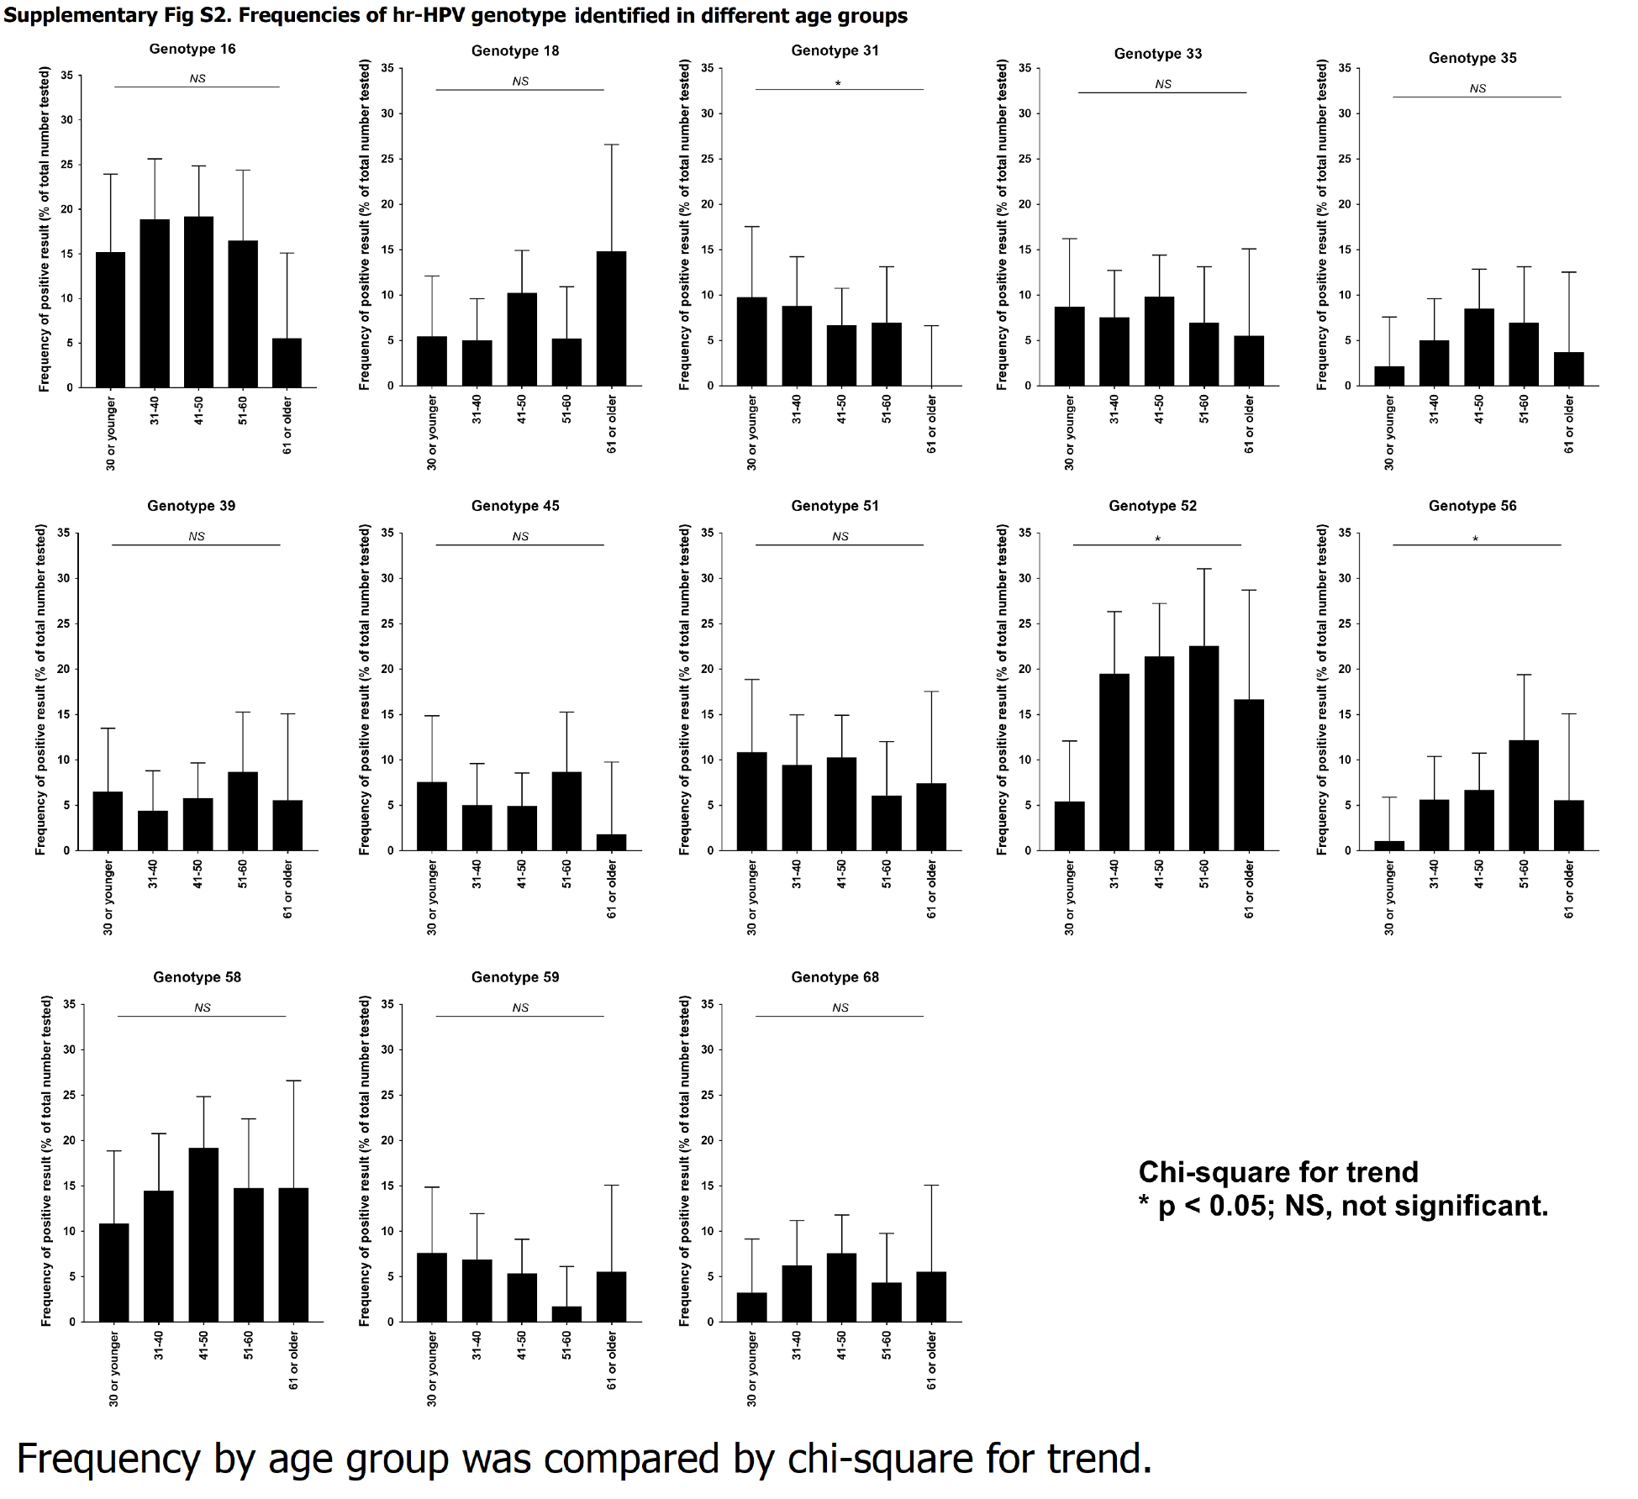
Supplementary Fig S2. Frequencies of hr-HPV genotype identified in different age groups.
Frequency by age group was compared by chi-square for trend.

Slide 4
Supplementary Fig S3. Frequency of abnormal anal cytology of anorectal swab.
The modification of the Bethesda System classification for cervical cytology was used for classification as listed below:
NILM (negative for intraepithelial lesion or malignancy)
ASC-US (atypical squamous cell of undetermined significance)
LSIL (low-grade squamous intraepithelial lesion)
ASC-H (atypical squamous cells, cannot exclude high-grade lesion)
HSIL (high-grade squamous intraepithelial lesions).
LSIL, ASC-H, and HSIL were defined as “abnormal cytology results”. Ratios of anorectal cytology results to total cases between HIV-positive and HIV-negative MSM were presented. Ratios between two groups were compared by chi-square test.

