Slide 1
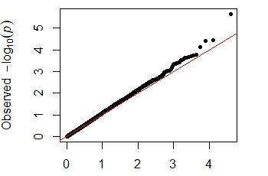
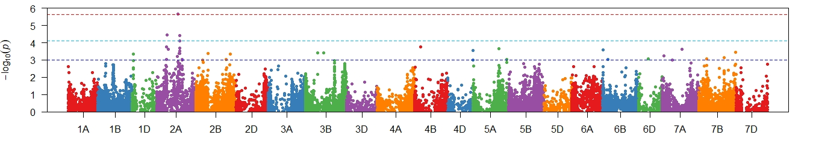
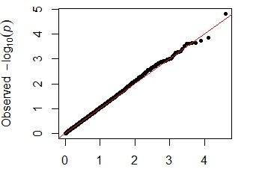
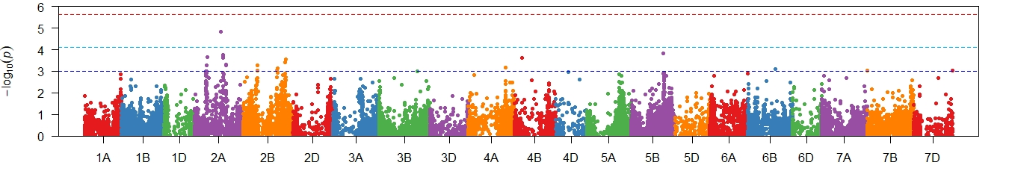
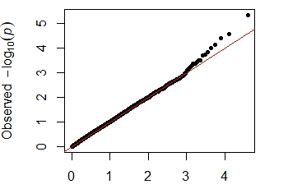
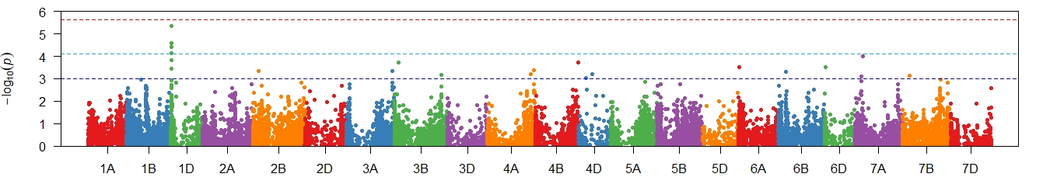
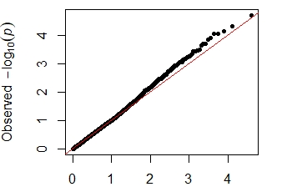
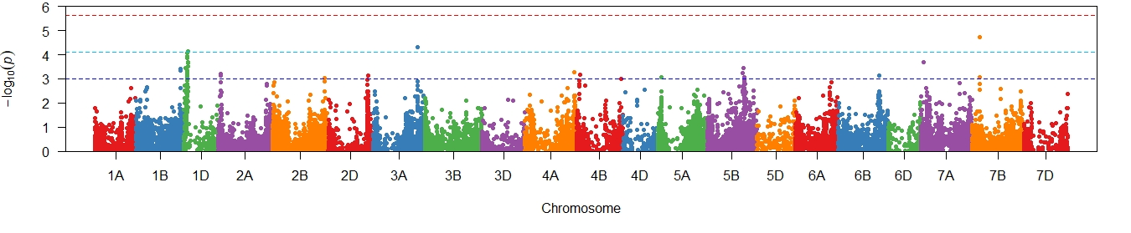
Supplementary Figure 2 Genome wide association scans for adjusted mean PGAD scores from four environments in 2018-2020. Q-Q and Manhattan plots are shown to the left and right, respectively. Horizontal dotted lines in each Manhattan plot represents suggestive (bottom), significant (middle) and highly significant (top) threshold levels for marker-trait associations.
Manjimup
2018
Manjimup
2019
Manjimup
2020
South Perth
2020

