Slide 1
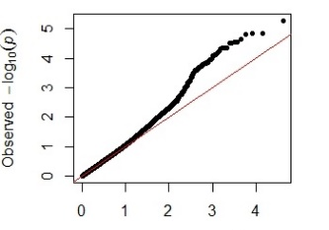
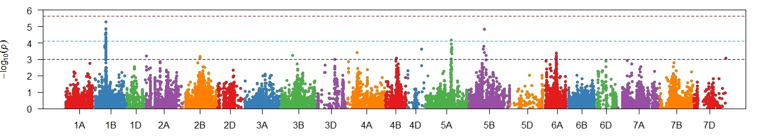
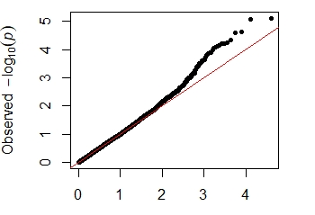
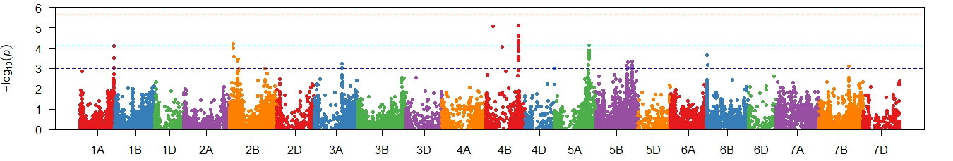
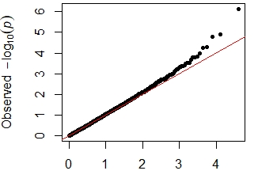
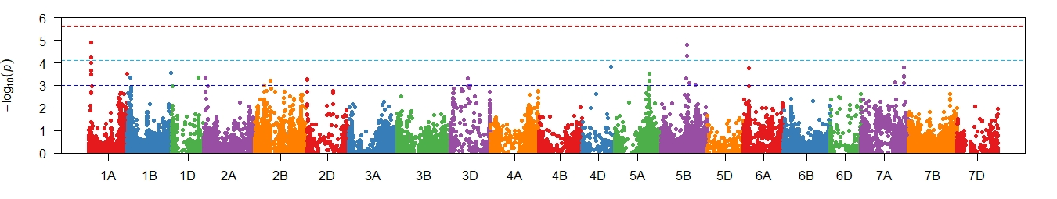
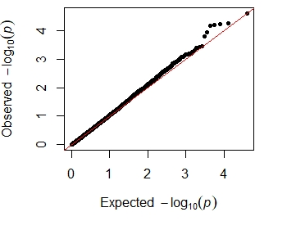
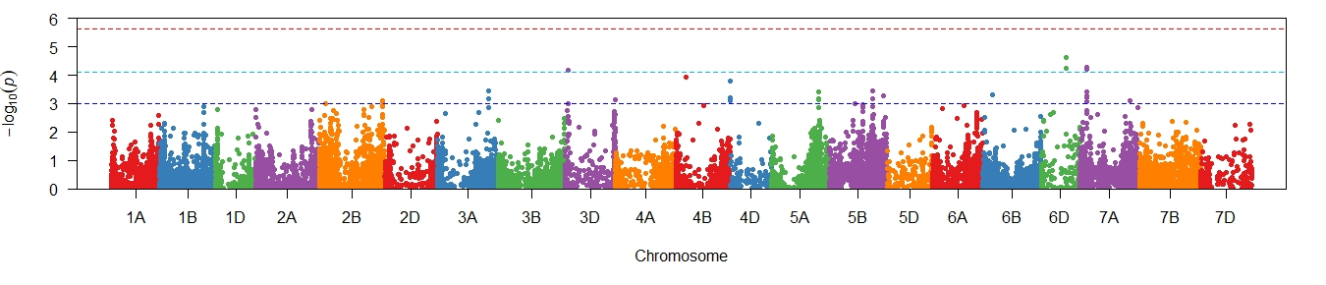
Supplementary Figure 3 Genome wide association scans for adjusted mean PLAD scores for four individual environments in 2018-2020. Q-Q and Manhattan plots are shown to the left and right, respectively. Horizontal dotted lines in each Manhattan plot represent suggestive (bottom), significant (middle) and highly significant (top) threshold levels for marker-trait associations. † Data previously published in Francki et al. 2020
Manjimup †
2018
Manjimup
2019
Manjimup
2020
South Perth
2020

