Slide 1
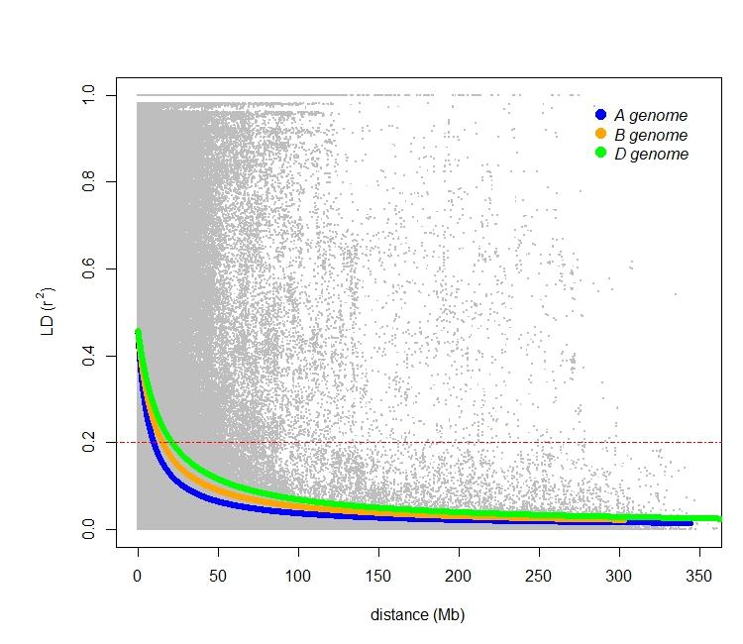
Supplementary Figure 1 Linkage disequilibrium decay based on 20,563 SNP markers for the A
(blue), B (orange), and D (green) genomes. Red dashed lines indicates LD decay level (R² = 0.2).

