Slide 1
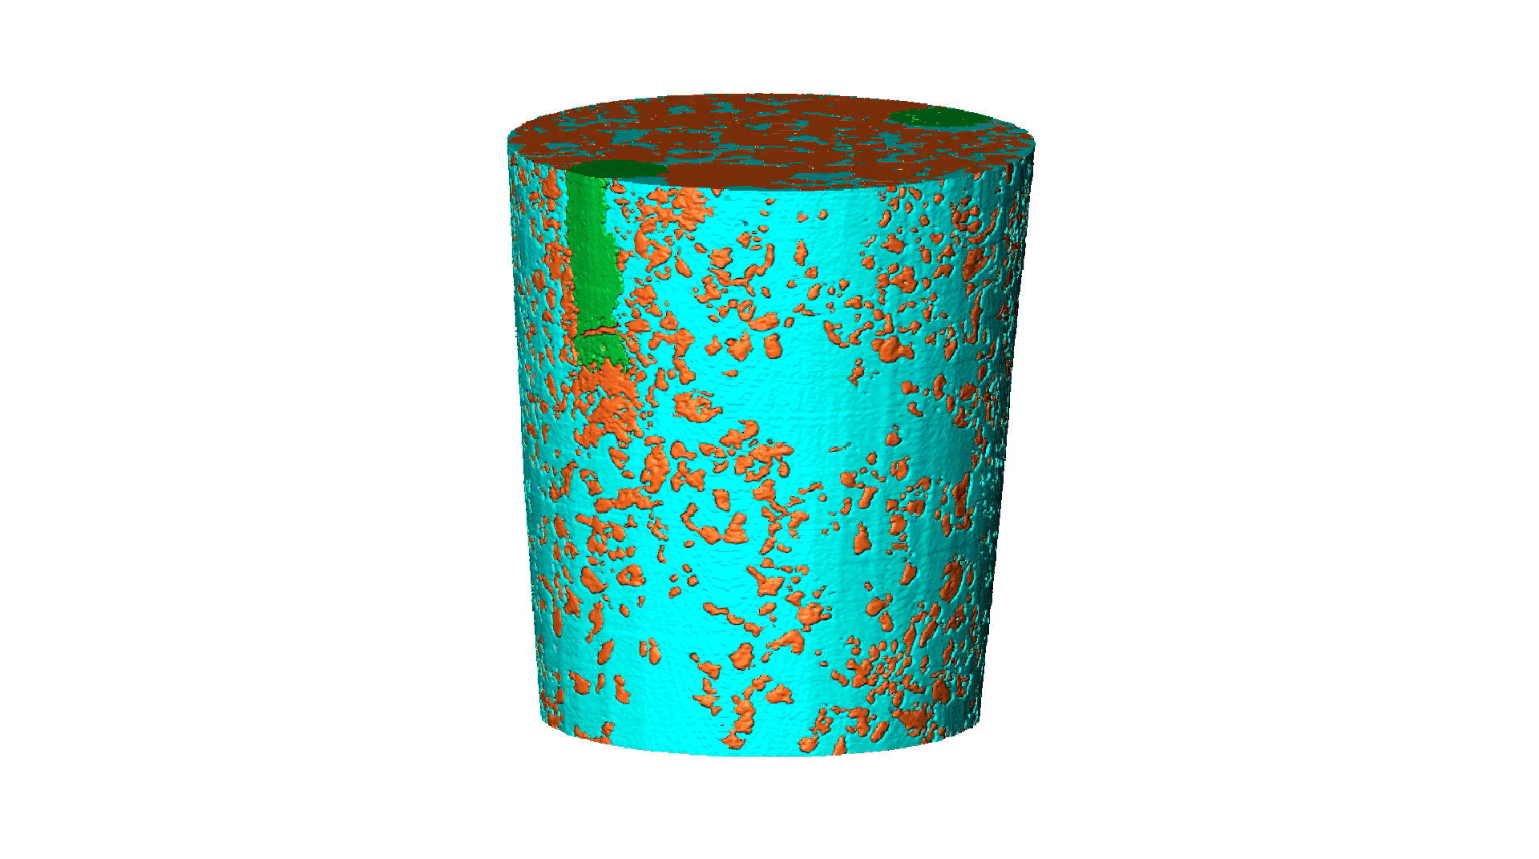
Monte Carlo simulations of synchrotron X-ray dose effects on root growth during in-vivo tomographic imaging
Supplementary Video (E2-TP6)

