Slide 1
GAS5 MS raw images

Slide 2
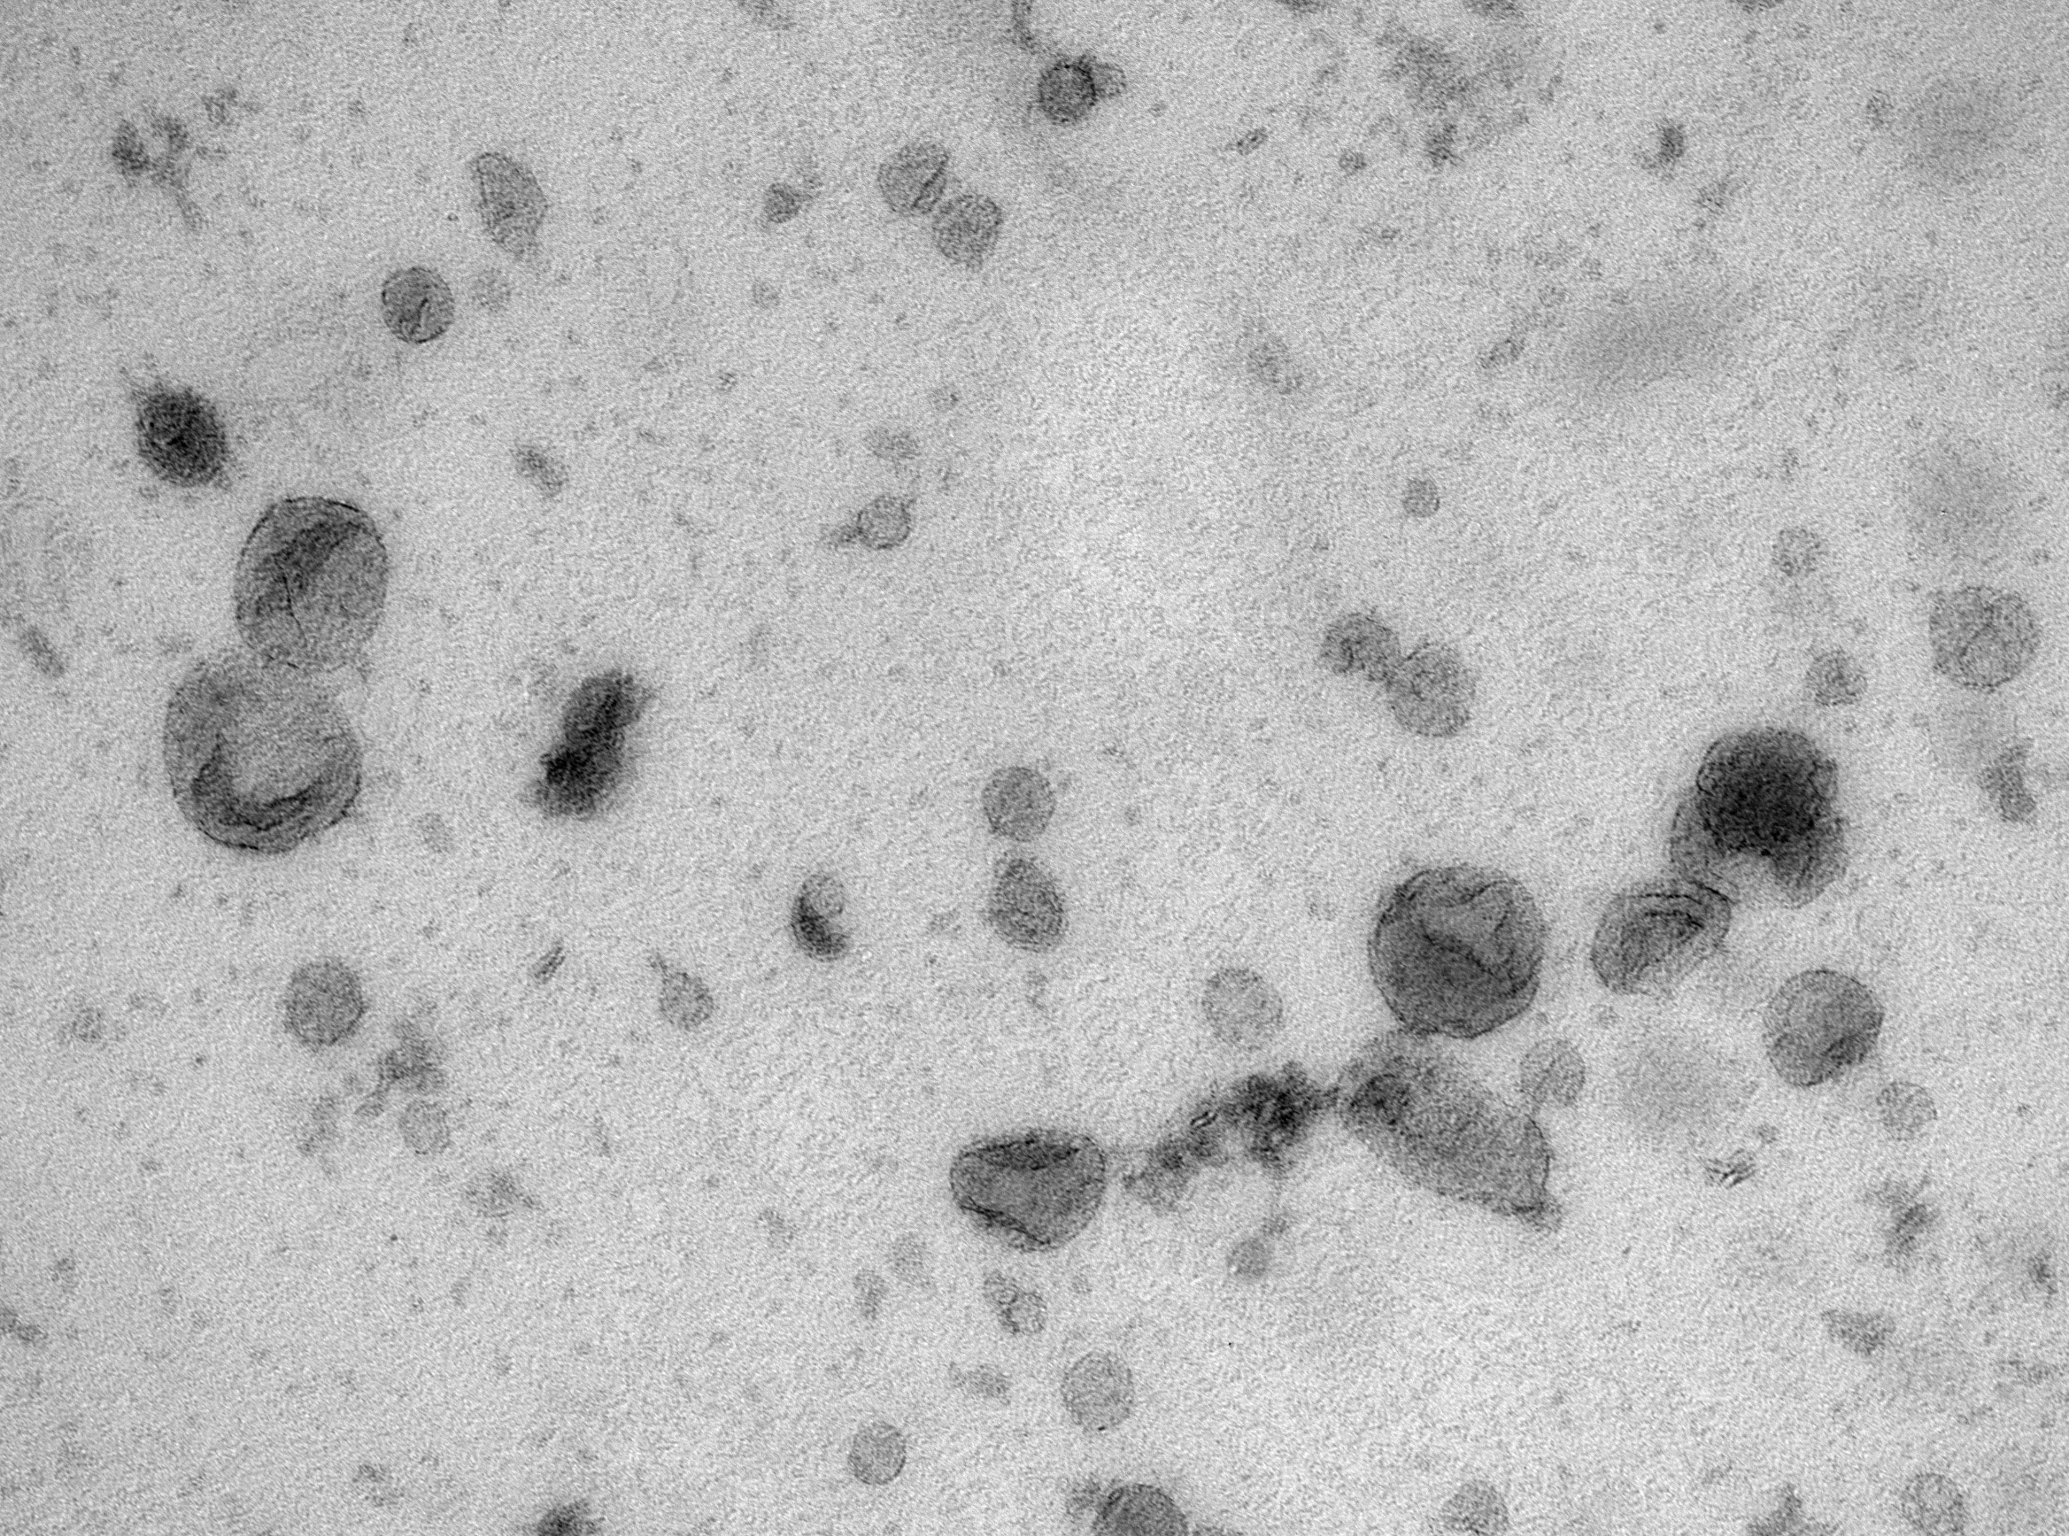
Fig. 2a

Slide 3
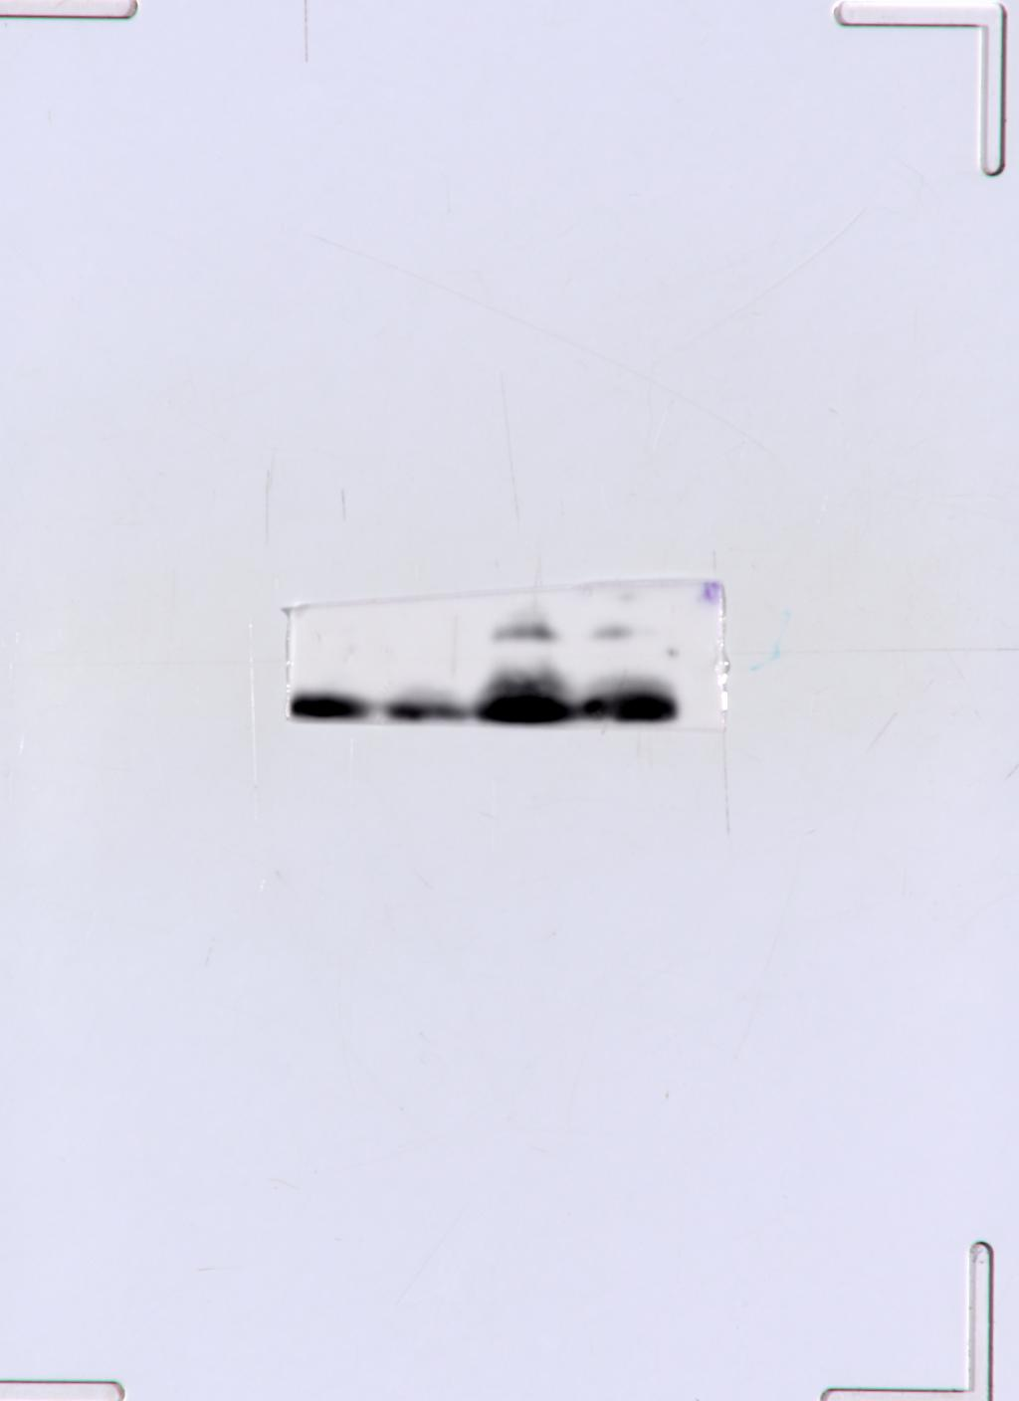
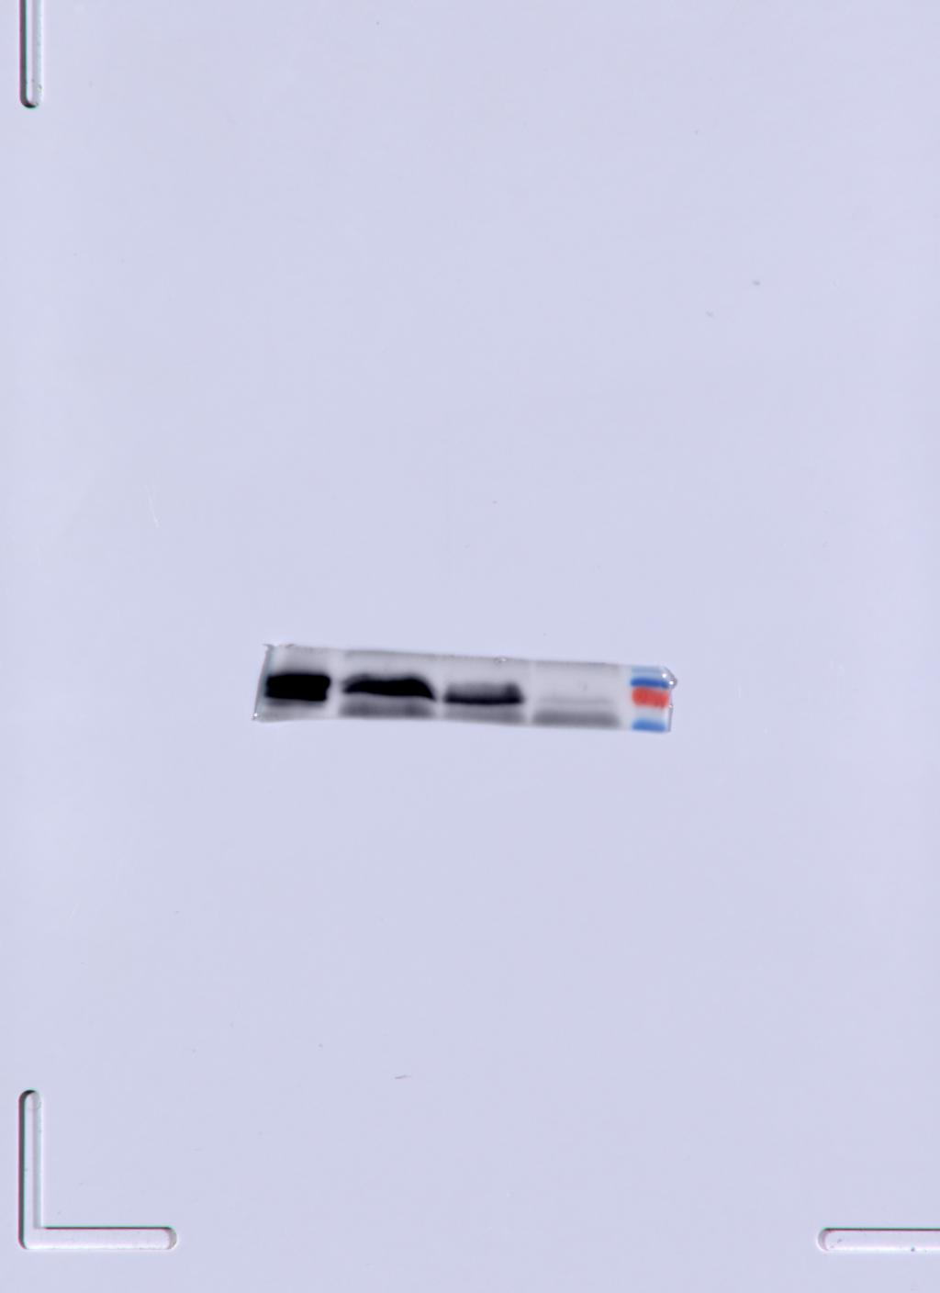
Fig. 2b
CD81
Hsp70
Serum exosome 1
Serum exosome 2
Serum exosome 1
Serum exosome 2

Slide 4
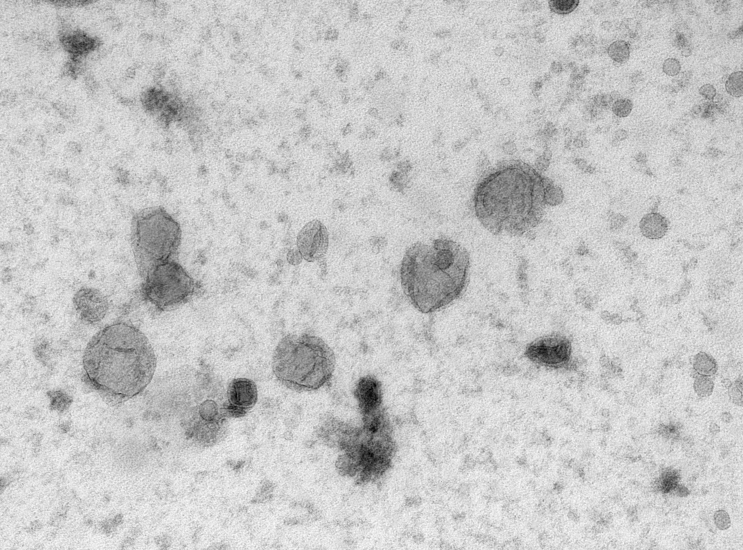
Fig. 5a

Slide 5
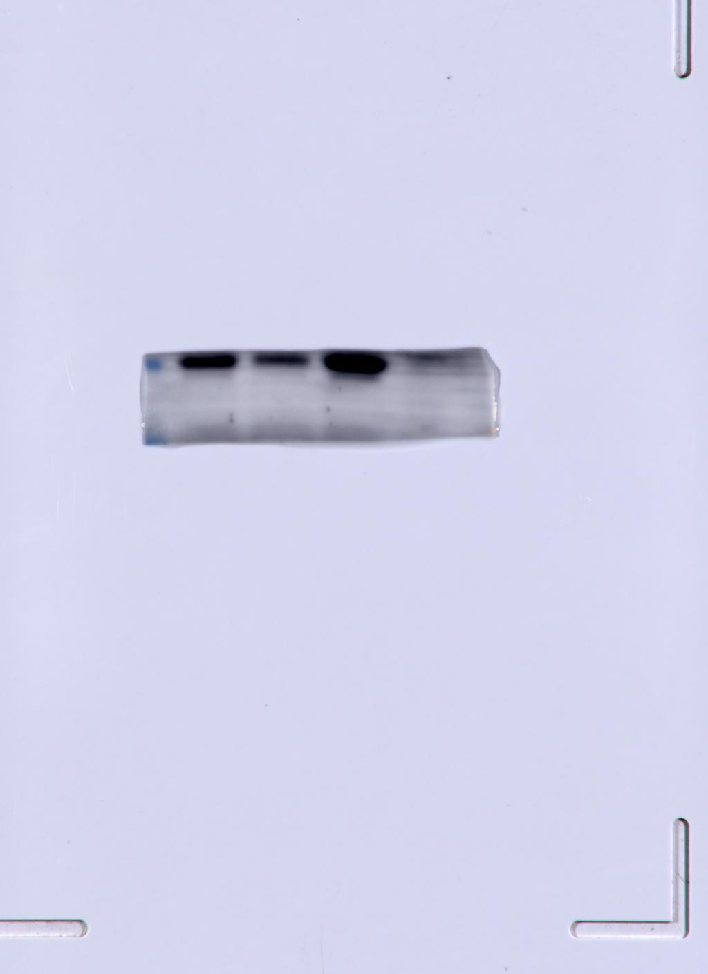
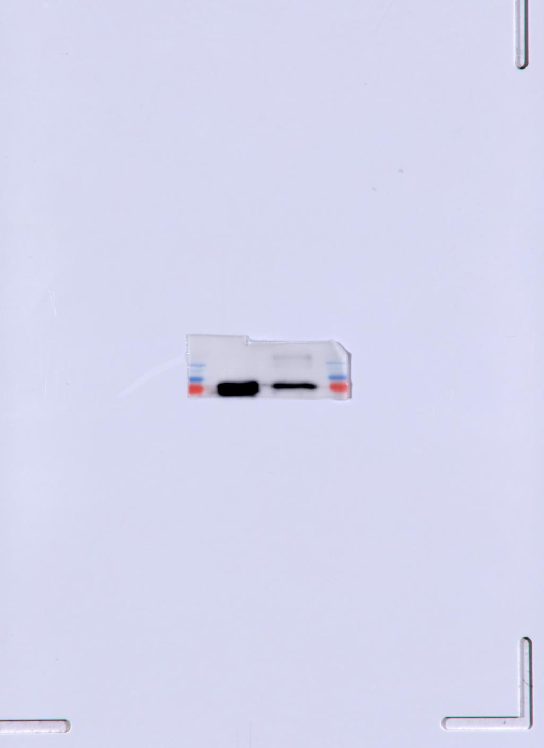
Fig. 5c
CD81
Hsp70
Cell supernatant exosome 1
Cell supernatant exosome 2
Cell supernatant exosome 2
Cell supernatant exosome 1

Slide 6
Fig. 5d

