Slide 1
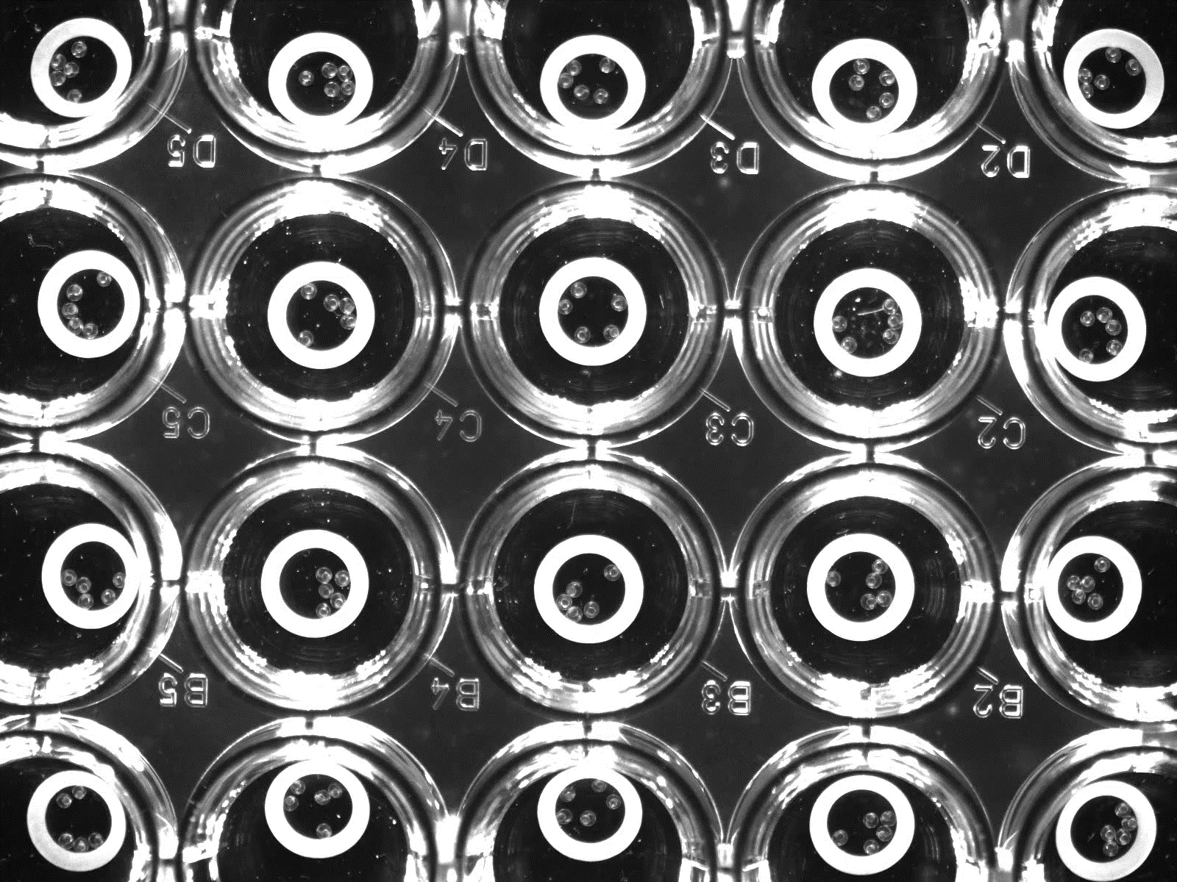
0.5% DMSO
(control)
1.3 µM
1.1 µM
0.1 µM
2.1 µM
Supplementary Material 4

