Slide 1
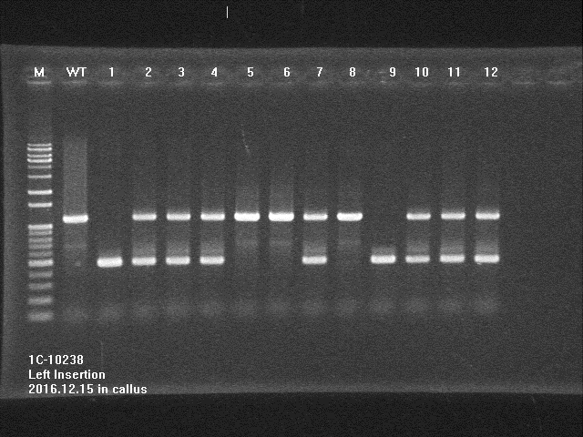
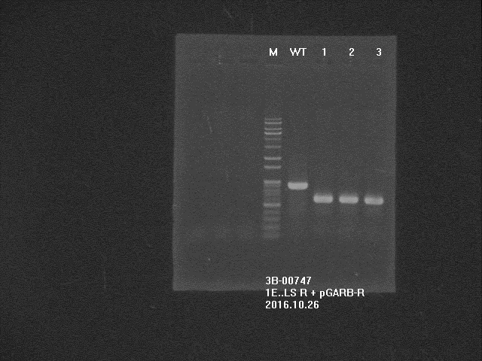
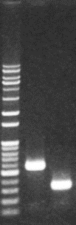
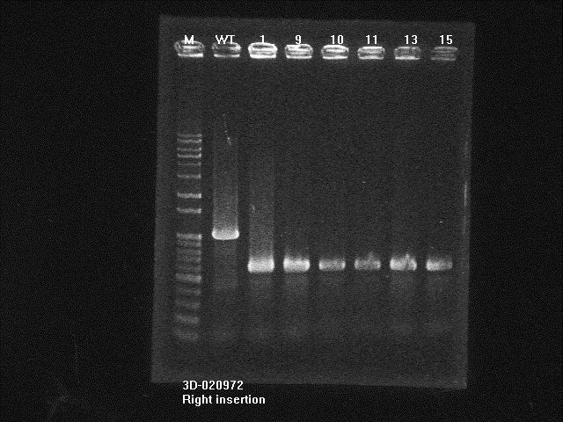
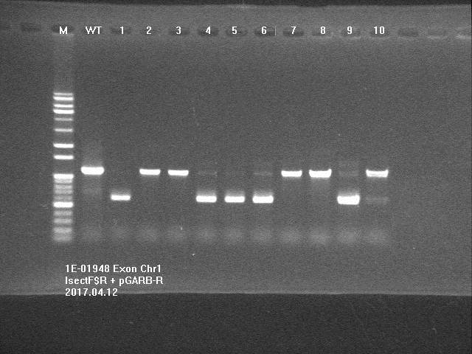
Supplementary Fig. 1
(A)
T-DNA
RBP
LB
LBP
RB
Chromosome
Intron
Left Primer
Intron
Exon
Exon
Exon
Intron
Right primer
(B)
3A-11407
M WT Homo
3B-00747
M WT Homo
NF-8522
M WT Homo
3D-02972
M WT Homo
1C-03248
M WT Homo
Supplementary Figure 1. Genotyping PCR was conducted to define T-DNA insertion into expected position on chromosome. (A) Scheme of genomic DNA PCR for genotyping. Genomic DNA was extracted from leaves of each mutant rice, and used for genomic DNA PCR using a pair of three primers RB, T-DNA right border; LB, T-DNA left border; LBP, primer adjacent to left border on T-DNA; RBP, primer adjacent to right border on T-DNA; Left Primer, primer on 5’ region of chromosome in NCBI sequence than T-DNA inserted region; Right Primer, primer on 3’ region of chromosome in NCBI sequence than T-DNA inserted region. (B) PCR product was visualized by Agarose gel electrophoresis. Three kinds of primers (Left primer, right primer and LBP or RBP) were mixed with genomic DNA from each cell lines and used to amplify targeted size of DNA. Lane WT, PCR product using genomic DNA extracted from wild-type rice callus;Lane M, 1 kbp plus 100 bp DNA ladder marker (ELPIS Biotech, Seoul, Korea). Lane Homo, PCR products showed expected size of DNA fragment in genomic DNA PCR from individual cell lines.

