Slide 1
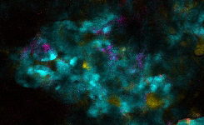
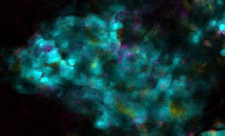
Supplementary video for Fig. 4E.
GMI-1359 Increases AML Cell Motility in the BM
STEADY STATE (BEFORE GMI-1359)
20min AFTER GMI-1359
Time lapse: 20 min
Time lapse: 1 h
100µm
Slow motility
Increasing motility
Video can be played by clicking play butters below each image.

