Slide 1
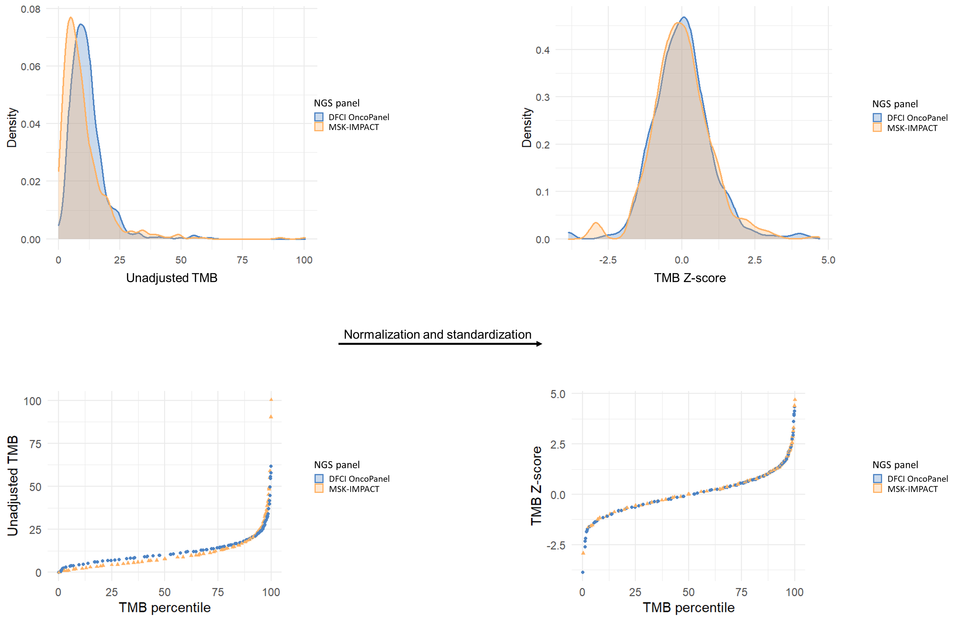
Supplementary Figure S4
A
C
B
D

