Slide 1
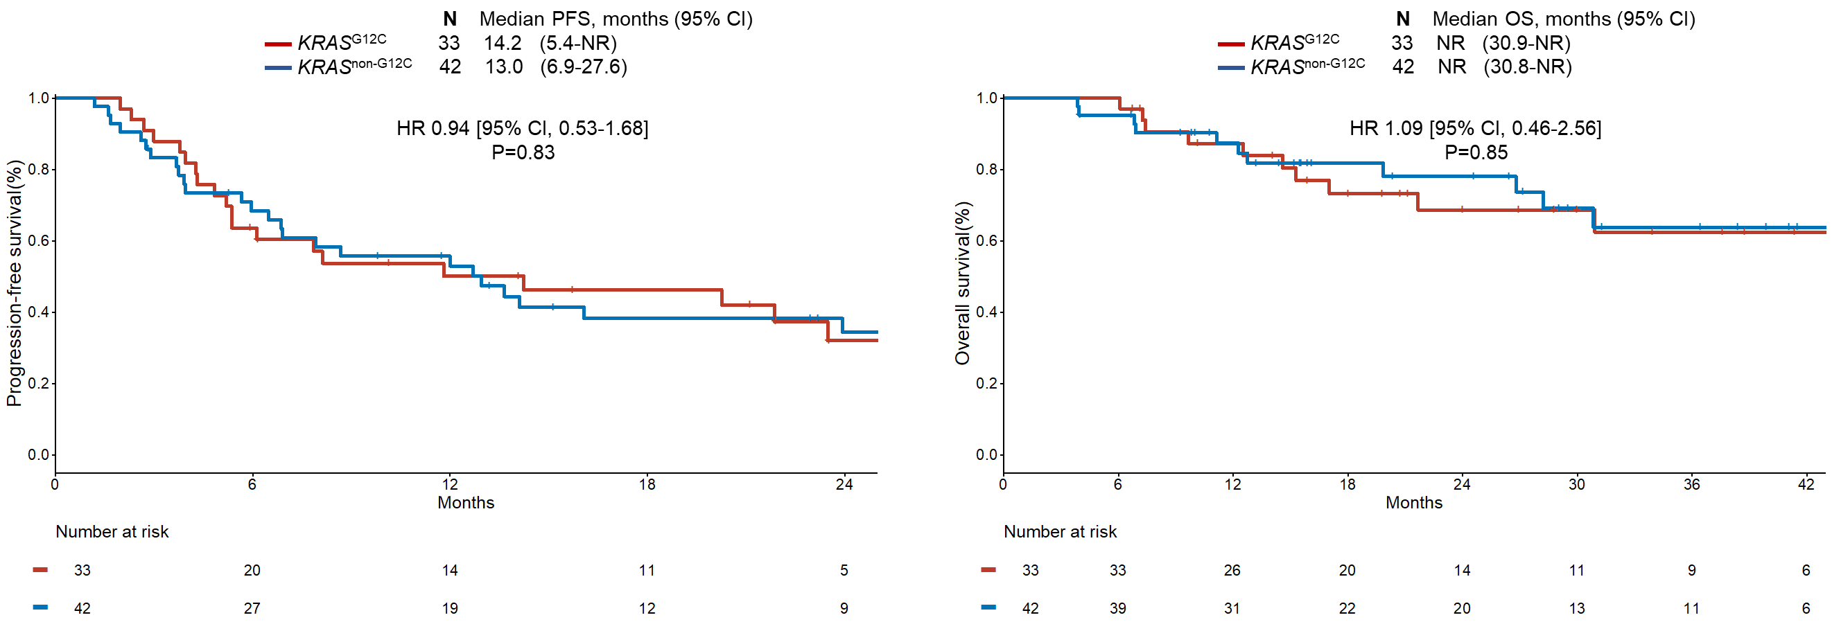
Supplementary Figure S3
a
b

