Slide 1
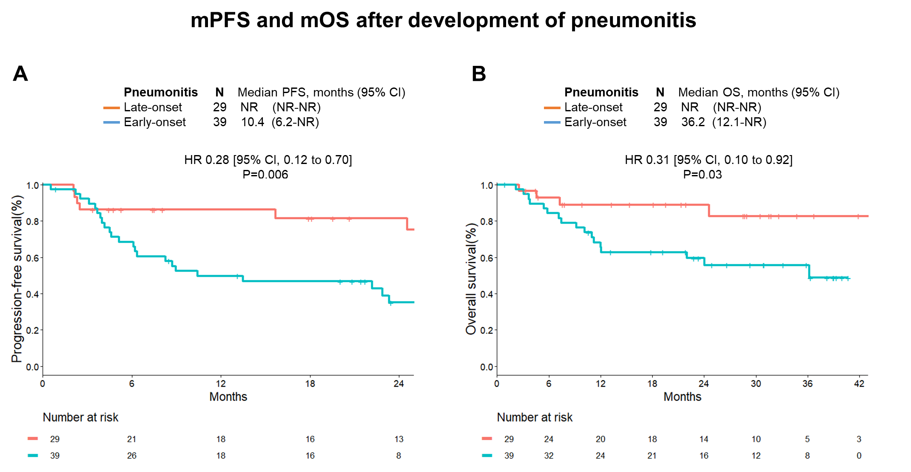
Supplementary Figure S9

