Slide 1
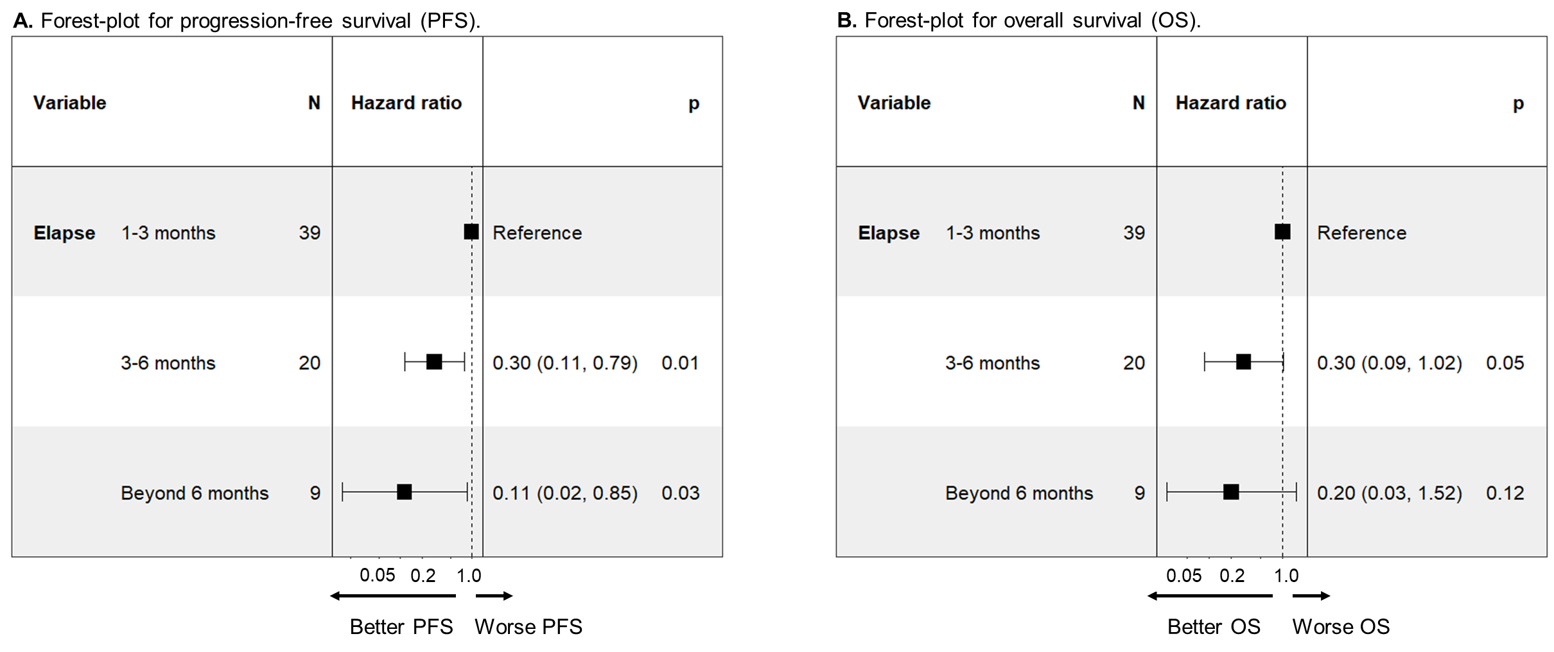
Supplementary Figure S8

