Slide 1
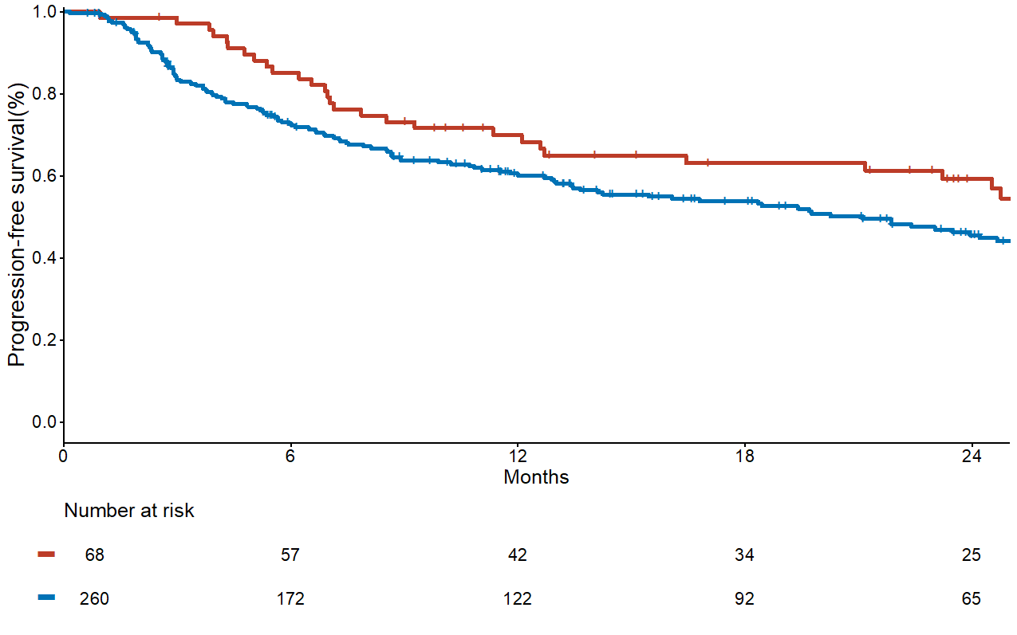
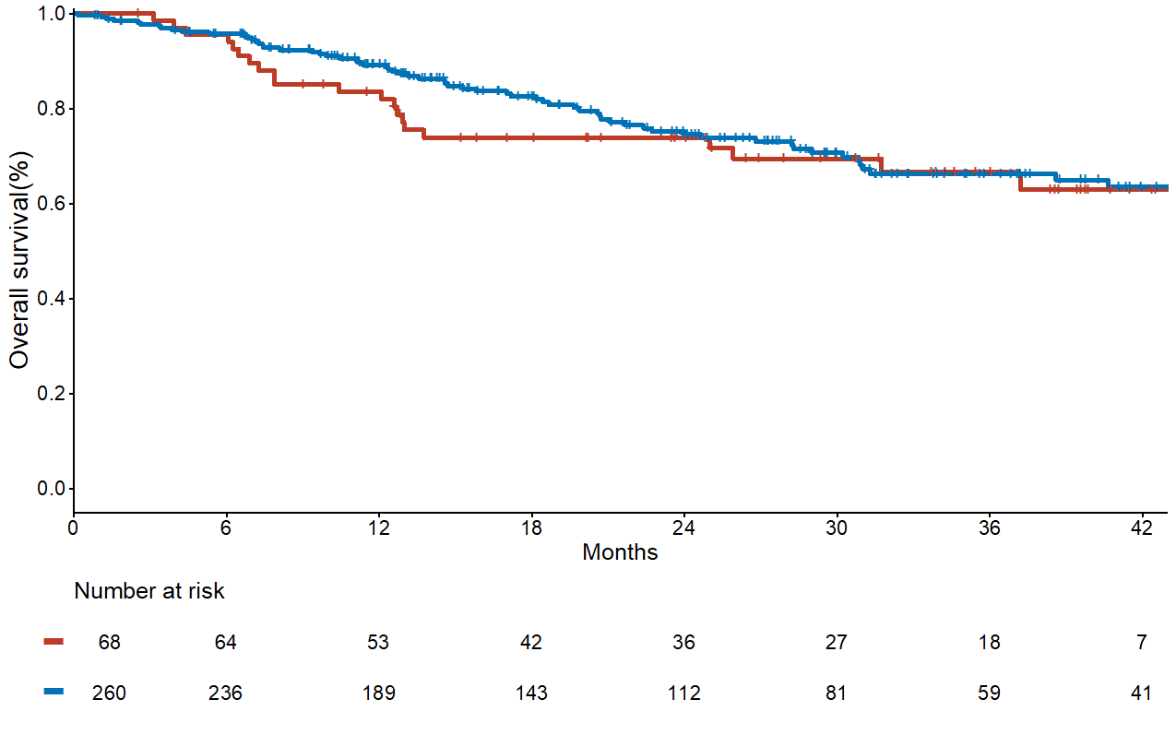
Supplementary Figure S6
A
B
Pneumonitis N Median PFS, months (95% CI)
Yes 68 33.7 (23.2-NR)
No
Pneumonitis N Median OS, months (95% CI)
Yes 68 NR (NR-NR)
No
260 21.1 (14.1-26.1)
260 NR (47.3-NR)
HR 0.65 [95% CI, 0.44-0.97]
P=0.03
HR 1.14 [95% CI, 0.70-1.87]
P=0.60

