Slide 1
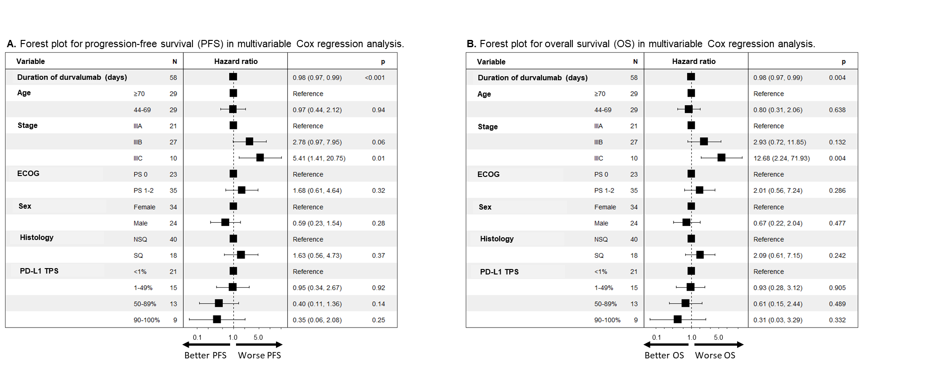
Supplementary Figure S7

