Slide 1
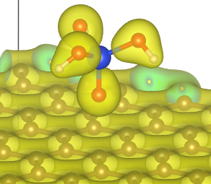
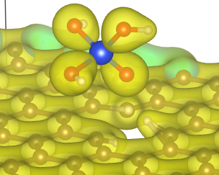
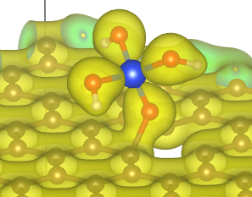
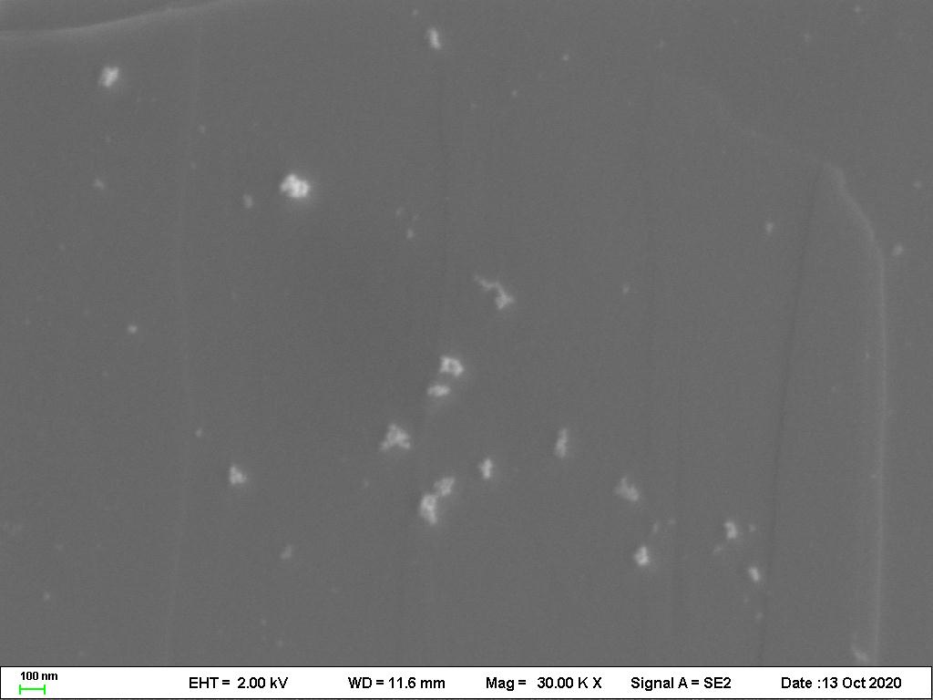
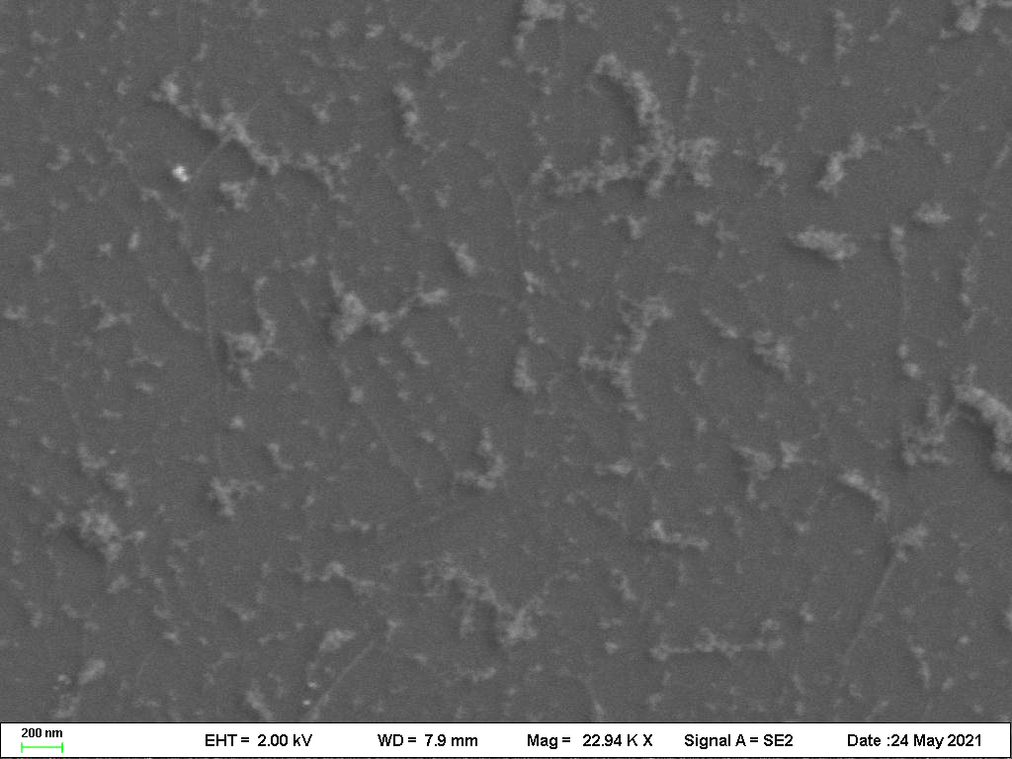
Graphical abstract
Physical adsorption
Chemical adsorption
Adsorption energy
Silica
Defect-free
Dangling bond
sp²-bonds
in DLC
Hydrogen termination
silica
silica
200nm
200nm

