Slide 1
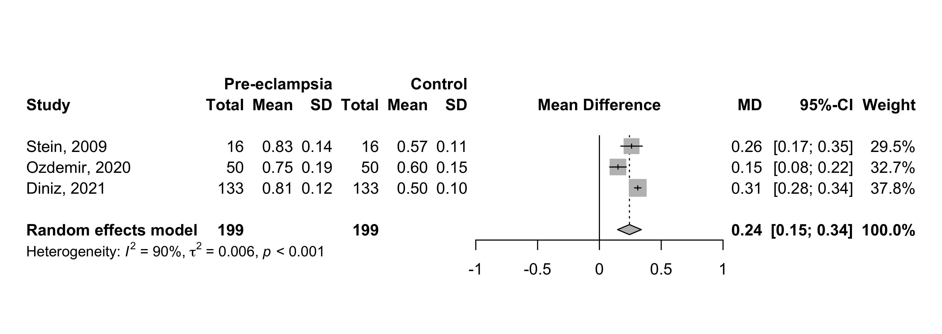
2022
Supplement 2: Peak ratio (PR) - Mean difference between all pre-eclampsia and control groups .

