Slide 1
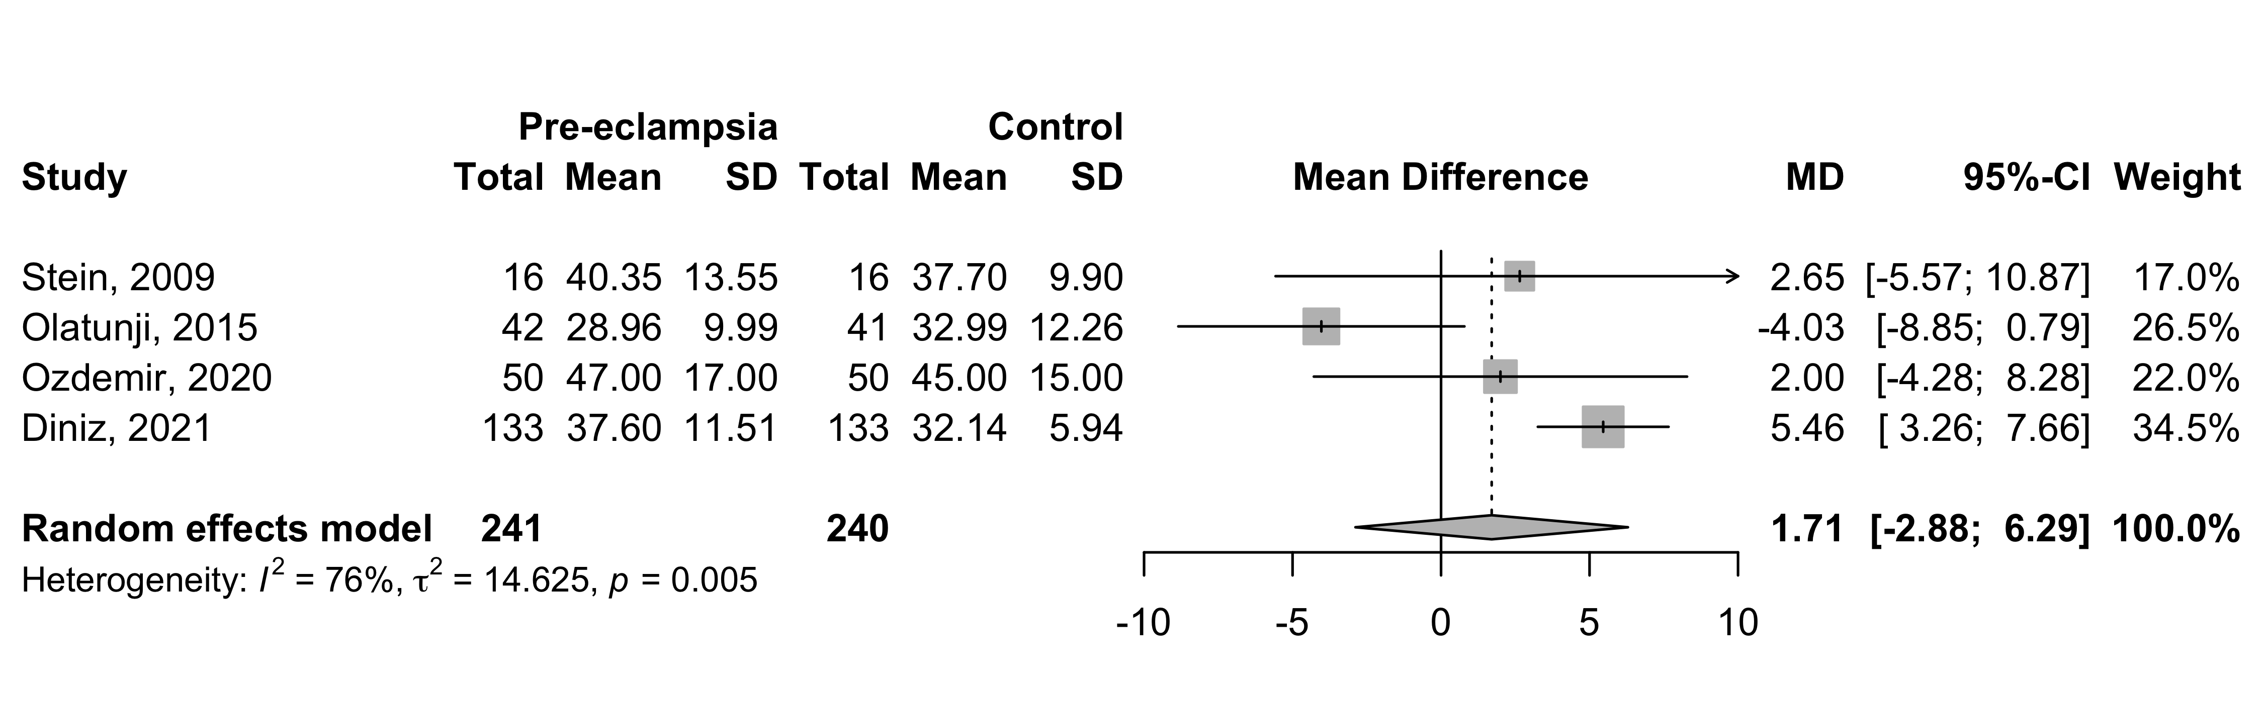
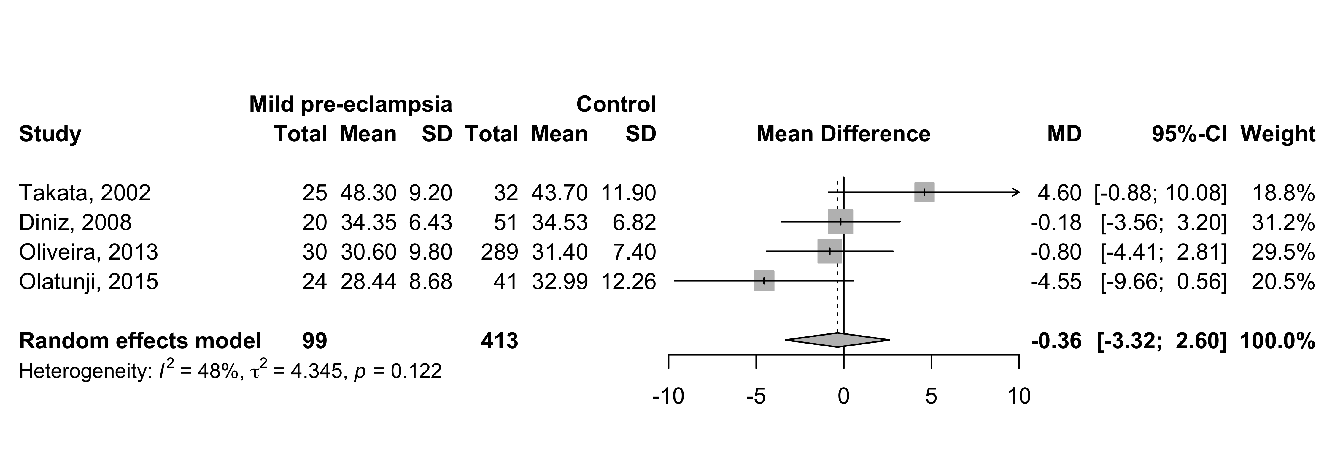

2022
Supplement 14: Peak systolic velocity (PSV) – mean difference between all pre-eclampsia x control groups and mild , severe pre-eclampsia x control groups.

