Slide 1
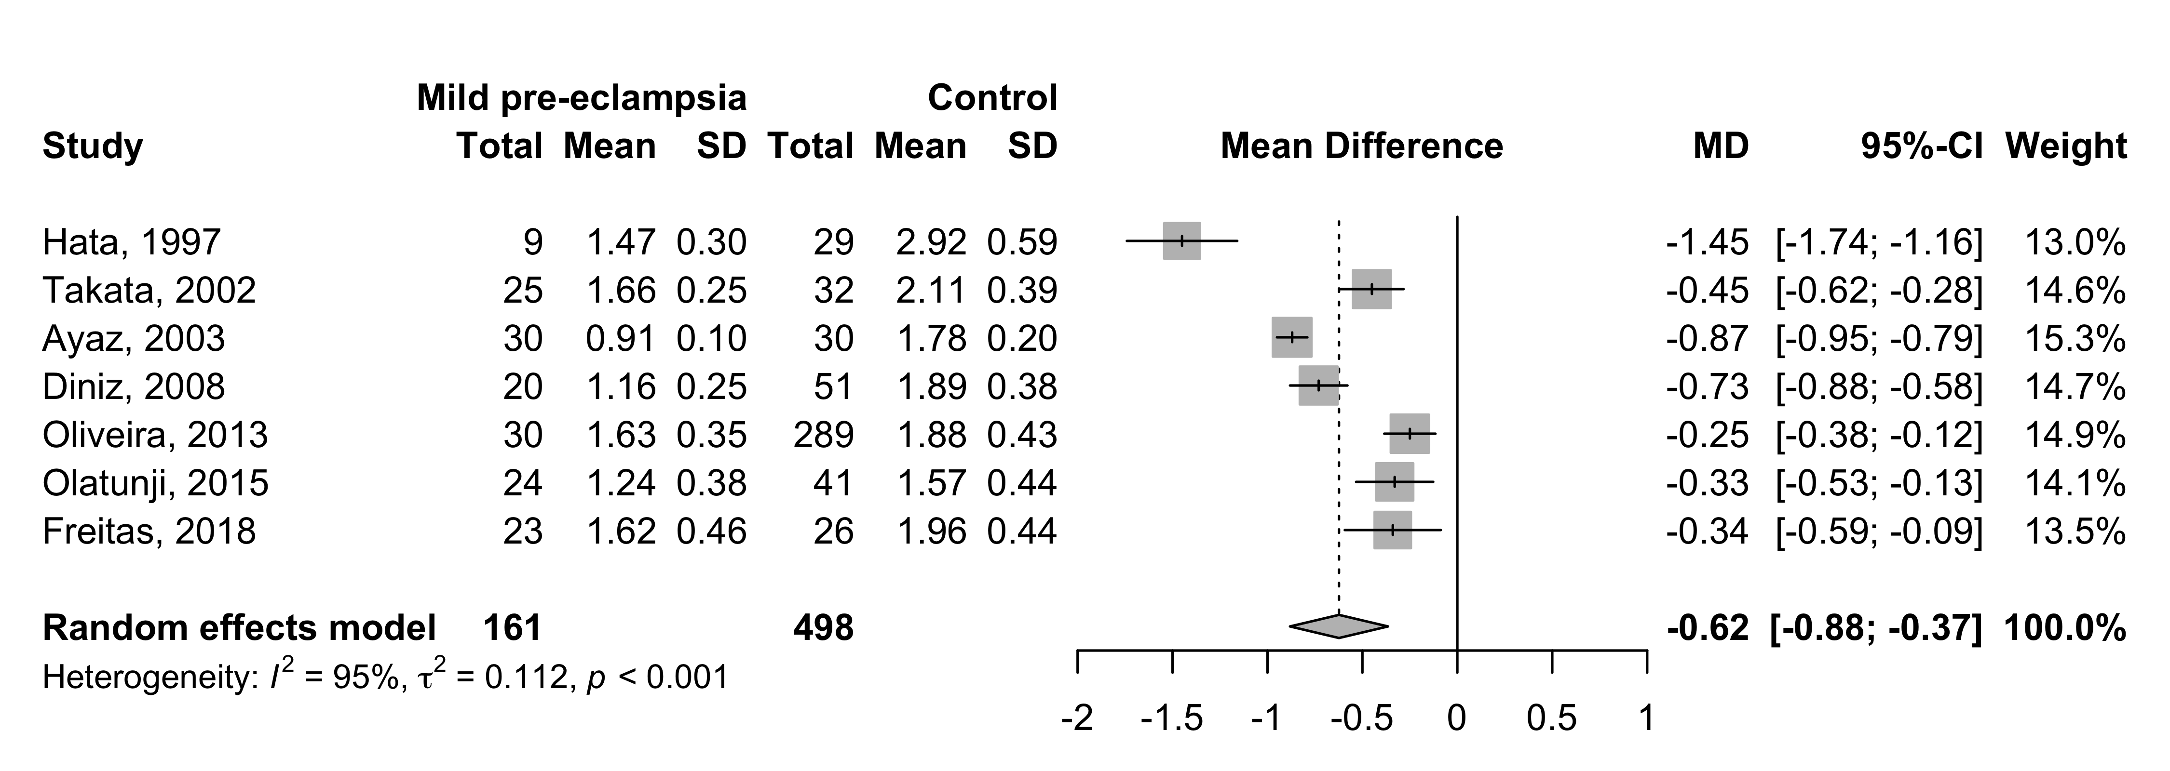
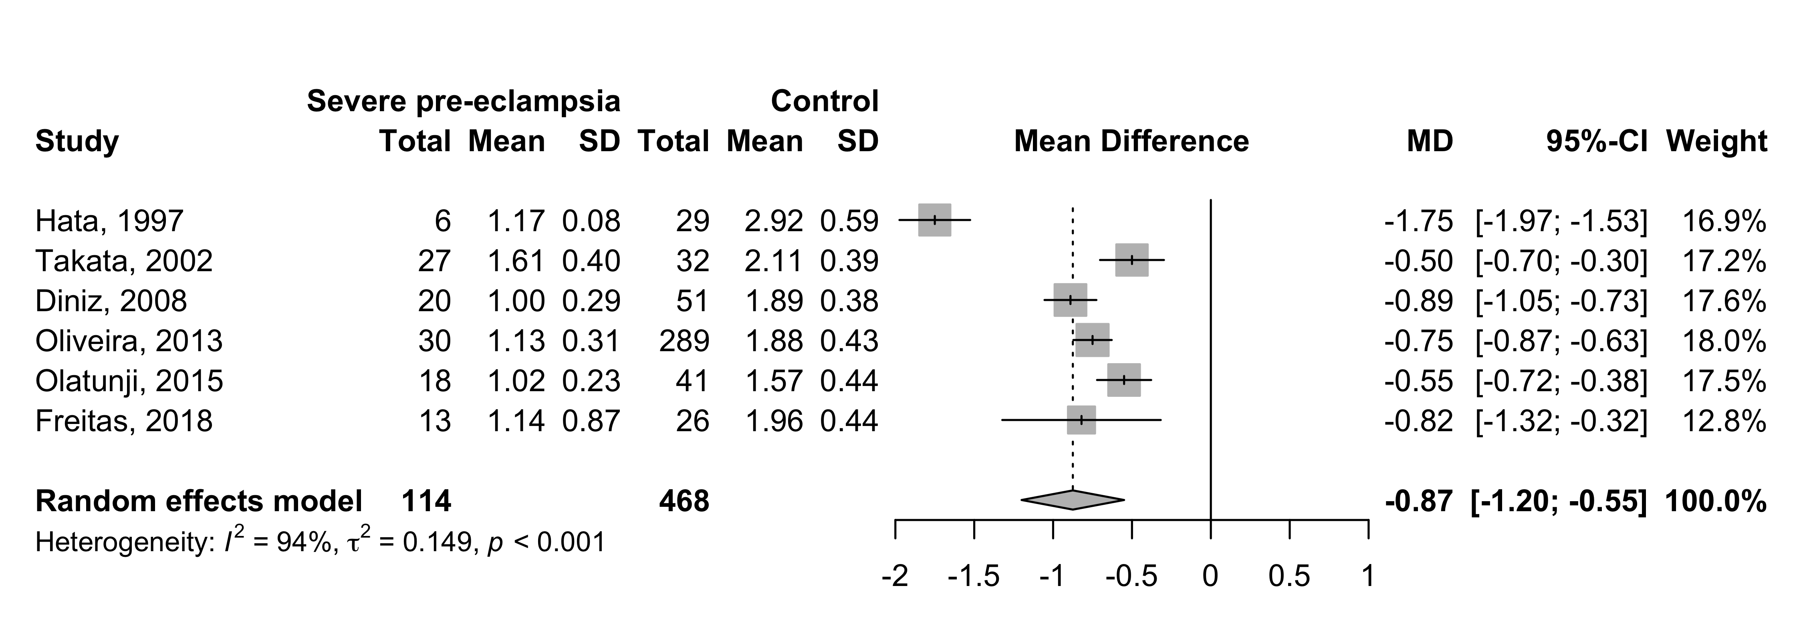
Supplement 12: Pulsatility index (PI) - mean difference between mild and severe pre-eclampsia
and control groups.

