Slide 1
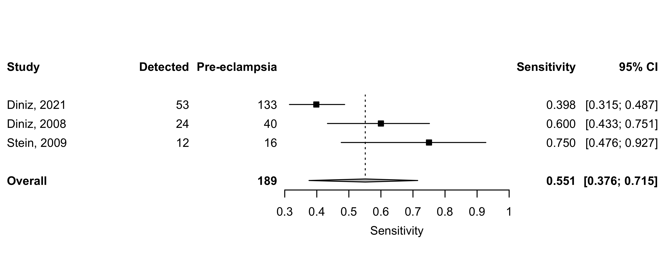
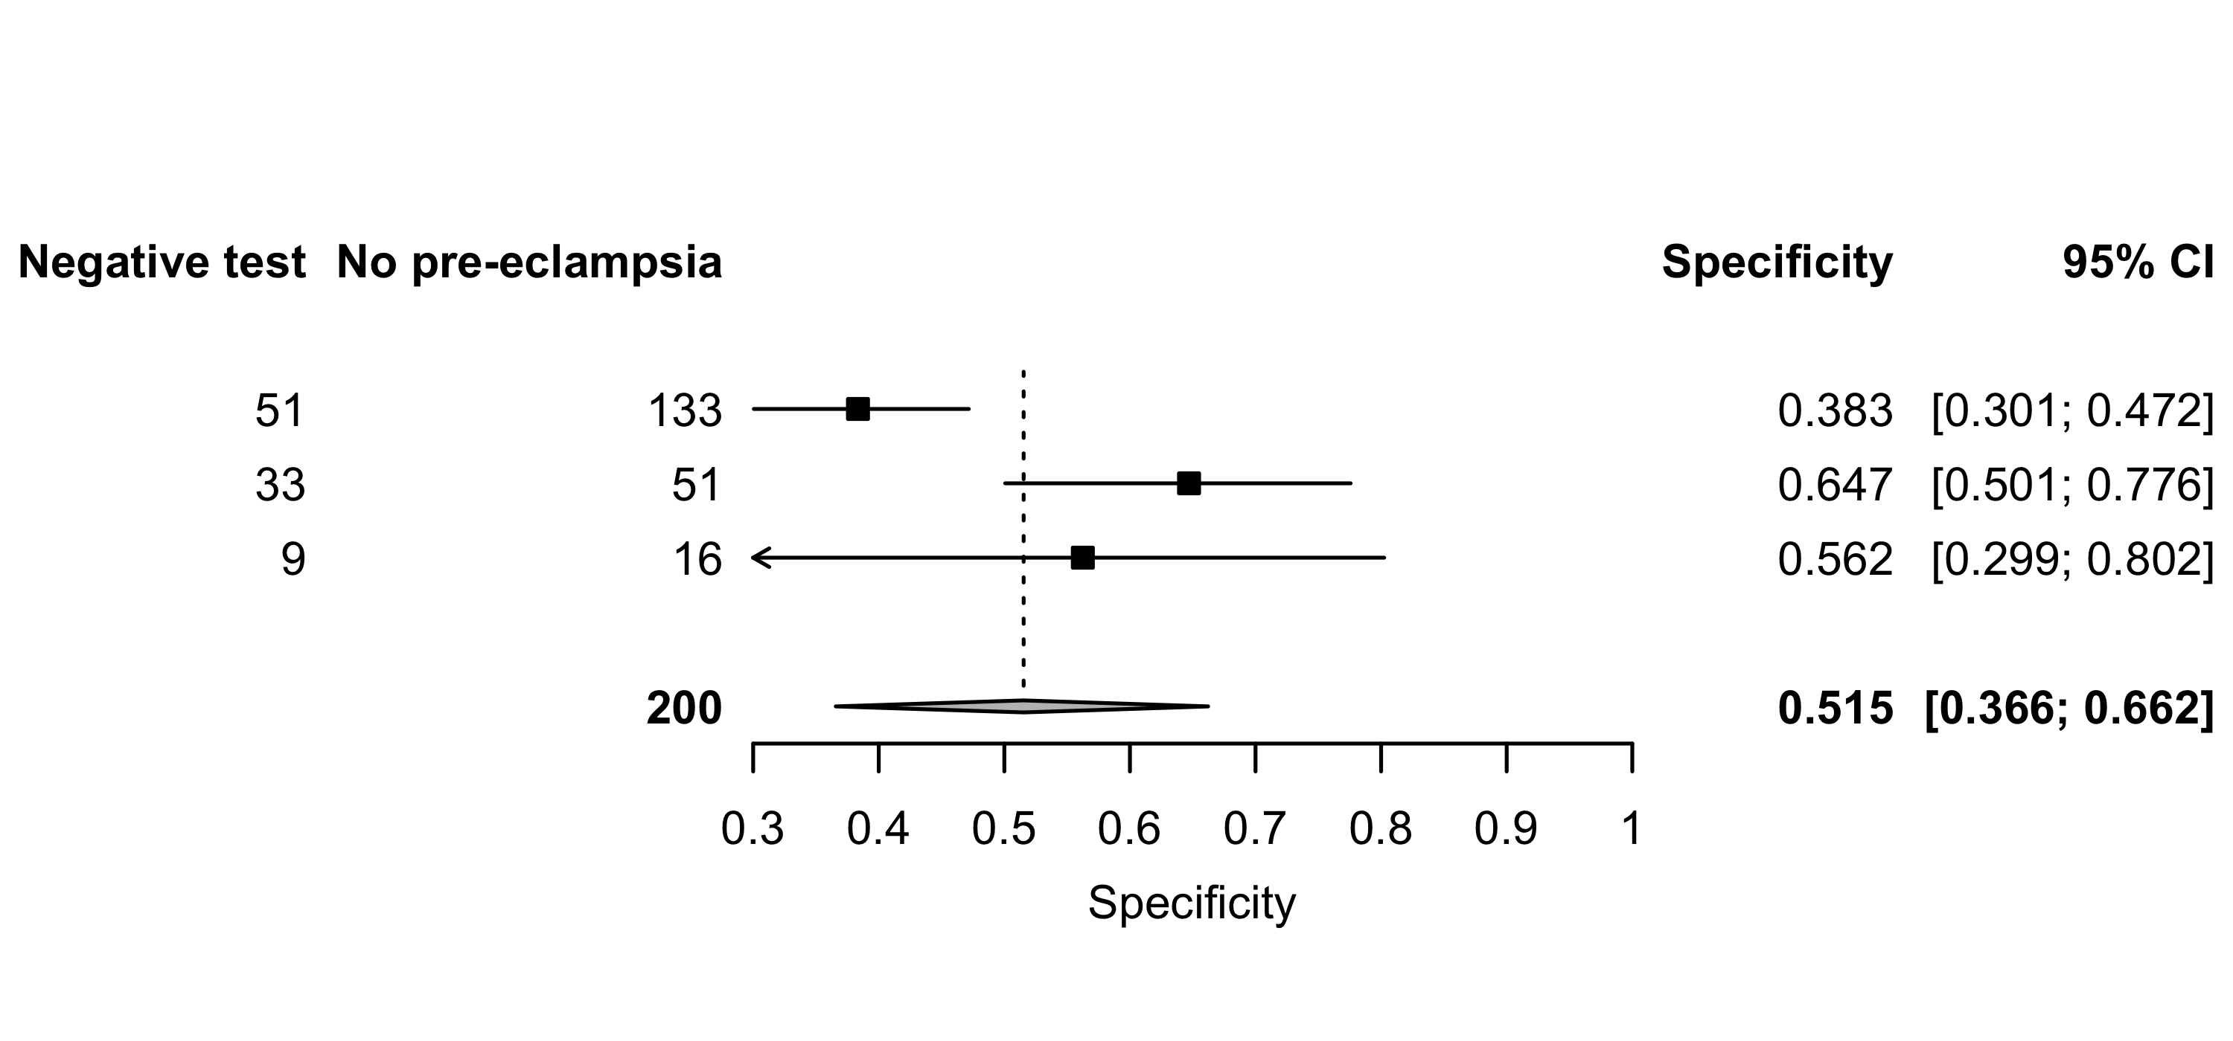
2022
Supplement 15: Peak systolic velocity (PSV) – Sensitivity and specificity for all pre-eclampsia.

