Slide 1
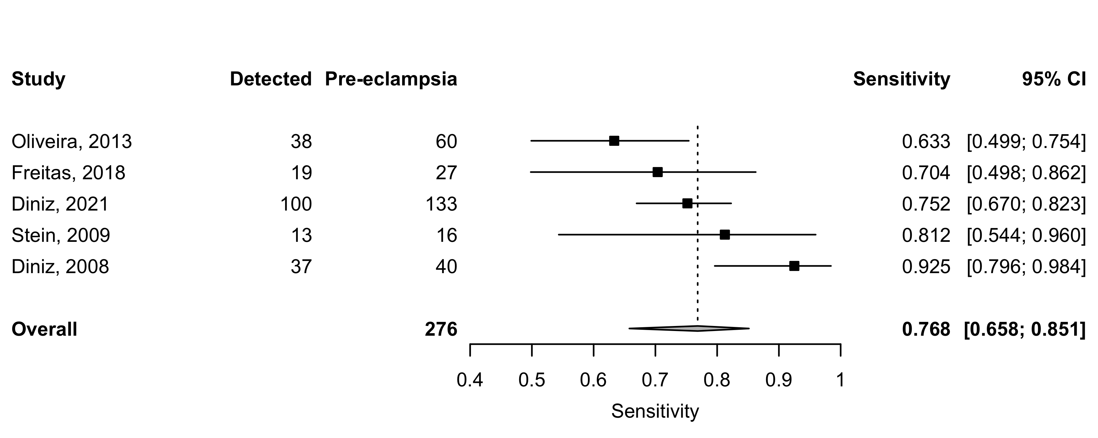
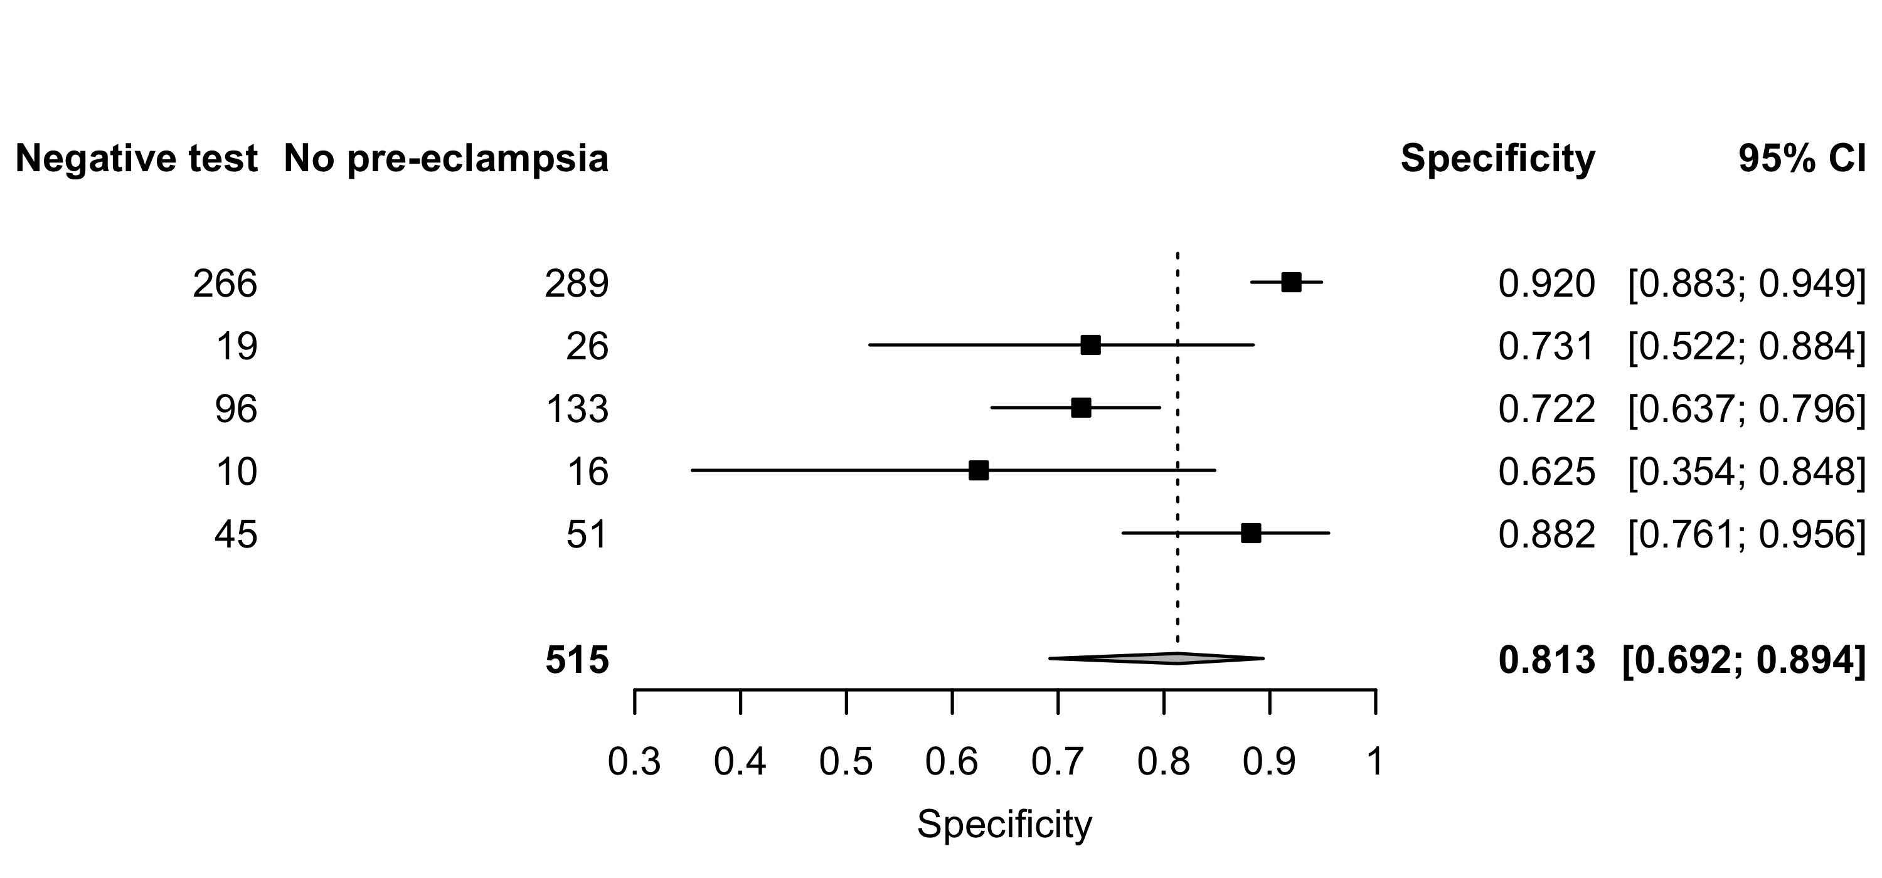
2022
Supplement 13: Pulsatility index (PI) – Sensitivity and specificity for all pre-eclampsia.

