Slide 1
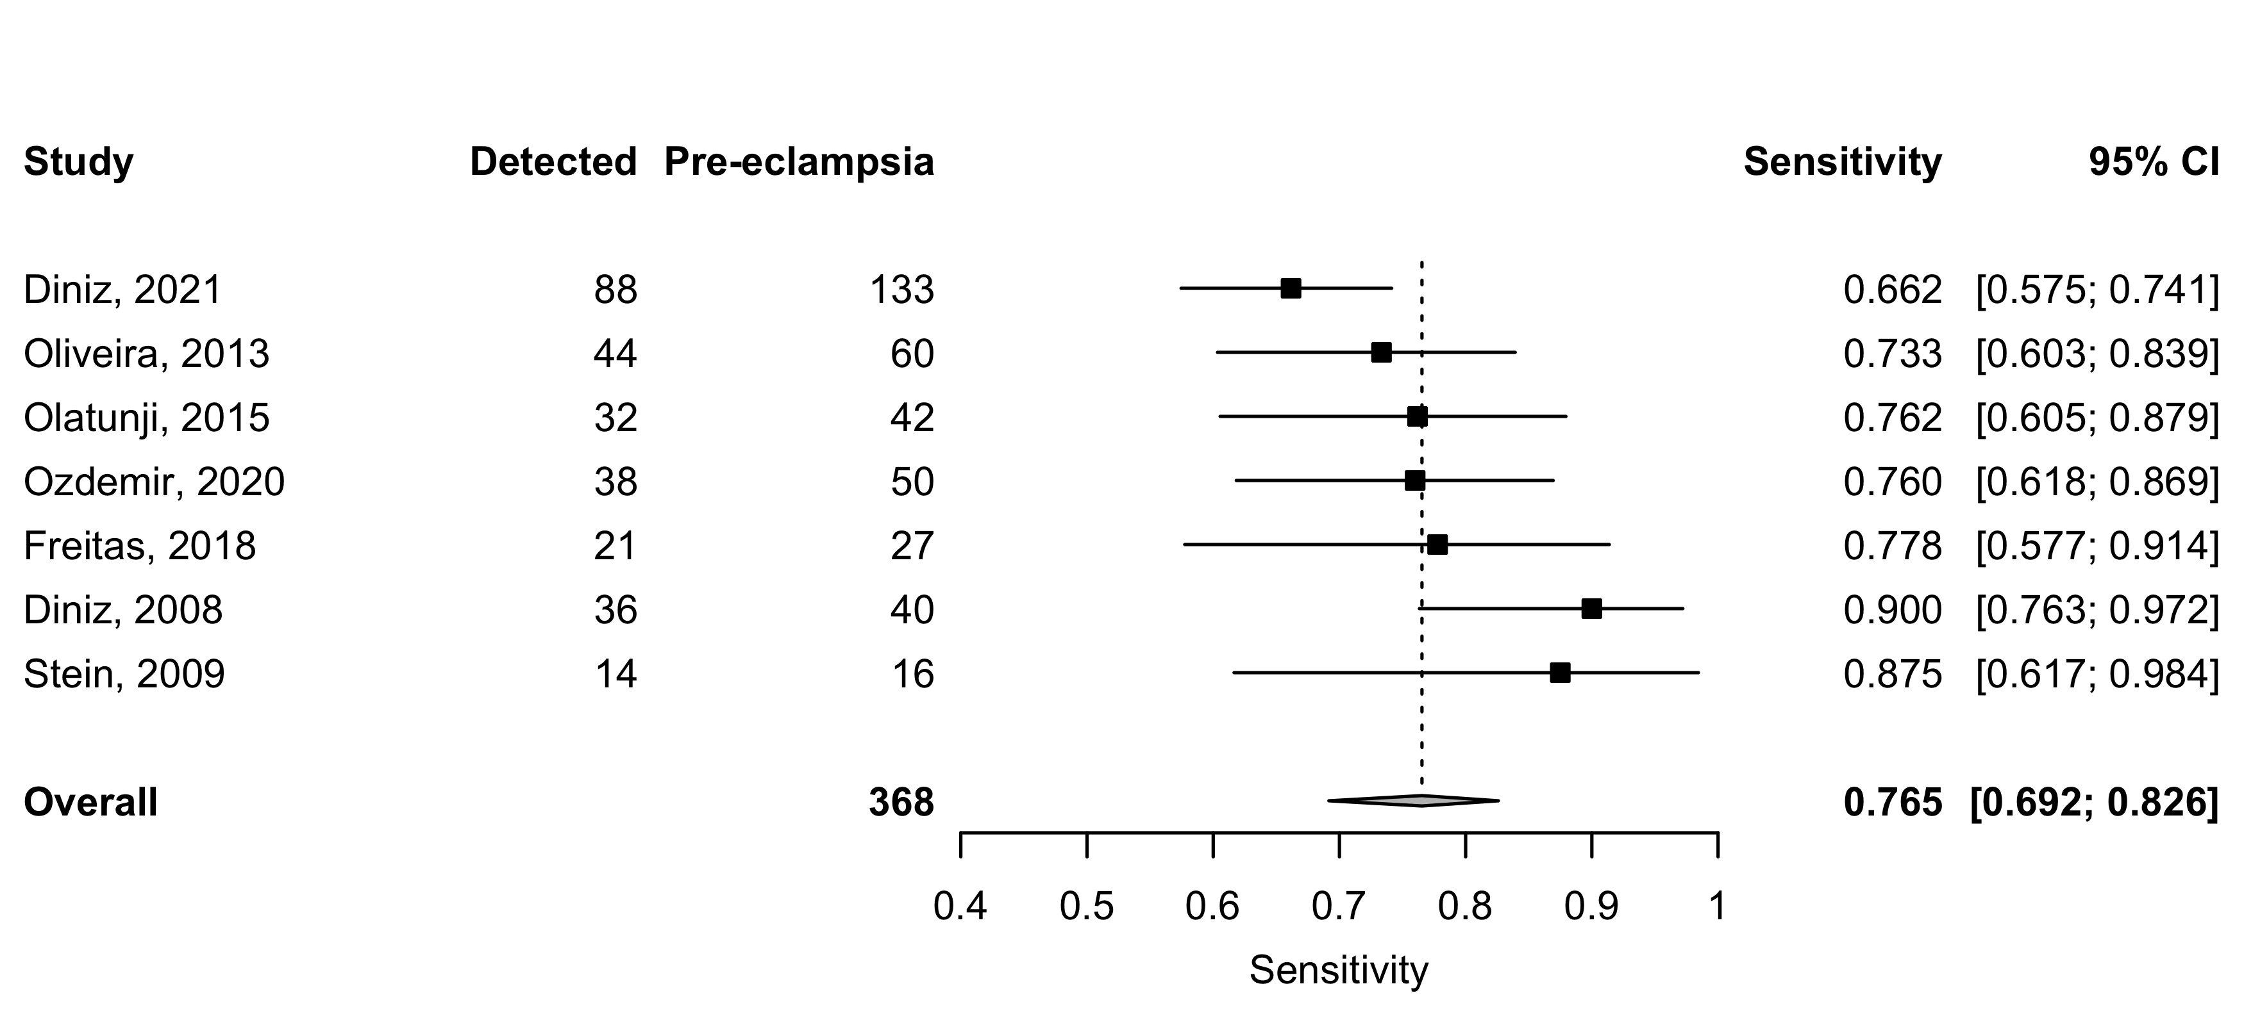
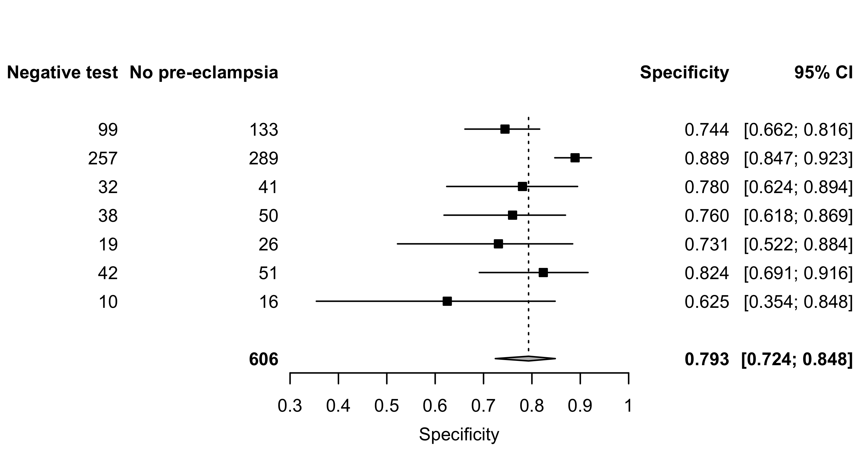
Supplement 10: Resistance index (RI) – Sensitivity and specificity for all pre-eclampsia.

