Slide 1
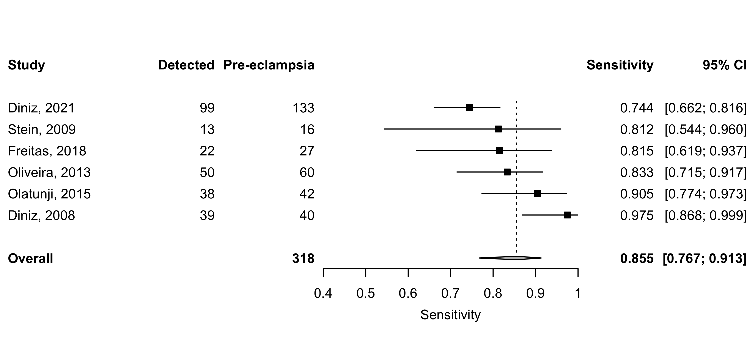
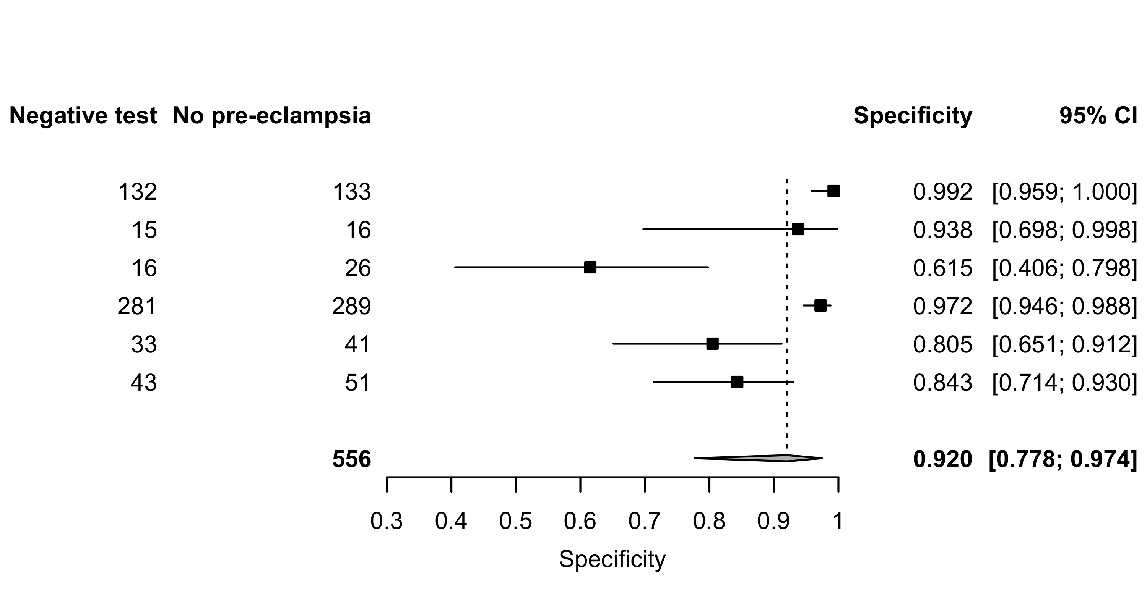
2022
Supplement 4: Peak ratio (PR) – Sensitivity and specificity for all pre-eclampsia.

