Slide 1
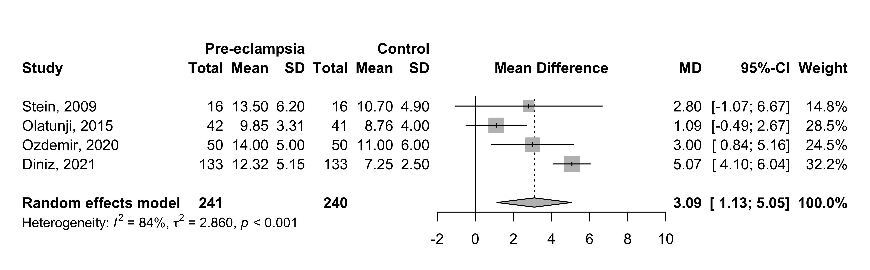
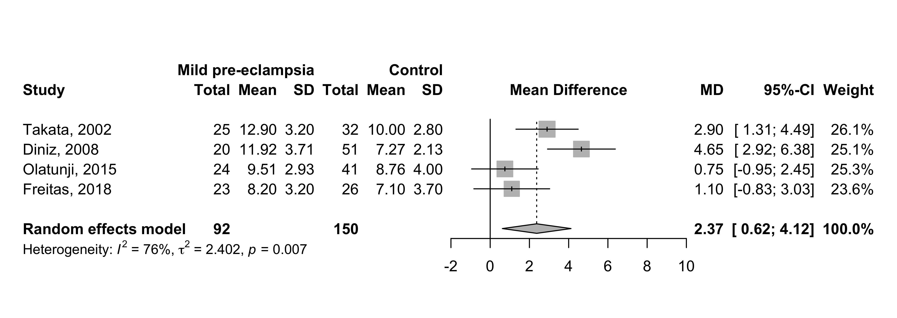
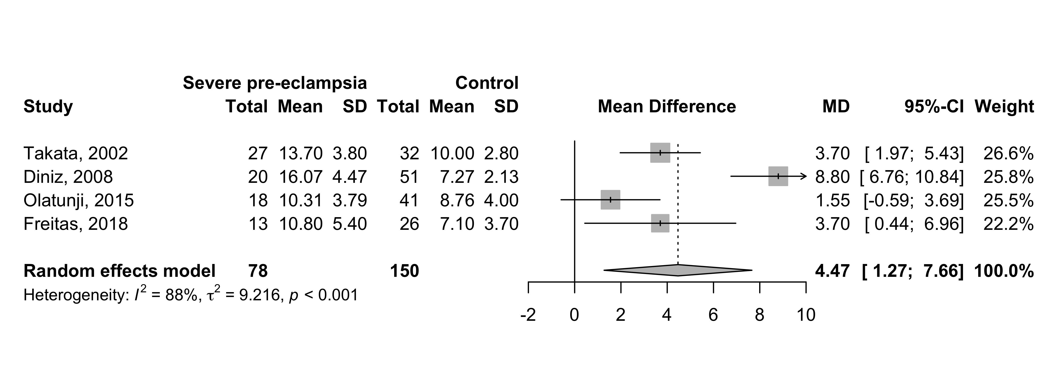
2022
Supplement 16: End diastolic velocity (EDV) – mean difference between overall preeclampsia x control groups, mild and severe preeclampsia x control groups

