Slide 1
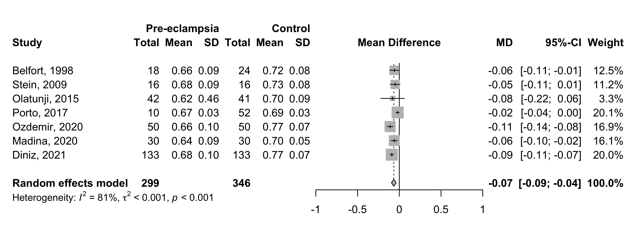
2022
Supplement 8: Resistance index (RI) – mean difference between all pre-eclampsia and control groups.

