Slide 1
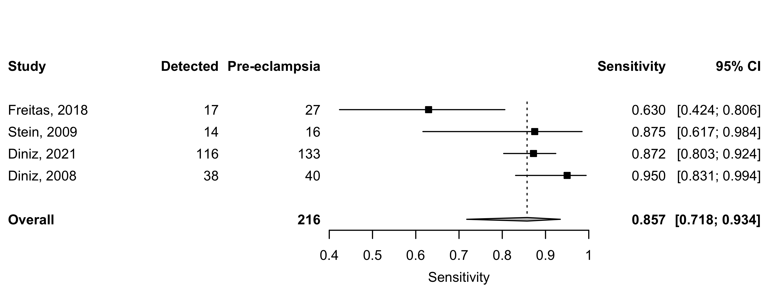
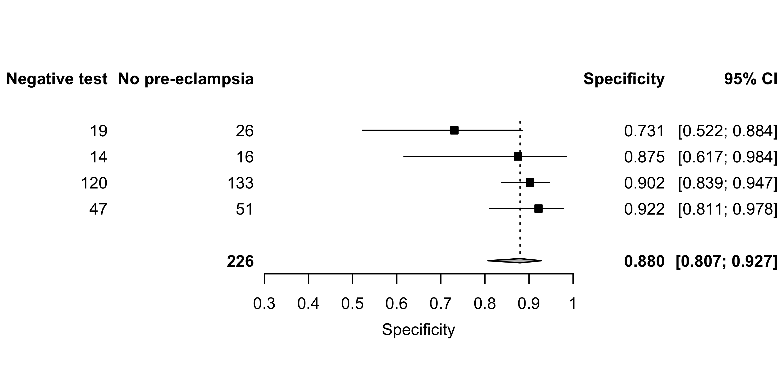
Supplement 7: Second peak (P2) –Sensitivity and specificity for all pre-eclampsia .

