Slide 1
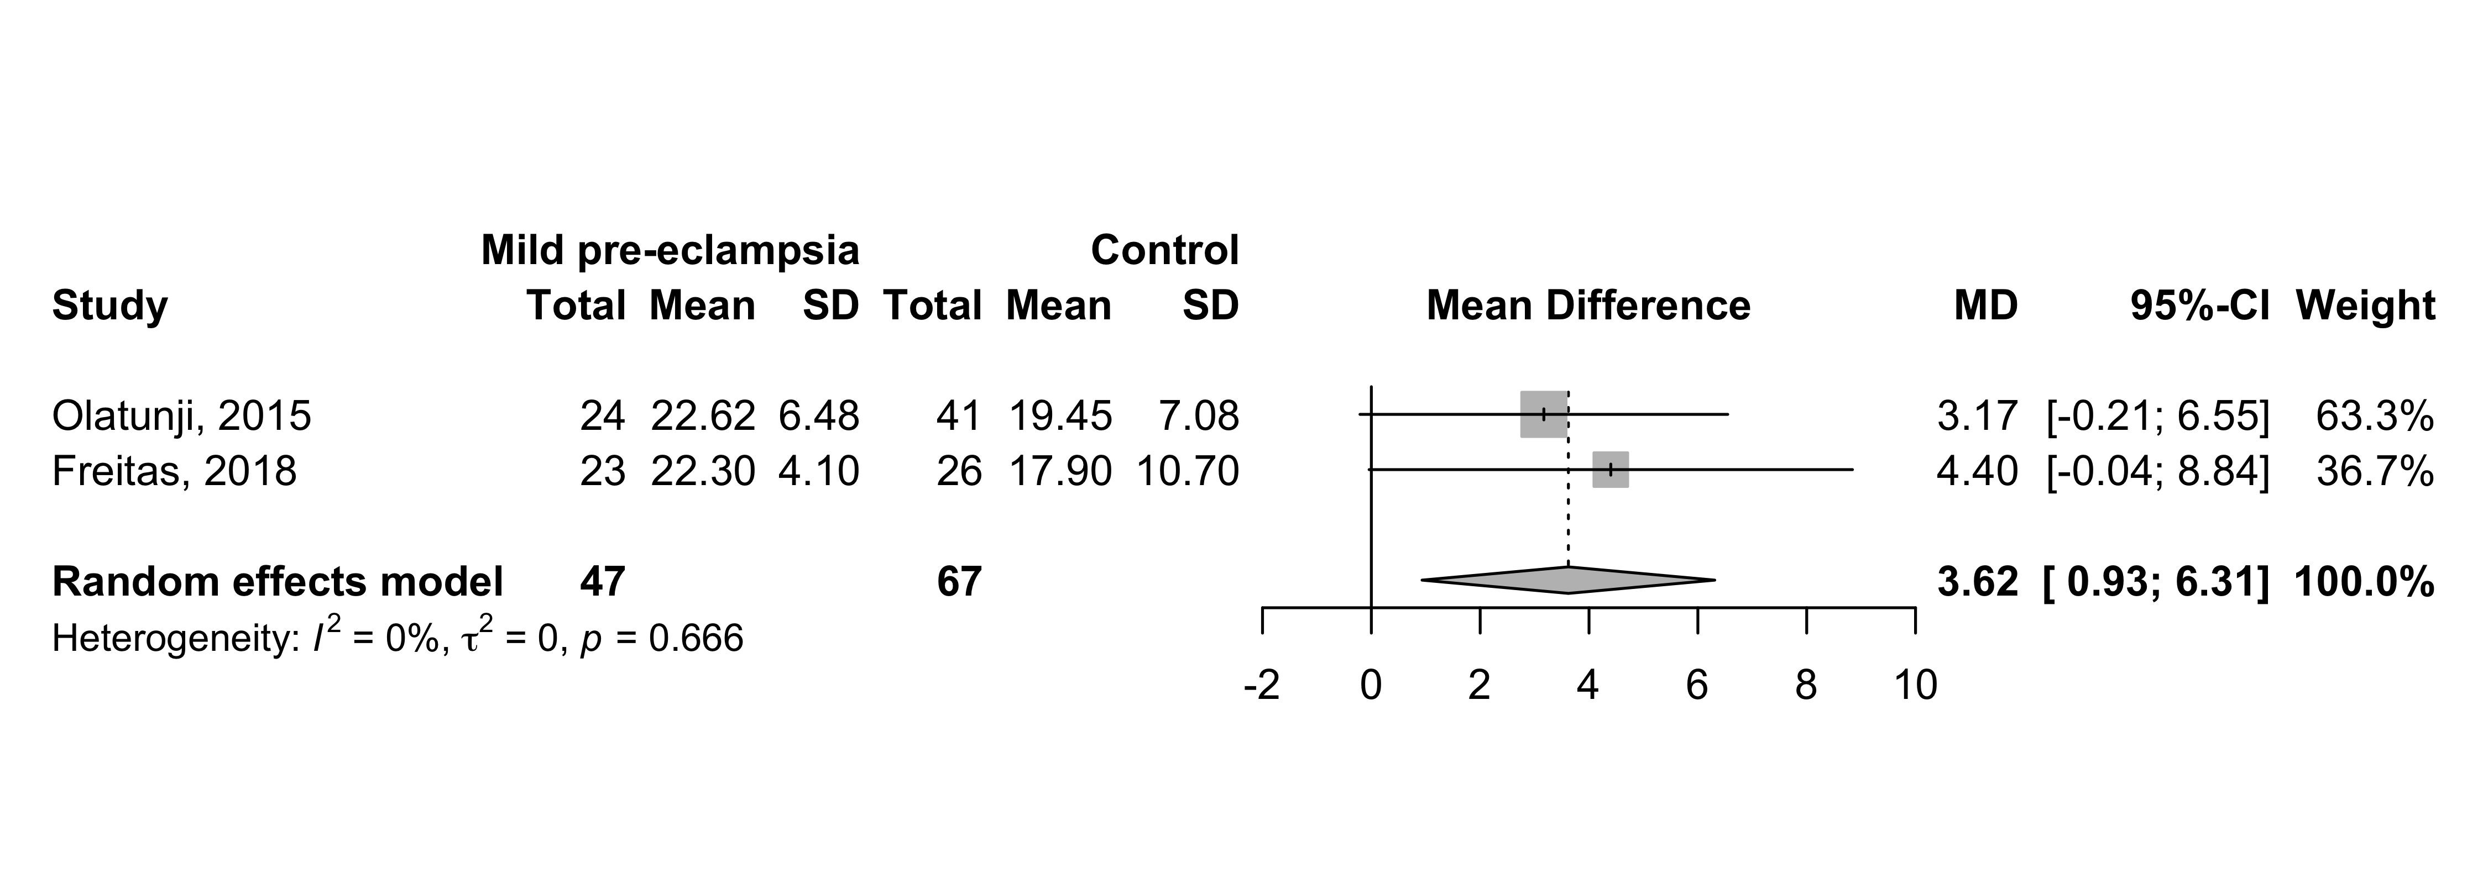
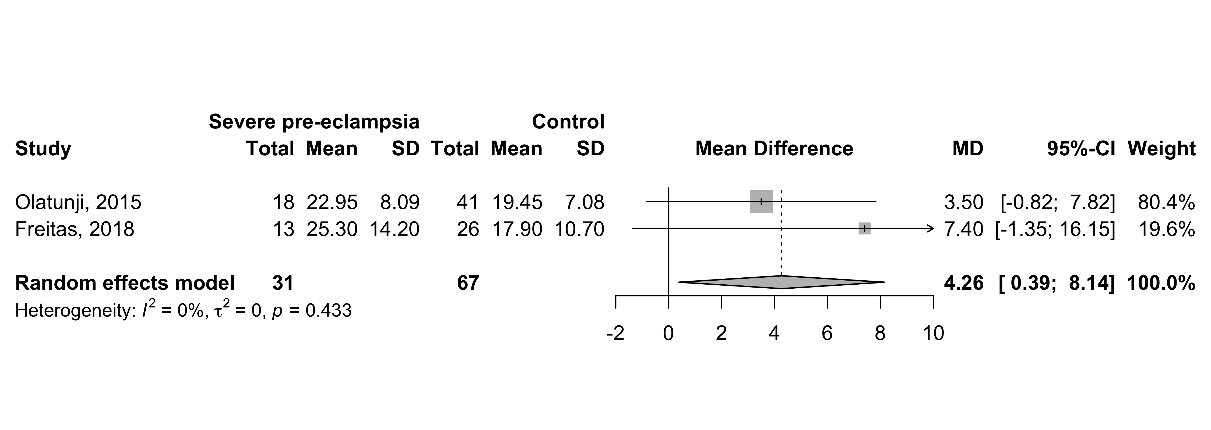
Supplement 6: Second peak (P2) - mean difference between mild and severe pre-eclampsia and control groups.

