Slide 1
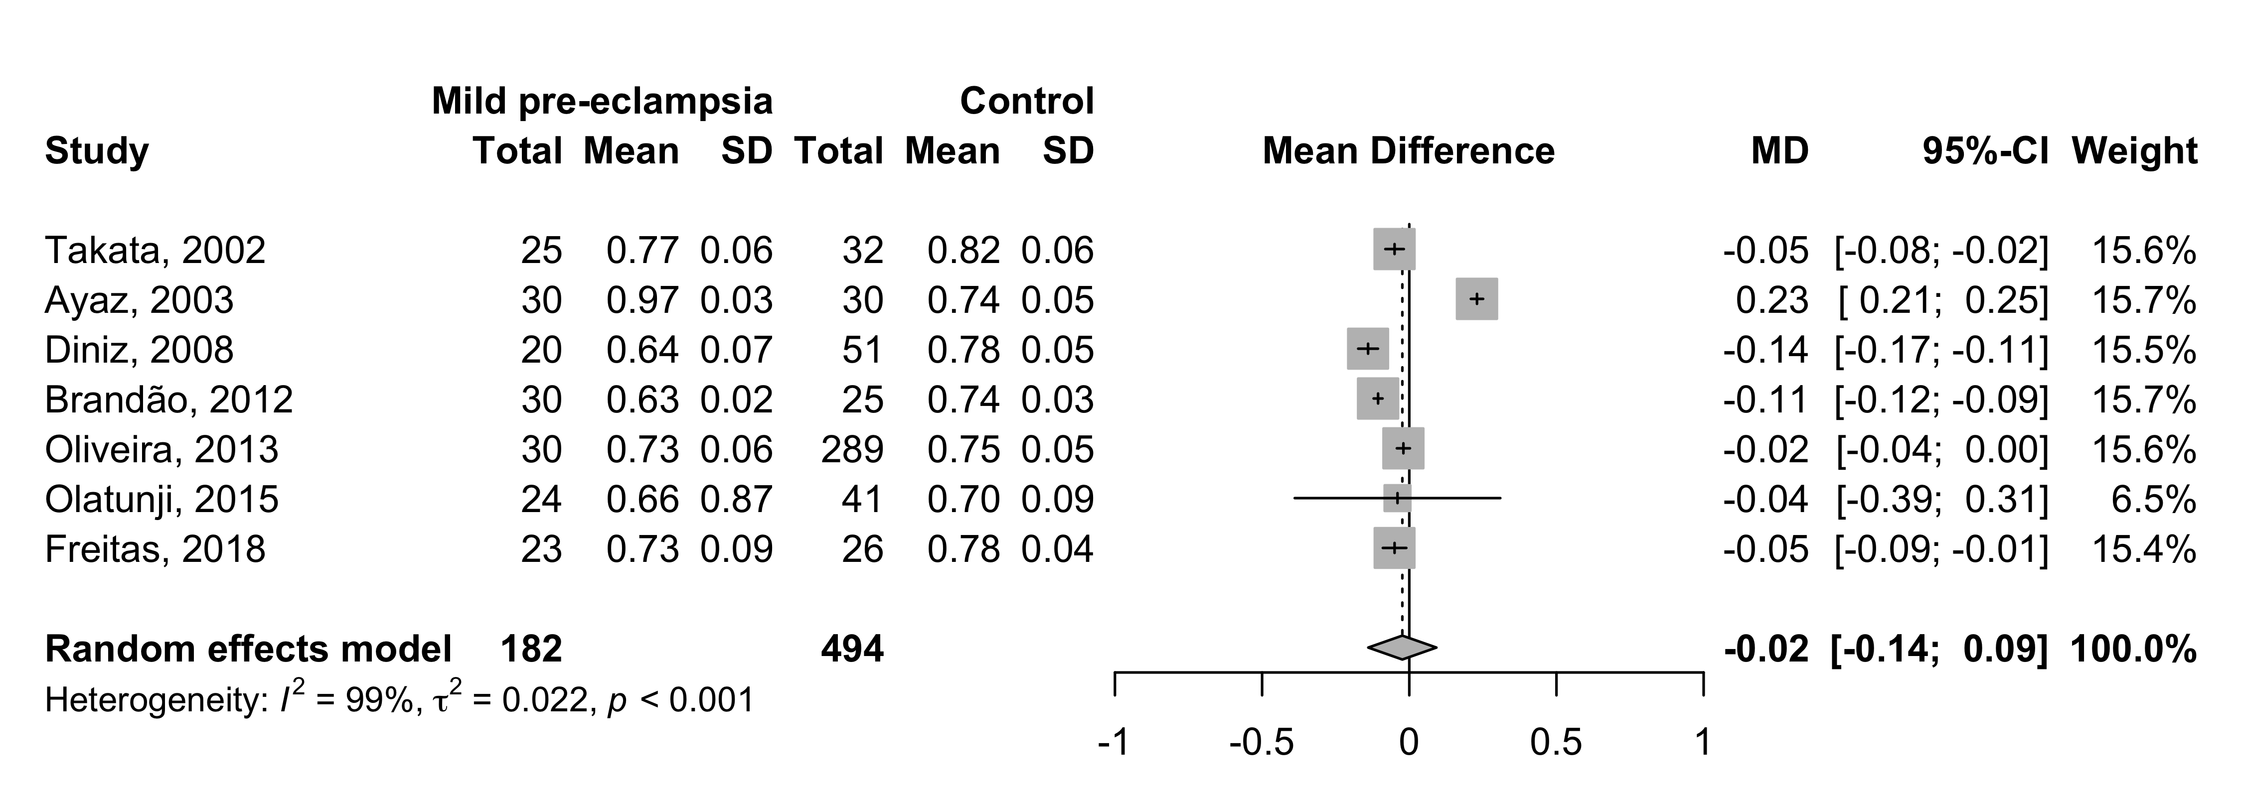
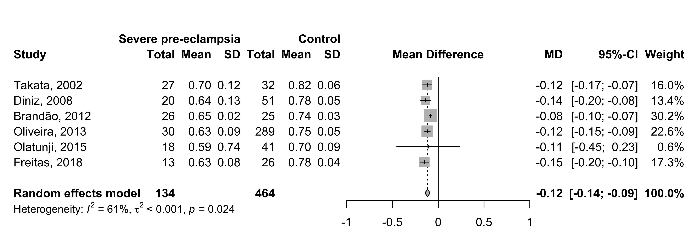
Supplement 9: Resistance index (RI) - mean difference between mild and severe pre-eclampsia
and control groups

