Slide 1
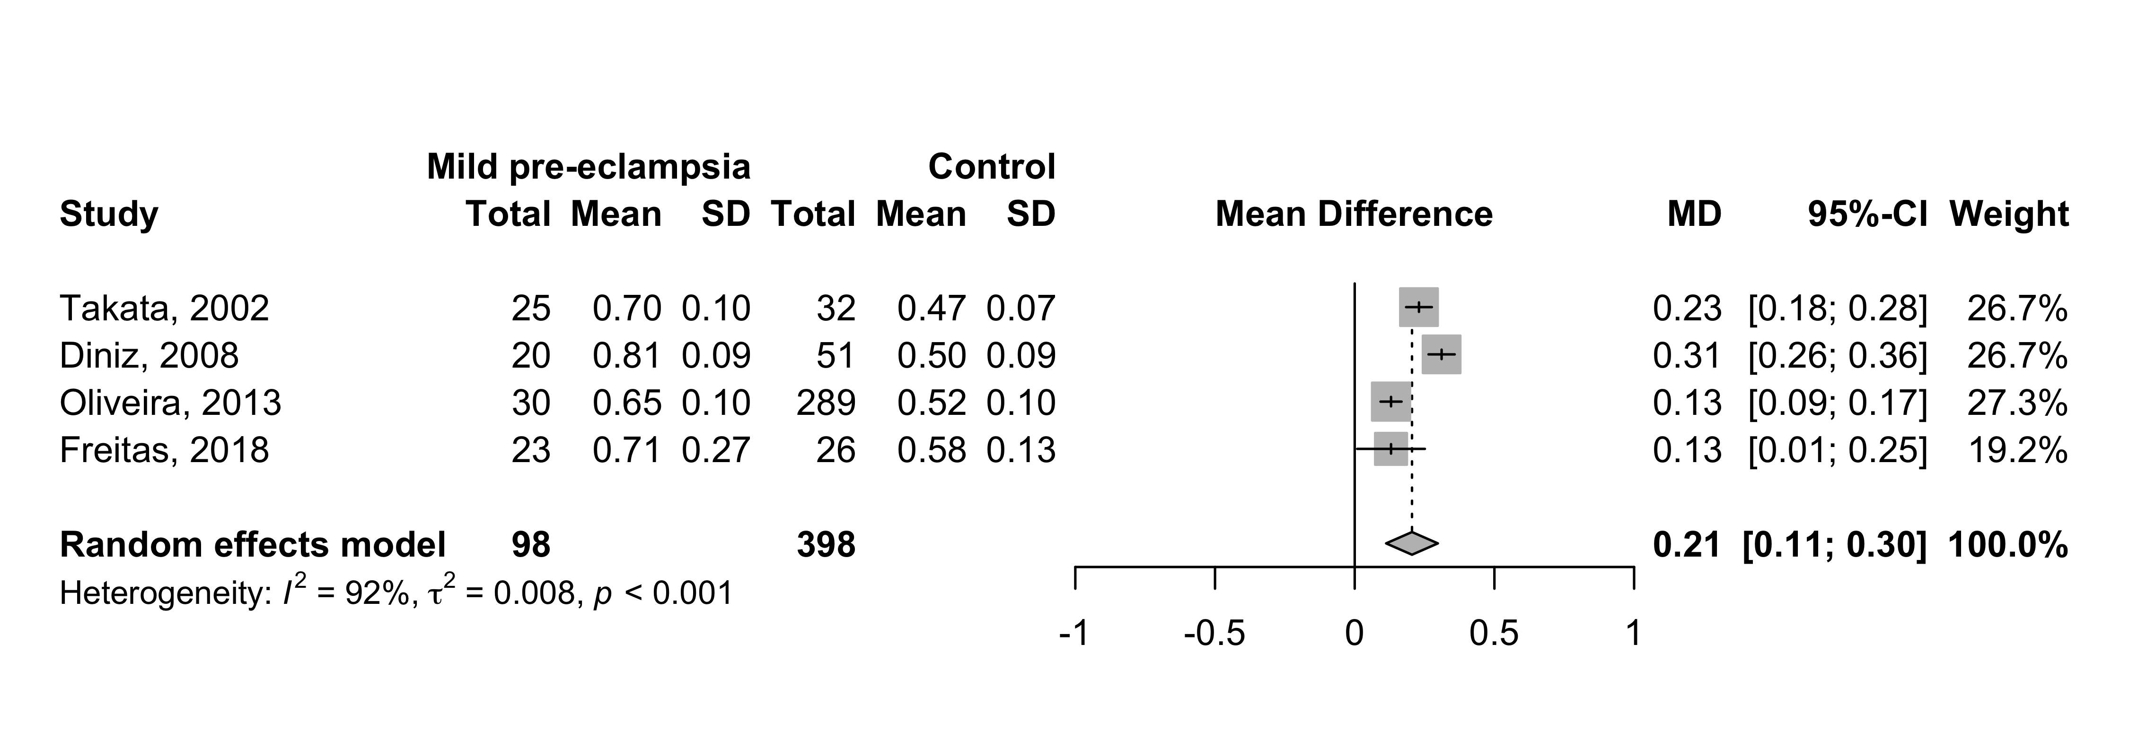
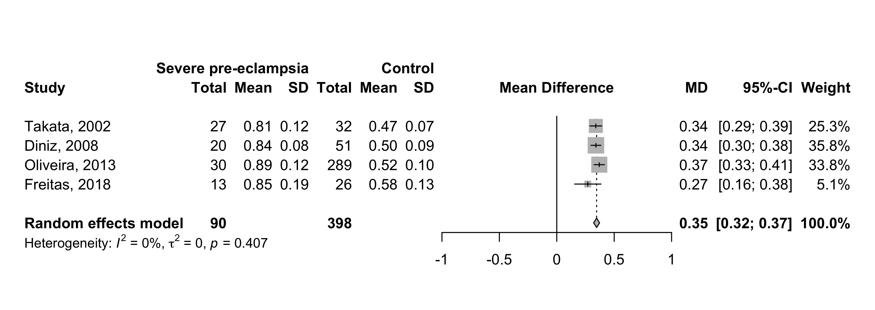
Supplement 3: Peak ratio (PR) - Mean difference between mild and severe pre-eclampsia and control group.

