Slide 1
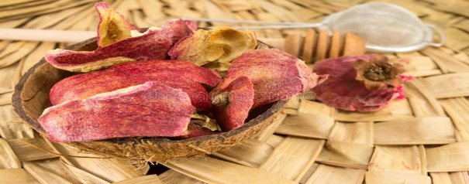
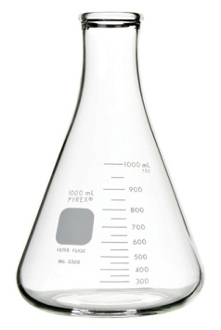
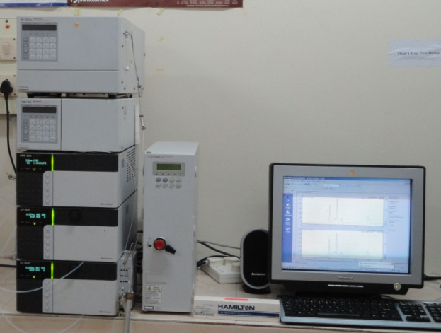
Graphical abstract
Microorganism
Sterilized
Pretreated
pomegrante
Hydrolysate
120 ᵒC
15 psi
20 min
Incubated at 30ᵒC
Agitated at
200 rpm for48 hrs
100 mL
100 mL
pH 7
Cooled at
Room
Temperature
Filtered Samples analyzed
in HPLC

