Slide 1
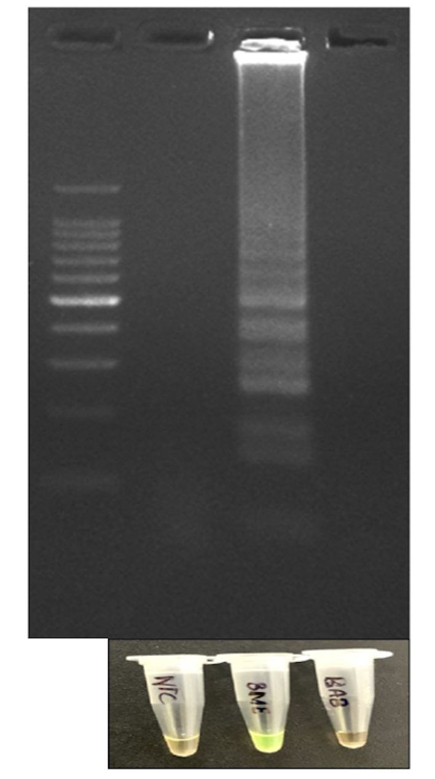
B. abortus
B. melitensis
M
NTC
Fig.1. Optimized B. melitensis LAMP assay
Agarose gel electrophoresis for LAMP amplicons Lane M: 100 bp ladder, lane 1: NTC, lane 2: Positive LAMP amplification with B. melitensis genomic DNA showing laddering pattern, lane 3: LAMP amplification with B. abortus genomic DNA showing no laddering
(b) Visualization of LAMP amplicon by SYBR Green I dye: Positive LAMP amplicons appeared green while the negative amplicons remained orange

Slide 2
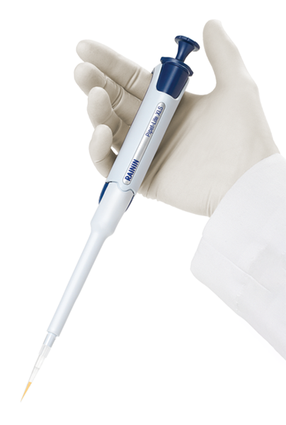
Fig. 2. The schematic illustration depicting the principle involved in LAMP-Lateral Flow Immunoassay (LAMP-LFIA)
Flow direction
LAMP Amplicon
Streptavidin-GNP conjugate
Anti-digoxigenin
Gold nanoparticle (GNP)
labelled LAMP amplicon
Streptavidin
Biotin
Albumin biotin labelled bovine
Digoxigenin

Slide 3
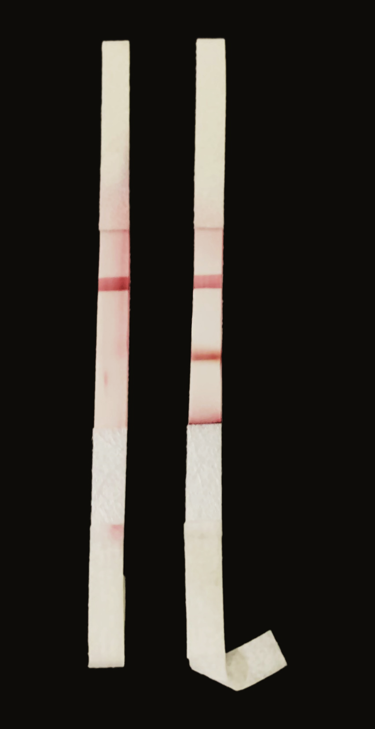
NTC PC
Fig. 2a. Optimized B. melitensis LAMP-LFIA
Strip 1: Non template control (NTC), Strip 2: B. melitensis (positive control)

Slide 4
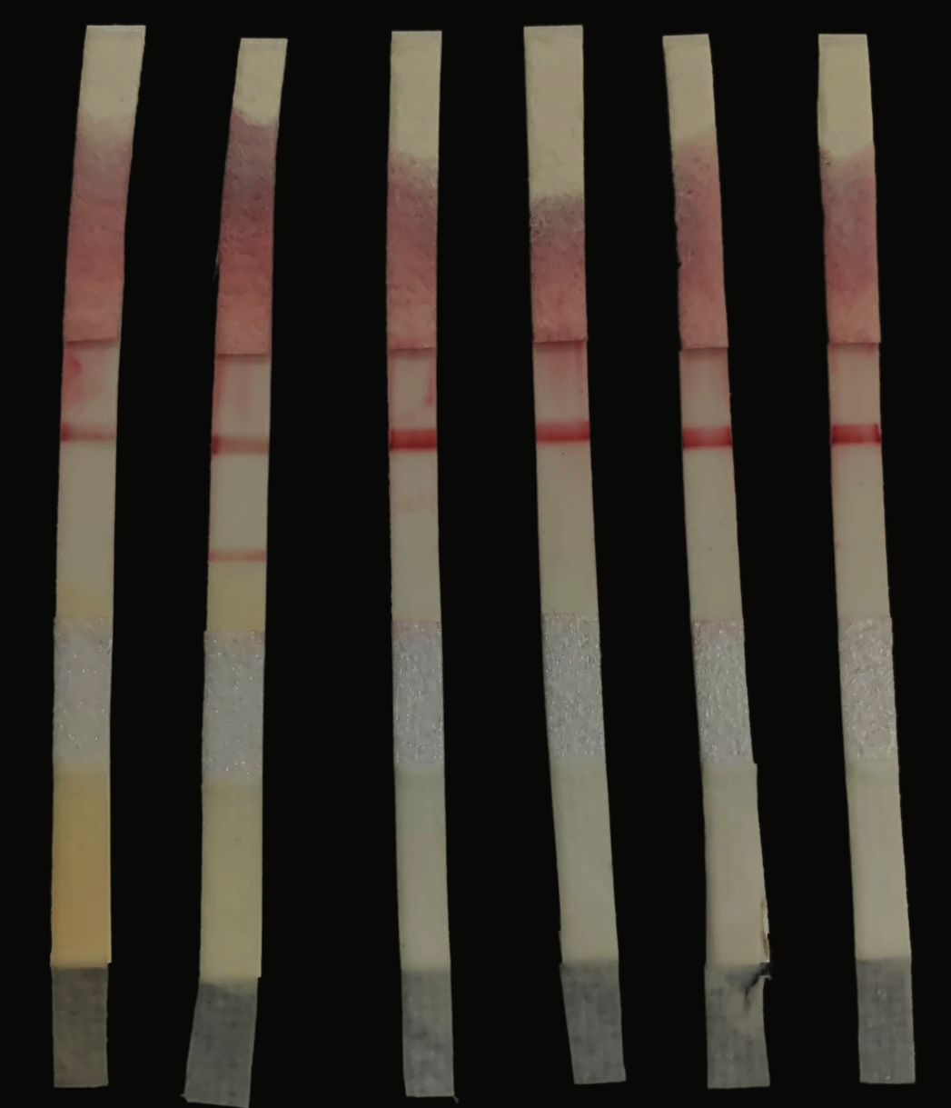

NTC
B. abortus S19
B. abortus S99
B. melitensis
B. abortus 544
C. jejuni
B. suis
P. vulgaris
V. parahemolyticus
P. multocida B:2
B. melitensis
P. aeruginosa
H. influenzae
K. pneumoniae
S. aureus
M. bovis AN5
M. tuberculosis
NTC
L. monocytogenes
Fig. 3a. Specificity of LAMP-LFIA with other Brucella spp.
Fig. 3b. Specificity of LAMP-LFIA with other bacterial species

Slide 5
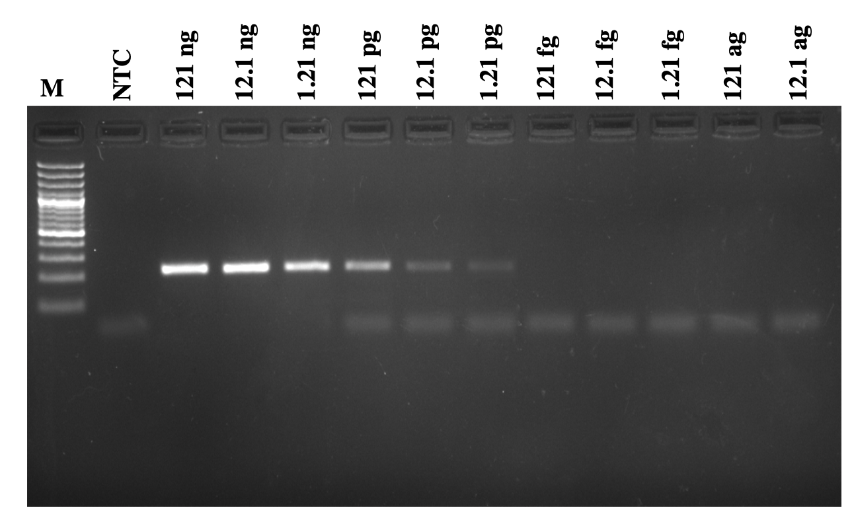
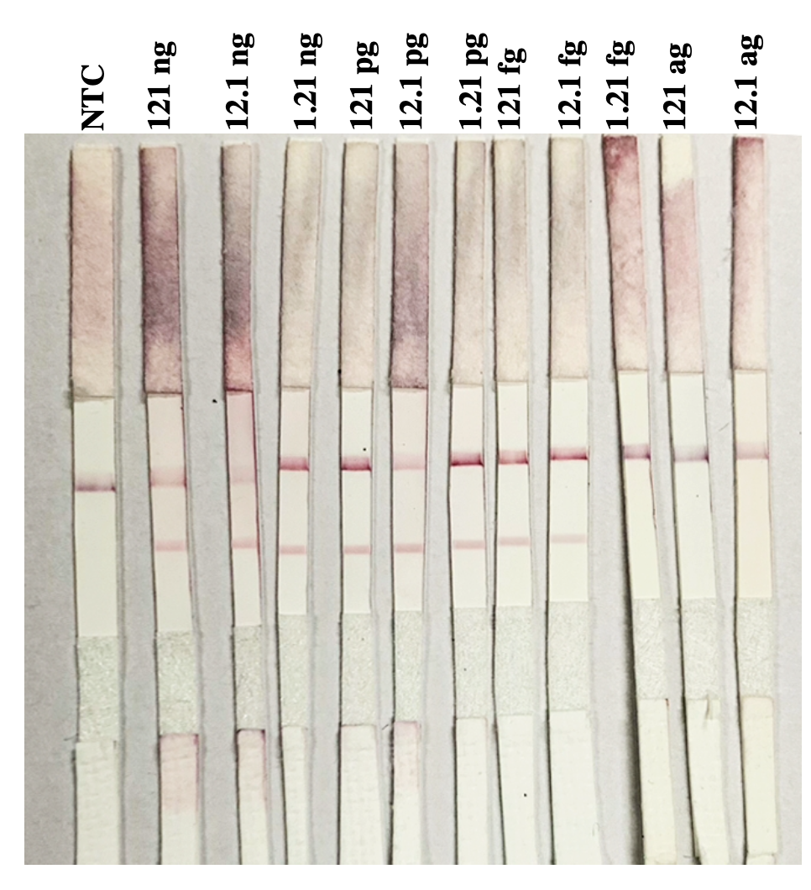
Fig. 4b. Analytical sensitivity of PCR using LAMP outer primers
Lane M:100 bp ladder, lane 1: NTC, lane 2: neat genomic DNA (121 ng), lane 3-7:ten fold serially diluted B. melitensis genomic DNA showing amplification band upto 1.21pg, lane 8-12: no amplification from 121fg to 12.1ag
Fig. 4a. Analytical sensitivity of LAMP-LFIA
Strip 1:NTC, strip 2: B. melitensis genomic DNA neat (121ng), strip 3-12: 10 fold serially diluted B. melitensis genomic DNA (12.1 ng to 12.1 ag) showing red band at both test and control line till 12.1 fg.

Slide 6
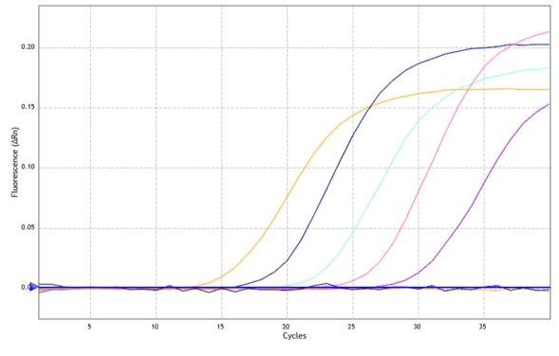
1.21 pg
121 pg
12.1 pg
121 fg
12.1 fg
Fig. 4c. Analytical sensitivity of RT-PCR using LAMP outer primers
(a) Amplification curve of RT-PCR obtained using B. melitensis LAMP outer primer showing amplification from 121pg to 12.1fg

Slide 7
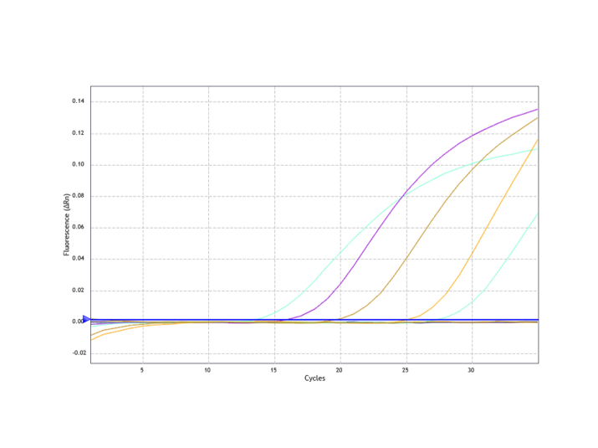
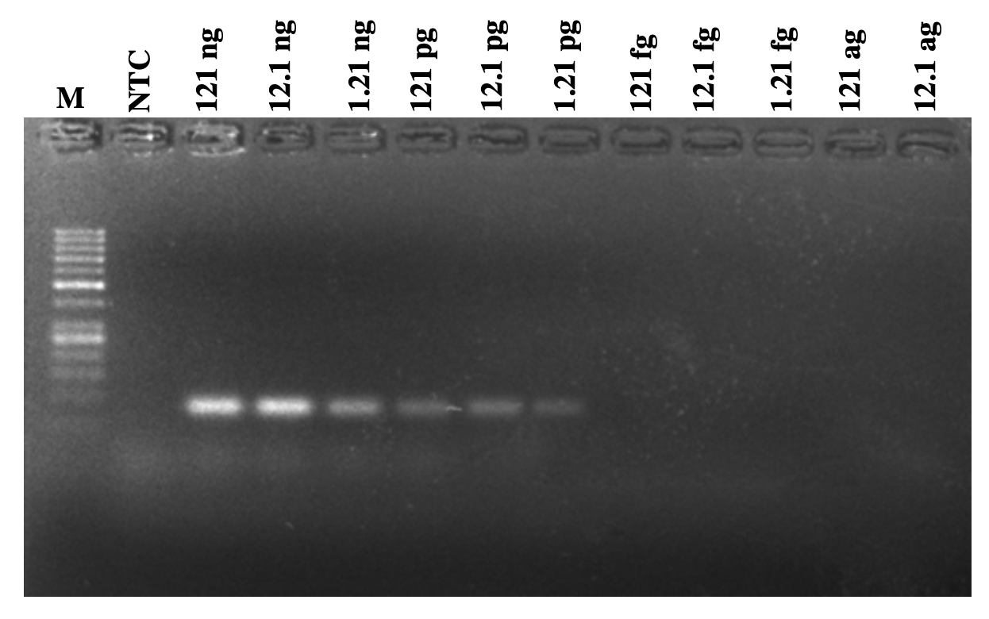
12.1 pg
121 pg
121 fg
1.21 pg
12.1 fg
Fig. 4d. Analytical sensitivity of PCR using established primer (Hinic et al., 2008).
1.5% agarose gel electrophoresis of PCR amplicon
lane M:100 bp ladder, lane 1: NTC, lane 2: neat genomic DNA (121 ng), lane 3-7:ten-fold serially diluted B. melitensis genomic DNA showing amplification band upto 1.21pg, lane 8-12: no amplification from 121fg to 12.1ag
Fig. 4e. Analytical sensitivity of LAMP by RT-PCR using established primer
(a) Amplification curve of RT-PCR obtained using B. melitensis LAMP outer primers showing amplification from 121pg to 12.1fg

Slide 8
Fig. 5. Evaluation of LAMP-LFIA in spiked milk samples: Visualization of spiked milk using LAMP-LFIA : Strip1: NTC, Strip 2: Negative control, Strip 3-7: serially diluted spiked milk sample (10⁴-1 CFU)

