Slide 1
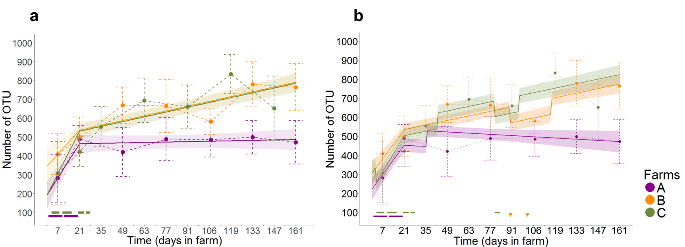
Notes:
Fig. S4. The dynamics of the number of OTU is significantly decreased by extended antibiotic treatment in the first 21st days of fattening but remains shaped by farm affiliation. (A) Distribution of the number of OTU at day 7 according to extended antibiotic treatment. Median values. quartiles and 1.5 quartile range are shown. The distribution of the number of OTU was significantly lower in calves receiving antibiotic treatment at day 7 comparing to the others. (B) Evolution of the number of OTU and model farm specific predicted profiles. For each farm. mean values +/- standard deviations of observed data are shown in dashed line. predicted profiles and their 95% confidence intervals are in solid lines and ribbons respectively). Extended antibiotic treatment at start in farms A and C are indicated on the bottom of figure.

