Slide 1
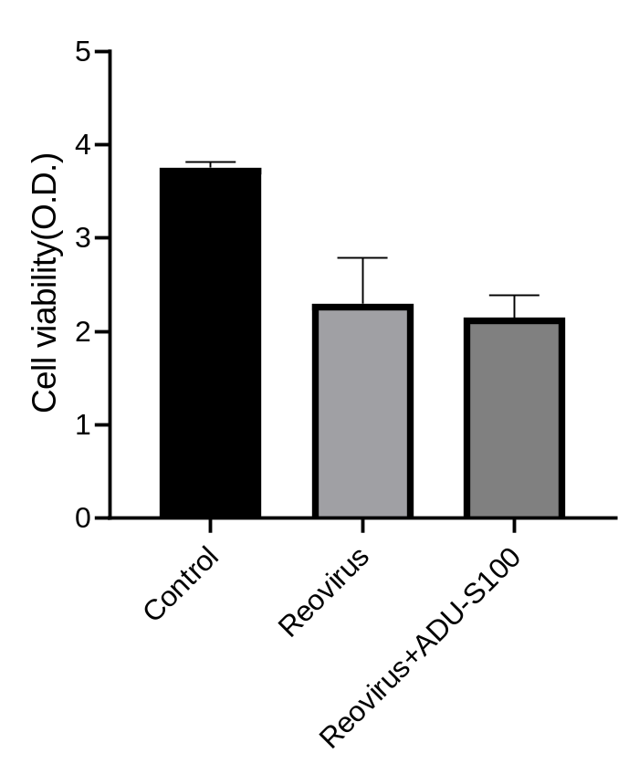
Supplemental figure 1
****
****
Supplemental Figure 1. The efficacy of reovirus and ADU-S100 against CT26 cells.
Murine colon cancer cells CT26 were plated in 96-well plates, treated with reovirus at a multiplicity of infection (MOI) of 10 with or without 10 μg ADU-S100, and cell proliferation was measured by WST-8 assay, n=5, ****p <0.0001, vs control. Data are presented as the means ± SD.

Slide 2
Supplemental Figure 2
****
****
Supplemental Figure 2. Expression of IFN-β mRNA in CT26 cell lines exposed to ADU-S100.
Expression of IFN-β mRNA in CT26 cells incubated in culture media supplemented with 10 μg or 50 μg ADU-S100 in a time course was evaluated by RT-PCR, n=5. ****p <0.0001.

Slide 3
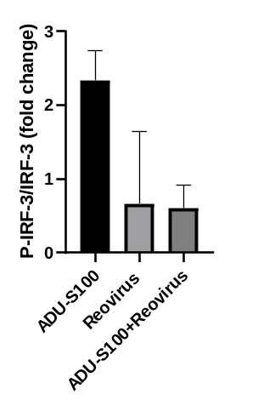
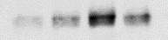


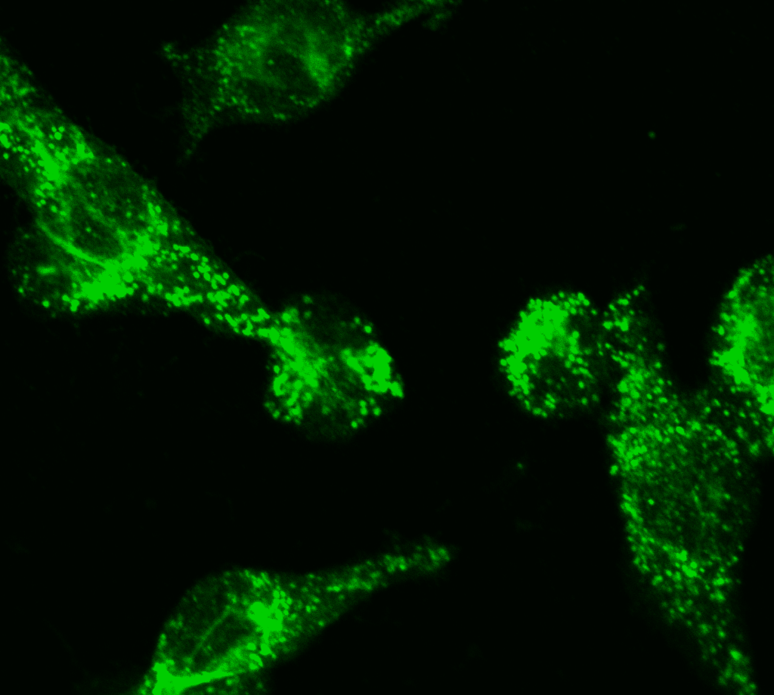
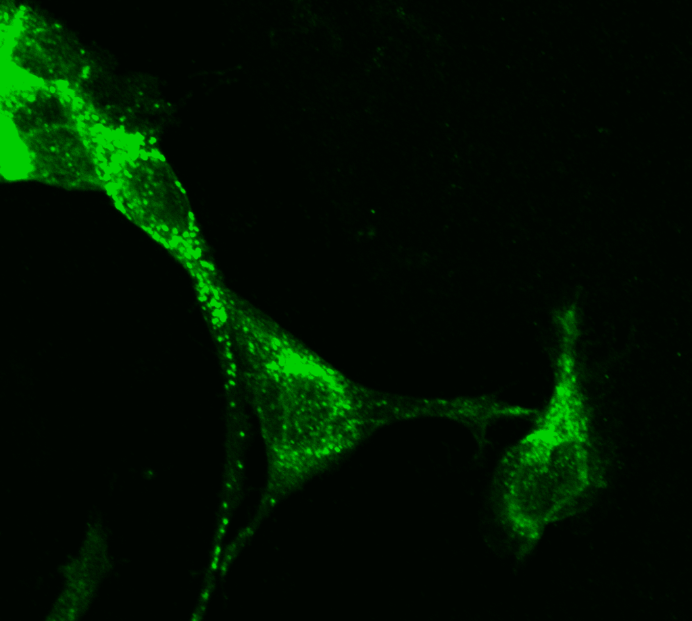
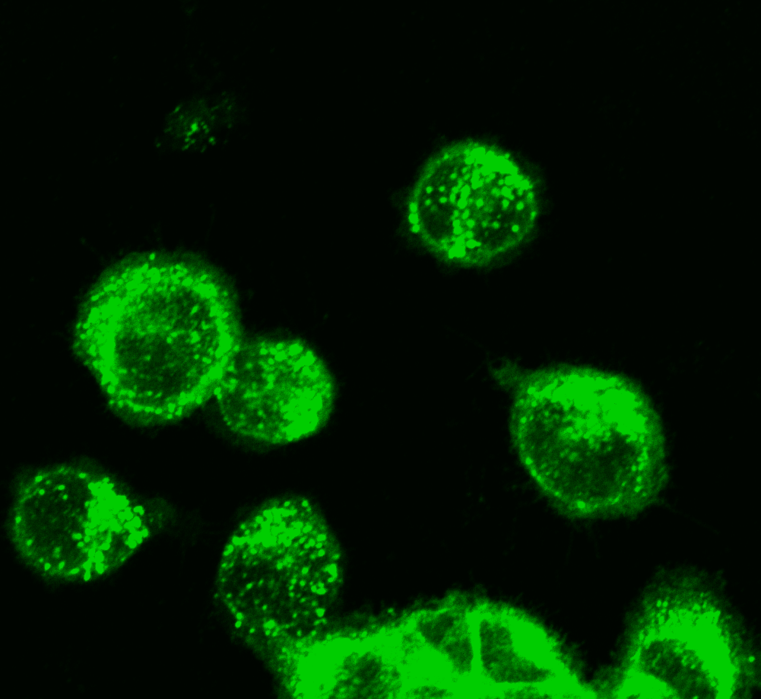
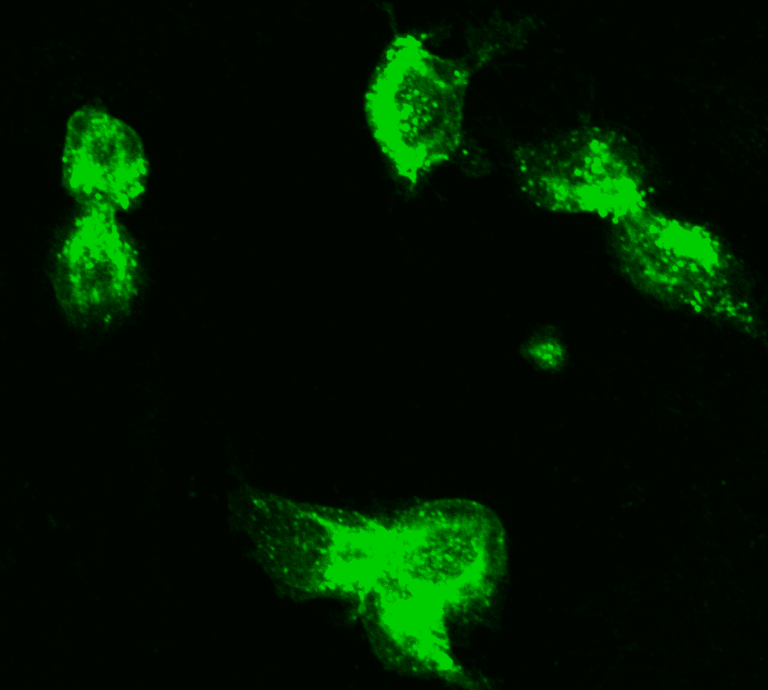
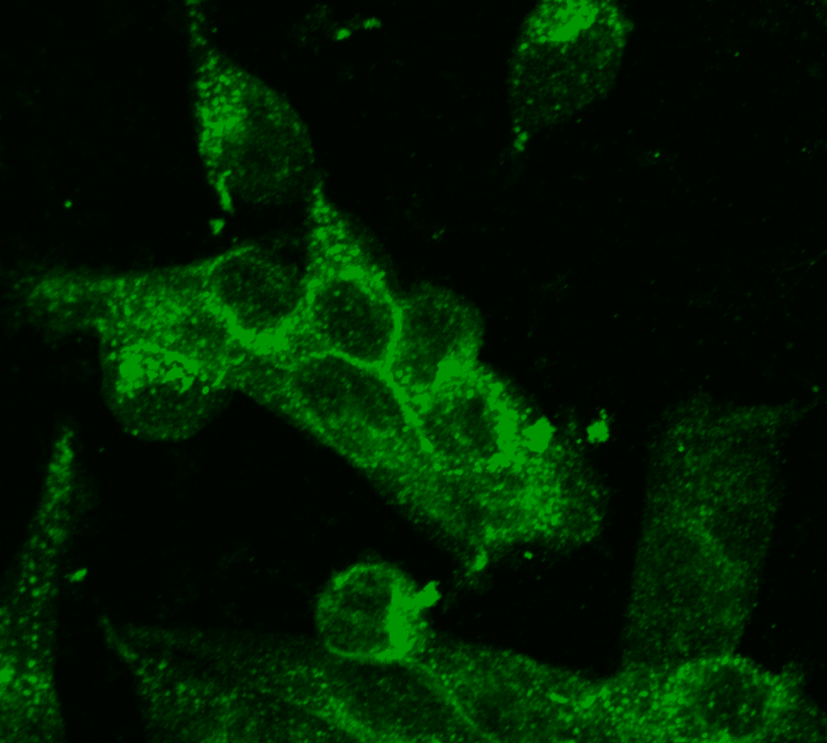
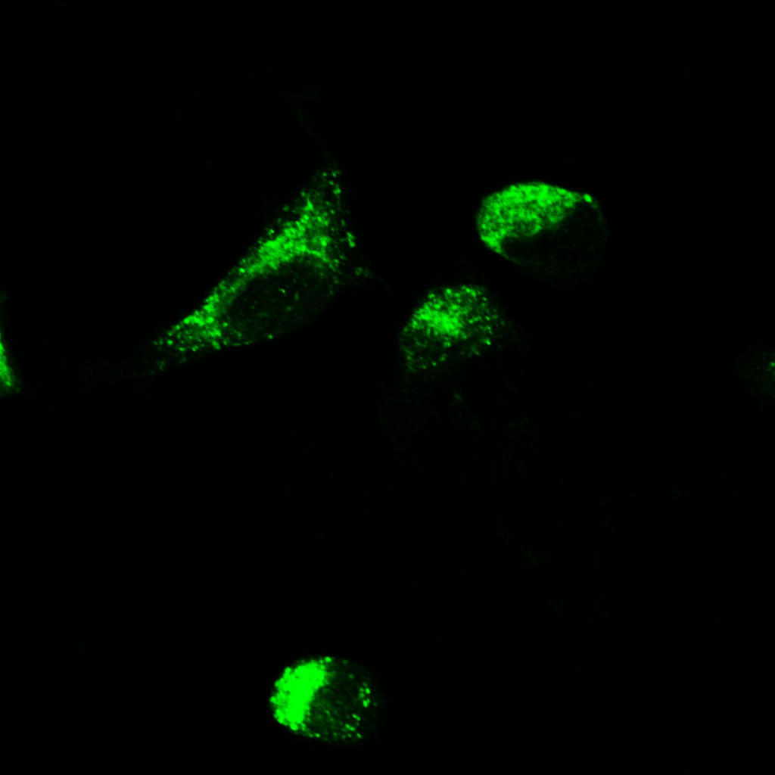
Supplemental figure 3
A
B
*
ADU-S100
Reovirus
ADU-S100
+Reovirus
*
0
1
2
6
0
1
2
6
0
1
2
6
P-IRF-3
(h)
IRF-3
β-actin
C
0h
1h
2h
D
****
Control
****
****
Reovirus
ADU-S100
ADU-S100
+Reovirus
Supplemental Figure 2. Activation of STING signaling in MC38 cells.
(A) Protein extracts from MC38 cells incubated in culture media supplemented with 50 μg ADU-S100, reovirus at a multiplicity of infection (MOI) of 10, or a combination of them were immunoblotted with anti-phospho-IRF3 and anti-IRF3 antibodies. β-actin is shown as a loading control. (B) The ratio of quantified P-IRF-3 and IRF-3 of western blot images of MC38 cells exposure to 50 mg ADU-S100 and/or reovirus at an MOI of 10 for 2 hours were quantified using ImageJ software, n=3. *p <0.05 vs control. (C) Nuclear translocation of IRF3 in MC38 cells incubated in culture media supplemented with or without 50 μg ADU-S100 and/or reovirus at an MOI of 10 was evaluated by fluorescence immunostaining using an anti-IRF3 antibody. Scale bars: 10 μm. (D) Expression of IFN-β mRNA in MC38 cell lines incubated in culture media supplemented with or without reovirus at an MOI of 10 and/or 10 μg ADU-S100 for 2 hour was evaluated by RT-PCR, n=5. ****p <0.0001.

Slide 4
Supplemental figure 4
Days post implantation
9
12
14
16
ADU-S100
Reovirus
*
Supplemental Figure 4. Kaplan-Meier survival curve of mice with treatment.
5.0×10⁶ CT26 cells were subcutaneously injected into the right flank of BALB/c mice (5 per group). ADU-S100 IT injection was performed nine days after transplantation of tumor cells in mice. IT treatment with reovirus was conducted with or without administration of ADU-S100 on days 12, 14, and 16 after transplantation of tumor cells in mice.
Kaplan-Meier survival curve of the different treatment groups (5 mice per group). Mice were categorized as dead when tumor volume reached 2,000 mm³, *p <0.05 vs control.

Slide 5
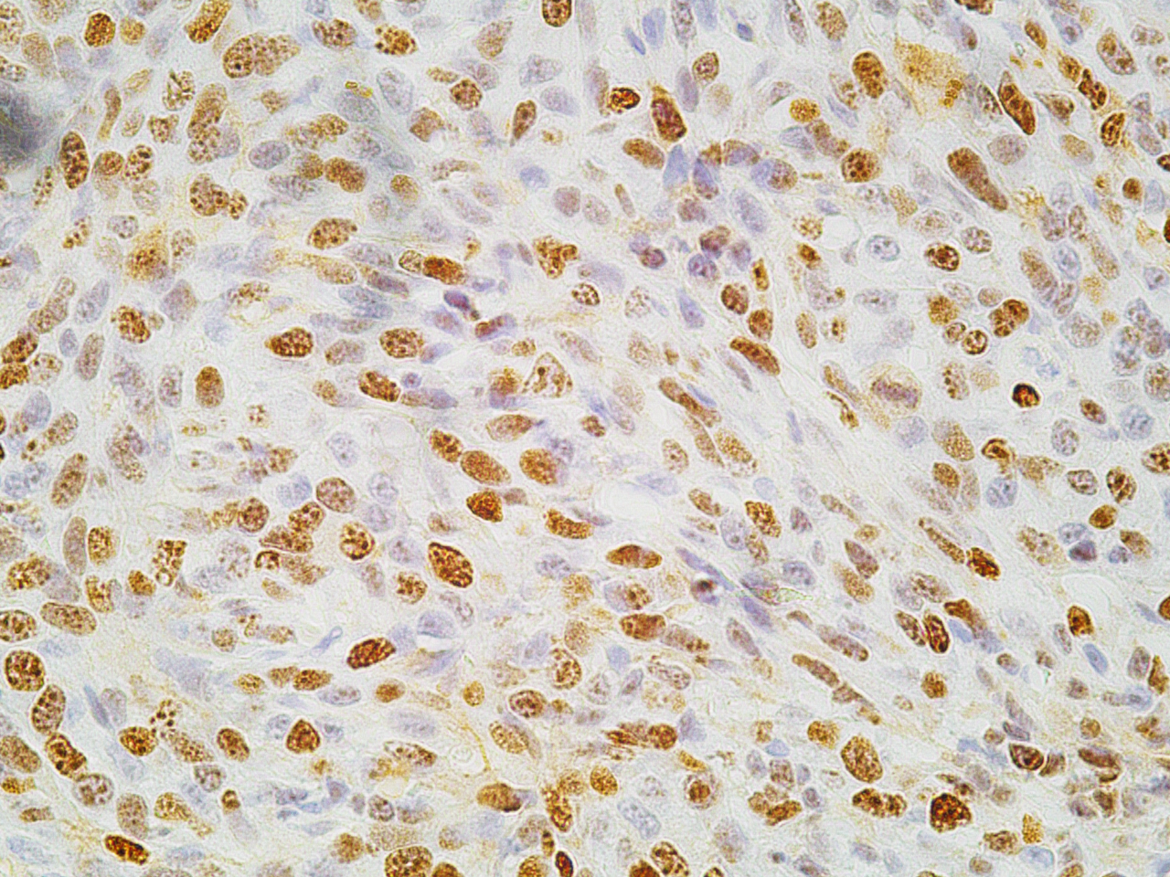
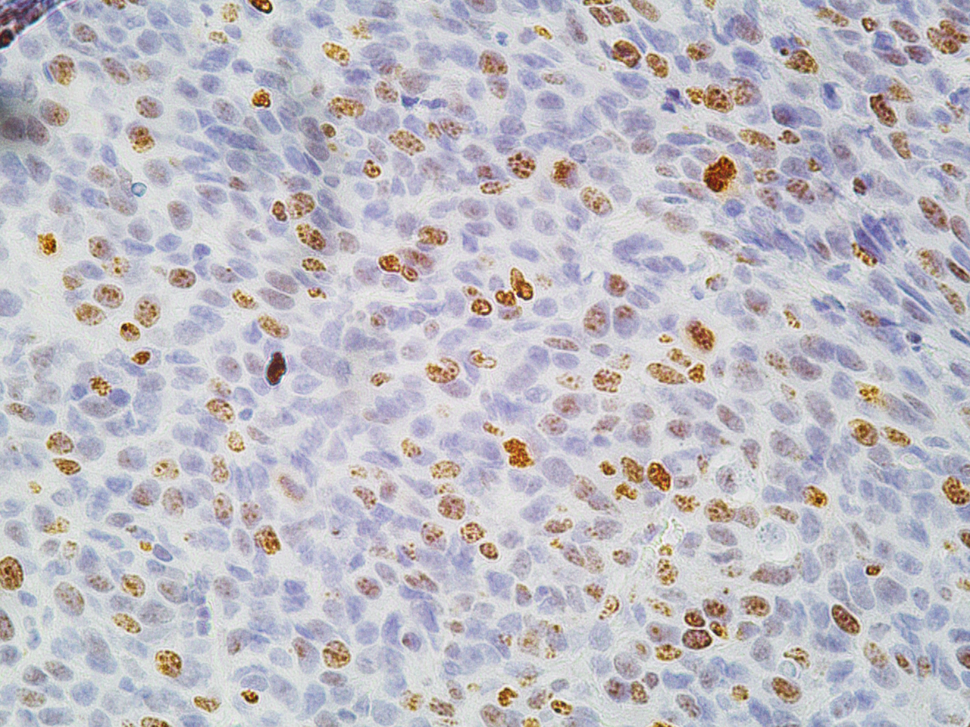
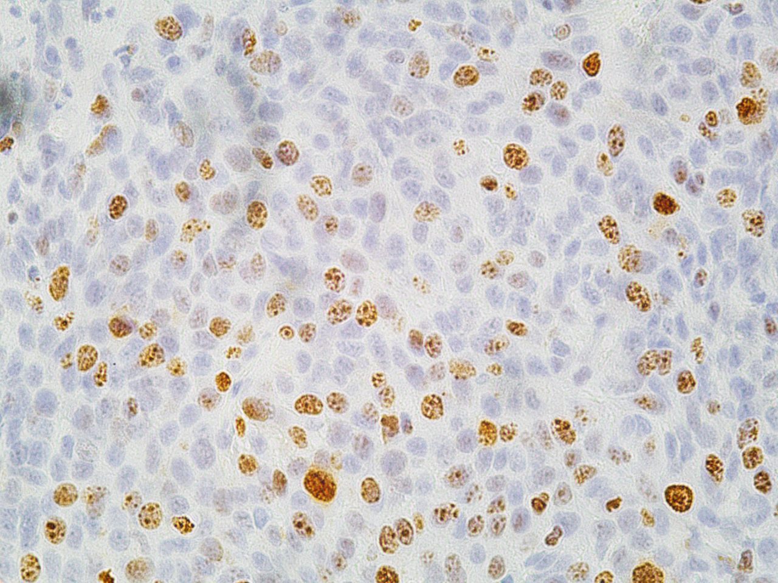
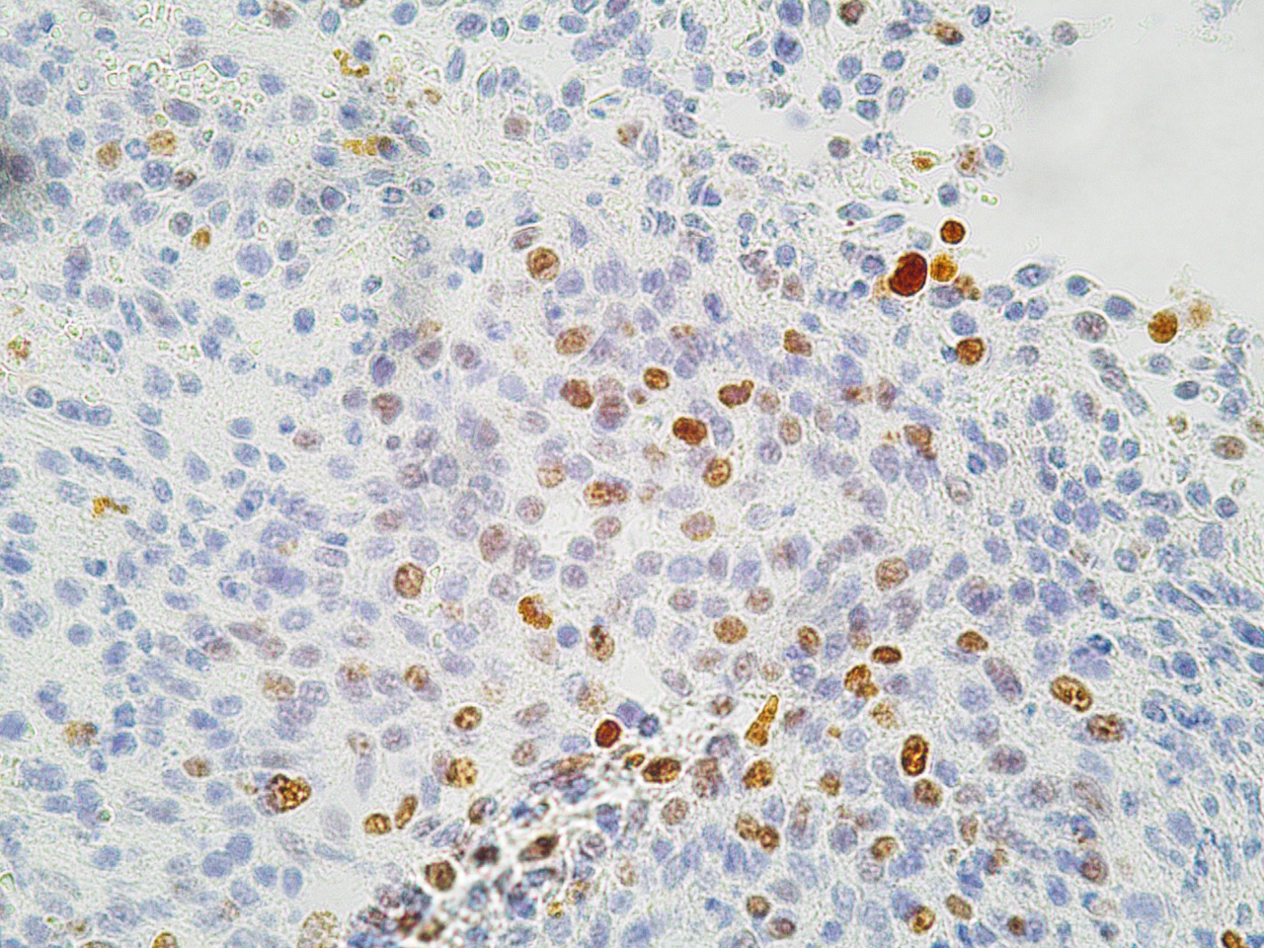
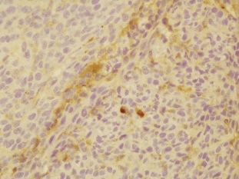
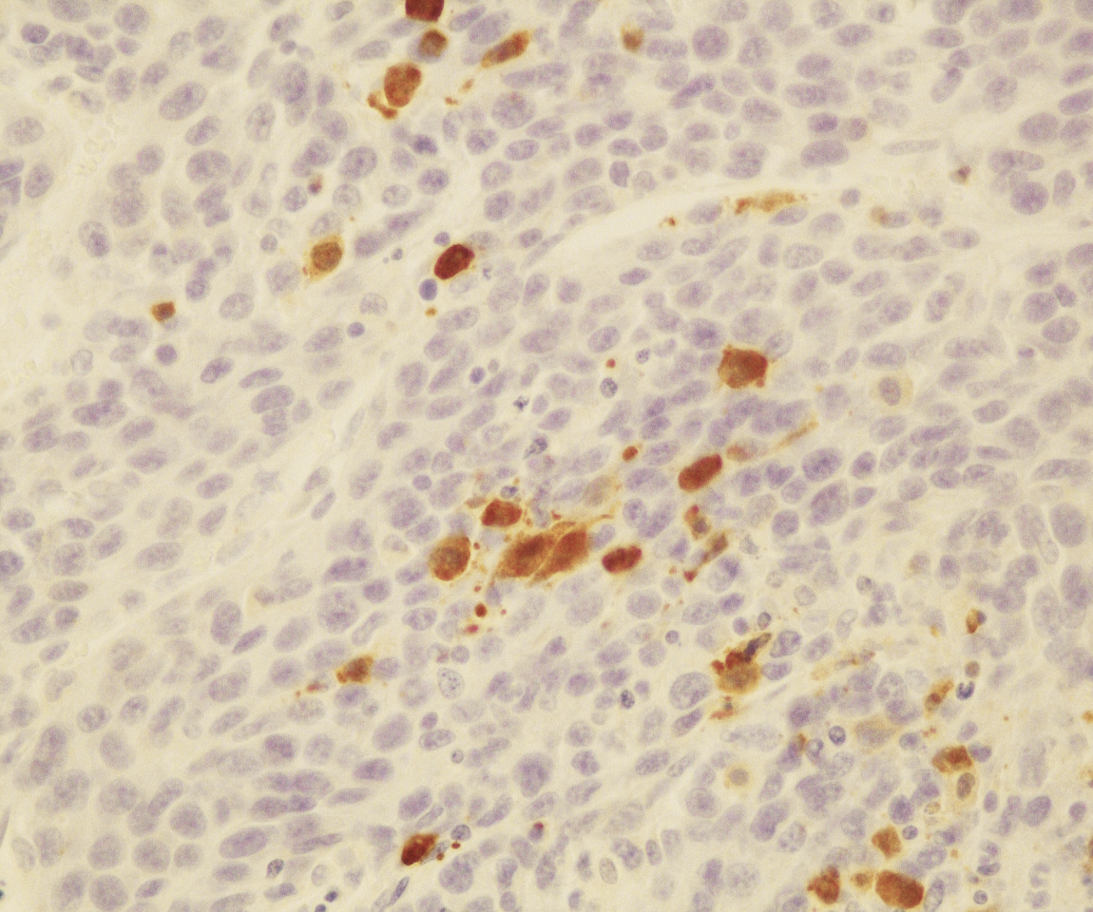
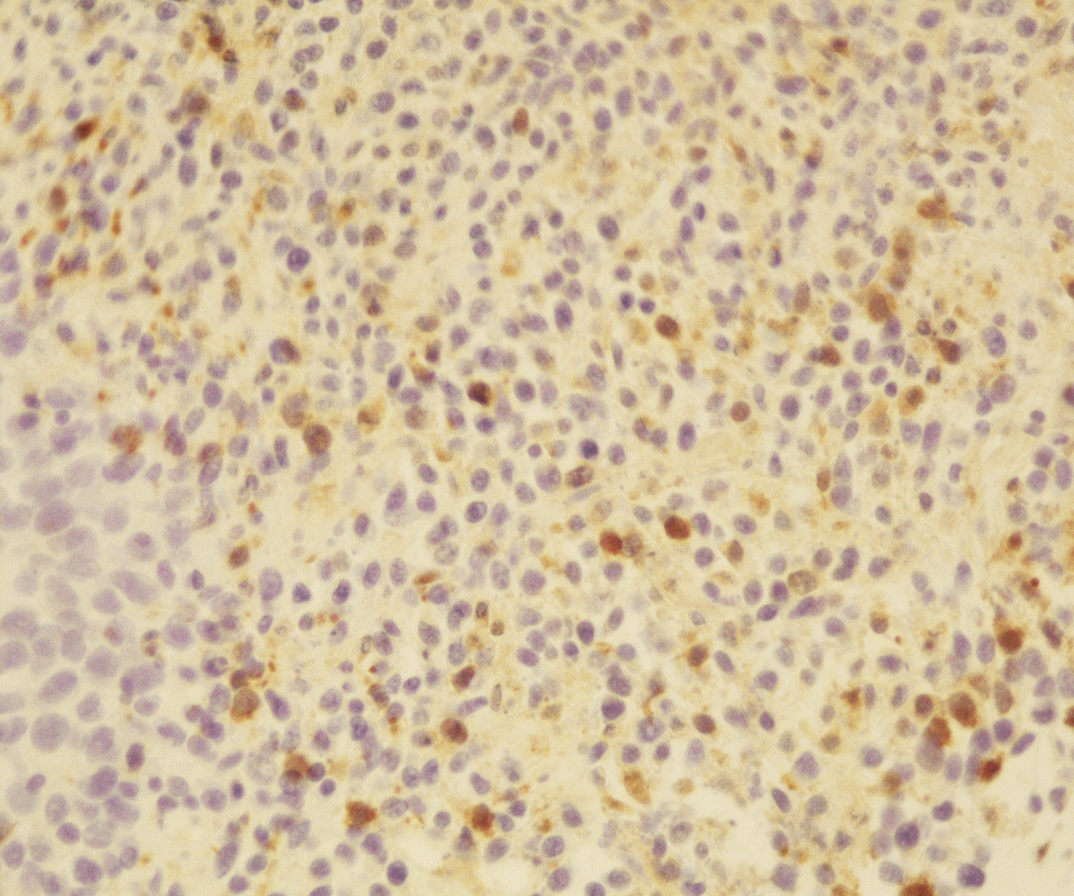
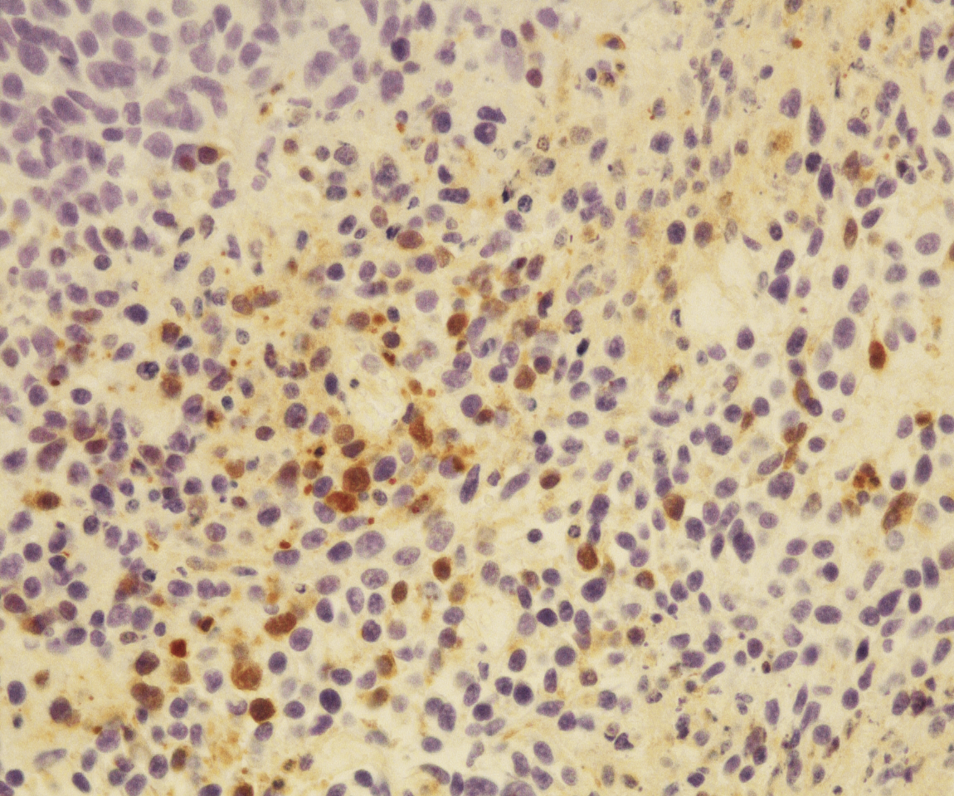
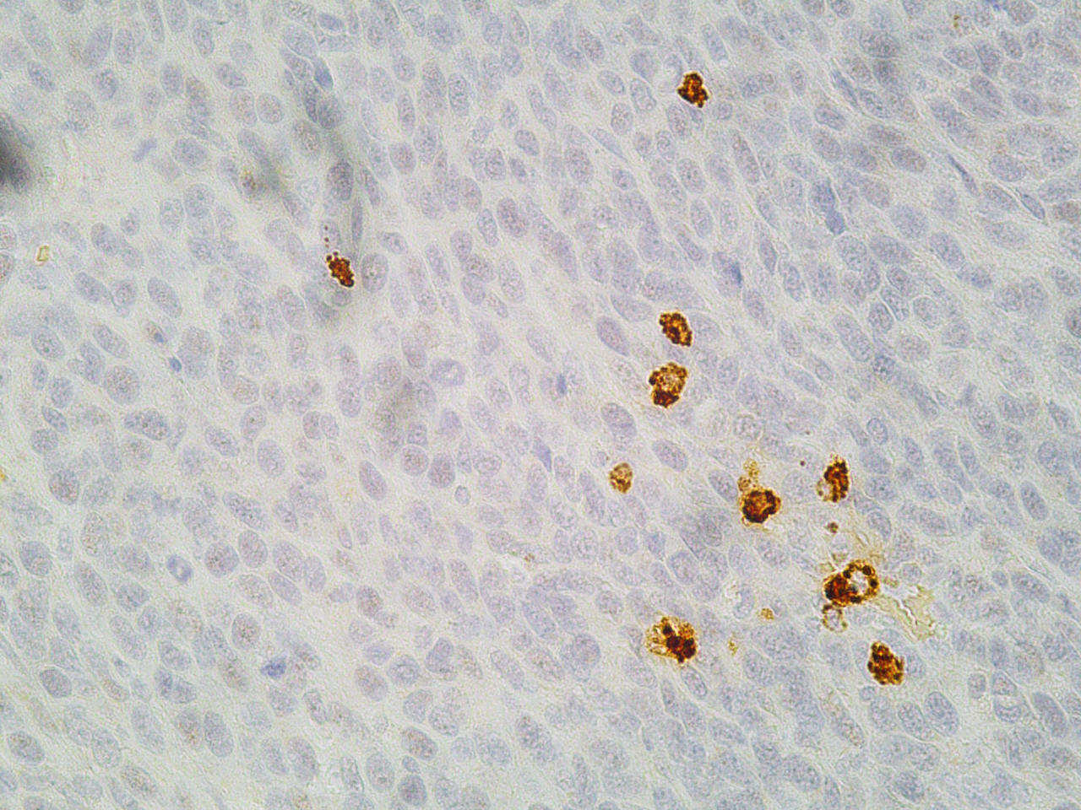
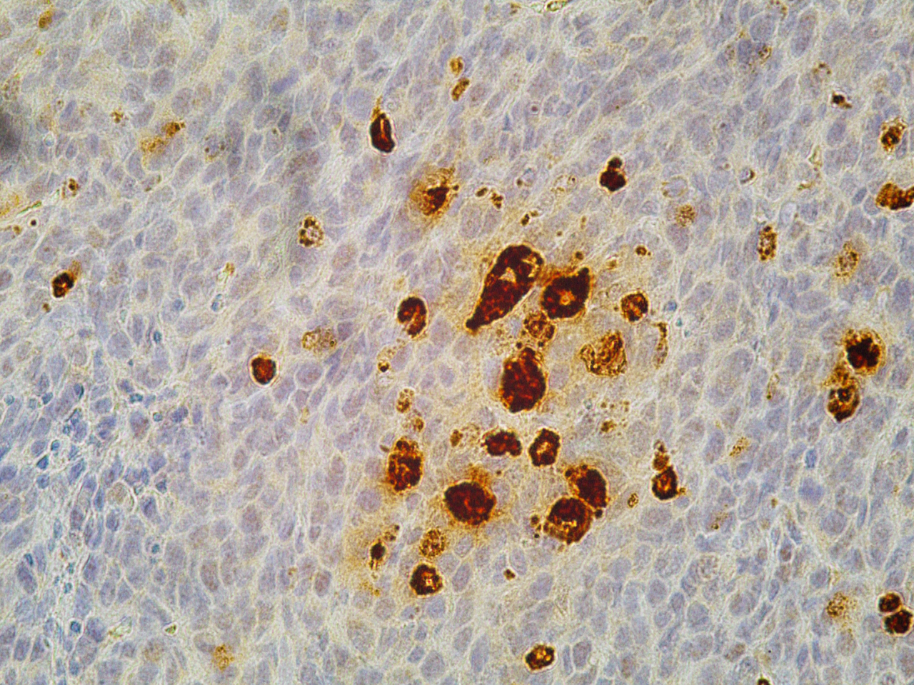
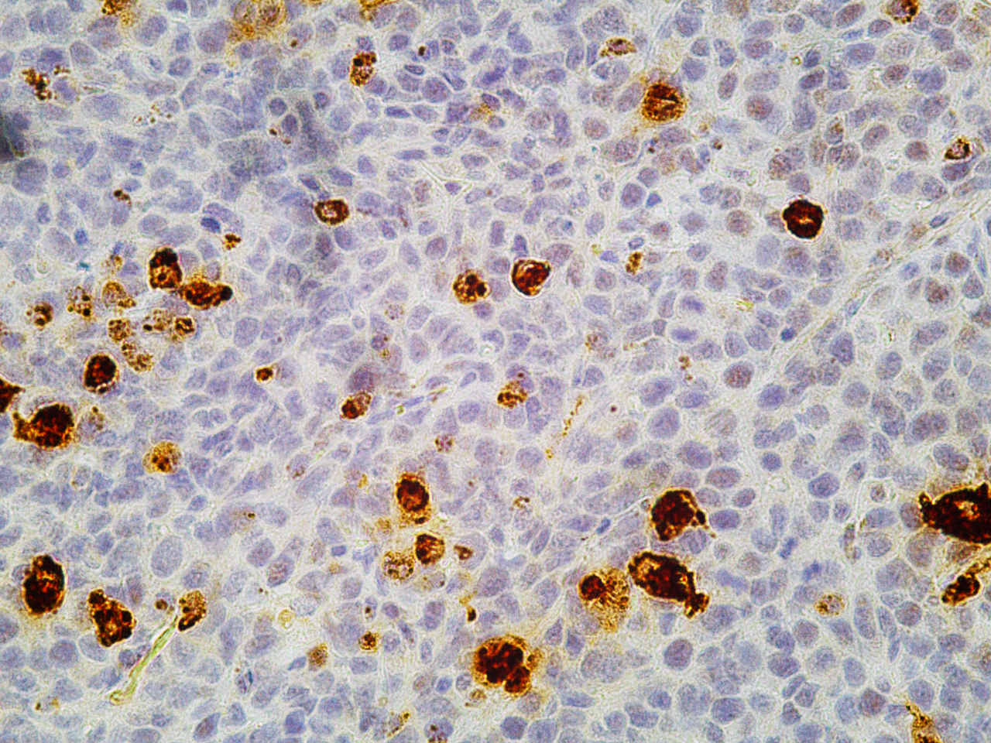
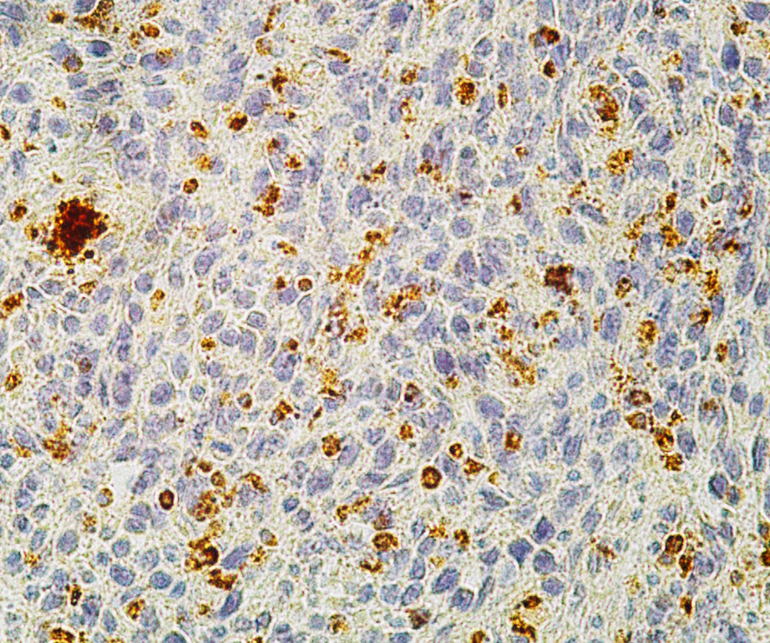
Supplemental figure 5
Control
Reovirus
ADU-S100
ADU-S100+Reovirus
Ki 67
Cleaved Caspase-3
Granzyme B
Supplemental Figure 5. Immunohistochemical staining of the tumors.
Immunohistochemical staining images of Ki-67, cleaved-caspase 3, and granzyme B of the tumors extracted from CT26-mice treated with an IT injection of reovirus at an MOI of 10 with or without an IT injection of 10 mg ADU-S100 on days 19 after transplantation. Scale bars: 50 μm.

