Slide 1
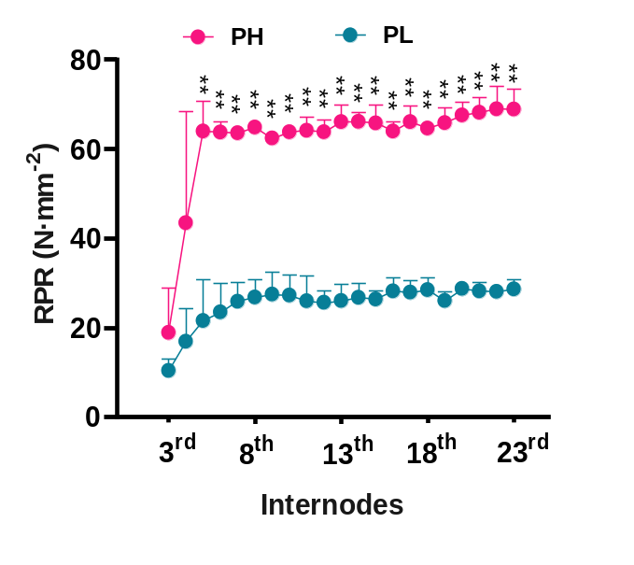
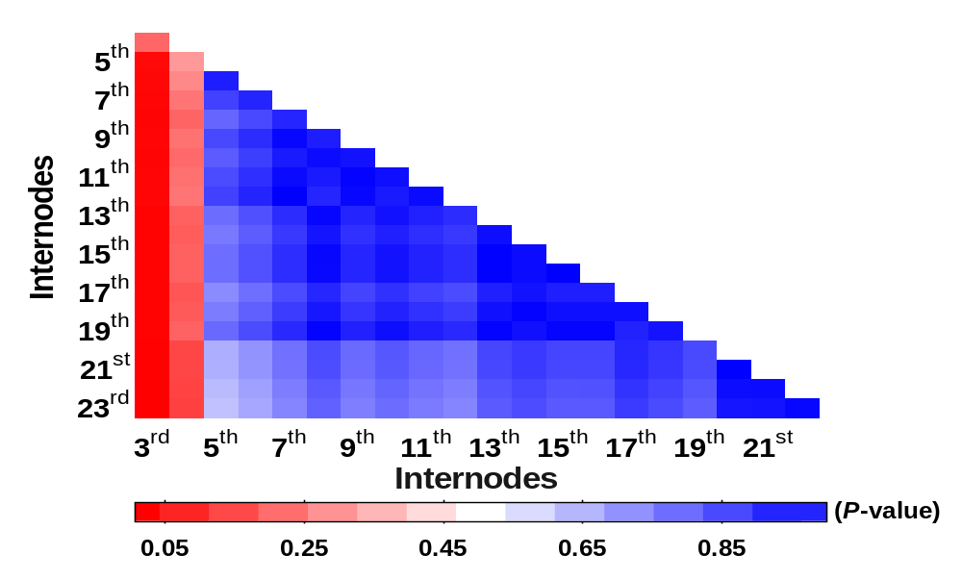
A
B
Annex 1 Analysis of RPR in sugarcane internodes. (A) Differences in RPR between the same internodes of different genotypes (values represent the mean ± SD, n=3, **p＜0.01). (B) Multiple comparison analysis of internodes RPR in sugarcane (values were calculated by one-way ANOVA and LSD test, n=6, α ≤ 0.05).

Slide 2
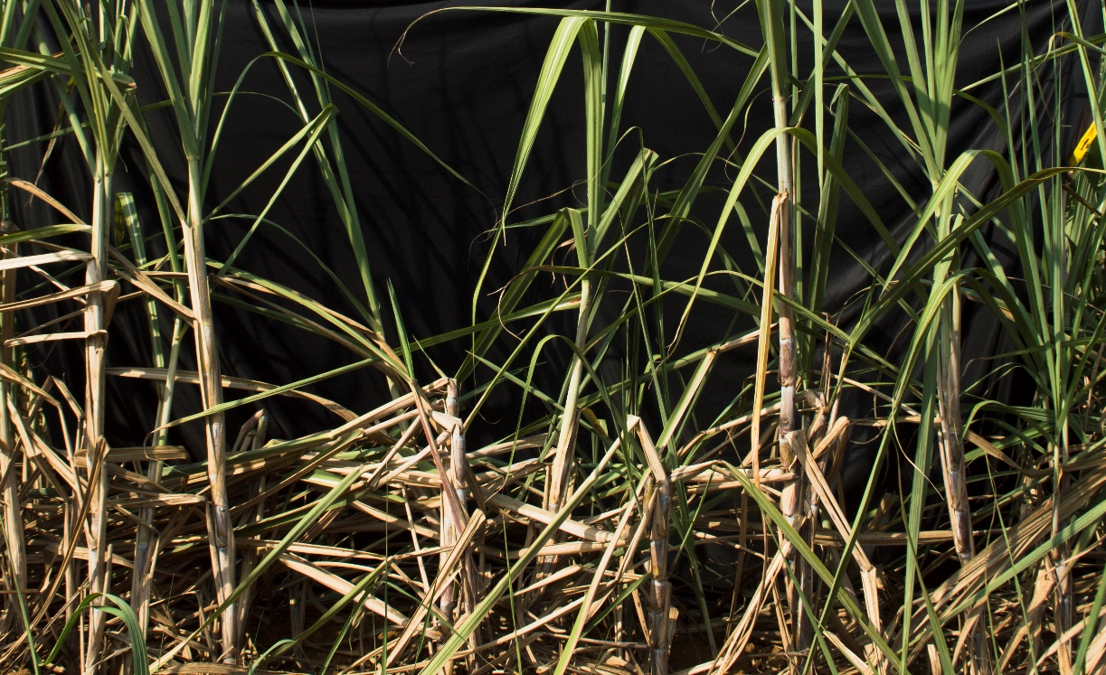

Annex 2 Greensnap of sugarcane in the field.

Slide 3
Annex 3 Diversity of mechanical strength in the sugarcane population
 | ª N | ^{b} Min | ^{c} Max | Mean | ^{d} SD | ^{e} CV
RPR (N·mm⁻²)
2019 | 270 | 23.5 | 79.7 | 43.7 | 8.29 | 0.19
2020 | 256 | 22.8 | 59.7 | 40.5 | 6.51 | 0.16
Breaking force (N)
2019 | 440 | 6.6 | 36.8 | 20.1 | 5.95 | 0.30
RPR, rind penetrometer resistance; ª N, sample number; ^{b} Min, minimum value; ^{c} Max, maximum value; ^{d} SD, standard deviation; ^{e} CV, coefficient of variation.

Slide 4
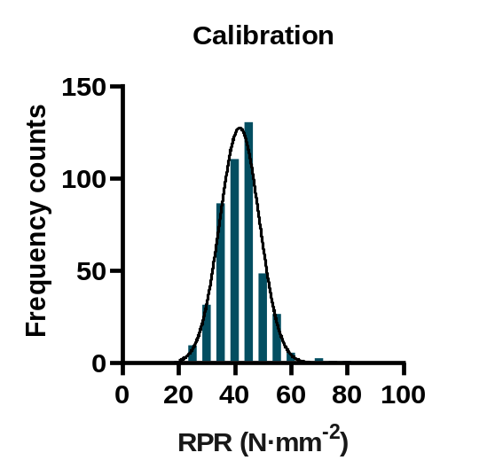
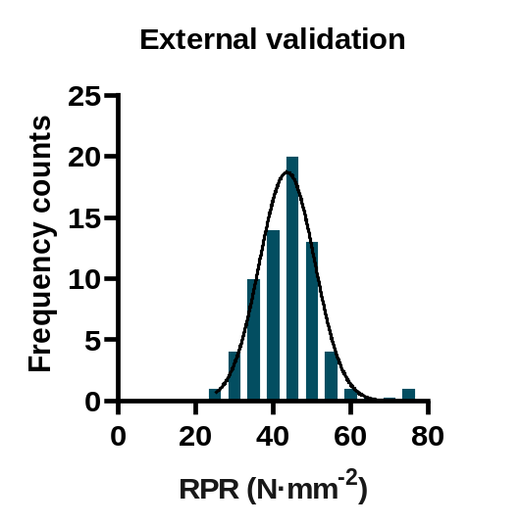
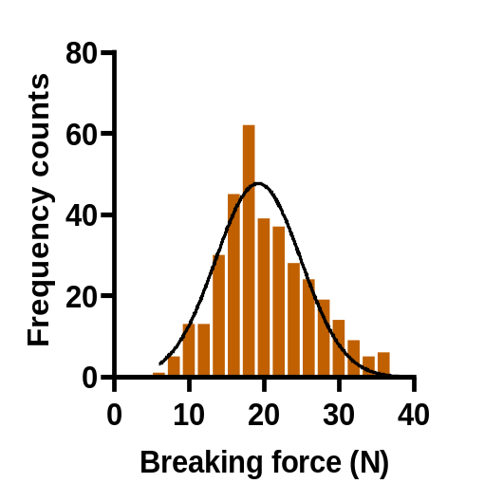
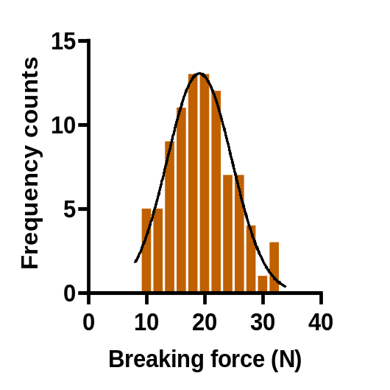
A
B
C
D
Annex 4 Statistics of sugarcane samples for calibration and external validation. (A, C) Frequency distribution of samples for calibration of RPR (A) and breaking force (C). (B, D) Frequency distribution of samples for external validation of RPR (B) and breaking force (D). RPR: rind penetrometer resistance.

Slide 5
Annex 5 Statistics for generated equations for RPR and breaking force in sugarcane stalks
 | Calibration |  |  |  |  |  |  |  |  |  | Cross-validation
 | Rank | N | SCM | Spectrum range | Mean | SD | RMSEC | R² | RPD |  | RMSECV | R²_{cv} | RPD
RPR (N·mm⁻²) | 22 | 526 | SNV | 5669.7-9626.9, 10406-11200.6 | 42.2 | 7.64 | 0.44 | 1.00 | 17.70 |  | 0.75 | 0.99 | 10.20
Breaking force (N) | 12 | 440 | FD+SNV | 4882.9-6464.2, 8037.9-9626.9 | 20.1 | 5.95 | 2.11 | 0.88 | 2.86 |  | 2.37 | 0.84 | 2.51
RPR: rind penetrometer resistance; N, sample number; SCM, scatter correction methods; SD, standard deviation of reference value; RMSEC, root mean square error of calibration; R², determination coeffcient of calibration; RMSECV, root mean square error of cross-validation; R²_{cv}, determination coeffcient of cross-validation; RPD, ratio of prediction to deviation; SNV, standard normal variate; FD+SNV, a combination of FD and SNV.

