Slide 1
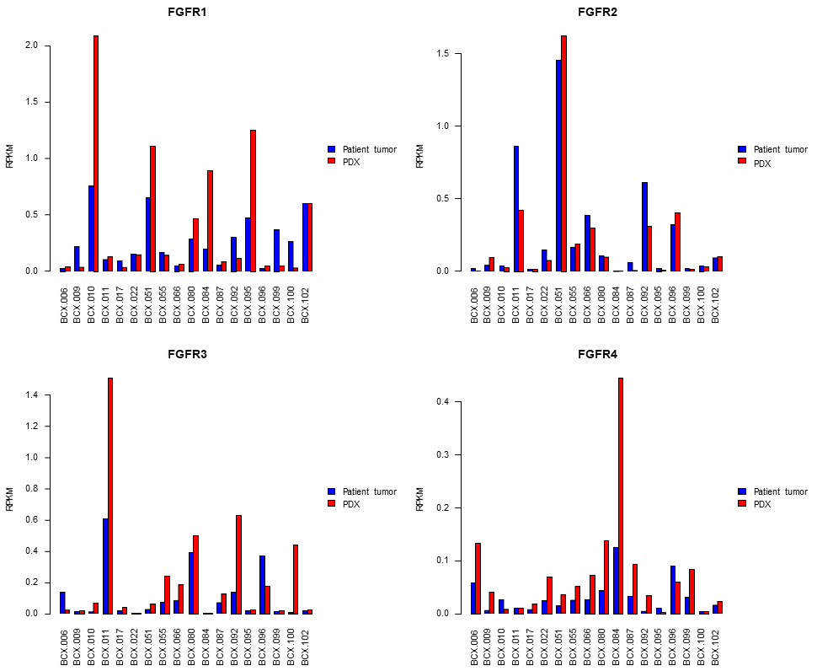
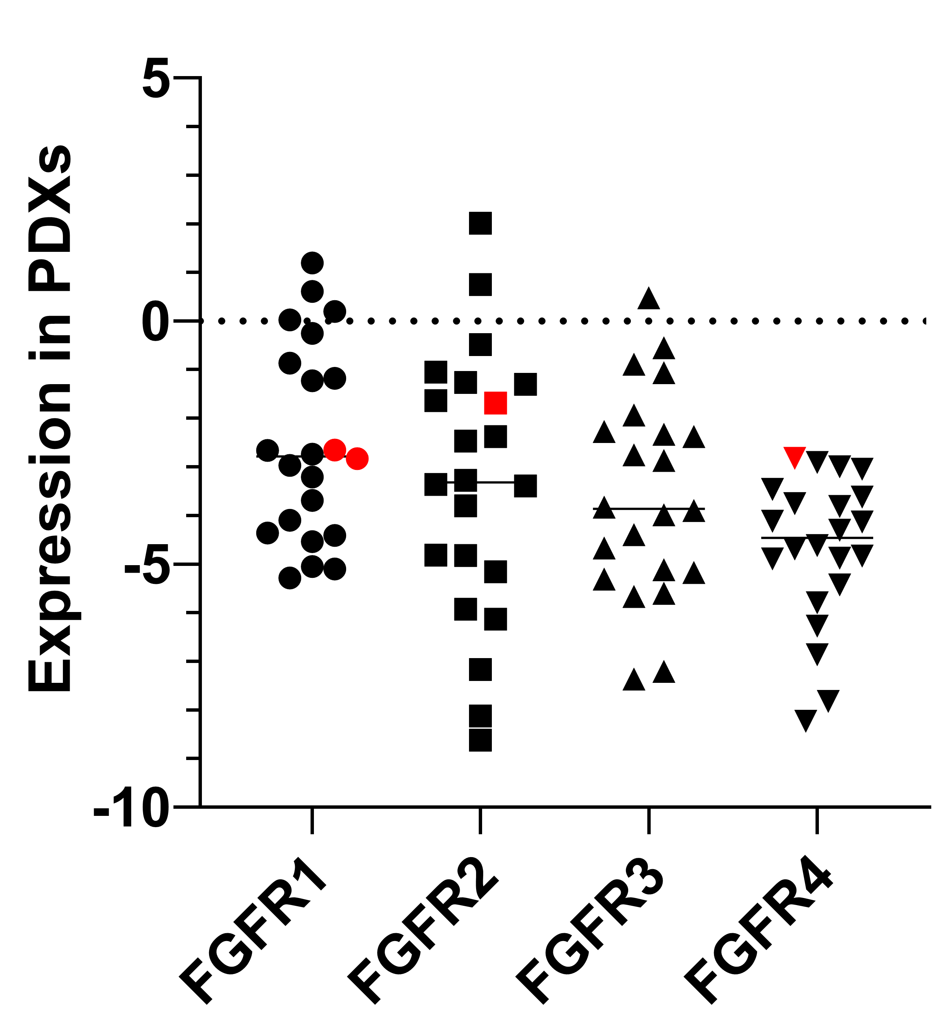
Supplementary Figure 1
a
b

Slide 2
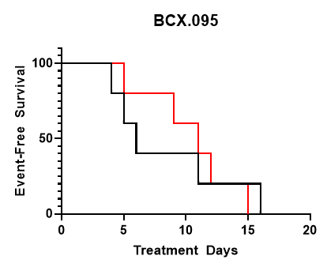
Supplementary Figure 2
a
b
c
d
e
f

