Slide 1
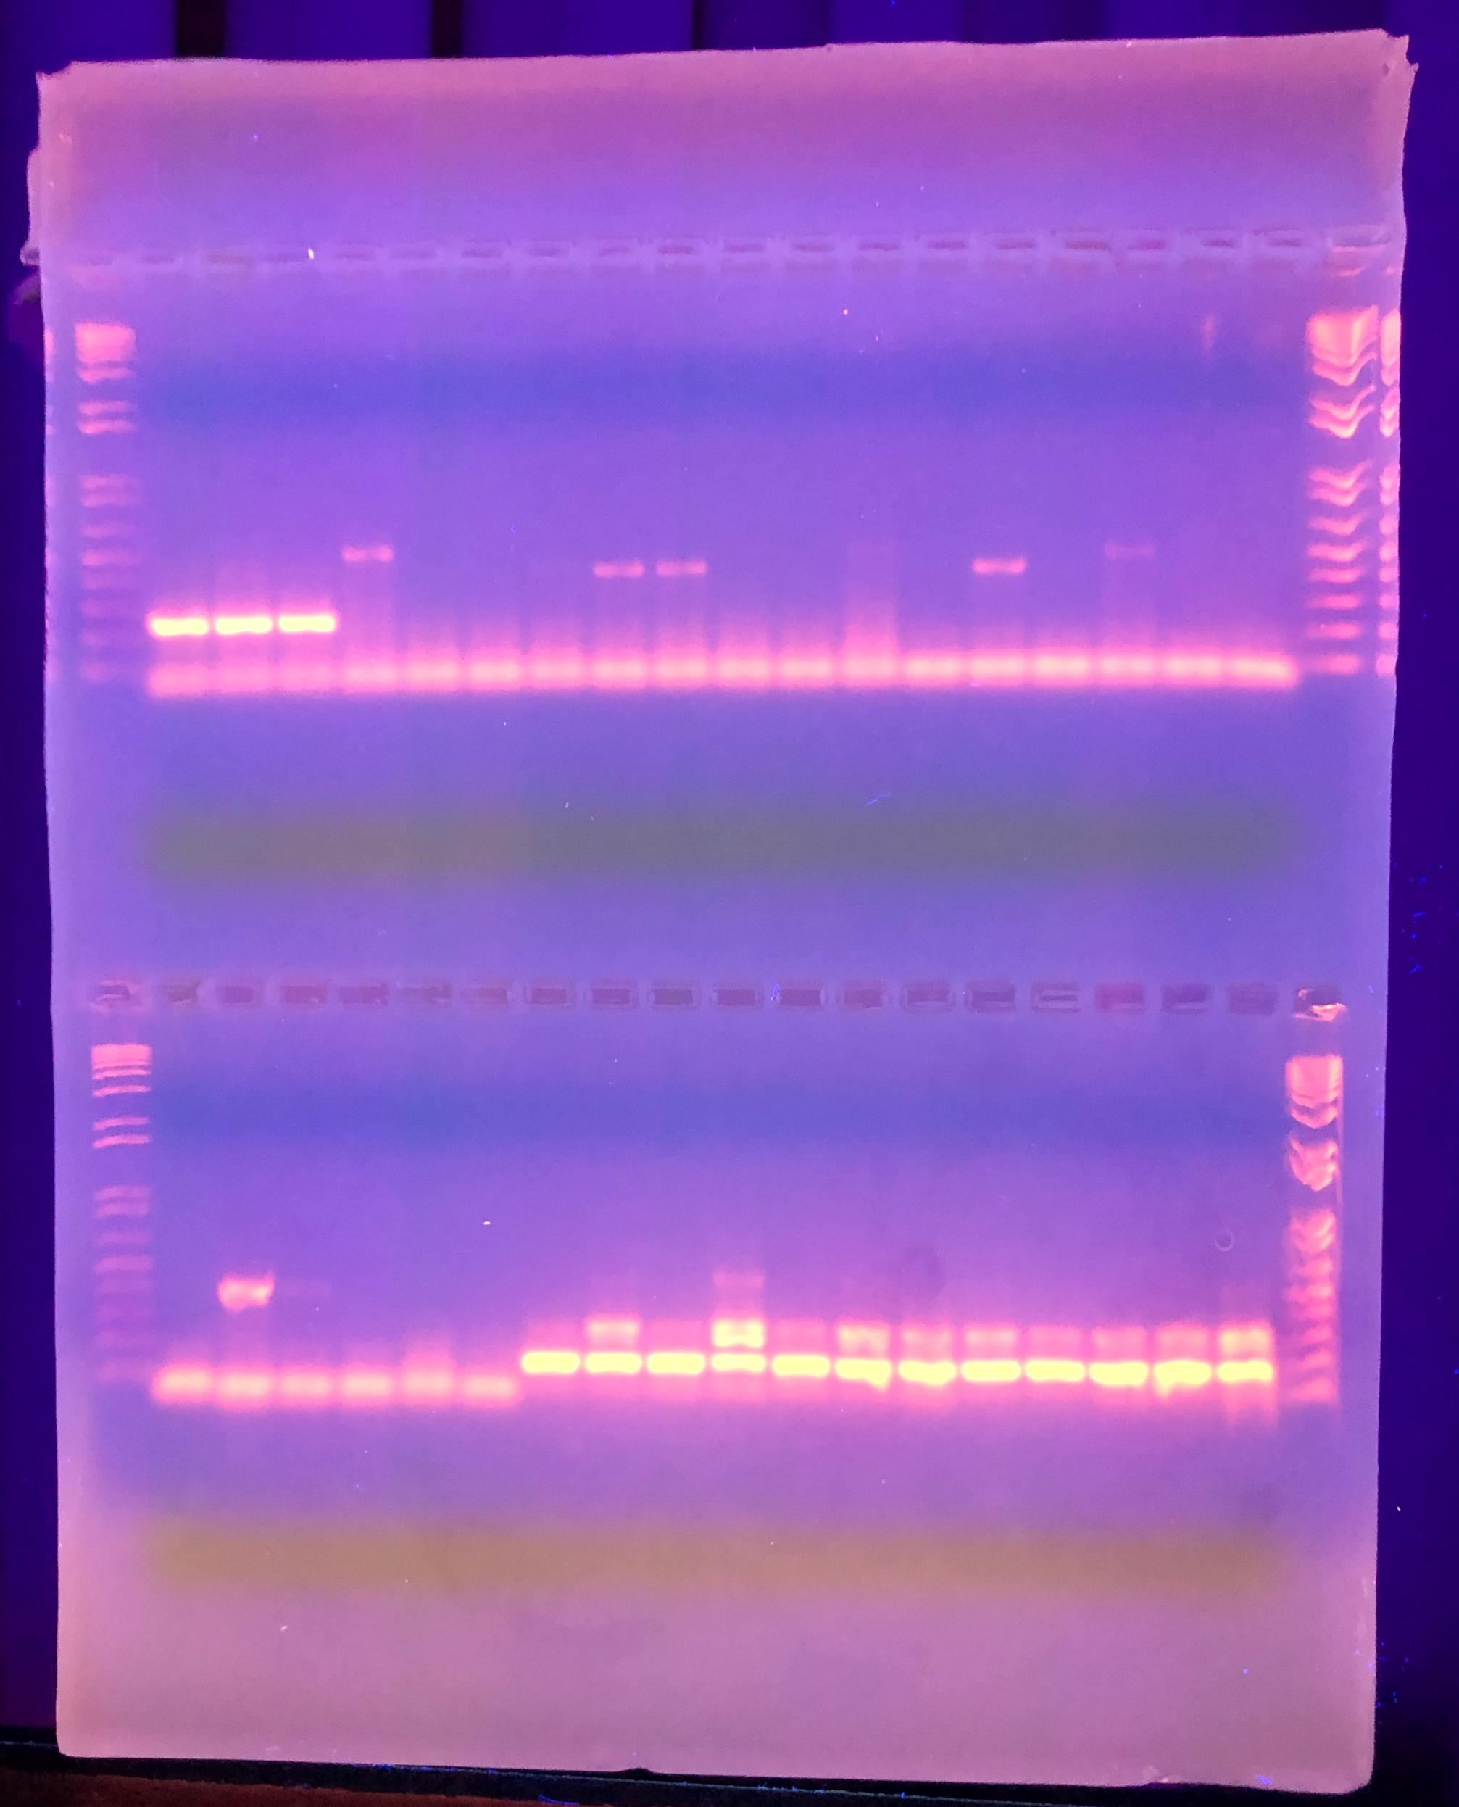
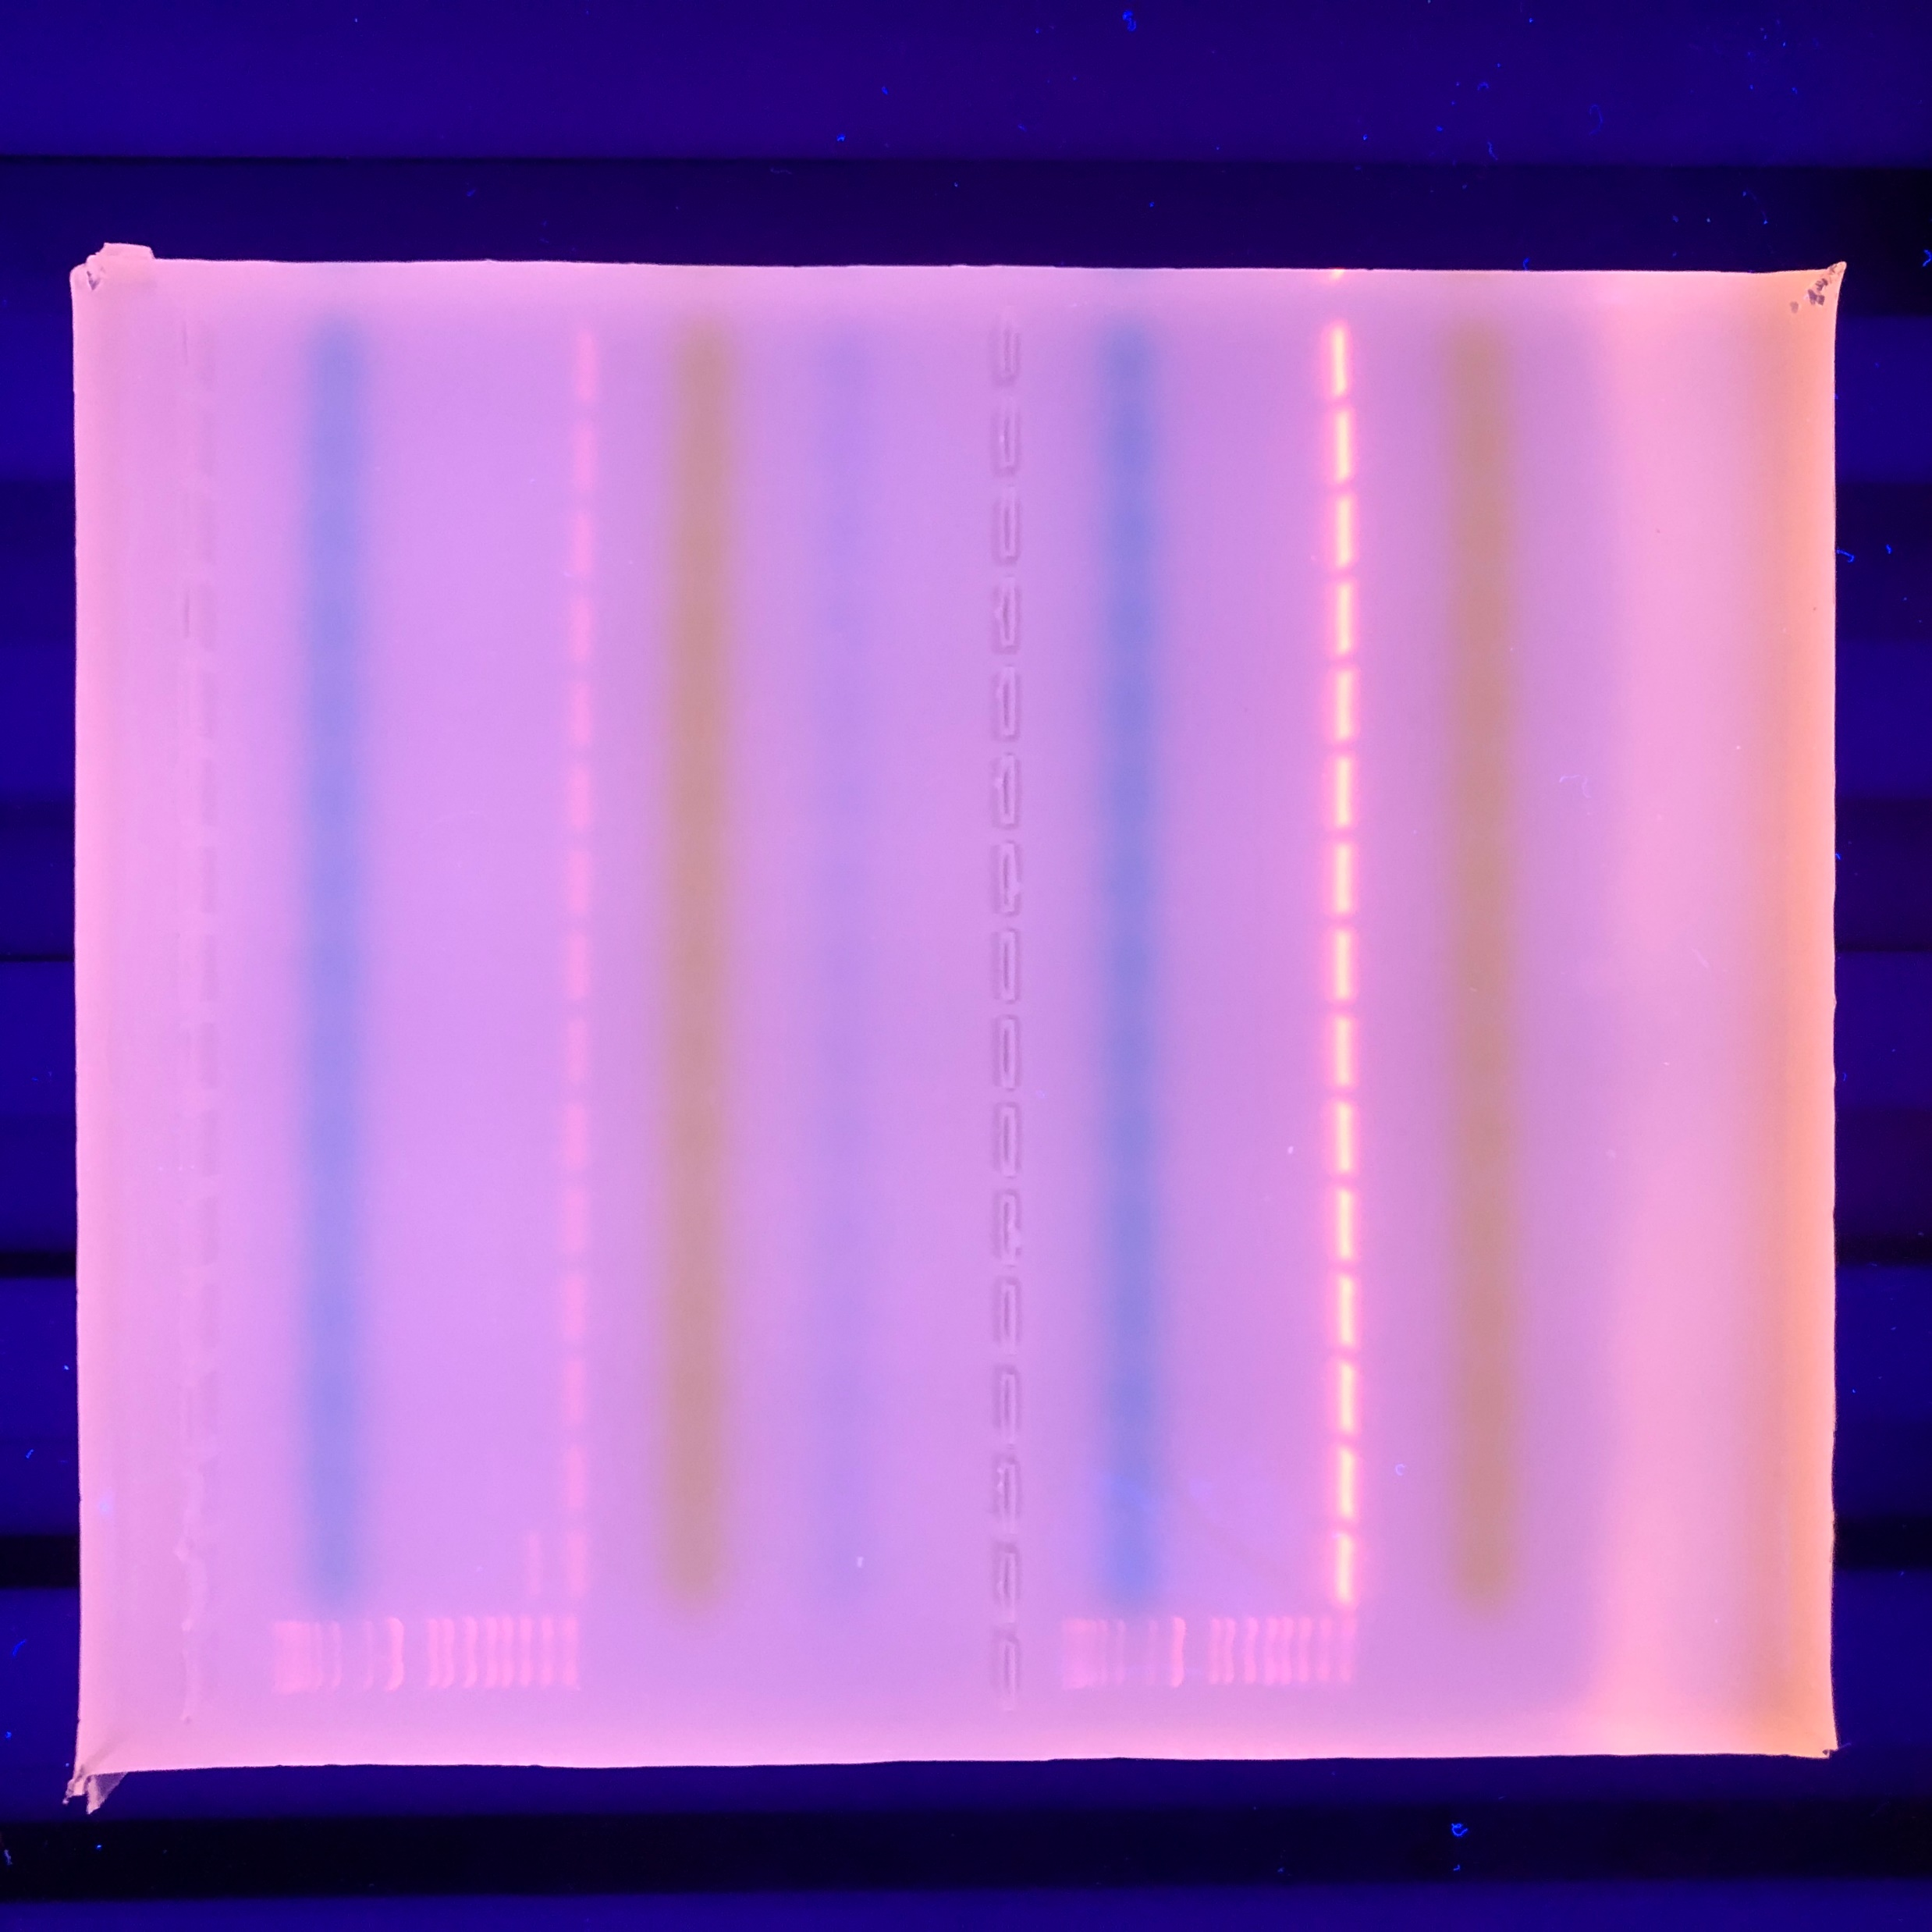
Supplemental Data
Original image for Figure 4A
Original image for Figure 4B
Original image for Figure 4C
Image not included in submission

