Slide 1
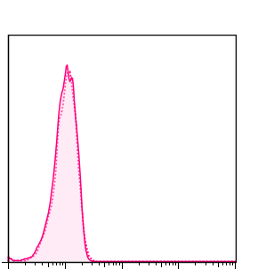
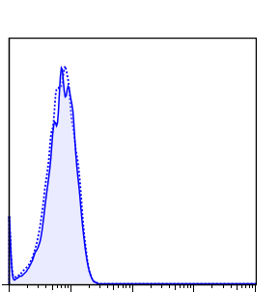
Supplementary Fig. 1
8B
9G
CD133
Isotype control
Count
Log fluorescence intensity (PE)

Slide 2
Supplementary Fig. 2
8B-tumour
CD3 DAPI
CD19 DAPI
Ly6g DAPI
Ly6c DAPI
F4/80 DAPI
CD11b DAPI
CD169 DAPI
CD11c DAPI
9G-tumour
CD3 DAPI
CD19 DAPI
Ly6g DAPI
Ly6c DAPI
F4/80 DAPI
CD11b DAPI
CD169 DAPI
CD11c DAPI

Slide 3
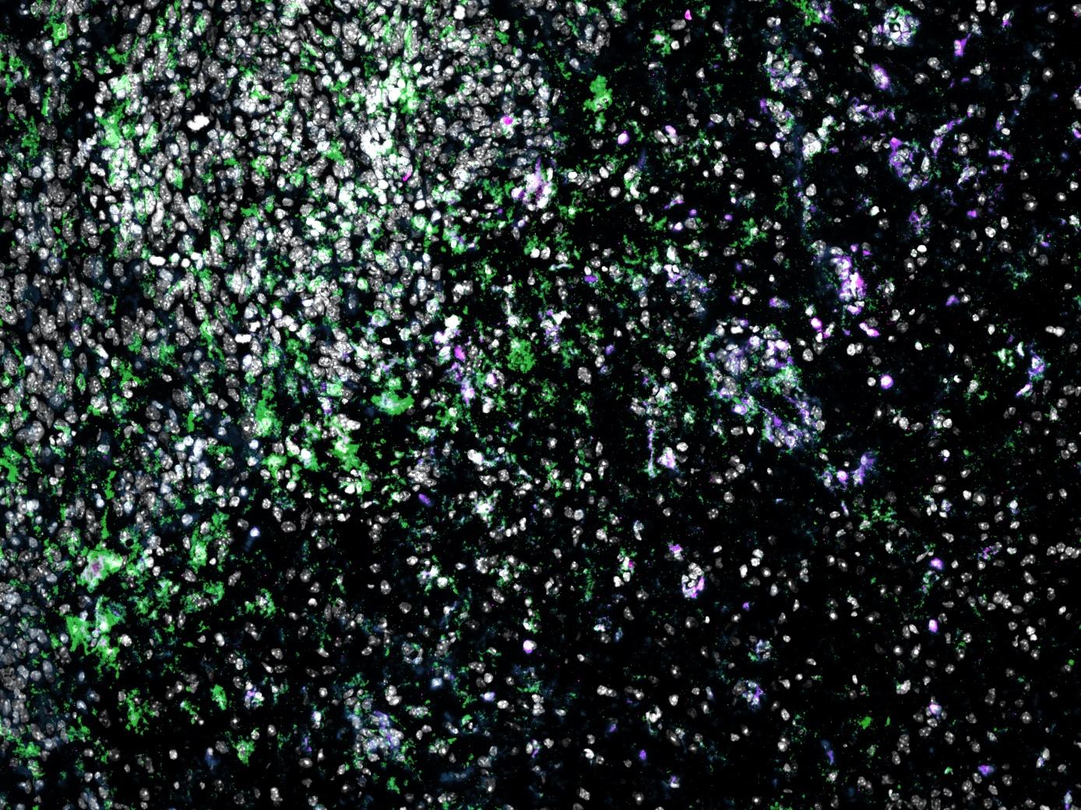
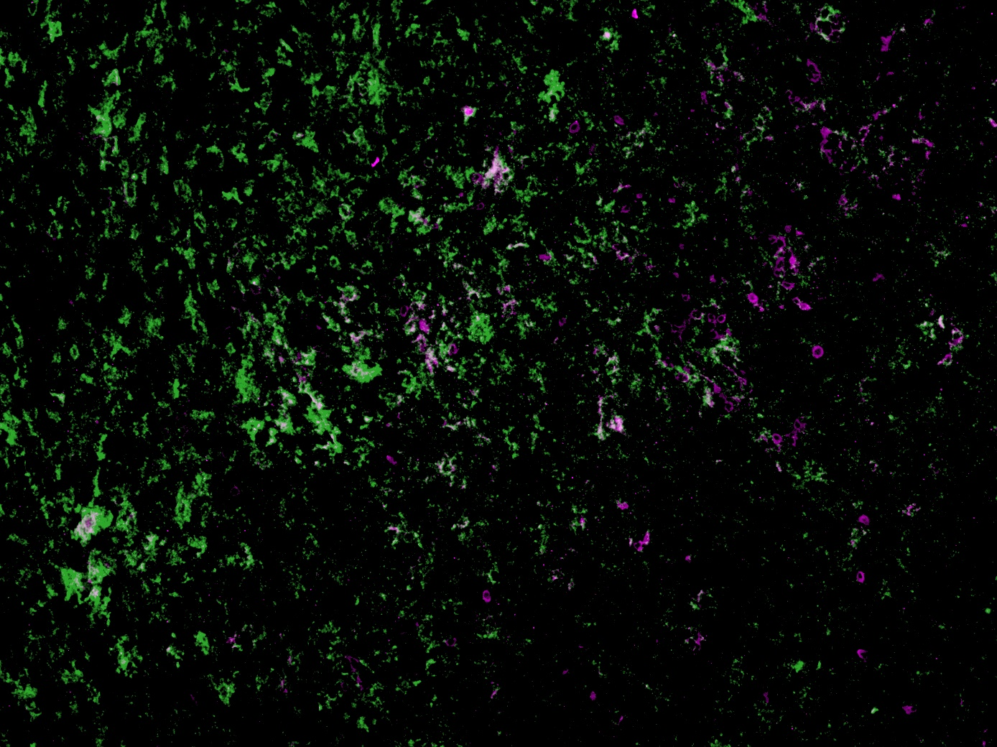
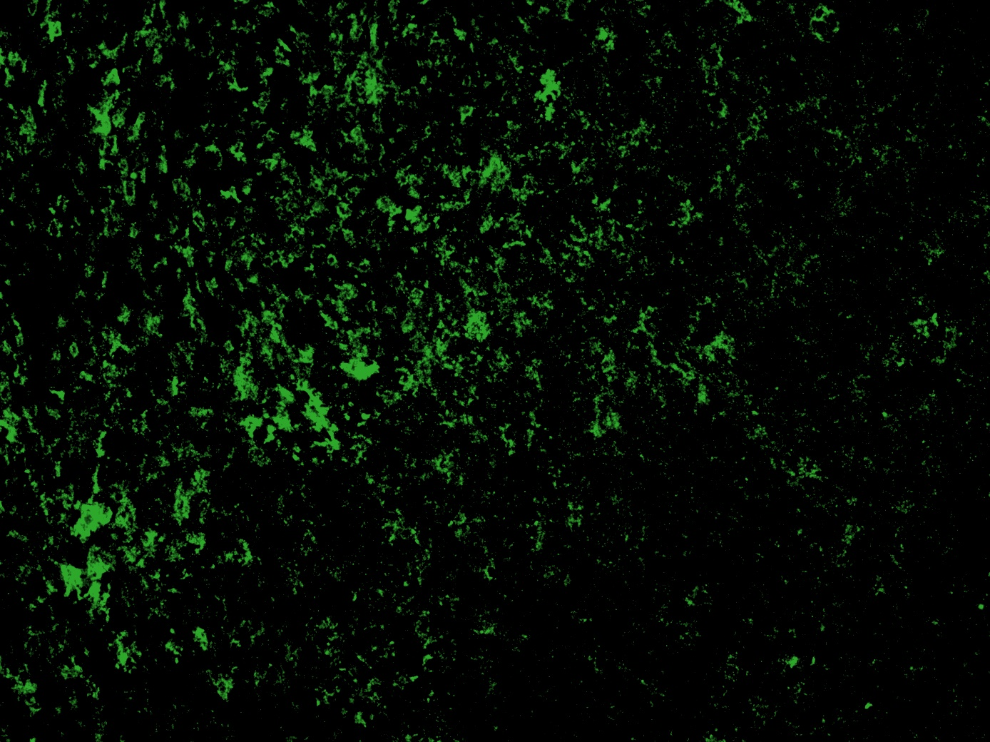
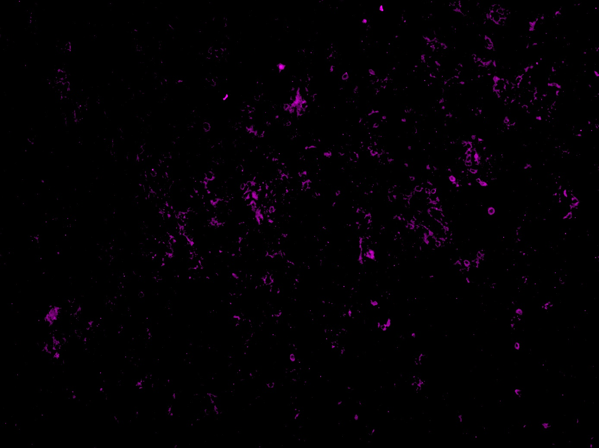
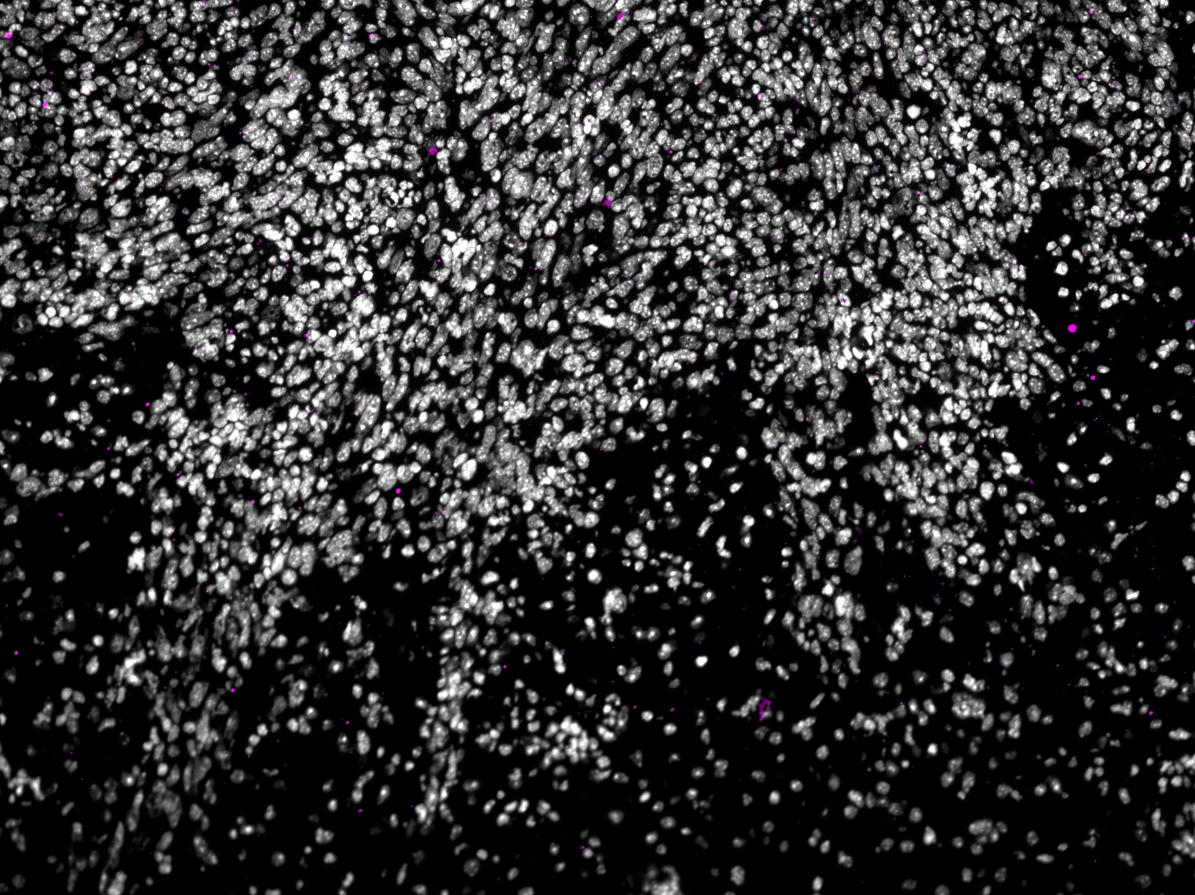



Supplementary Fig. 3
A
Tumour
Tumour
DAPI
F4/80
P2RY12
F4/80
P2RY12
Healthy region
Healthy region
Tumour
F4/80
Tumour
P2RY12
Healthy region
Healthy region
B
Tumour
DAPI
Rat IgG2a
Rat IgG2b
Tumour
Rat IgG2a
Rat IgG2b
Healthy region
Healthy region
Tumour
Rat IgG2a
Tumour
Rat IgG2b
Healthy region
Healthy region

Slide 4
Supplementary Fig. 4
A
B
Group
Frequency | Rat IgG | M1/70 | RB6 -8C5 | Total
% total |  |  | M1/70
% column |  |  | M1/70
% row |  |  | M1/70
Alive | 0 | 3 | 1 | 4
 | 0.00 | 20.00 | 6.67 | 26.27
 | 0.00 | 60.00 | 20.00
 | 0.00 | 75.00 | 25.00
Dead | 5 | 2 | 4 | 11
 | 33.33 | 13.33 | 26.67 | 73.33
 | 100.00 | 40.00 | 80.00
 | 45.45 | 18.18 | 36.36
Total | 5 | 5 | 5 | 15
 | 33.33 | 33.33 | 33.33
% survival
Result
Days post tumour inoculation
Notes:
ボンフェローニ法で補正ずみ

Slide 5
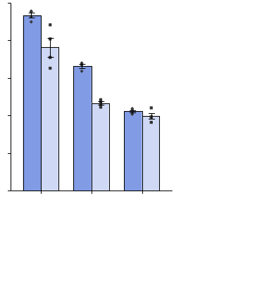
Supplementary Fig. 5
A
0
B
P=0.138
P=0.022
P=0.00014
P=0.00017
P=0.0000001
IL-6 secretion (unit)
U0126
DMSO
DMSO
DMSO
LY294002
DMSO
DMSO
SP600125
PD0325901
SB203580
C
50000
P=0.0008
8B
40000
P= 0.0001
9G
30000
Cellrox® deepred
(Mean fluorescence intensity)
NS
20000
10000
0
0
500
5000
NAC conc. (μM）

Slide 6
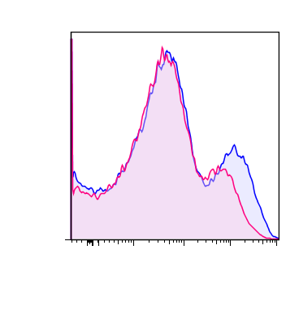
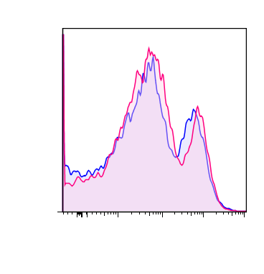
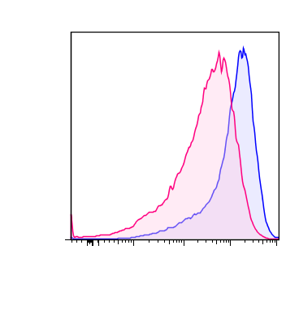
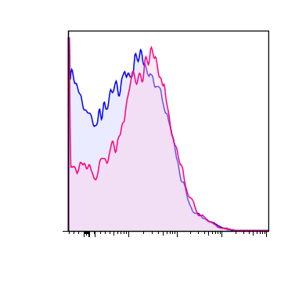
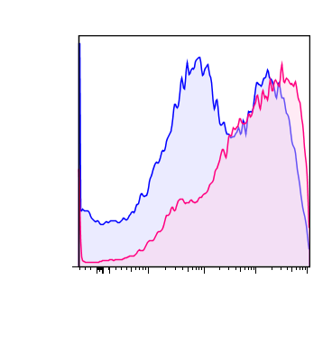
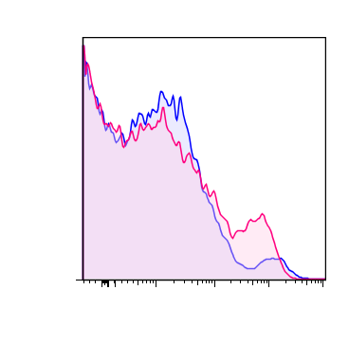
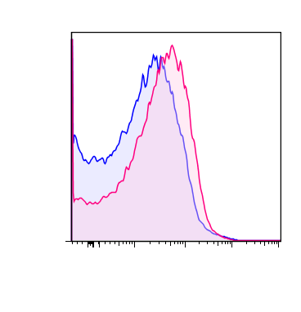
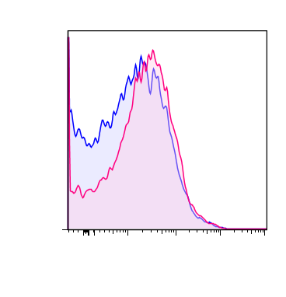
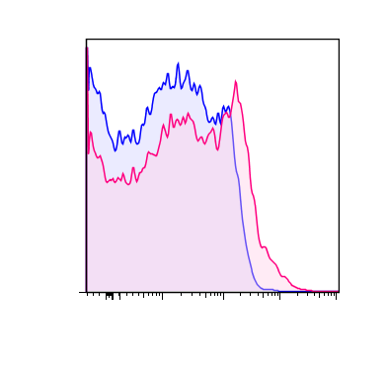
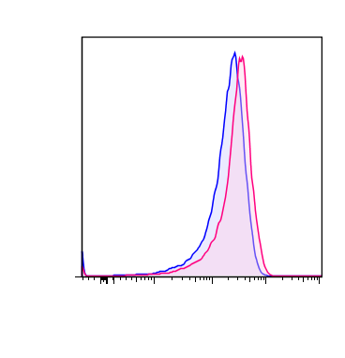
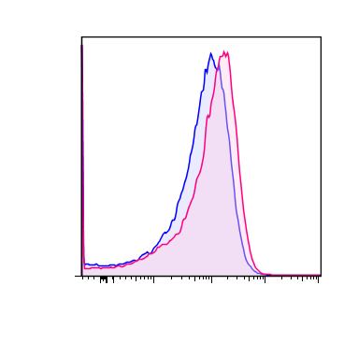
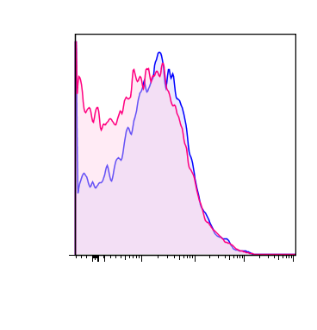
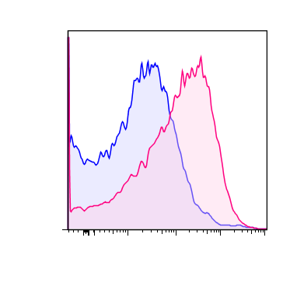
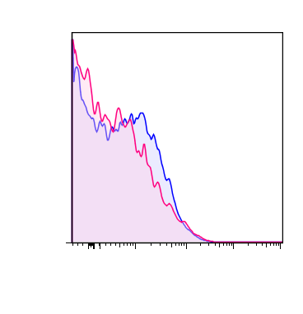
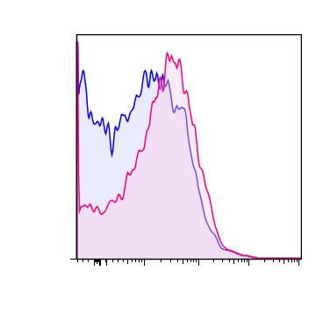
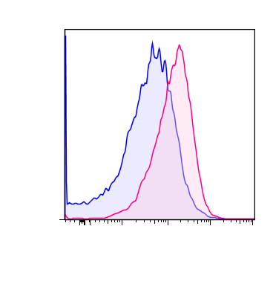
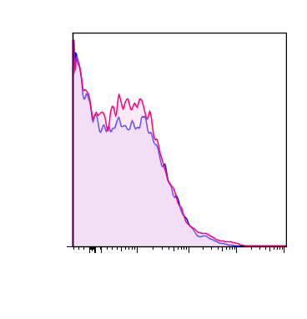
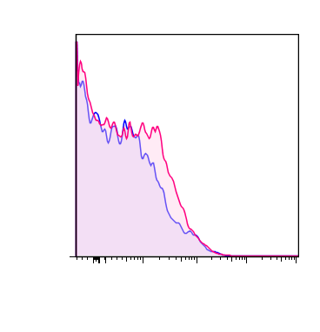
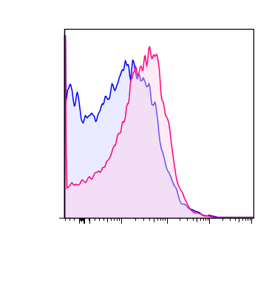
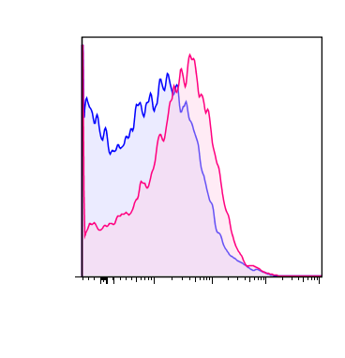
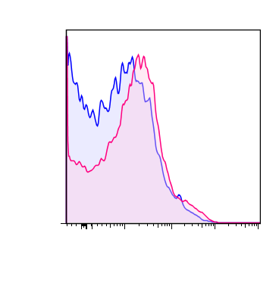
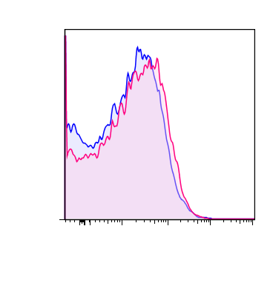
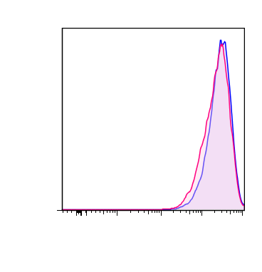
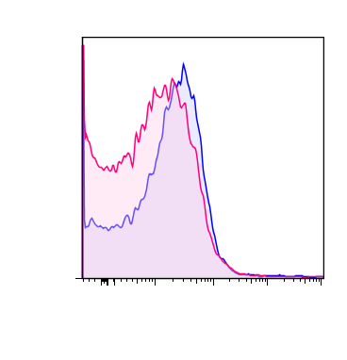
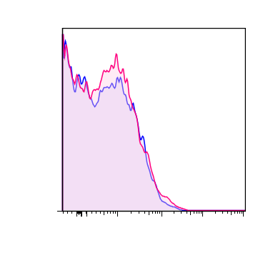
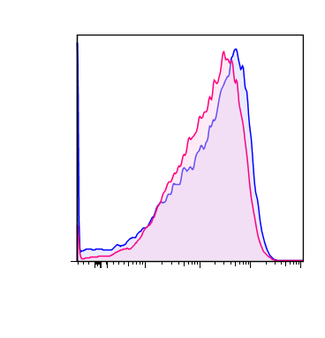
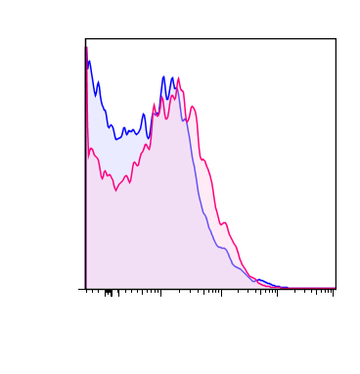
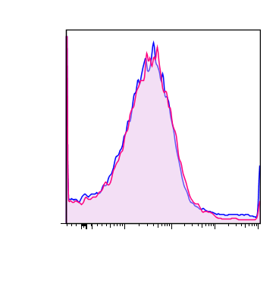
Supplementary Fig. 6
CD11c
CD24
F4/80
CD69
8B-Mφ
9G-Mφ
Ly6c
CD273
Ly6g
CD184
CD31
CD275
CD115
SSEA-1
CD38
CD152
CD117
CD274
Count
CD206
CD41
CD126
rIgG2b
(APC)
CD205
CD184
CD44
CD14
rIgG2b
(PE)
CD169
CD25
CD34
Log fluorescence (PE)
Log fluorescence (APC)

Slide 7
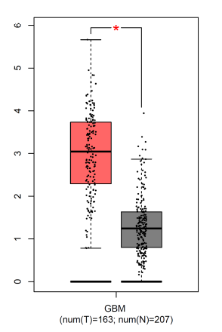
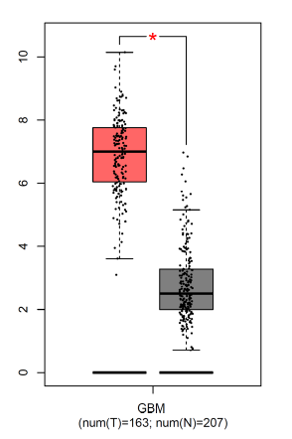
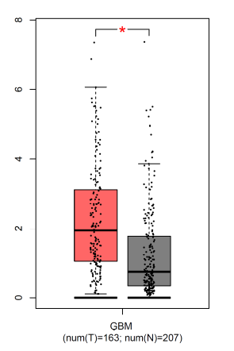
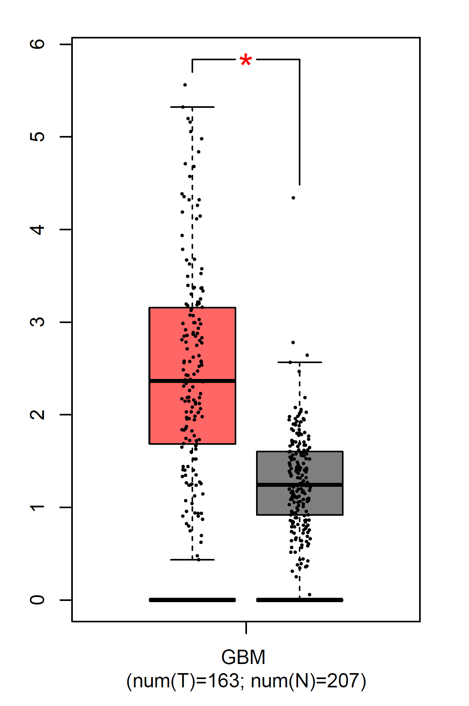
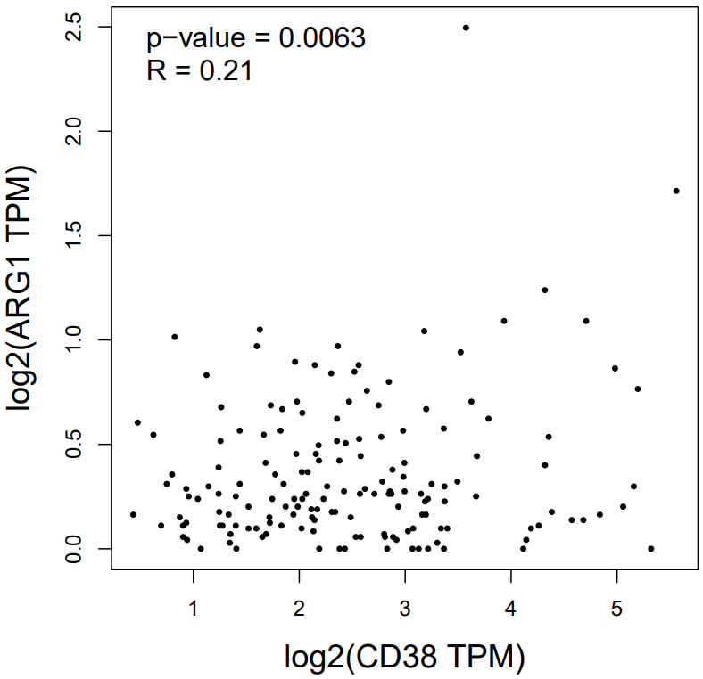
Supplementary Fig. 7
A
CD11B
CD14
IL-6
CD38
log2(Transcripts Per Million + 1)
B

